Slide 1
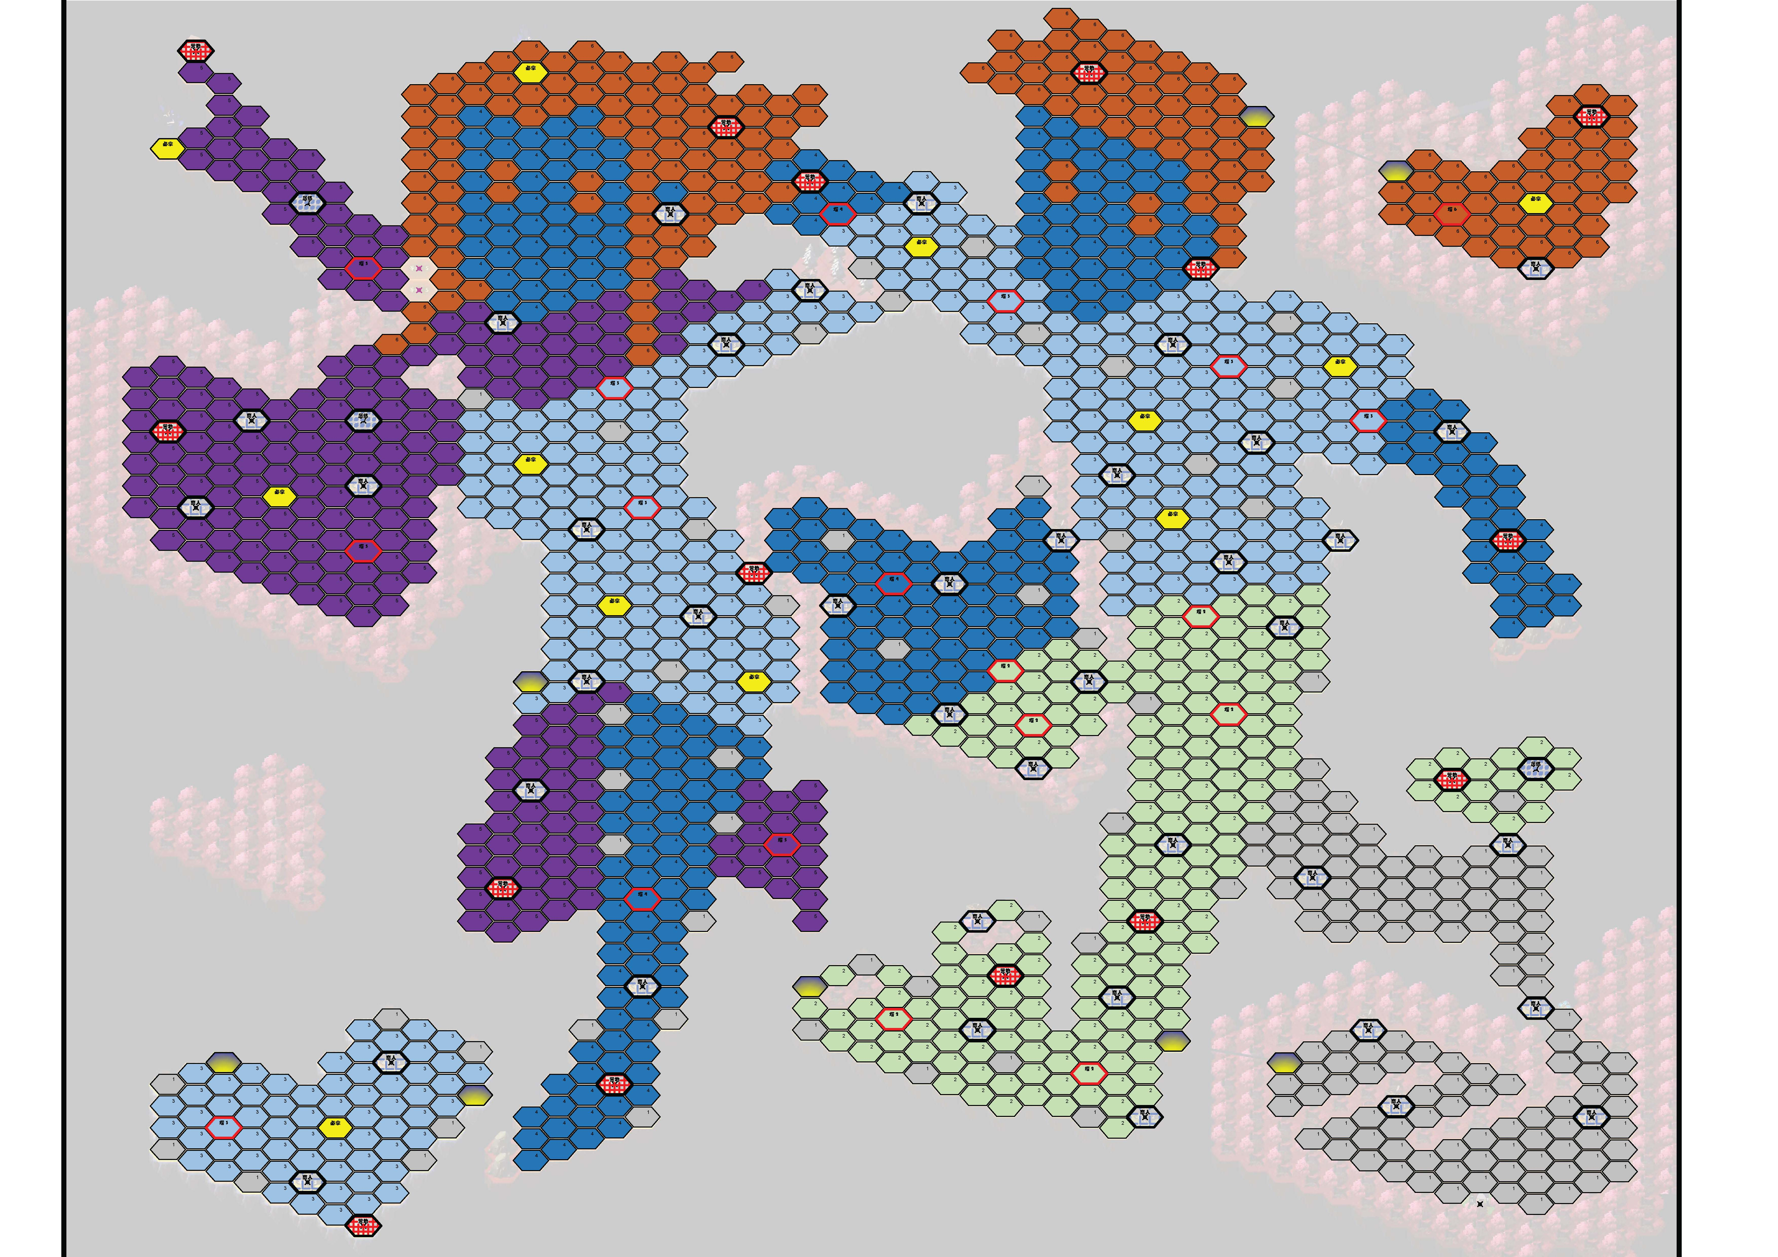

1
1
1
1
1
1
1
18.05_4

Slide 2
3
1
1?
1
1
1
1
18.05_3

Slide 3
3
1
1
1
1
1
1
1
1
1
18.05_2
1
2
1
1

Slide 4
3
1
1
1
1
1
1
1
1
2
1
1
1
1
1
18.05
1
1
1
3
1

Slide 5
18.00

Slide 6
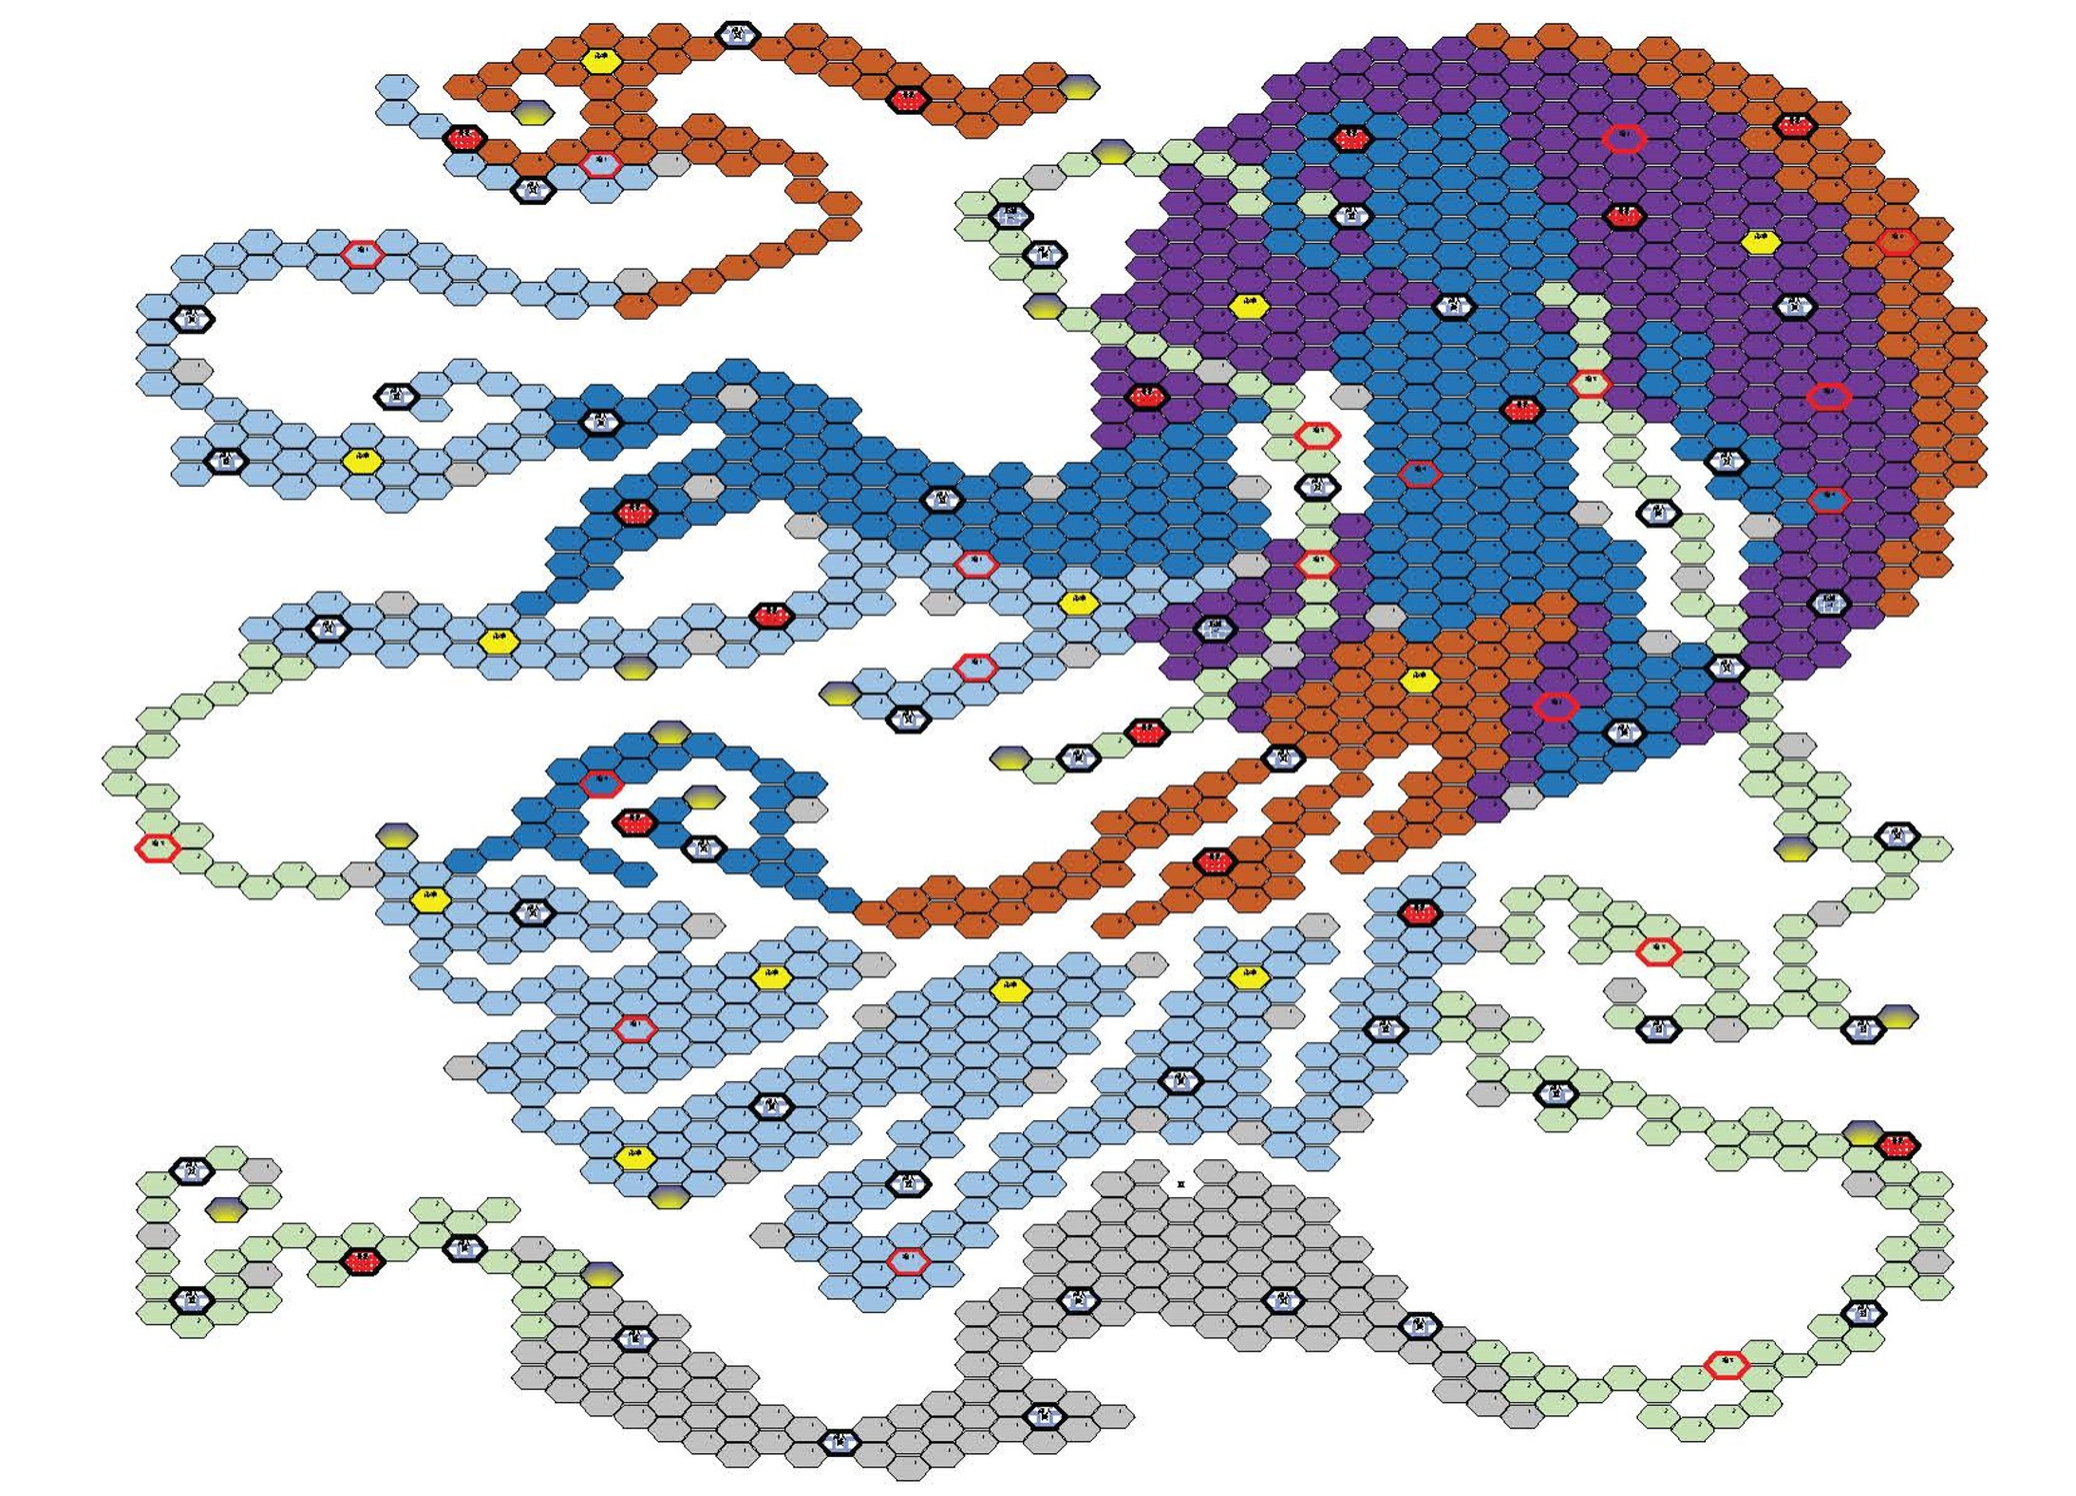
17.11_zi
5
蹭一步

Slide 7
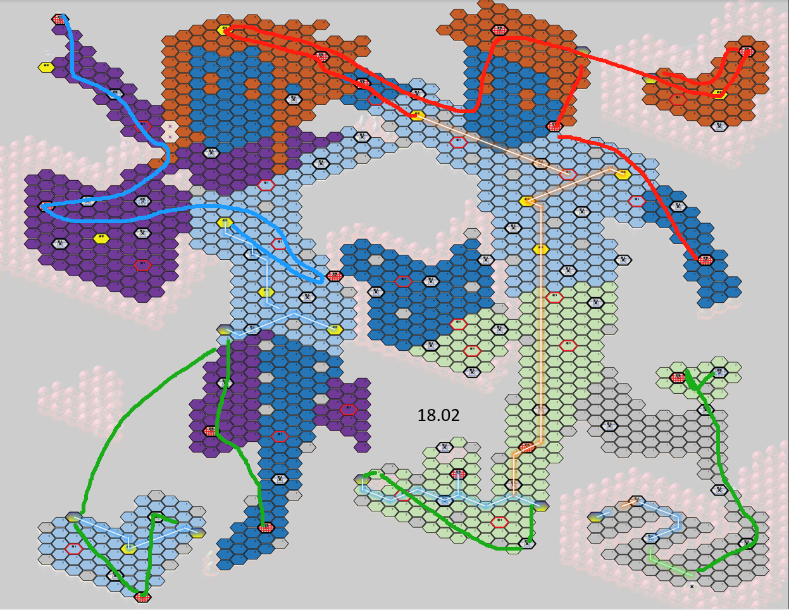
18.02

Slide 8
18.01

Slide 9
1
1
3
1
1
1
1
1
1
2
1
1
1
18.04
1
1
1
1
3
1
3

Slide 10
1
1
1
1
1
2
2
2
18.03
1

