Slide 1
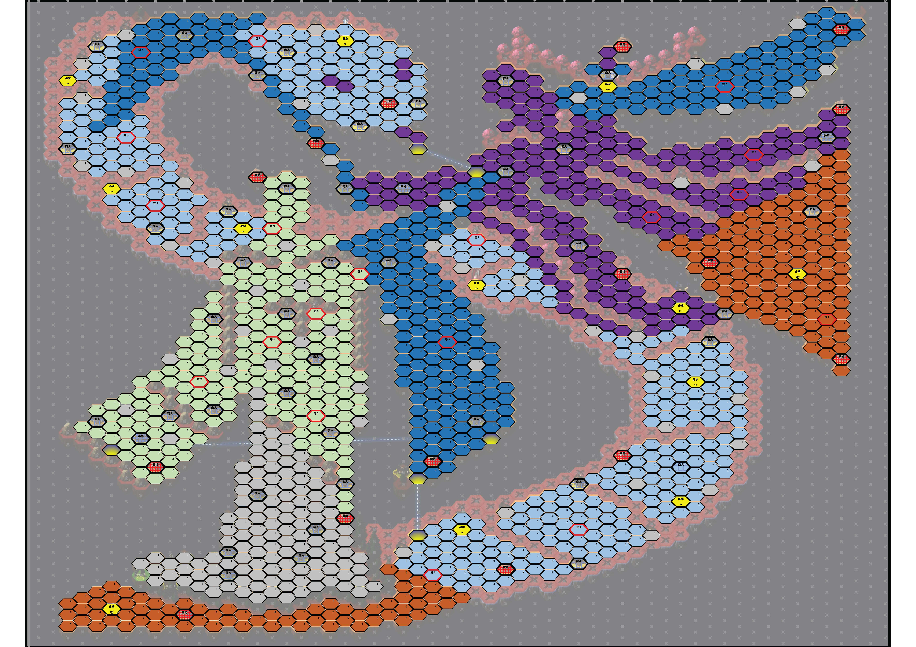

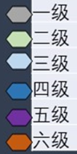
19.12
195-0
2

Slide 2
4
1
1
1
1
19.15
2
2
2

Slide 3
4
1
1
1
1
19.14
2
2
2

Slide 4
4
1
1
3
1
2
1
1
19.13
2
2
2

Slide 5
4
1
1
1
1
19.10
2
2
2

Slide 6
4
1
1
1
1
19.11
2
2
2

Slide 7
4
1
1
1
19.09
2
2
2

Slide 8
1
4
1
1
1
1
19.08
2
1
1
2
2

Slide 9
1
4
1
1
4
1
19.07
2
2
2

Slide 10
4
1
1
1
4
1
19.07_2
2
2
2

Slide 11
4
1
1
19.06
2
2
2

Slide 12
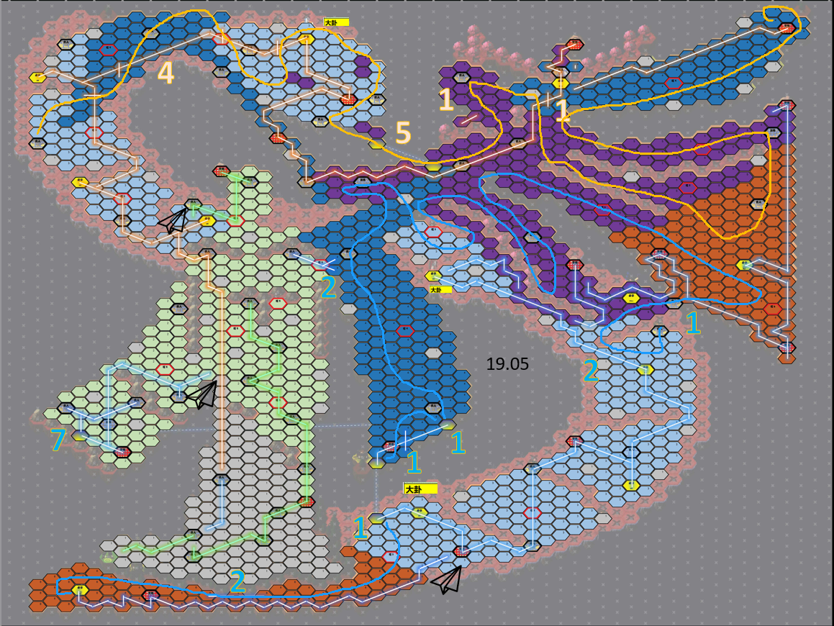
4
1
5
1
2
1
19.05
2
7
1
1
1
2

Slide 14
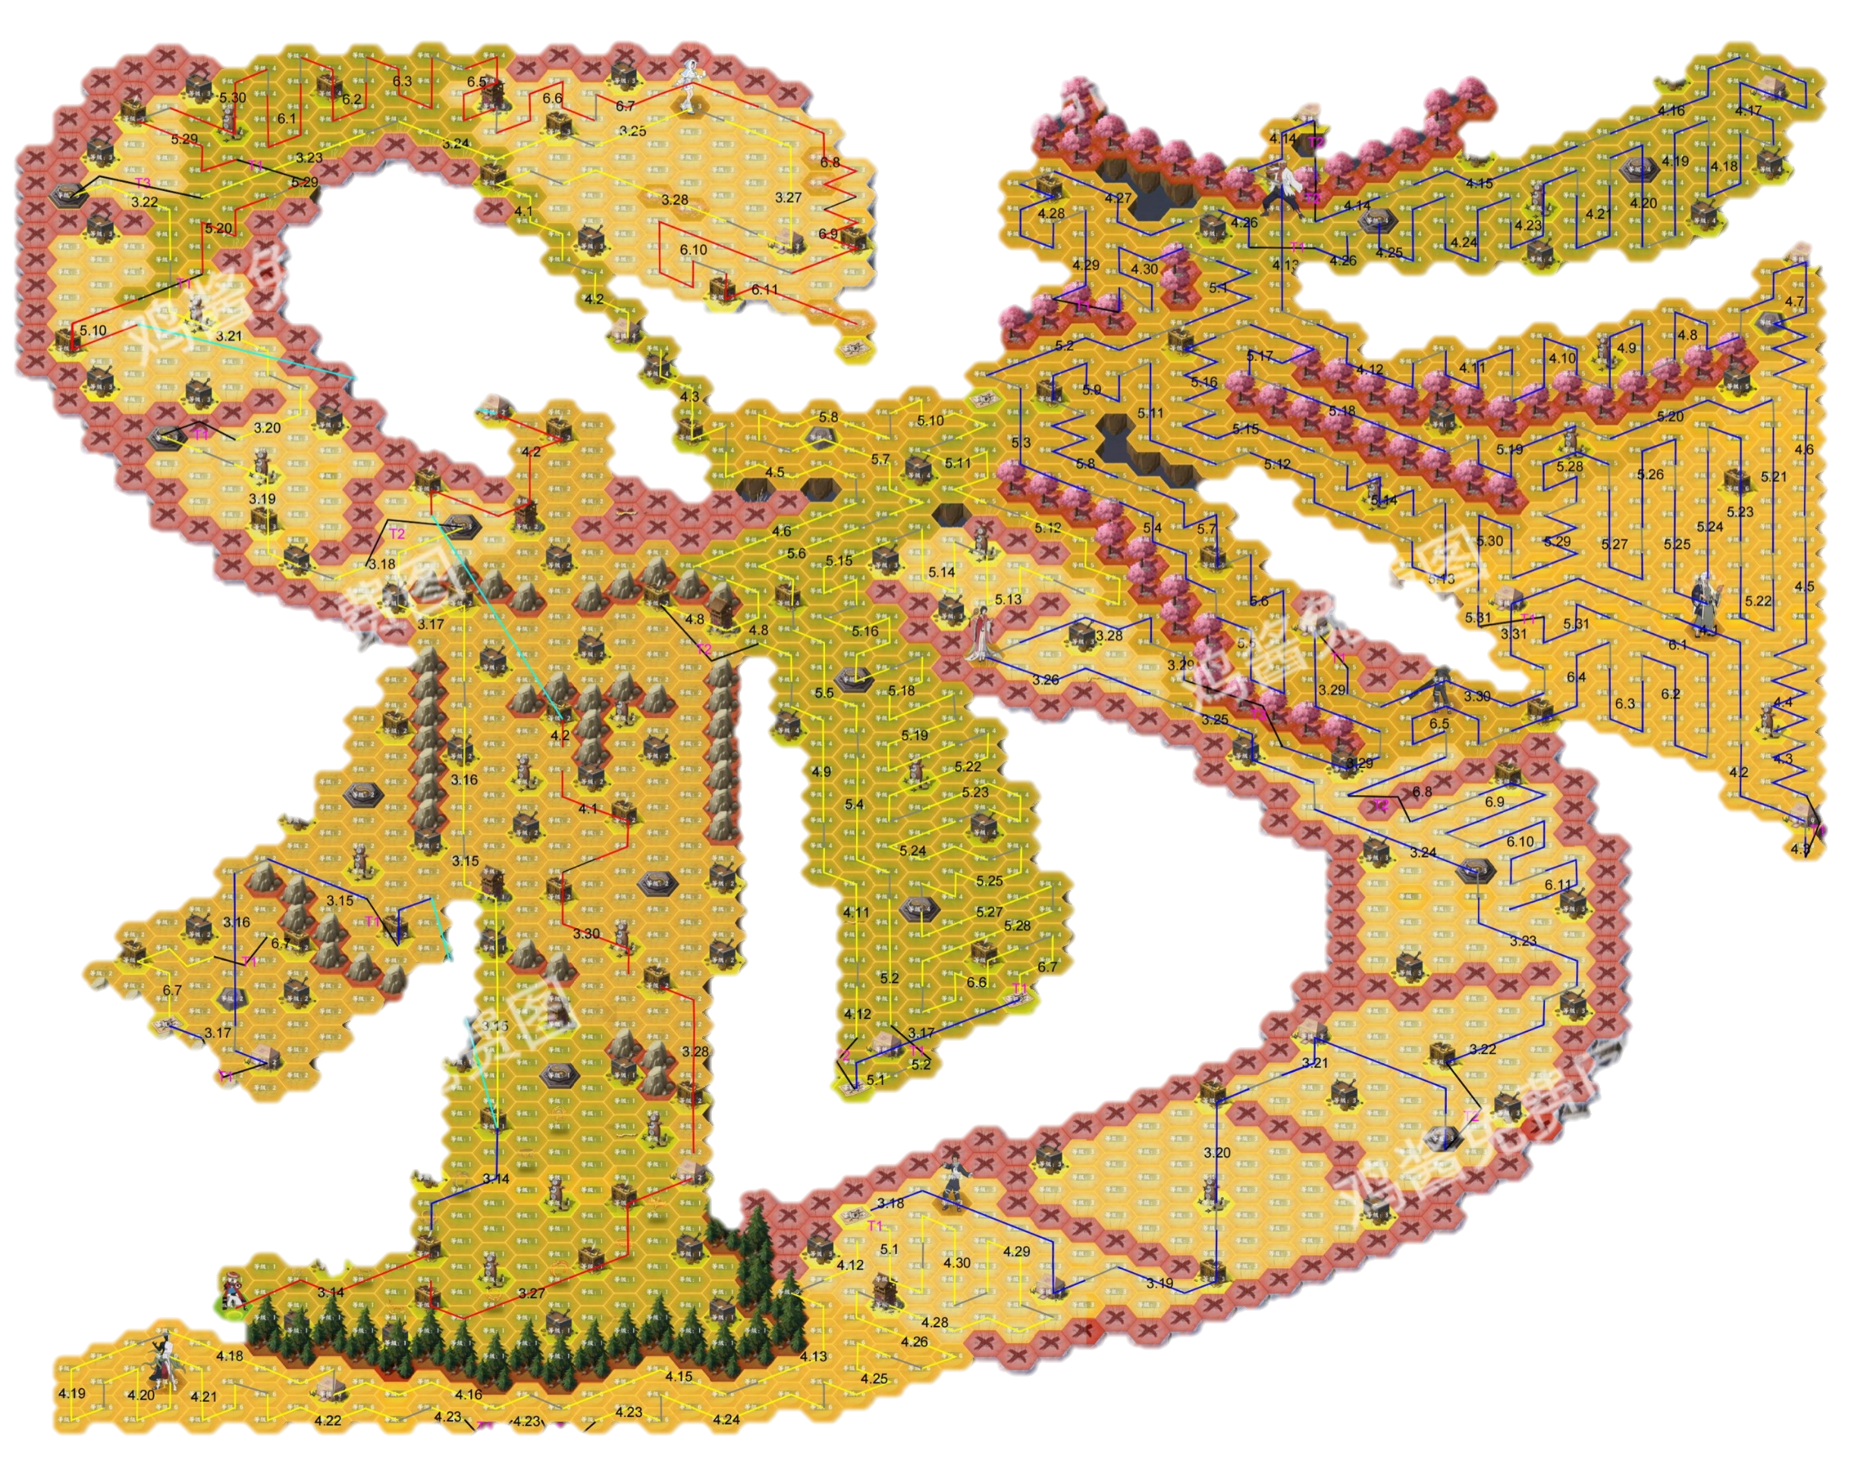
19.03

Slide 15
19.02

Slide 16
19.01

