Slide 1

Microarchitectural review
Microarchitectural Review

Slide 2
Block Diagram
Camera
USB
LEDs
Software
.8svx and .bmp
I2C Controller
HEX6
Game Loop
SDRAM Controller
SDRAM
Visual Out
VGA Controller
Visual Processing
Audio Out
Audio Controller
Audio Processing

Slide 3
Plan for Software
There is a memory mapping available for our board - specifically SDRAM
#define SDRAM_BASE 0xC0000000
#define SDRAM_SPAN 0x03FFFFFF
There is a tutorial file that counts up LEDs on FPGA side through C code
We will access the SDRAM on FPGA by mimicking that code
Testing -
We will first test if we can store a bitmap via usb into SDRAM and display via VGA.
We will then test if we can store a WAV/8svx file into SDRAM and output via some speaker/headphone

Slide 4
Modular-Level Implementation
Bitmap
(x_{U}, y_{U})
Θ^{T}_{U}
CORDIC_{U}
DTW_{U}
k
Counter
Ang^{k}_{U}
Θ^{R}_{U}
Score_{U}
k
Shifter_{U}
Cluster
Unit
(x₀, y₀)
Angle
Label
Unit
k
Θ^{T}_{LL}
(x_{LL}, y_{LL})
CORDIC_{LL}
DTW_{LL}
Score_{LL}
Arithmetic Unit
(x₁, y₁)
Result
LUT
(x₂, y₂)
Shifter_{LL}
Θ^{R}_{LL}
Ang^{k}_{LL}
k
Θ^{T}_{LR}
Score_{LR}
CORDIC_{LR}
DTW_{LR}
(x_{LR}, y_{LR})
Ang^{k}_{LR}
Shifter_{LR}
Θ^{R}_{LR}

Slide 5
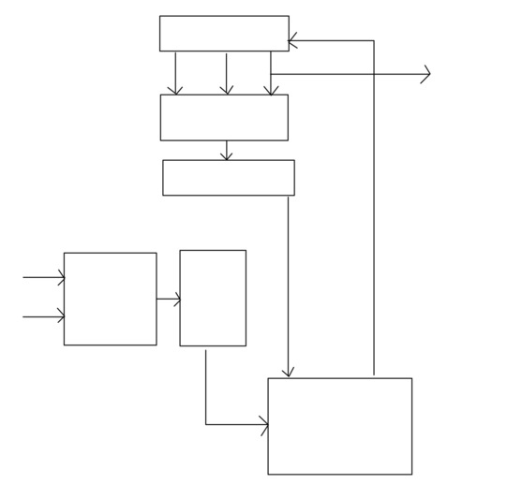
DTW Accelerator
Shift Register
Output Score
Minimum Unit
Flip Flop
Reference Image Data
Distance Unit
Flip Flop
Player Video Data
Accumulator

Slide 6
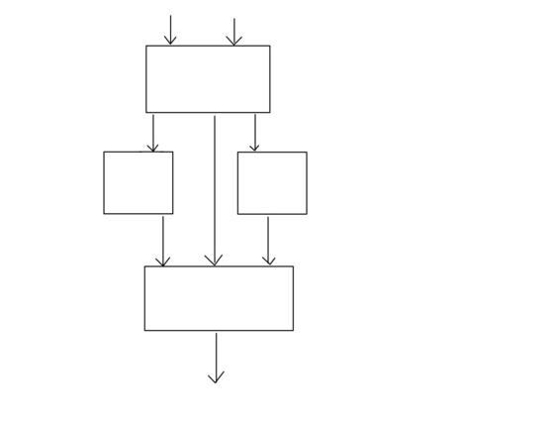
CORDIC Accelerator
x
y
LUT
Mult
Mult
Accumulator
Angle

