Slide 1

Title Page
Log In
Sign Up

Slide 2
Sign Up Page
First Name:
Last Name:
Username:
Password:
Submit
Submit will take you to your farm page

Slide 3

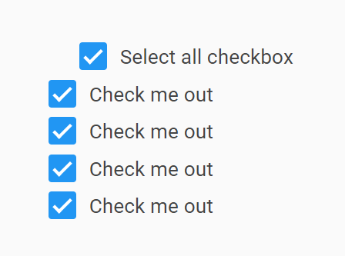
Farm Page
First and Last Name
User Name
Crop Inventory:
Apple, Corn, Pumpkin
Silver Goal
1. Friends: this would show your level of friendship with them.
2. Can click friends name to take them to their “farm.”
Stretch Goal:
Crop Preferences
Checkbox for like/dislike
Make Friends

Slide 4
Make Friends Page
To give a gift
and make a friend:
Select the crop you’d like to give.
Select the user you’d like to give it to
Submit choice
Crops List:
Apple
Pumpkin
Corn
Wheat
List of users:
User 1
User 2
User 3
User 4
User 5
User 6
Submit
Back to Farm

