Slide 1
Review
2012-12-27

Slide 2
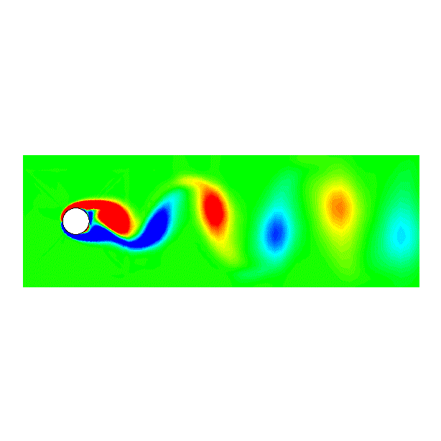
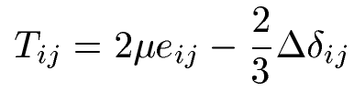
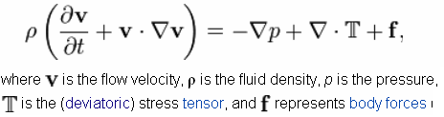
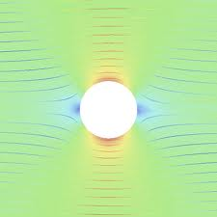





Decomposition of Motion
Stokes hypothesis
Decomposition I
Translation+rotation+strain
N-S equation
http://en.wikipedia.org/wiki/Navier%E2%80%93Stokes_equations
Decomposition II
Points with
Isolated, called singular points
Other area in flow is potential flow, satisfy

Slide 3
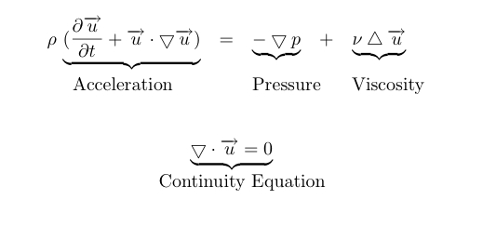
We have learned…
How governing equations in fluids were setup
How to use these equations to solve real problem
  Computational tools
    NS equations
  Analytical tools
    NS equations and potential flow theory

Slide 4
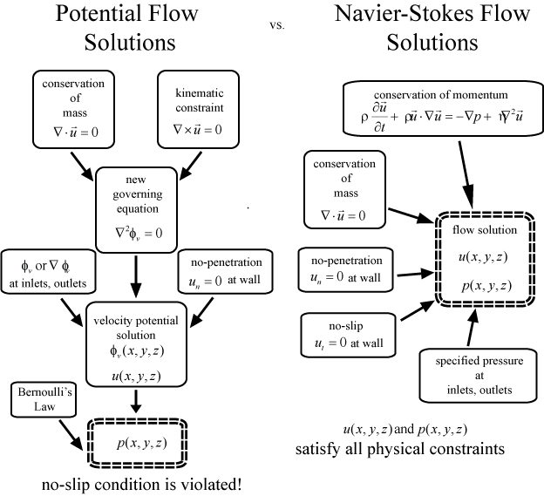
Again!
http://www.kirbyresearch.com/index.cfm/wrap/textbook/microfluidicsnanofluidicsse37.html

Slide 5
Suggestions to your future work
What will do good to you
  Know the tools well
    Know how to use CFD packages
    Know the limitation
  Understand the basic rules, use these rules to understand the computation results
  Use parametric study to find the dominating factors that govern the problem
  Never let “junk in, junk out” happens in your work

Slide 6
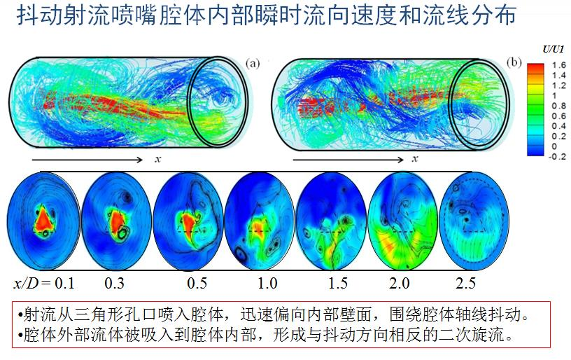
What will make you a good graduate student and a good science worker
Know the equations well
  Let the equation guide your work
J. Mi

Slide 8
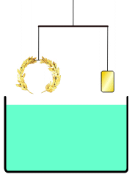
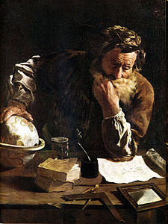
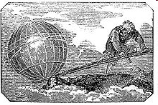
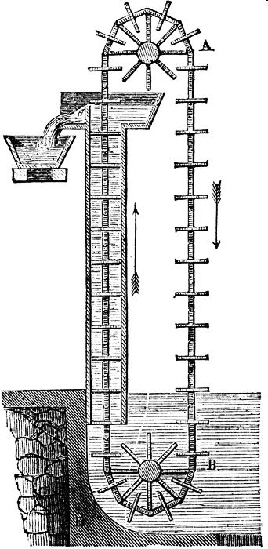
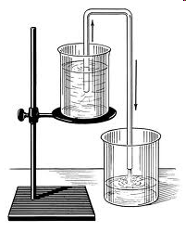
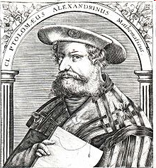
250 BC
Archimedes
阿基米德
Give me a place to stand on,
and I will move the Earth.
Greek crown
Ptolemies and The Alexandrian school
托勒密
120 BC
Siphon 虹吸
Chain pump

Slide 9
Isaac Newton 1642-1727
Define viscosity
Daniel Bernoulli 1700-1782
Relation between pressure and velocity
Leonhard Euler 1707-1783
Develop equation sets describe fluid motion
Without viscous effect
George Stoke 1819-1903
Develop full equation sets describe flow
With viscous effect
Ludwig Prandtl 1875-1953
Boundary layer, outside no viscous effect,
Inside need to solve full N-S equation

Slide 10
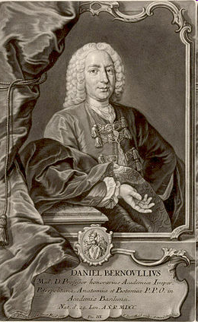

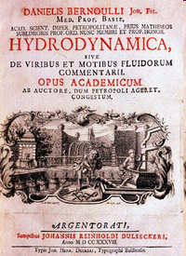
Daniel Bernoulli 1700-1782
Born in Holland, farther Johann
24yrs old, take a chair position in Russian Academy of Science St. Petersburg, Russia
Study blood flow, develop
Study the mobility of the infectious disease smallpox, develop Statistics
Left Russia 1733 back to Basel, Switzerland
Chair in the University of Basel till death

Slide 11
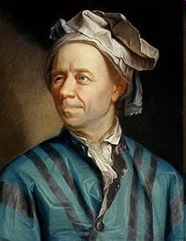
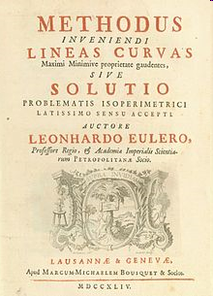
Leonhard Euler 1707-1783
Born in Basel, went to University of Basel in age of 13, master degree age of 16
Student of Johann Bernoulli
Age 20 went to St. Petersburg
Chair position in 1733
1734 married to painter’s daughter
1741 went to Berlin Academy
1766 back to St. Petersburg
Nearly blind in the last 20 yrs of life
Great contributions to number theory, graph theory, complex analysis, mechanics
1753

Slide 12
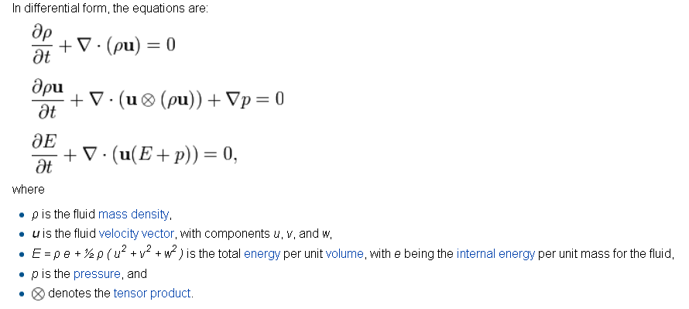
Euler equation

Slide 13
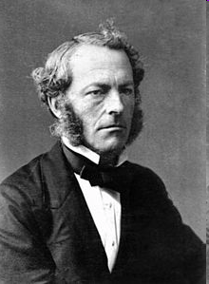
George Stoke 1819-1903
Born in Ireland
Cambridge University
Study pendulum motion in fluids, develop the Stokes hypothesis
Chair in mathematics department, represent Cambridge in Parliament, president of Royal society
Baronet

Slide 14
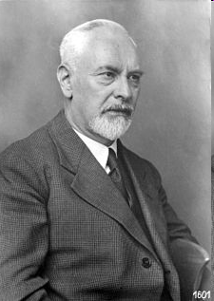
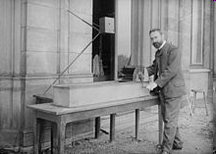
Ludwig Prandtl 1875-1953
Born and educated in Munich
First job in factory
Teaching in Hannover 1901
August 12, 1904 the third International Congress of Mathematicians in Heidelberg, Germany. Fluid Flow in Very Little Friction
1904 Professor in University of Göttingen
Contributions include boundary layer, shock wave theory, thin-airfoil wing theory and others
Famous student includes Ackeret, Heinrich Blasius, Busemann, Nikuradse, Pohlhausen, Schlichting, Tietjens, Tollmien, von Kármán, and many others (85 in total).

Slide 15
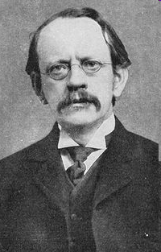
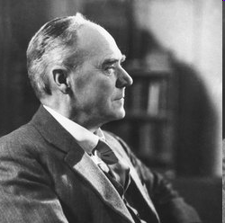
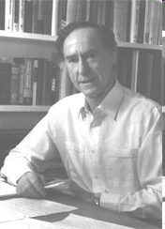
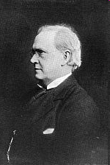
Cambridge
J.J. Thompson
1856-1940
G.I. Taylor
1886-1975
G. Batchelor
1920-2000
George Stokes
1819-1903
Horace Lamb
1849-1934

