Slide 1
总结
2013-12-23

Slide 2
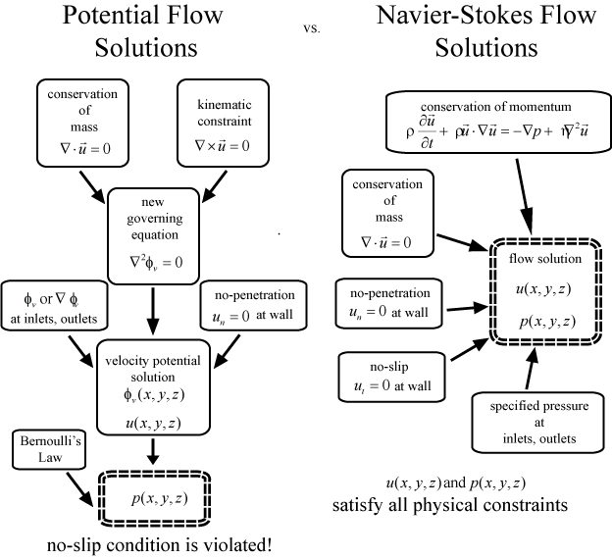
Again!
http://www.kirbyresearch.com/index.cfm/wrap/textbook/microfluidicsnanofluidicsse37.html

Slide 3
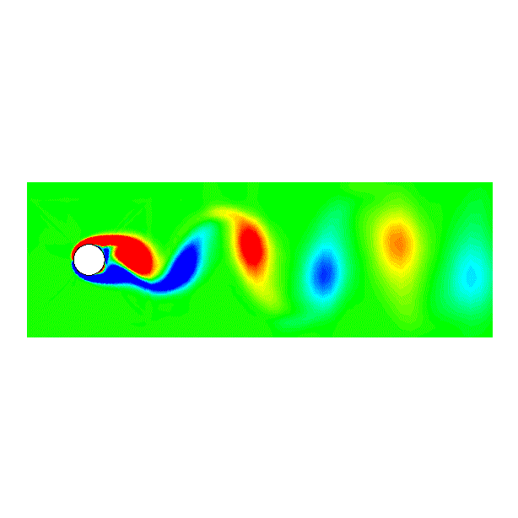
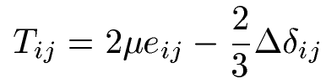
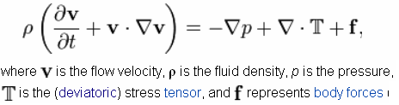
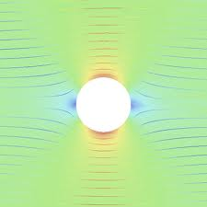





运动分解
Decomposition of Motion
Stokes hypothesis 斯托克斯假设
Decomposition I 分解1
Translation+rotation+strain
平动+转动+形变
N-S equation
http://en.wikipedia.org/wiki/Navier%E2%80%93Stokes_equations
Decomposition II 分解2
Points with
Isolated, called singular points
Other area in flow is potential flow, satisfy

Slide 4
张量
张量表示法的意义 σ_{ij}
基本的张量运算

Slide 5
流体特性
粘性
  牛顿流 μ constant
  非牛顿流
    μ 随剪切率(速度梯度)或者时间发生变化，

Slide 6
流体中的力
体力 ρg_{i}
面力 σ_{ij}

Slide 7
应力张量σ_{ij}
对称 σ_{ij=} σ_{ji}
对称张量的特性

Slide 8
运动
拉格朗日描述
欧拉描述
  运动分解
    平动
      质点加速度 Du_{i}/Dt
    相邻质点相对运动速度
    c_{j}u_{i} = (c_{j}u_{i}+ c_{i}u_{j})/2+ (c_{j}u_{i}- c_{i}u_{j})/2=S_{ij}+Ω_{ij}
      转动 Ω_{ij}
      形变 S_{ij}
        线形变
        角形变

Slide 9
运动方程
微分形式的运动方程
  连续性方程
  动量方程
    斯托克斯假设 σ_{ij} =2μS_{ij} + b I，
积分形式的运动方程
  连续性方程
  动量方程

Slide 10
微分形式的运动方程
简化，
  求解层流管流
  Cf=16/Re
  λ=64/Re

Slide 11
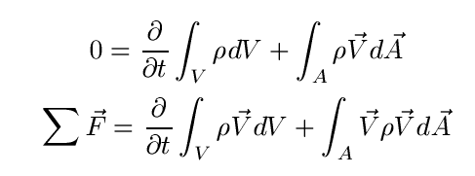
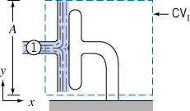
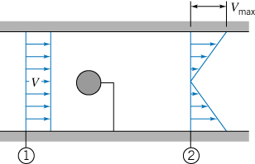
积分形式的运动方程

Slide 12
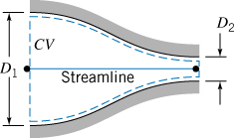
能量方程
伯努利积分
  动量方程沿流线积分；
  无粘性损失；
  沿流线P/ρ+(V²/2)+gz=const.
拉格朗日积分
  无旋流场
  任意两点P/ρ+(V²/2)+gz=const.
要求会使用伯努利方程求解不可压、定常、无粘、均匀流动的速度和压强

Slide 13
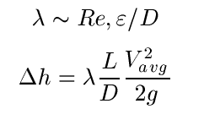
湍流
雷诺平均后的动量方程
雷诺应力
湍流模型
  普朗特0方程模型
  k-ε 模型
要求知道RANS方程推导过程
理解雷诺应力的物理意义
理解k-e模型的物理意义
会计算湍流管流压头损失

Slide 14
无粘流动
速度势φ(x,y)流函数ψ (x,y)
复势W(z)= φ+i ψ, z=x+iy
复速度dW/dz=u-iv
典型流场
  均匀来流W=cz；
  涡W=Γ ln(z)/2πi;
  源/汇 W=m ln(z)/2π;
  偶极子 W=Mt
要求会使用复势计算圆柱在均匀来流中的压强分布

Slide 15
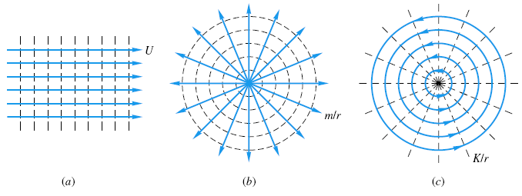
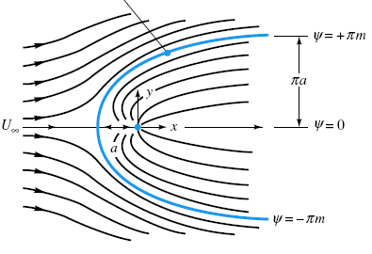
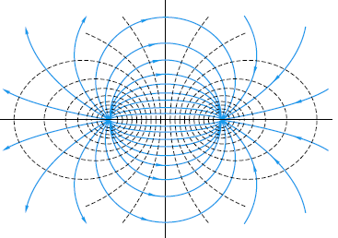
Examples of potential flows
Uniform stream in x direction
Source源
Sink汇
Doublet偶极子

Slide 16

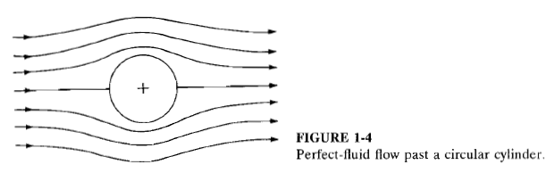
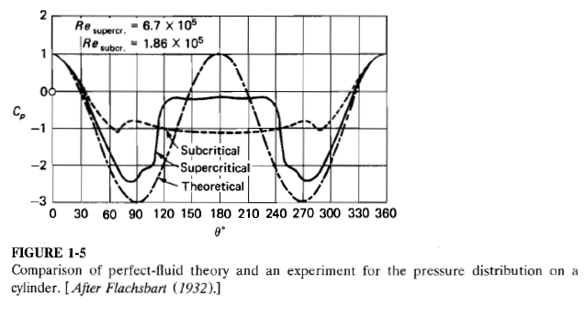
Cylinder in cross flow
壁面压强系数
角度

Slide 17
建议
希望通过课程学习，以后能
  了解工具
    熟悉CFD商业软件
    清楚商业软件的原理，知道它们的缺陷
  熟悉NS方程，包括它的各种形式RANS等
  能够设计parametric studies来研究你面对的问题，从计算结果中提炼有用的信息，帮助你做出决策
  不了解工具，不了解原理的计算将会是“junk in, junk out”

Slide 19
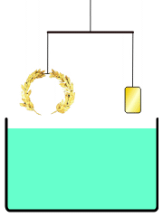
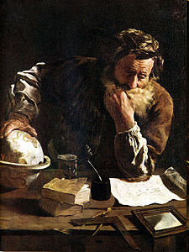
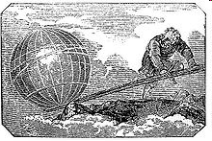
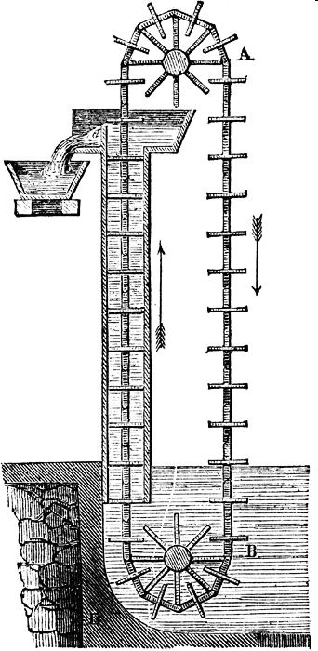
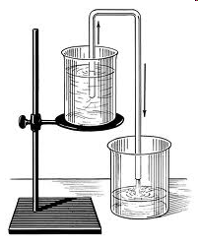
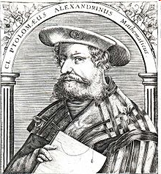
250 BC
Archimedes
阿基米德
Give me a place to stand on,
and I will move the Earth.
Greek crown
Ptolemies and The Alexandrian school
托勒密
120 BC
Siphon 虹吸
Chain pump

Slide 20
Isaac Newton 1642-1727
Define viscosity
Daniel Bernoulli 1700-1782
Relation between pressure and velocity
Leonhard Euler 1707-1783
Develop equation sets describe fluid motion
Without viscous effect
George Stoke 1819-1903
Develop full equation sets describe flow
With viscous effect
Ludwig Prandtl 1875-1953
Boundary layer, outside no viscous effect,
Inside need to solve full N-S equation

Slide 21
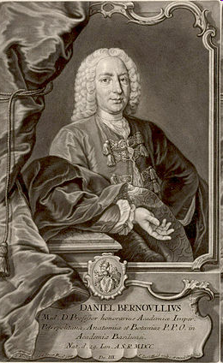

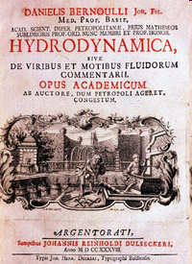
Daniel Bernoulli 1700-1782
Born in Holland, farther Johann
24yrs old, take a chair position in Russian Academy of Science St. Petersburg, Russia
Study blood flow, develop
Study the mobility of the infectious disease smallpox, develop Statistics
Left Russia 1733 back to Basel, Switzerland
Chair in the University of Basel till death

Slide 22
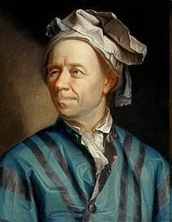
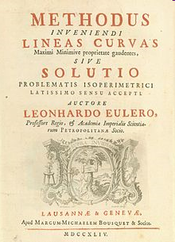
Leonhard Euler 1707-1783
Born in Basel, went to University of Basel in age of 13, master degree age of 16
Student of Johann Bernoulli
Age 20 went to St. Petersburg
Chair position in 1733
1734 married to painter’s daughter
1741 went to Berlin Academy
1766 back to St. Petersburg
Nearly blind in the last 20 yrs of life
Great contributions to number theory, graph theory, complex analysis, mechanics
1753

Slide 23
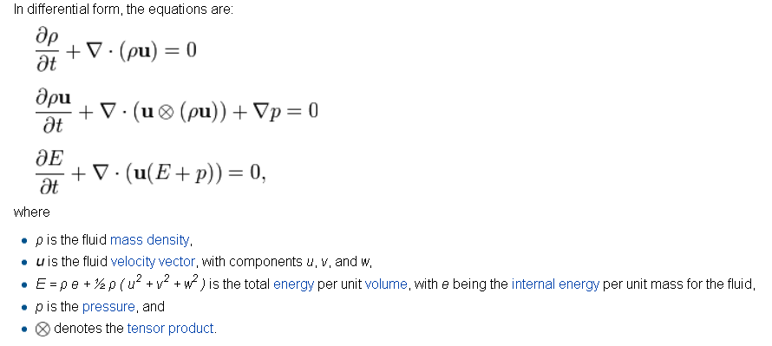
Euler equation

Slide 24
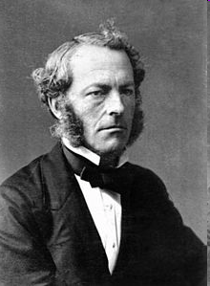
George Stoke 1819-1903
Born in Ireland
Cambridge University
Study pendulum motion in fluids, develop the Stokes hypothesis
Chair in mathematics department, represent Cambridge in Parliament, president of Royal society
Baronet

Slide 25
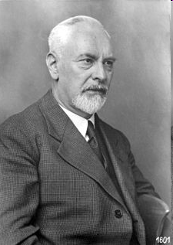
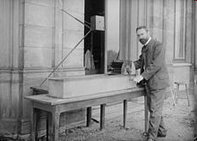
Ludwig Prandtl 1875-1953
Born and educated in Munich
First job in factory
Teaching in Hannover 1901
August 12, 1904 the third International Congress of Mathematicians in Heidelberg, Germany. Fluid Flow in Very Little Friction
1904 Professor in University of Göttingen
Contributions include boundary layer, shock wave theory, thin-airfoil wing theory and others
Famous student includes Ackeret, Heinrich Blasius, Busemann, Nikuradse, Pohlhausen, Schlichting, Tietjens, Tollmien, von Kármán, and many others (85 in total).

Slide 26
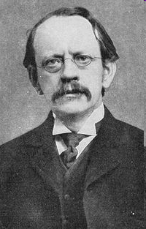
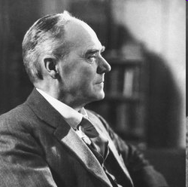
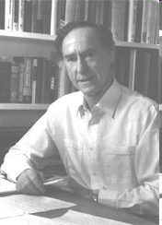
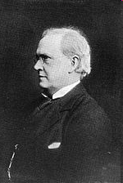
Cambridge
J.J. Thompson
1856-1940
G.I. Taylor
1886-1975
G. Batchelor
1920-2000
George Stokes
1819-1903
Horace Lamb
1849-1934

