Slide 1
湍流的几种测量方法
高南
2007年12月20日

Slide 2
内容
可视化 Flow visualization
数据采集 DAQ
速度
  热线，PIV，LDV
压强
  平均压强，脉动压强
部分内容下载自Dantec, National instrument
Validyne, Omega, Panasonic网站

Slide 3
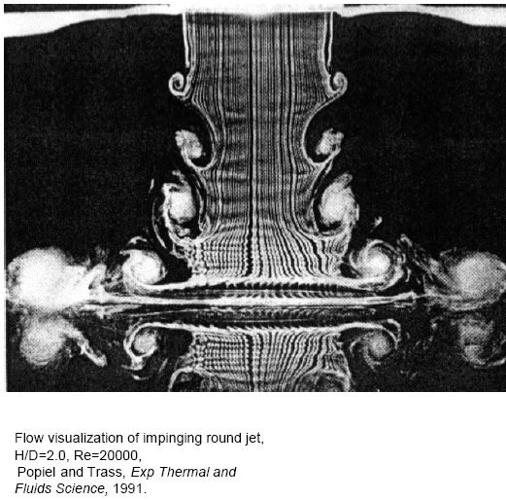
流场可视化
Flow visualization
“Seeing is believing”
“没有照片，没有真相”

Slide 4
流场可视化
Flow visualization
空气实验
  发烟线 smoke wire
  干冰 dry ice
  人造雾 (油滴，液滴，舞台雾发生器)
水动力实验
  染料 dye injection
  氢气泡 Hydrogen bubble
  激光引发荧光 Laser induced fluorescent

Slide 5
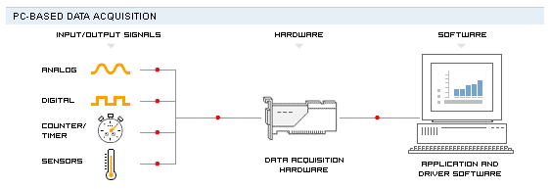
数据采集
各种信号通过计算机记录下来的系统
把模拟信号(-5V到+5V或者其他范围)转换成数字信号,Analog-Digital(AD)，反过来称DA
www.ni.com National Instrument

Slide 6
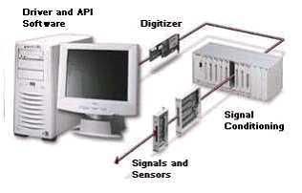
采集过程
传感器-信号处理-模拟数字AD转换-记录
传感器输出的信号量级
  应力应变片:微伏
  热电偶:毫伏
  热线风速仪:伏
信号到DAQ前预处理
  放大gain，移动offset
模数转换AD
  使用转换卡Data Acquisition Card(DAQ) 又称digitizer
通过软件记录数据
  一般通过软件Labview编程

Slide 7
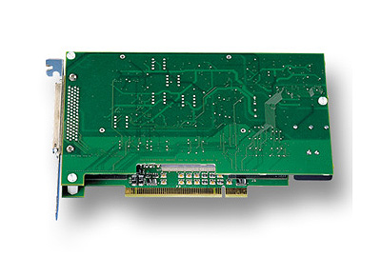
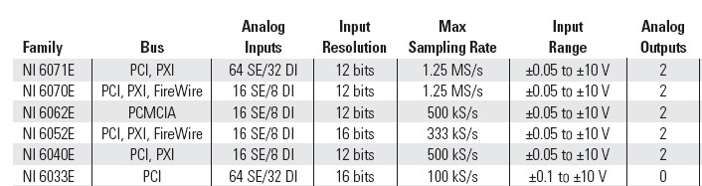
数据采集卡DAQ Card
采集卡
  适用方法,PCI,PCMCIA,USB等
  通道数,16AD,2DA
  位数:12,14,16bits, 决定精度, 10V/2¹²
  采样速度:10MHz-1GHz
  输入范围，+-5V等
  价格，1500-15000RMB

Slide 8

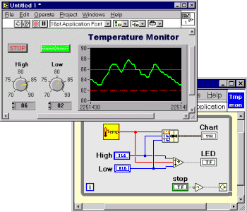
与DAQ卡通信方法:

Slide 9
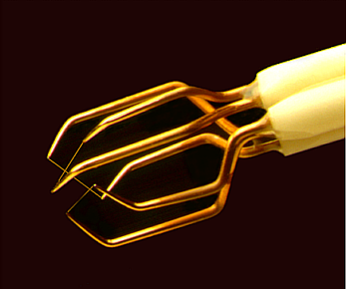
热线风速仪
Hot-Wire Anemometry
测量流场的平均和脉动速度
修改过的电路可以测量平均和脉动温度

Slide 10
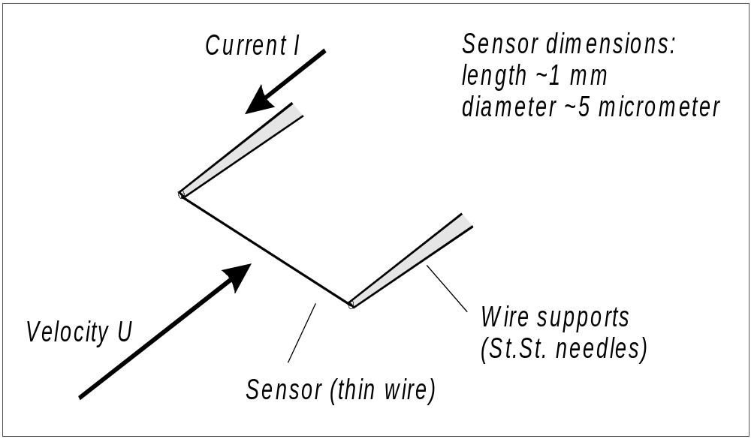
热线工作原理
Principles of operation
细小的金属丝(一般为钨丝或者白金丝)处于来流速度U的流场中.
当电流通过金属丝, 会生成热 (I²R_{w}). 当进入平衡状态，这些热被对流换热带走

Slide 11
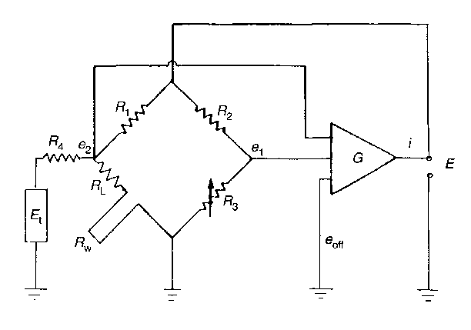
恒温测量系统
Constant Temperature Anemometer CTA
原理:
传感器的电阻被放大器维持恒定
优点(对比恒流测量系统):
- 简单易用
- 高频率响应
- 低噪
- 被广泛接收
缺点:
- 价格高于恒流系统

Slide 12
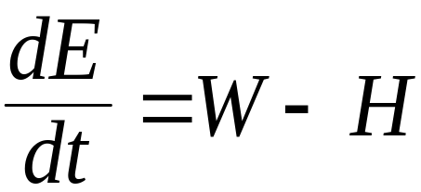
控制方程 Governing equation I
Governing Equation:
E = 金属丝热能thermal energy stored in wire
E = C_{w}mT
C_{w} = 金属丝比热heat capacity of wire
m = 金属丝质量 mass of wire
W = 发热量power generated by Joule heating
W = I² R_{w}
而 R_{w} = R_{w}(T_{w})
H =换热量heat transferred to surroundings

Slide 13


控制方程 Governing equation II
Heat transferred to surroundings
( 对流convection to fluid
+ 传到conduction to supports
+ 辐射radiation to surroundings)
对流Convection Qc = Nu · A · (Tw -Ta)
Nu = h ·d/k_{f} = f (Re, Pr, M, Gr ),
Re = ρ U/μ
传导Conduction f(T_{w} , l_{w} , k_{w}, T_{supports})
辐射Radiation f(T_{w}⁴ - T_{f}⁴)

Slide 14
简化分析Simplified analysis
稳态传热:
W = H I²R_{w} = h A ( T_{w} –T_{a} ) I²R_{w} = Nu k_{f} / d A (T_{w} –T_{a} )
h = 对流换热系数film coefficient of heat transfer
A = 对流换热面积heat transfer area
d = 金属丝直径wire diameter
k_{f} = 流体的导热系数heat conductivity of fluid
Nu = 纽希尔特数dimensionless heat transfer coefficient
强制对流的条件下 Forced convection regime,
Nu = A₁ + B₁ · Re^{n} = A₂+ B₂ · U^{n}
I²R_{w}² = E² = (Tw -Ta)(A + B · U^{n}) “King’s law”
电压的变化是流场速度的函数

Slide 15
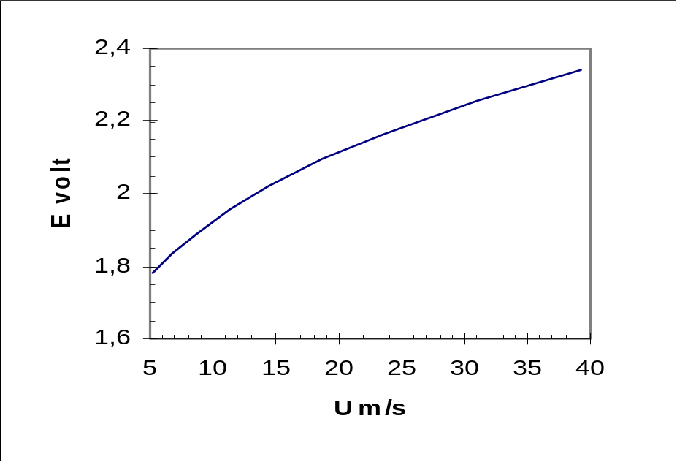
电压的变化是流场速度的函数
例子， 当King’s law coeff. A = 1.51, B = 0.811, n = 0.43)
_{电压输出}
_{流速}
Output voltage as fct. of velocity

Slide 16
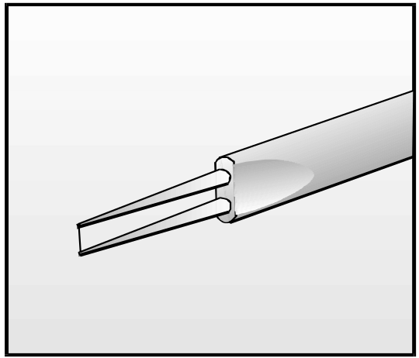
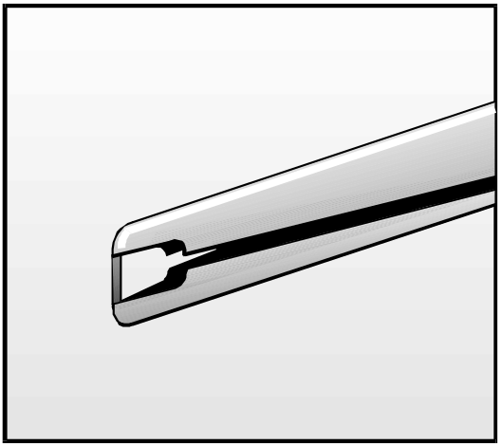
探头分类
热线探头
  尽可能先选用热线
  价廉，响应快，可以维修
热膜探头
  当测量水流速或者测量环境较脏的时候，选用热膜代替热线
  响应速度较慢，不能修复
  绝缘，不受化学、机械干扰
_{热线}
_{热膜}

Slide 17
对探头的要求
为了达到较高的频率响应，总体来说，金属丝的热容量(heat capacity)应该越小越好.
其他要点:
越小越好 (测量的空间解析力<探头大小)
长径比 (l/d) 应该大约100， 两端的影响才可以忽略不计
金属丝应该耐高温，这样可以在高温度下运行实验，降低噪音影响
同样温度变化，金属丝电阻变化越大越好，这样也可以减低噪音

Slide 18
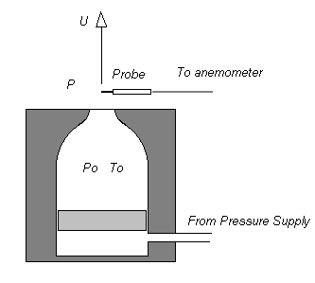

热线的标定
标定-找到流场速度和传感器输出的一个函数关系 U=f(E)
_{空气}

Slide 19
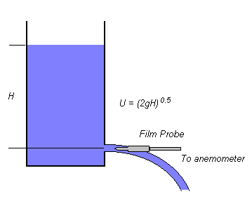
热膜标定
热膜在水中的标定
- 如图所示，用一个容器形成射流，估算流速
- 把探头放到滑车上在水里拖动
_{水}

Slide 20
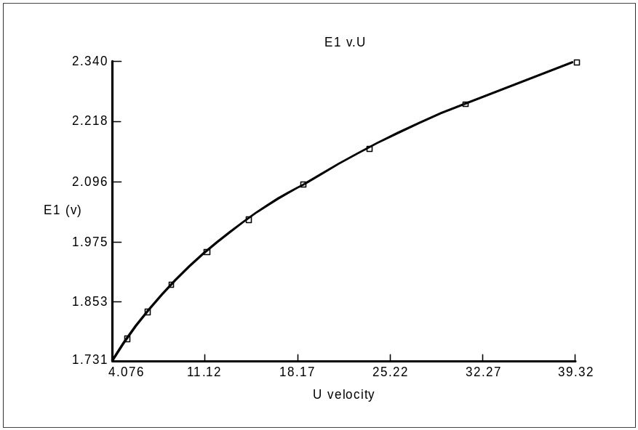
典型的标定曲线
热线标定曲线
回归曲线Curve fit (velocity U as function of output voltage E): U = C₀ + C₁E + C₂E² + C₃E³ + C₄E⁴
_{输出电压}
_{速度}

Slide 21
应对方法:探头被污染
热线容易被以下物质污染
  灰尘dust particles
  油滴 oil vapours
  化学物质chemicals
导致
  敏感度下降，标定曲线便宜
  热线响应速度下降
解决办法Cure
  清理热线 Clean the sensor
  重新标定 Recalibrate

Slide 22
应对方法: 环境温度发生变化
环境温度变化的影响
传热大小正比于探头和环境的温差
E² = (T_{w}-T_{a})(A + B·U^{n})
如果 T_{a} 发生变化:
- 传热发生变化
- 流体性质发生变化
在空气中测量 :
- 探头温度较高
- 空气性质变化较小
水的性质变化相对较大，探头温度较低，所以温度变化在液体中测量影响更大:

Slide 23
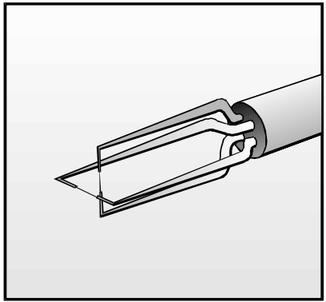
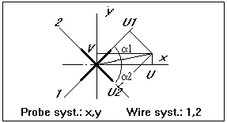
X 型探头测量二维流场
X型探头 (两线和探头的轴成 ±45º):
利用角度变化，热线的输出会发生变化的现象
这样速度被分解成 (U,V)
where U₁ and U₂ in wire coordinate system are found by solving:

Slide 24
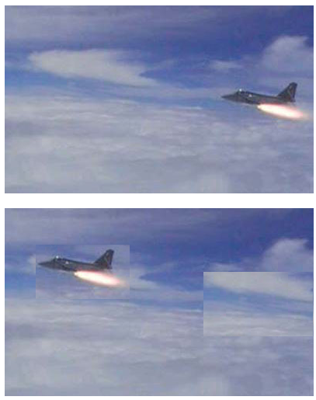
利用照相的方法测量流场速度
连续拍摄两张照片
间隔时间已知
距离通过图片求得
可得物体移动速度
这就是PIV基本原理

Slide 25
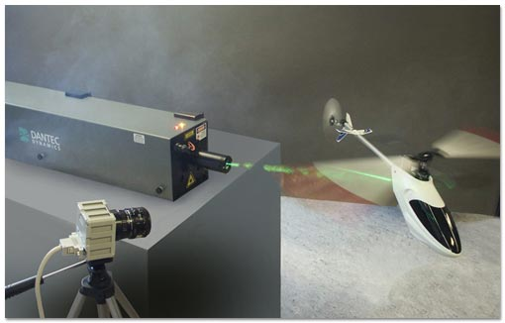
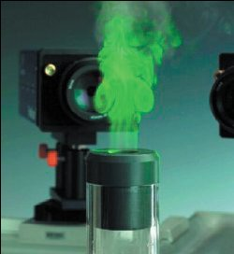
Particle Image Velocimetry (PIV)
PIV利用电子拍照，数据处理等现代方法
是一个全流场测量技术, 它在一个平面内给出一个瞬时的流场速度
一般测量两个速度分量
如果使用stereoscopic方法可以测量这个平面的三维速度

Slide 26
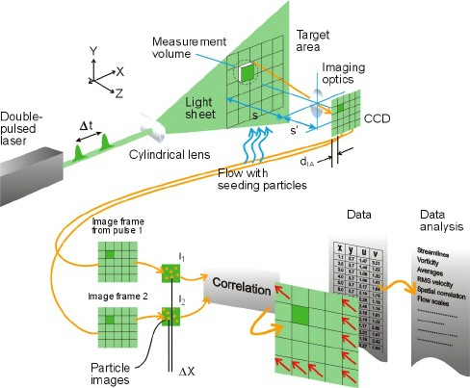
PIV测量过程

Slide 27

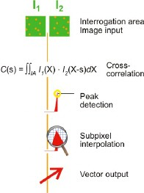
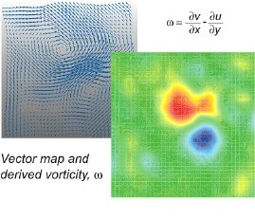
PIV数据处理

Slide 28
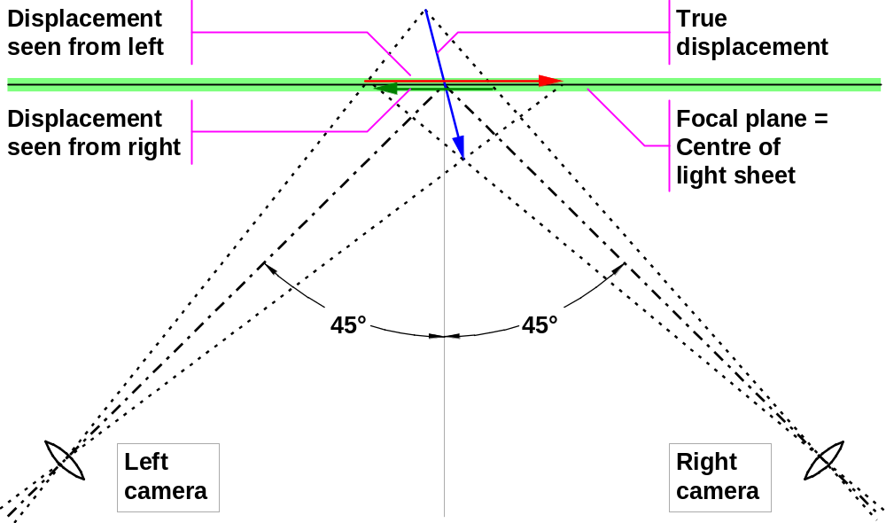
Fundamentals of stereo vision
True 3D displacement (ΔX,ΔY,ΔZ) is estimated from a pair of 2D dis- placements (Δx,Δy) as seen from left and right camera respectively
Notes:
3D-PIV is based on the same fundamental principle as human eye-sight: Stereo vision. Our two eyes see slightly different images of the world surrounding us, and comparing these images, the brain is able to make a 3-dimensional interpretation. With only one eye you will be perfectly able to recognise motion up, down or sideways, but you may have difficulties judging distances and motion towards or away from yourself.
As with 2D measurements, stereo-PIV measures displacements rather than actual velocities, and here cameras play the role of “eyes”. The most accurate determination of the out-of-plane displacement (i.e. velocity) is accomplished when there is 90° between the two cameras. In case of restricted optical access, smaller angles can be used at the cost of a somewhat reduced accuracy.
For each vector, we extract 3 true displacements (ΔX, ΔY, ΔZ) from a pair of 2-dimensional displacements (Δx, Δy) as seen from left and right camera respectively, and basically it boils down to solving 4 equations with 3 unknowns in a least squares manner. Depending on the numerical model used, these equations may or may not be linear.

Slide 29
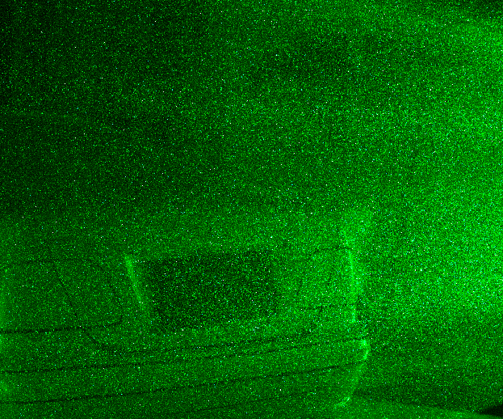
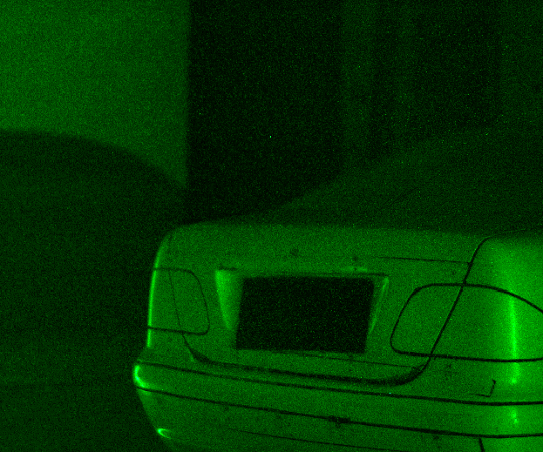
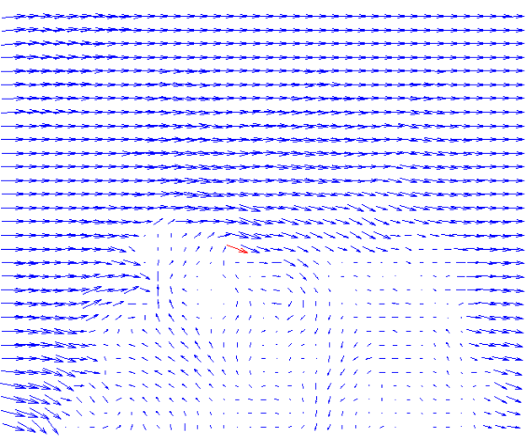
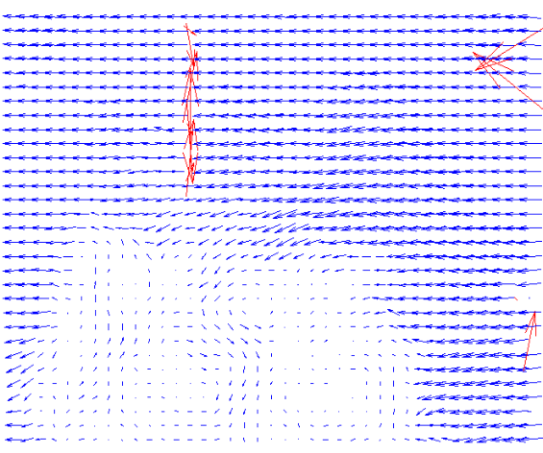
Left / Right 2D vector maps
Left & Right camera images are recorded simultaneously.
Conventional PIV processing produce 2D vector maps representing the flow field as seen from left & right.
The vector maps are re-sampled in points corresponding to the interrogation grid.
Combining left / right results, 3D velocities are estimated.
Notes:
The actual stereo-measurements start with conventional 2D-PIV processing of simultaneous recordings from left and right camera respectively.
This produces two 2-dimensional vector maps representing the instantaneous flowfield as seen from the left and right camera respectively.
Using the camera model including parameters from the calibration, the points in the chosen interrogation grid are now mapped from the lightsheet plane and onto the left and right image plane (CCD-chip) respectively.
The 2D vector maps are re-sampled in these new interrogation points using for example bilinear interpolation to estimate 2D vectors in these points based on the nearest neighbours.
With a 2D displacement seen from both left and right camera estimated in the same point in physical space, the true 3D particle displacement can now be estimated by solving 4 equations with 3 unknowns in a least-squares manner.

Slide 30
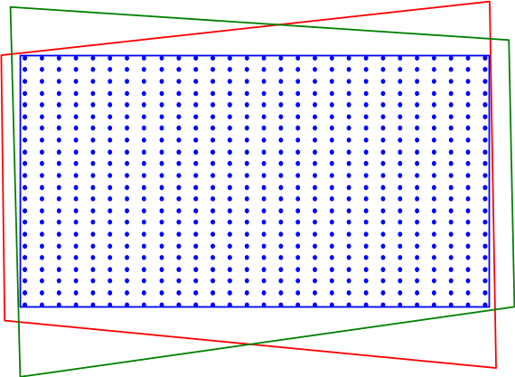
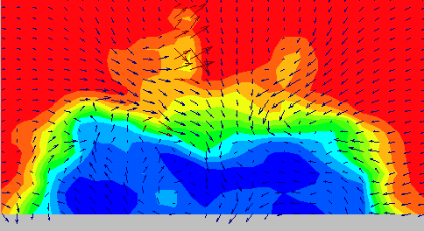
3D reconstruction
Overlap area with
interrogation grid
Resulting 3D vector map
Left 2D vector map
Right 2D vector map
Notes:
With Dantec Dynamics FlowManager a large number of matching 2D vector map pairs can quickly be recorded, yielding a corresponding number of 3D vector maps after a bit of post processing.
A large number of vector maps are required to calculate reliable statistics such as 3D mean velocities, rms values and cross-correlation coefficients.

Slide 31
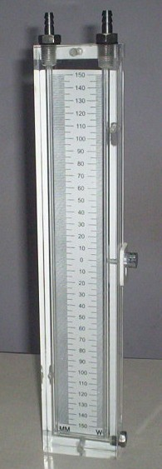
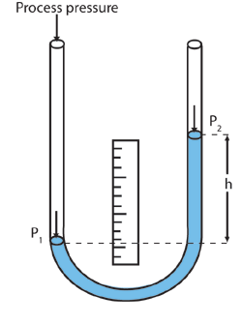

平均压强- U型管
我们测量的“压强”一般来说是相对的
  压强差
U型管压力计
液体振荡怎么办？
  用眼睛来平均
_{U型管压力计}
_{manometer}

Slide 32
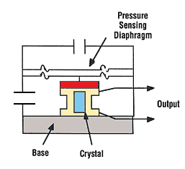
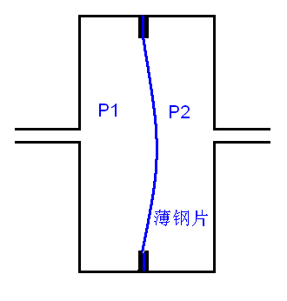
平均压强- 压力传感器
Pressure transducer
压力传感器
  电容式
  压电材料式
通过导管和被测点连接
需要通过其它压力计，比如U形管来标定
_{diaphragm}
_{电容式}
_{Capacitance type}
_{压电式}
_{Piezoelectric}

Slide 33
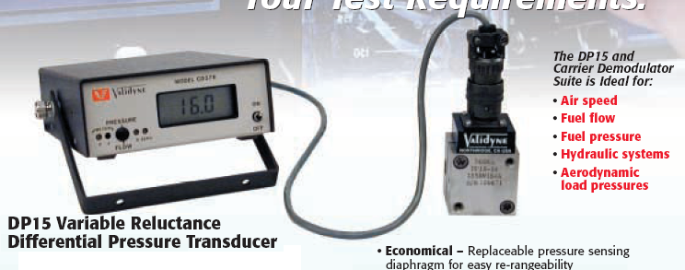
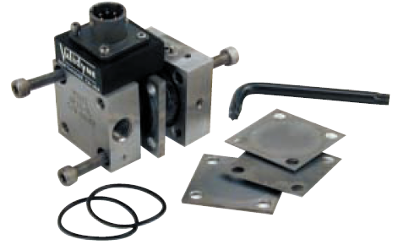
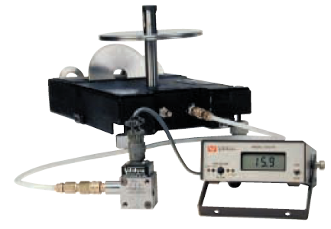
Validyne DP15 压力传感器

Slide 34
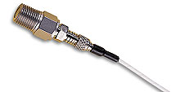
脉动压强
当压强发生快速变化的时候
  压力传感器中存在质量较大的金属片
  除金属片外空腔和导管还有大量空气/液体
  所以，当被测点压强变化时，金属片不会快速随之发生形变
  频率响应低
对策
  使用小金属片
  减小空腔体积，不使用导管
  频率响应高
  Dynamic pressure transducer

Slide 35
Dynamic pressure transducer
因为美国Kulite公司的产品最为市场认同，Dynamic pressure transducer有时被称作Kulite transducer
选购此种传感器注意事项
  http://www.advizia.com/v41/Advisor.asp?User=transducers&Rnd=559
  频率响应，大小，介质，温度要求，平均压强范围

Slide 36
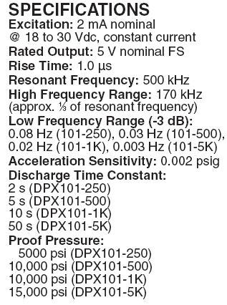
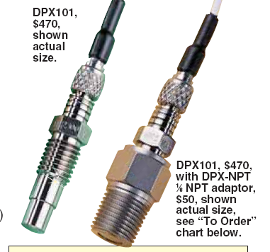
Omega DPX101传感器

Slide 37

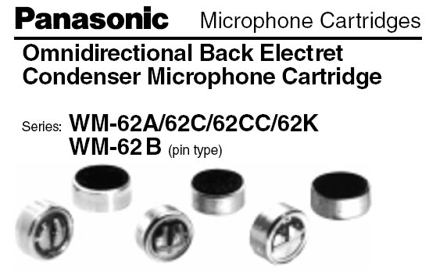
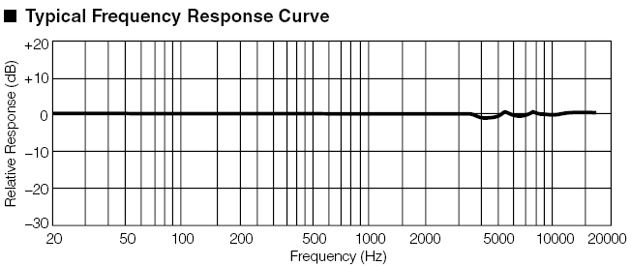
测量脉动压强的廉价选择:麦克风

