Slide 1
实验一：压强测量
Lab 1: Pressure Measurements
高南
2013-3-27

Slide 2
内容
压强
平均压强测量方法
  U型管、布尔顿管、压电材料、金属膜
脉动压强测量方法
  高频压强传感器

Slide 3
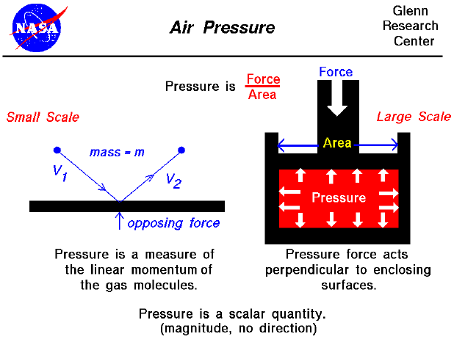

Slide 4
Pressure definition
压强=力/面积
Pressure is the action of one force against another over, a surface. The pressure P of a force F distributed over an area A is defined as:
P = F/A

Slide 5
How Much is a Pascal (Pa)帕斯卡
1 N/m²
  is a very small pressure
  Therefore kilopascal (kPa)
1 atmosphere (14.7 psi, 750mmHg) is approximately 100 kPa = 1 bar
1 kPa is about 7 mmHg

Slide 6
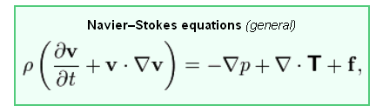
纳维斯托克斯方程

Slide 7
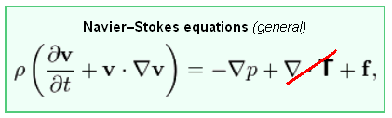
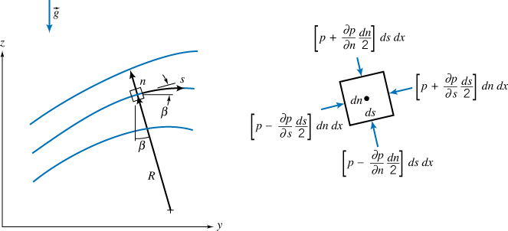
欧拉公式

Slide 8

伯努利方程

Slide 9
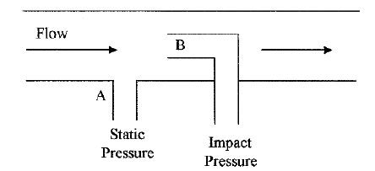
静压、动压和总压
Static, dynamic, and impact pressures
Static pressure is the pressure of fluids or gases that are stationary or not in motion. 静压只的是本地压强
Dynamic pressure is the pressure exerted by a fluid or gas when it impacts on a surface or an object due to its motion or flow. In Fig., the dynamic pressure is (B − A). 动压指的是把运动空气阻挡到静止所要承受的压强
Impact pressure (total pressure) is the sum of the static and dynamic pressures on a surface or object. Point B in Fig. depicts the impact pressure. 总压是本地静压和动压之和
Notes:
Point A is considered as static pressure although the fluid above it is flowing.

Slide 10
Definition Of Pressure
定义
Gauge pressure表压
The pressure is referenced to atmospheric pressure and by convention
is measured in the positive direction, i.e. 7 psig.
相对于本地大气压的压强大小
Absolute pressure绝对压强
The pressure is referenced to zero absolute pressure and has units of
psia. Absolute pressure can only have a positive value.
某点的绝对压强=测点表压+本地大气压强
Vacuum pressure真空度
The pressure is referenced to atmospheric pressure and by convention
is measured in the negative direction, i.e. -50 mm Hg.
相对于本地大气压的压强大小，通常为负值

Slide 11
Pressure Measurement
压强单位
A number of measurement units are used for pressure. They are as follows:
Pounds per square foot (psf) or pounds per square inch (psi)
Atmospheres (atm)
Pascals (N/m²) or kilopascal (1000Pa)*
Torr = 1 mm mercury
Bar (1.013 atm) = 100 kPa
14.696 lbf/in2 equals 33.9 feet of H2O
14.696 lbf/in2 equals 29.921 inches of of Hg

Slide 12
Pressure Units
单位换算
The following conversion factors should help in dealing with the various units:
1 psi= 51.714 mmHg
= 2.0359 in.Hg
= 27.680 in.H2O
= 6.8946 kPa
1 bar= 14.504 psi
1 atm. = 14.696 psi

Slide 13
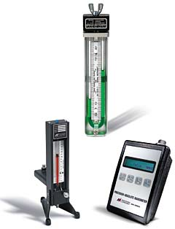
Manometer basics
Characterized by its inherent accuracy and simplicity of operation. 操作简单
It’s the U-tube manometer, which is a U-shaped glass tube partially filled with liquid. U型管
This manometer has no moving parts and requires no calibration. 不需标定
Manometer measurements are functions of gravity and the liquid’s density, both physical properties that make the U-tube manometer a NIST standard for accuracy. 受重力和液体密度影响

Slide 14
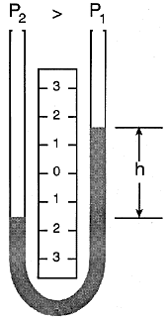
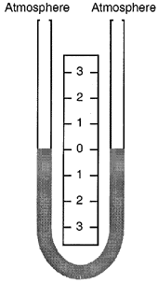
Manometer
With both legs of a U-tube
manometer open to the
atmosphere or subjected to the
same pressure, the liquid
maintains the same level in
each leg, establishing a zero
reference.
With a greater pressure applied to the left side of a U-tube manometer, the liquid lowers in the left leg and rises in the right leg.
The liquid moves until the unit weight of the liquid, as indicated by h, exactly balances the pressure.

Slide 15
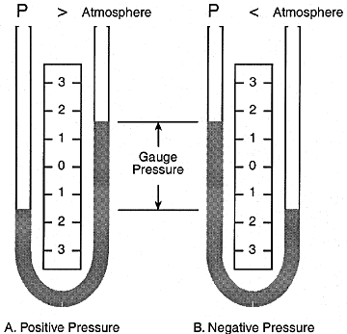
Manometer
Gauge pressure is a measurement relative to atmospheric pressure and it varies with the barometric reading.
A gauge pressure measurement is positive when the unknown pressure exceeds atmospheric pressure (A), and is negative when the unknown pressure is less than atmospheric pressure (B).

Slide 16
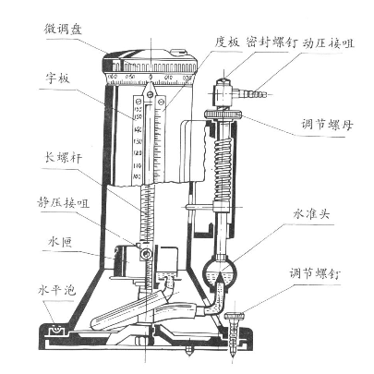
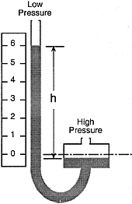
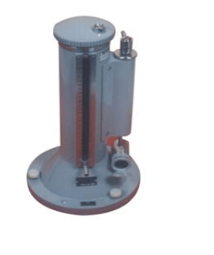
Reservoir (Well) Manometer
In a well-type manometer, the cross-sectional area of one leg (the well) is much larger than the other leg. When pressure is applied to the well, the fluid lowers only slightly compared to the fluid rise in the other leg.
YJB2500补偿式微压计
http://wenku.baidu.com/view/c62dfe2b7375a417866f8f24.html
补偿式微压计使用说明书

Slide 17
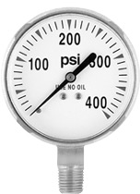
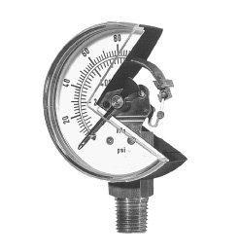
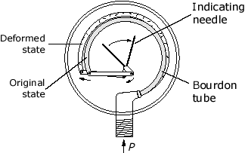
压强测量装置Pressure Measuring Devices
Bourdon Gage:布尔顿管
http://www.cpigauges.com/images/gauges/WeldGageStlCsBM400psi.jpg
http://www.efunda.com/DesignStandards/sensors/bourdon_tubes/images/Bourdon_tube_A.gif
http://www.hydraulicspneumatics.com/FPE/images/sensors1_1.jpg
Principles: change in curvature of the tube is proportional to difference of pressure inside from that outside the tube
原理：压强增加、管曲率变化
Applications: tire pressure, pressure at the top or along the walls of tanks or vessels 用途：压力容器

Slide 18
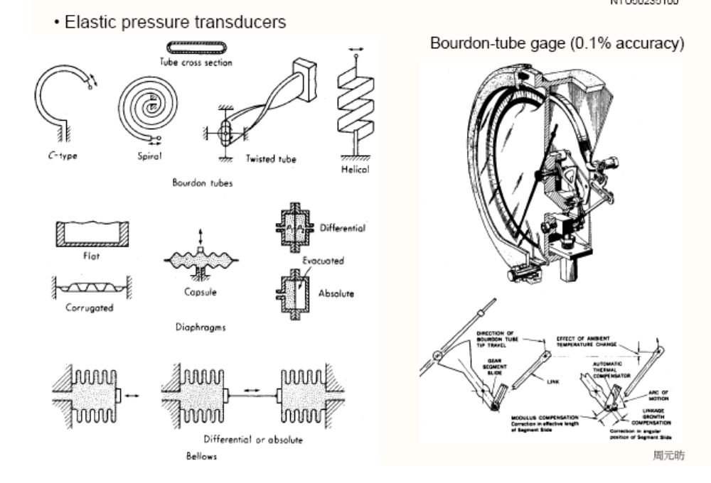

Slide 19
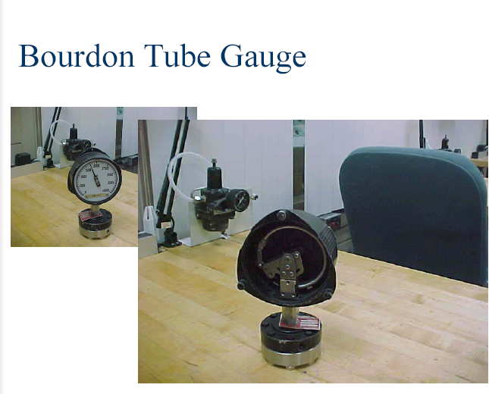

Slide 20
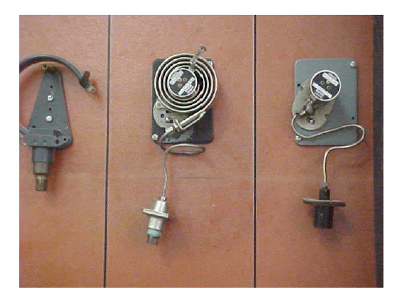
Bourdon Tubes

Slide 21
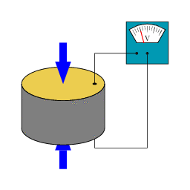
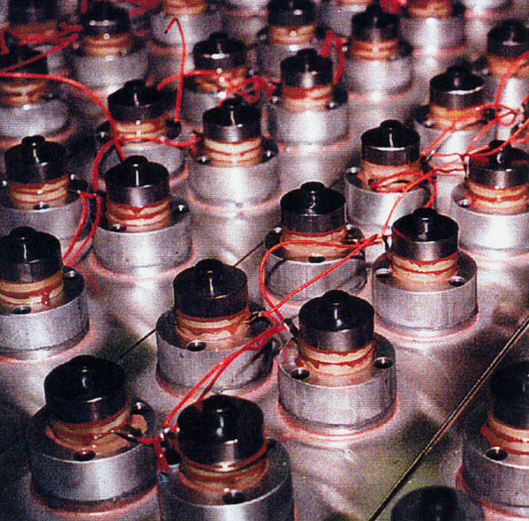
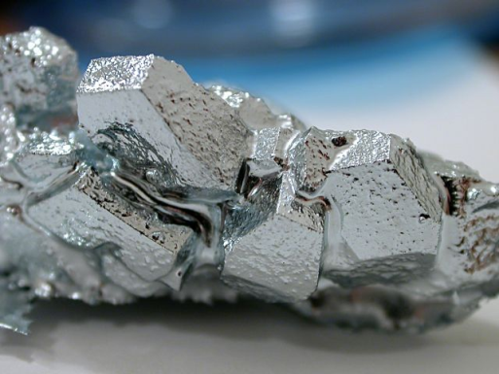
压强测量装置Pressure Measuring Devices
Quartz Gage 石英压敏材料
Piezoelectric transducers
http://www.ransohoff.com/images/systems/transducerlgr.jpg
http://upload.wikimedia.org/wikipedia/commons/c/c4/SchemaPiezo.gif
Principles: ∆ Pressure → ∆ Charge → ∆ Voltage
Applications: measurements with high accuracy, good repeatability, high resolution.
e g. Quartz Clock
CE319F - Elementary Mechanics of Fluids - Laboratory
UT Austin

Slide 22
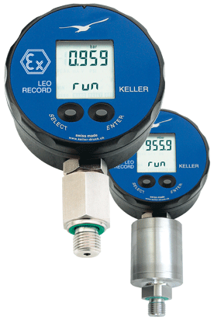
压强测量装置Pressure Measuring Devices
Piezoresistive Gage 压电电阻
Digital Manometer
Principles: ∆Pressure = ∆Charge = ∆Resistance = ∆Voltage
Applications: Very accurate for small pressure differentials
e.g. Difference between indoor and outdoor pressure
CE319F - Elementary Mechanics of Fluids - Laboratory
UT Austin

Slide 23
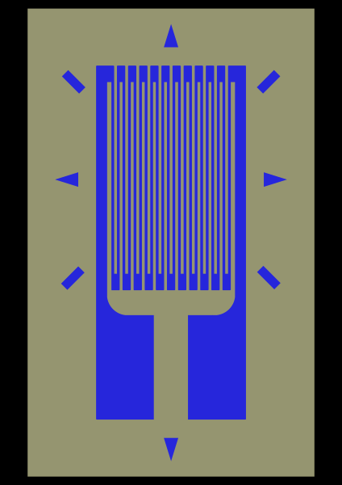
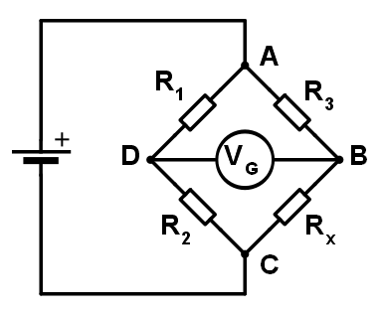
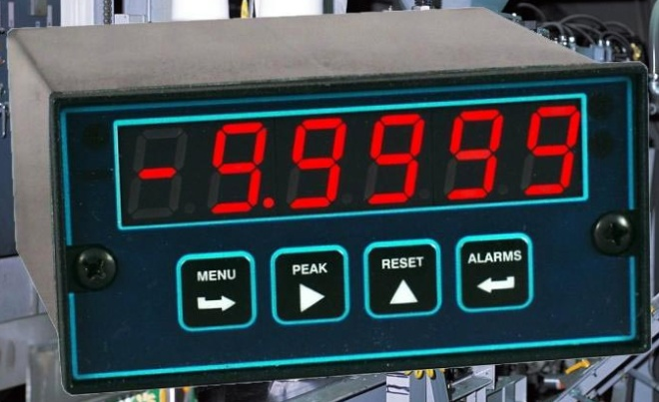
压强测量装置Pressure Measuring Devices
Strain Gage
Principles: ∆ P → ∆ Resistance → ∆ Voltage
Applications: Sensors for internal combustion engines, automotive, research etc.
CE319F - Elementary Mechanics of Fluids - Laboratory
UT Austin

Slide 24
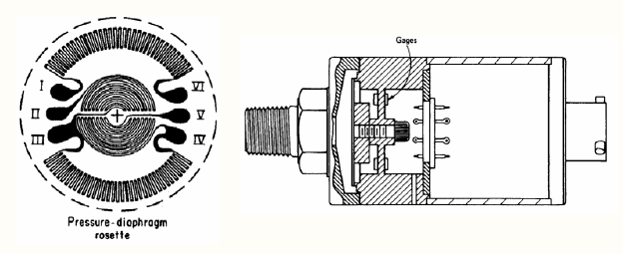

Slide 25
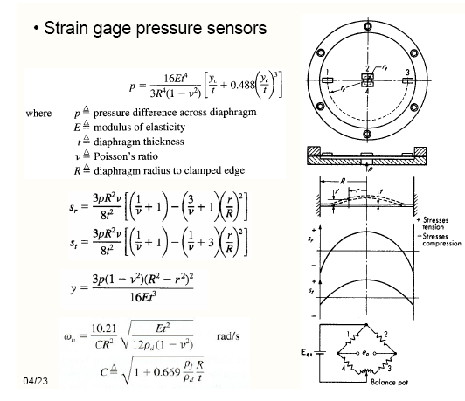

Slide 26
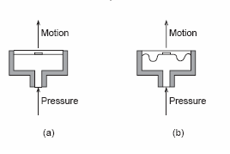
Diaphragm
压强测量装置Pressure Measuring Devices
(a) flat diaphragm; (b) corrugated diaphragm
A diaphragm usually is designed so that the deflection-versus-pressure characteristics are as linear as possible over a specified pressure range, and with a minimum of hysteresis and minimum shift in the zero point.

Slide 27
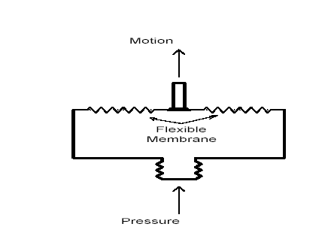
Diaphragm

Slide 28
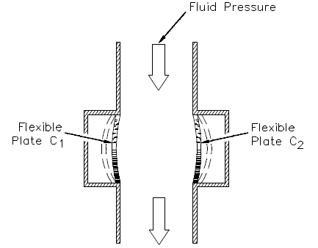
Capacitance 电容器

Slide 29
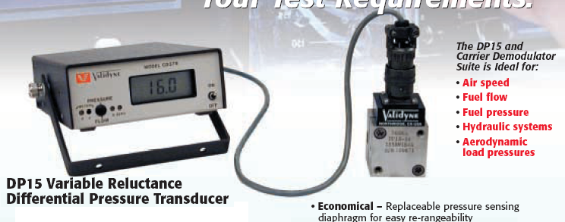
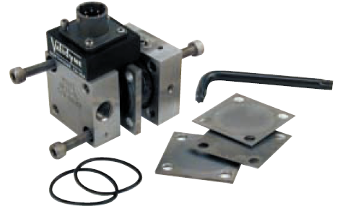
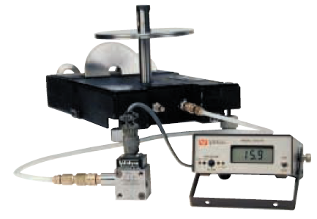
Validyne DP15 压力传感器

Slide 30
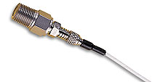
脉动压强
当压强发生快速变化的时候
  压力传感器中存在质量较大的金属片
  除金属片外空腔和导管还有大量空气/液体
  所以，当被测点压强变化时，金属片不会快速随之发生形变
  频率响应低
对策
  使用小金属片
  减小空腔体积，不使用导管
  频率响应高
  Dynamic pressure transducer

Slide 31
Dynamic pressure transducer
因为美国Kulite公司的产品最为市场认同，Dynamic pressure transducer有时被称作Kulite transducer
选购此种传感器注意事项
  http://www.advizia.com/v41/Advisor.asp?User=transducers&Rnd=559
  频率响应，大小，介质，温度要求，平均压强范围

Slide 32
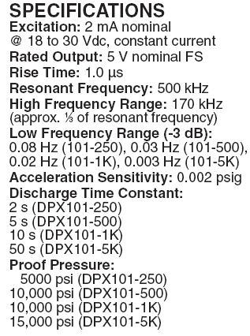
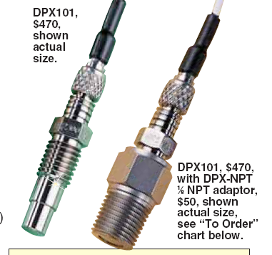
Omega DPX101传感器

Slide 33

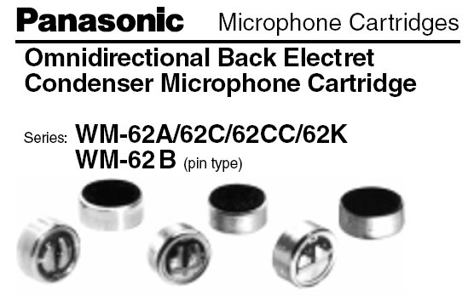
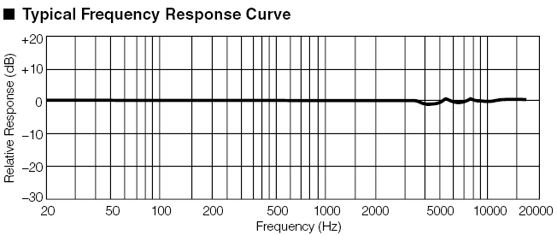
测量脉动压强的廉价选择:麦克风

