Slide 1
低速风洞
Low speed wind tunnel

Slide 2
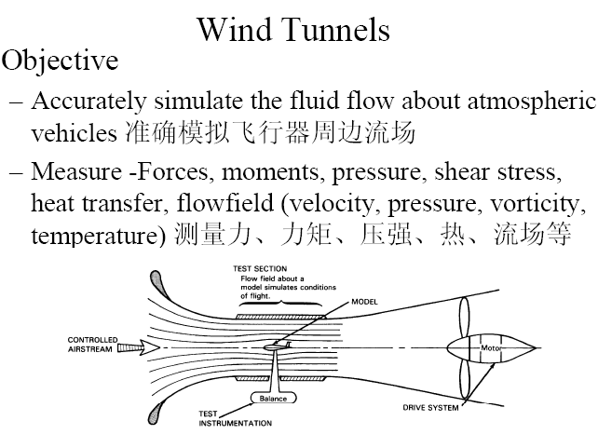

Slide 3
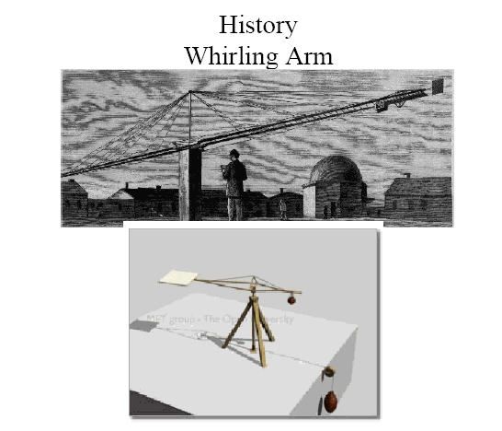

Slide 4
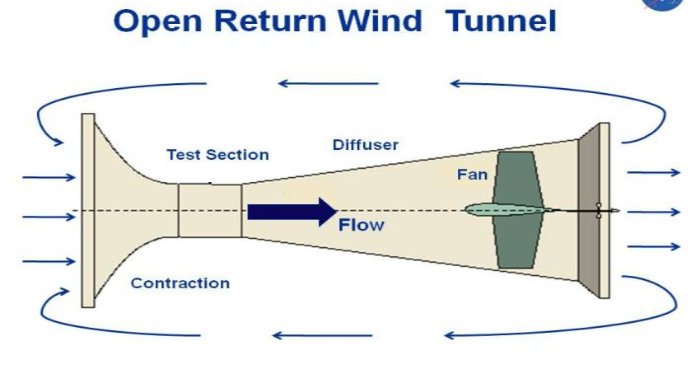

直流式、埃菲尔式
Advantages of the Open Return Tunnel
Low construction cost. 投资小
Superior design for propulsion and smoke visualization. There is no accumulation of exhaust products in an open tunnel. 入口空气干净，没有循环污染
Disadvantages of the Open Return Tunnel
Poor flow quality possible in the test section. Flow turning the corner into the bellmouth may require extensive screens or flow straighteners. The tunnel should also be kept away from objects in the room (walls, desks, people ...)that produce asymmetries to the bellmouth. Tunnels open to the atmosphere are also affected by winds and weather. 流场品质低，入口须离其他物体有一定距离
High operating costs. The fan must continually accelerate flow through the tunnel. 耗能大
Noisy operation. Loud noise from the fan may limit times of operation. 噪音大

Slide 5
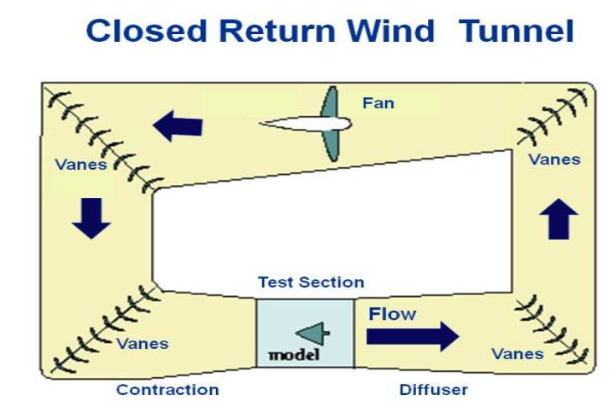
回流式、普朗特式
Advantages of the Closed Return Tunnel
Superior flow quality in the test section. Flow turning vanes in the corner and flow straighteners near the test section insure relatively uniform flow in the test section. 流动品质高
Low operating costs. Once the air is circulating in the tunnel, the fan and motor only needs to overcome losses along the wall and through the turning vanes. The fan does not have to constantly accelerate the air. 能耗低
Quiet operation relative to an open return tunnel. 噪音小
Disadvantages of the Closed Return Tunnel
Higher construction cost because of the added vanes and ducting. 投资大
Inferior design for propulsion and smoke visualization. The tunnel must be designed to purge exhaust products that accumulate in the tunnel. 如果做发动机和烟雾实验，实验段入口空气脏
Hotter running conditions than an open return tunnel. Tunnel may have to employ heat exchangers or active cooling 需要冷却

Slide 6
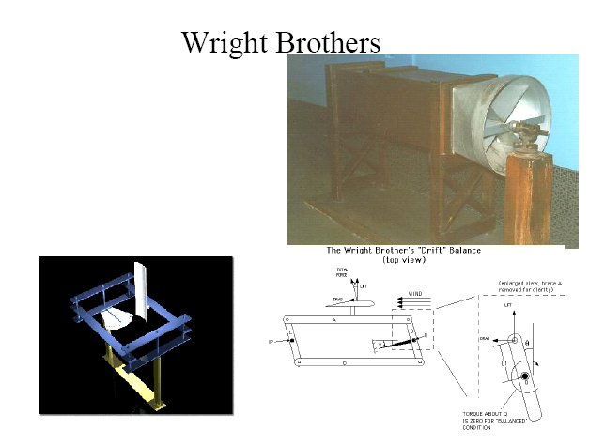

Slide 7
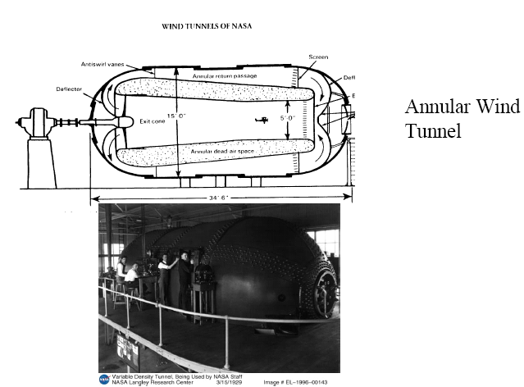
加压风洞

Slide 8
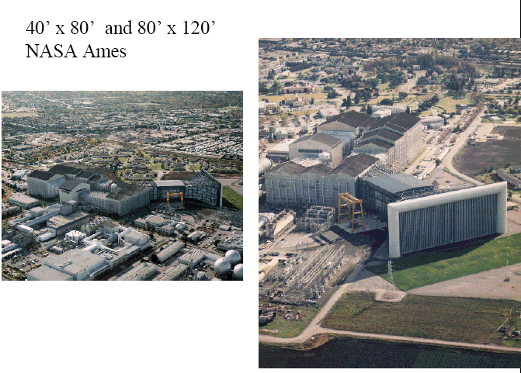

Slide 9
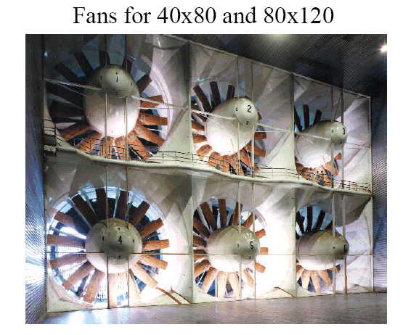

Slide 10
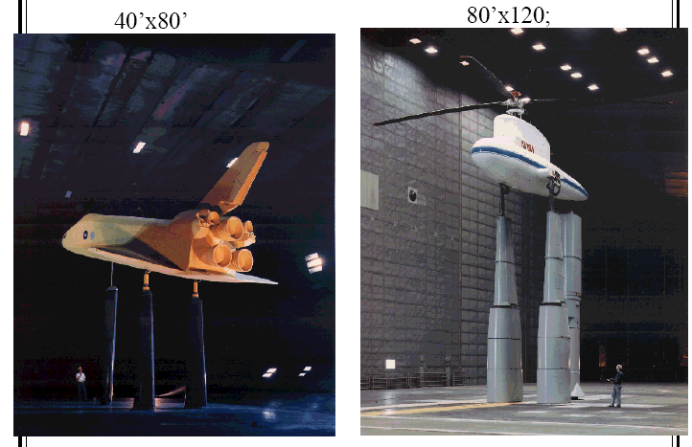

Slide 11
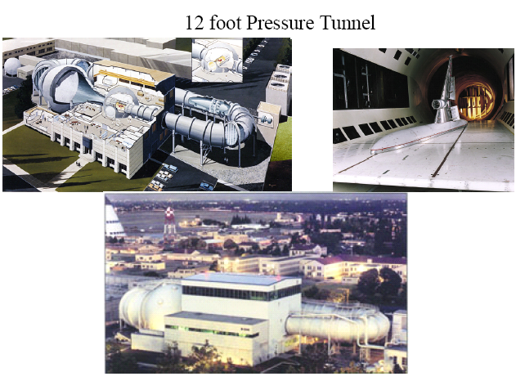

Slide 12
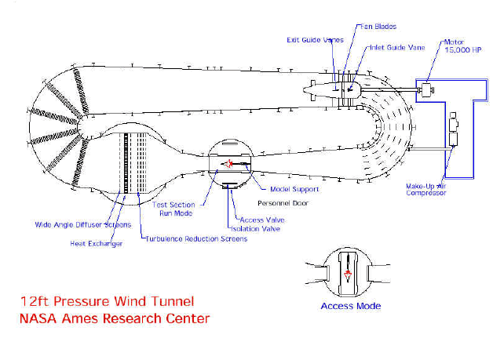

Slide 13
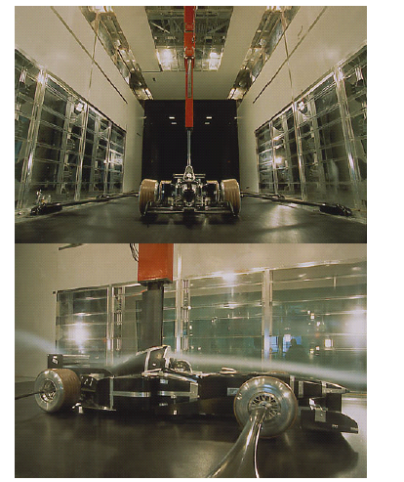
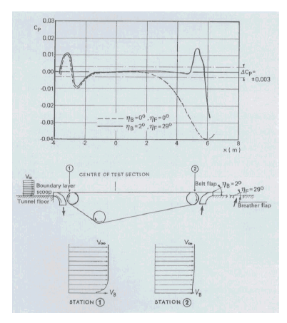

Slide 14
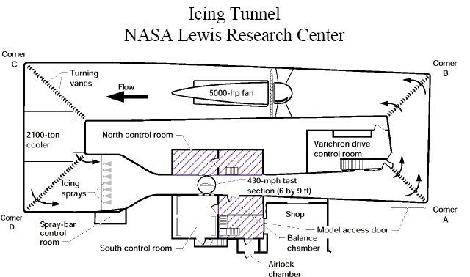

Slide 15
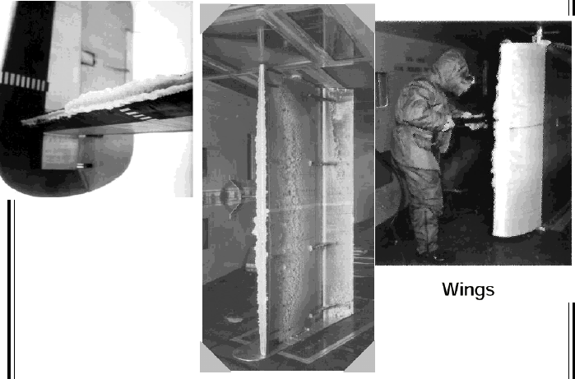

Slide 16
风洞设计过程
明确目标
  动力是什么
  实验段速度要求？
  湍流度要求

Slide 17
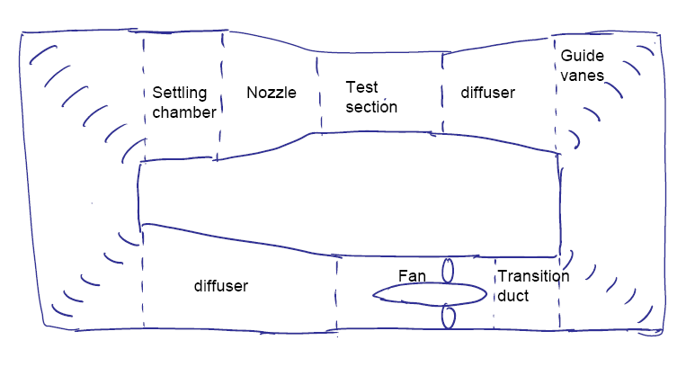
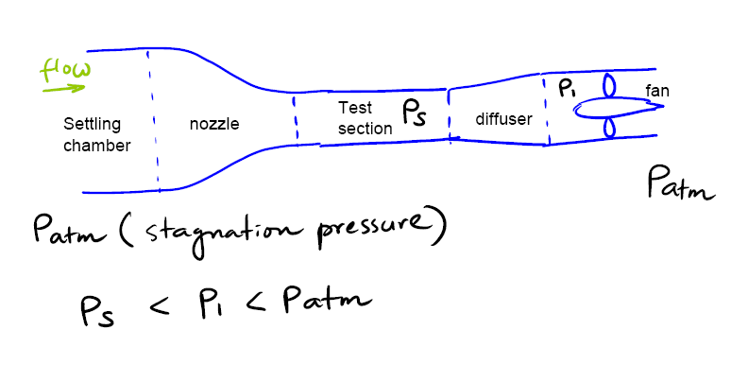
风洞设计过程
确定形式

Slide 18
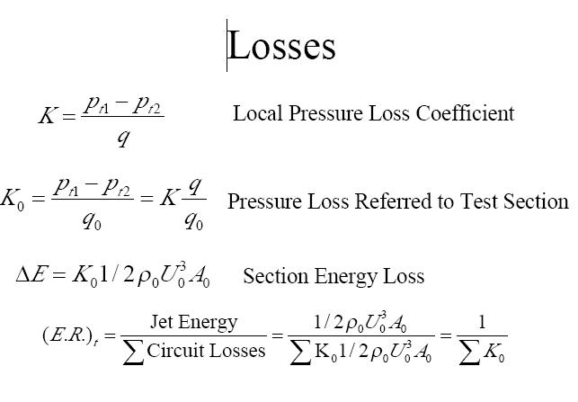
估算能量

Slide 19
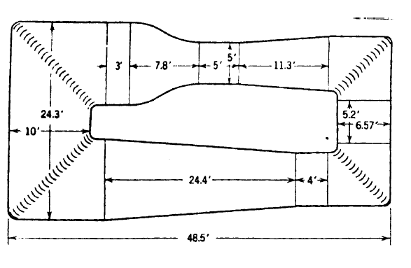
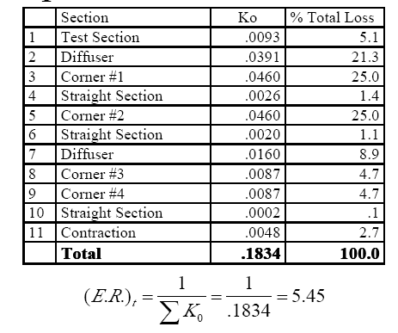

Slide 20
伍荣林，王振羽 “风洞设计原理”， 北航出版社
Rae, W. H. Jr. and Pope A.,Low-Speed Wind Tunnel Testing, John Wiley
& Sons, 2nd Ed., 1984.
Dryden, H. L., “Reduction of Turbulence in Wind Tunnel”, NACA Report
392, 1931.
Schubauer, G. B., Spangenberg, W. G., Klebanoff, P. S., “Aerodynamic
Characteristics of Damping Screens”, NACA TN 2001, 1950.
Scheiman, J. and Brooks, J. D., “Compression of Experimental and
Theoretical Turbulence Reduction from Screens, Honeycombs and
Honeycomb-Screen Combinations”, J. Aircraft, Vol. 18, pp.638-643, 1981.
Mehta, R., “The Aerodynamic Design of Blower Tunnel with Wide Angle
Diffuser”, Progress in Aerospace Science, Vol. 18, pp. 59-100, 1977.
Tsien, H. S., “On the Design of the Contraction Cone for a Wind Tunnel”,
J. Aeronautical Science, pp. 68-70, 1943.
Laws, E. M. and Livesey, J. L., “Flow through Screens”, Annual Review of
Fluid Mechnics, Vol. 10, pp.247-266, 1978.
http://www.iaa.ncku.edu.tw/~jjmiau/exp/download/ch2_%20950123.pdf

Slide 21
作业

