Slide 1
计算流体力学CFD介绍
高南
2014年10月16日

Slide 2
什么是 CFD?
求解流动控制方程，得到流场速度压力分布
CFD相对实验的优越性
  reduction in lead time and costs of new designs
  ability to study systems where controlled experiments are difficult to perform (large systems)
  ability to study systems under hazardous conditions at and beyond normal performance limits
  detail of results

Slide 3
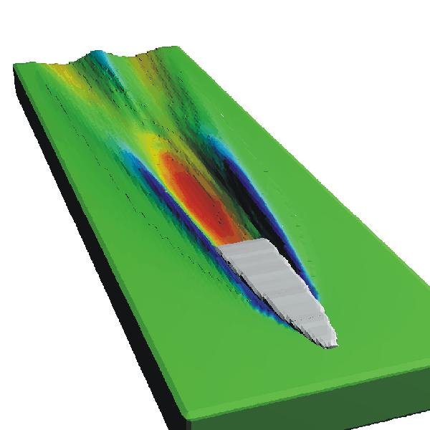
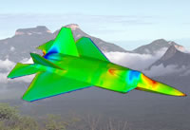
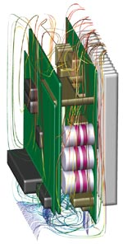
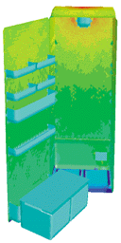
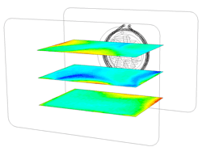
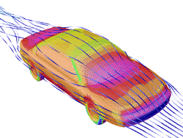
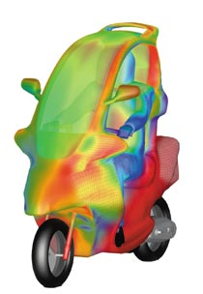
适用领域
Aerospace
Automobile and Engine Applications
Appliances
Boats
Computers

Slide 4
CFD求解过程
定义求解区域
划分网格
控制方程离散化
设置边界条件，速度或者压强等
循环直至收敛

Slide 5
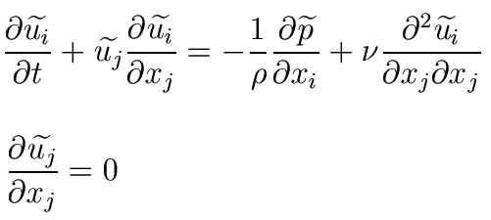
纳维 斯托克式方程
Navier Stokes Equations
方程：
把方程在每个网格上离散， 每个网格形成关于u₁,u₂,u₃,P的4个方程。
_{*本讲所列方程均为不可压缩，忽略重力}

Slide 6
Discretising equations 方程离散化
i-1,j+1
i,j+1
i+1,j+1
i-1,j
i,j
i+1,j
i-1,j-1
i,j-1
i+1,j-1
Need to know 需要知道
  values of each variable (eg u) at each point 每点的速度
  values of the first derivative 速度在各方向导数
  values of cross-derivatives各方向二次导数
  values of second derivatives
  ……..and more

Slide 7
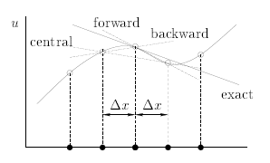
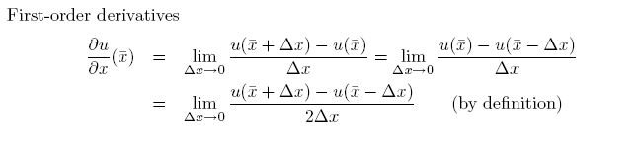
Finite Difference Method 有限差分

Slide 8
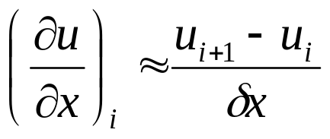
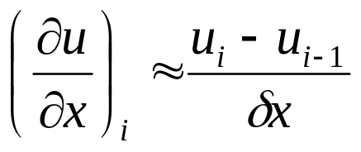
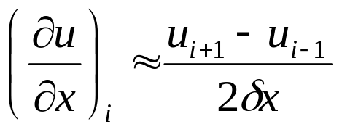
1st & 2nd Order Finite Difference
1st order forward difference
1st order rearward difference
2nd order central difference

Slide 9
Structured grids (eg hex)
结构化网格（比如：四边形）
Advantages:
Equations relatively simple
Cell shape is easily controlled
Numerical errors are smaller
Can be fitted to flow direction
Can be fitted to gradients in flow
Optimises memory use
Disadvantages:
Fitting to complex geometries requires a lot of time and skill

Slide 10
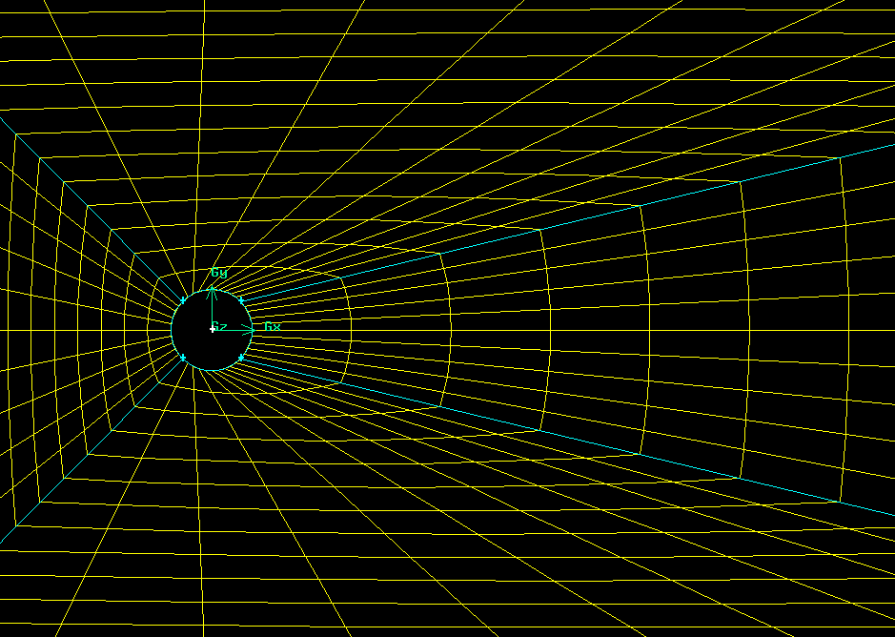
Structured grid 结构化网格

Slide 11
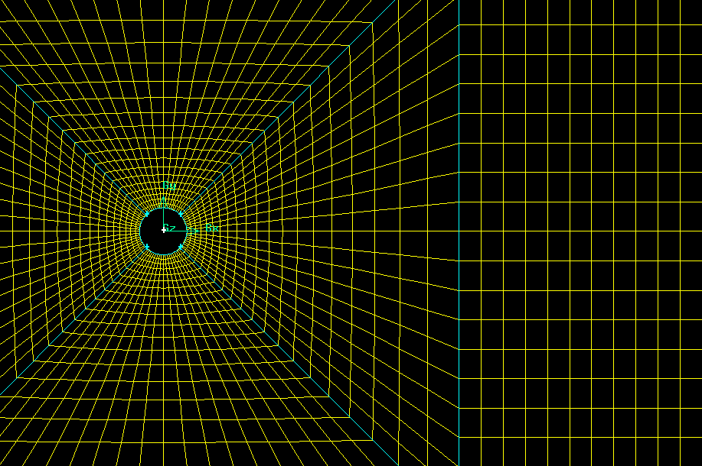
Structured grid (2)

Slide 12
Un-structured grids (eg tet)
非结构化网格
Advantages:
Can be fitted to unusual shapes
‘One-click’ creation
Disadvantages:
Generally larger errors
Limited control over cell shape – ‘skewness’

Slide 13
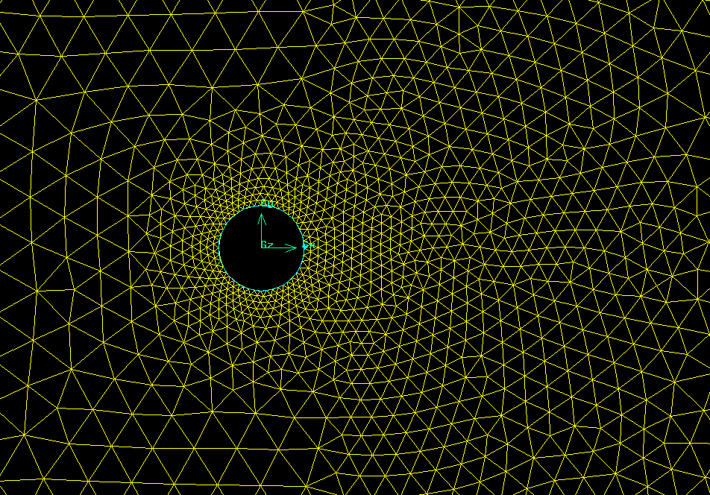
Unstructured grid

Slide 14
CFD求解 计算过程
给每个网格设定初值，设定边界值
For i=1 to N %从时间t_{o}开始，每步增加Δt
  While u,v,w 还在变化
      For j= 1 to M %第1个到第M个网格
        Compute u
        Compute v
        Compute w
        Compute p
      End
  End
End

Slide 15
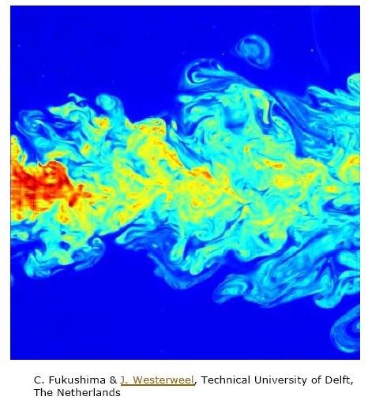
对网格大小和时间步长的要求
准确捕捉到流场所有特性
  网格尺寸要小到最小涡旋长度尺度的若干分之一
  时间步长要小到最小涡旋时间尺度的若干分之一
能够达到这种要求的模拟被称作湍流的直接数值模拟(Direct Numerical Simulation, DNS)

Slide 16
DNS
一定是三维模拟
非常‘昂贵’，小尺度～1/Re_{L}^{3/4}
“the number of grid points and the cost required increase roughly with Re³” (Rodi 2006)
主要用在科研，来分析湍流的物理特性一般Re=2000~6000

Slide 17
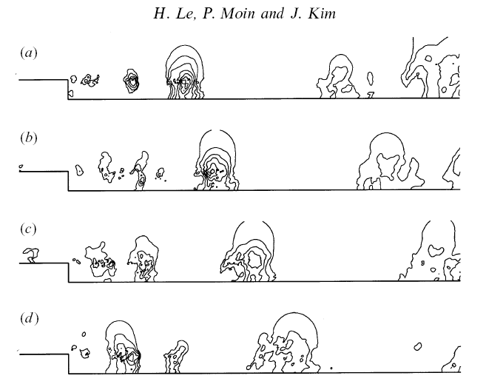
Le et al, 1996, 背向台阶的直接模拟
Re=5100
grid 512x192x64
克雷机，每步10秒
共需24天计算时间

Slide 18
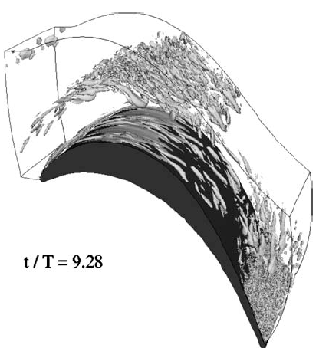
DNS
最近一两年，欧美几个研究机构开始计算一些工程中的流场
例如卡尔斯鲁厄大学W. Rodi小组，1千万网格，Re～10⁵
200-400个CPU
_{Rodi 2006}
_{燃气轮机压缩机叶片的大尺度结构，Re=51800}

Slide 19

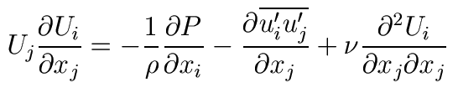

雷诺平均后的方程
Reynolds Averaged Navier Stokes (RANS)
很多实际问题中只关心流场的平均量
利用雷诺分解
代入动量方程，对每项求平均，得
需要建立雷诺应力 与‘已知量’的关系，才能得到解 (close momentum equation)

Slide 20
商用CFD软件
FLUENT，CFX ，ANSYS等等
1 前处理
2 计算
3 后处理

Slide 21
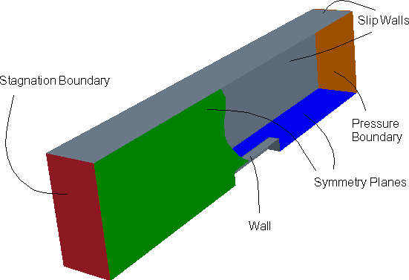
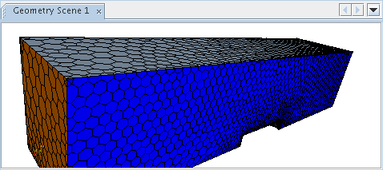
1) Pre-Processor
Consists of the input of
a flow problem to CFD
User Activities:
  define geometry & generate grid (50% time)
  selection of phenomena to be modeled
  definition of fluid properties
  specification of boundary and initial conditions

Slide 22
2) Solver
Three primary numerical solution techniques
  finite difference, finite element, finite control volume
The numerical method performs the following:
  Approximates the unknown variables by simple functions
  Discretization by substitution of the approx-imations into the governing flow equations and subsequent mathematical manipulations
  Solution of the algebraic equations

Slide 23
Solver - Finite Volume Method
  Based on control volume formulation of analytical fluids
  The domain is divided into a number of control volumes (aka cells, elements) - the variable of interest is located at the centroid of the control volume.
  The differential form of the governing equations are integrated over each control volume.
  Finite difference approximations are substituted for the terms in the integrated equations (discretization) →converts the integral equations into a system of algebraic equations.
  Set of algebraic equations are solved by an iterative method.

Slide 24
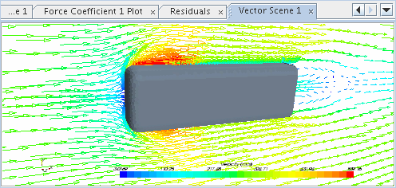
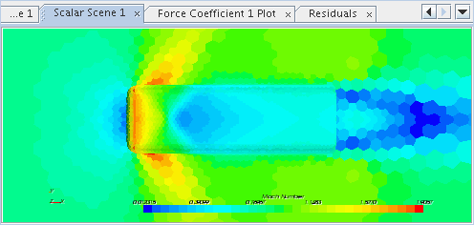
3) Post Processor
Provides a “user friendly” (??) way to look at the results of a simulation
  Domain geometry and grid display
  Vector Plots
  Contour Plots
  Particle Tracking

