Slide 1
Fluid mechanics
2010-9-29

Slide 2
Course will be given in English

Slide 3
高南
综合实验一号楼411B (公安处西侧)
8470-6414
137-9519-0354
gaonan@dlut.edu.cn

Slide 4
Purpose
Solve problems
  More complex problems than undergrad fluids course
    Complex geometry
    Heat transfer involved
    High speed, compressible
    Turbulence
  Methods
    Analytical and numerical

Slide 5
Evaluation
50%: 8 homework assignments
  Work independently, discussion allowed
  Written in English
  Cheating will be prosecuted! 0 mark for that assignment caught first time, 0 for all the assignments caught second time.
50%: in-class final, close book
  In English

Slide 6
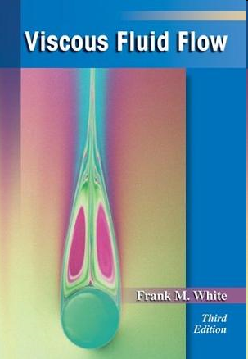
Textbook
Frank White

Slide 7

E-library

Slide 8
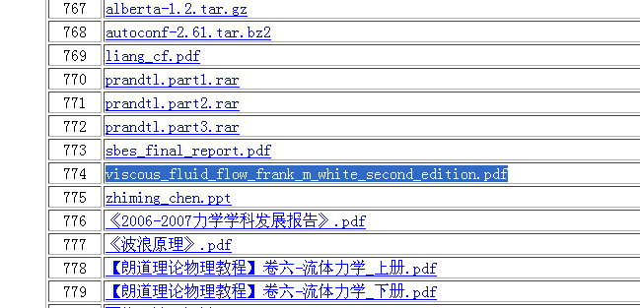
Textbook
 | viscous_fluid_flow_frank_m_white_second_edition.pdf

Slide 9
Scope
Properties of fluids (chapter 1)
  Review of some of the “names”
  Thermodynamics
Setup equations (Chapter 2)
  Continuity, momentum, energy
Using equations
  Simple flows (chapter 3)
  Boundary layers (chapter 4)
More using equations
  Flow stability (chapter 5)
  Turbulent flow (chapter 6)
  Compressible flow (chapter 7)

Slide 10
Strategy
Guide you through this book, rather than deriving every theory and equation

Slide 11
Today
Viscous and inviscid flow
Flow kinematics
  Translation
    Acceleration
  Rotation
  Strain

Slide 12
Flows
Many other ways to characterize flows
  Incompressible and compressible 不可压和可压流
  Rotational and irrotational 有旋和无旋流
  Newtonian and nonnewtonian 牛顿流和非牛顿流
  …
Viscous flow
Inviscid flow
粘性流
无粘流

Slide 13
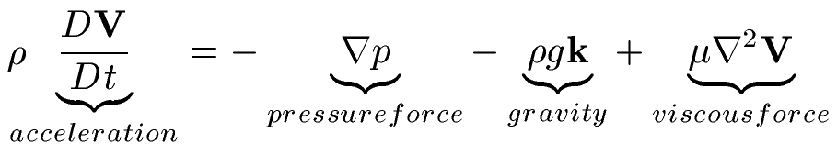

Inviscid flow
Momentum equation 动量方程
Inviscid flow
  viscous force relative small
  If irrotational 如果还是无旋流动
    Velocity potential

Slide 14



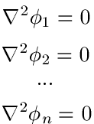

Potential flow
Velocity potential
If incompressible
Laplace equation
Linear

Slide 15
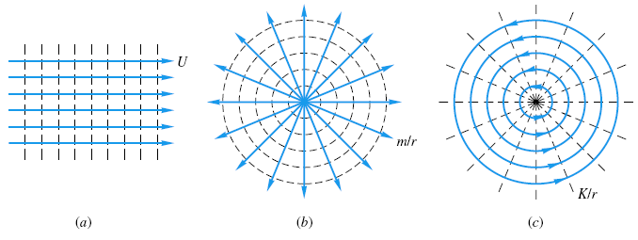
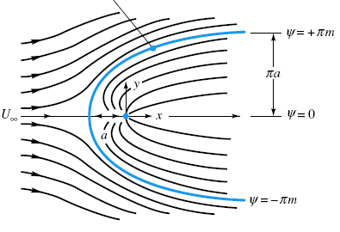
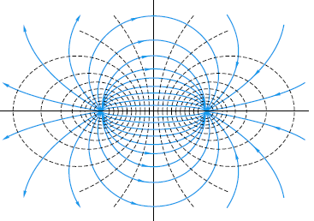
Examples of potential flows
Uniform stream in x direction
Source源
Sink汇
Doublet偶极子

Slide 16

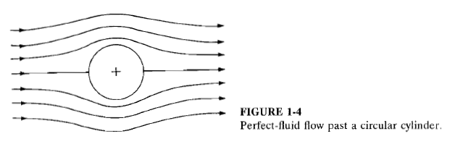
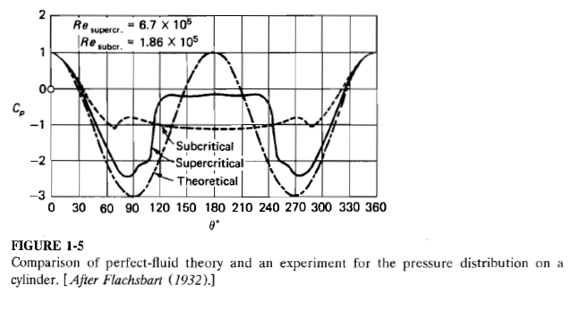
Cylinder in cross flow
壁面压强系数
角度

Slide 17
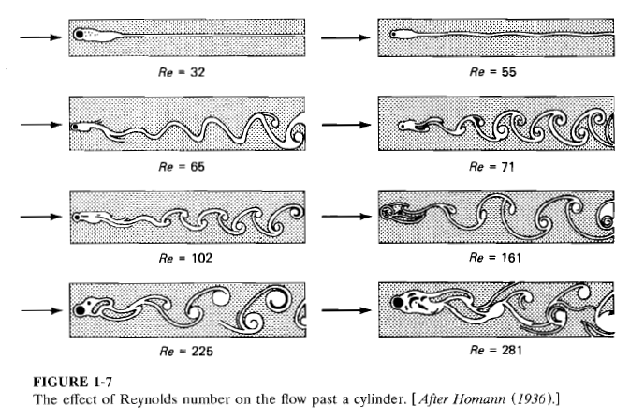
Cylinder in cross flow

Slide 18
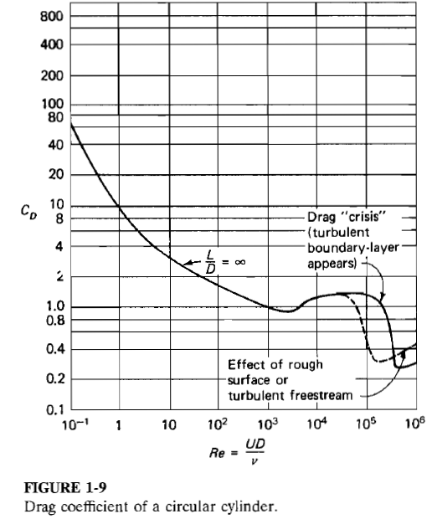
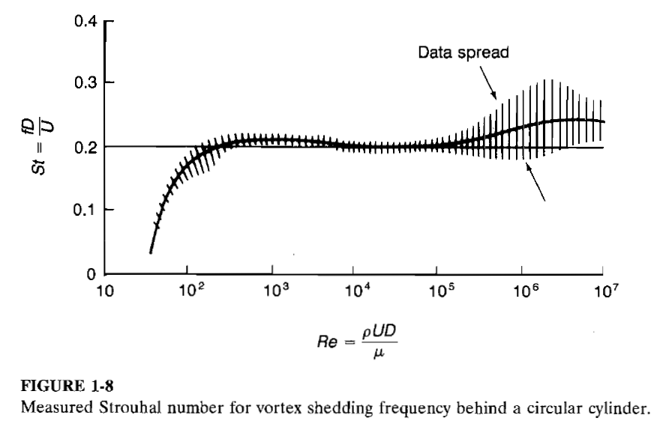
Cylinder in cross flow
Drag coefficient
St=f D/U
Re
f:涡脱频率
f: Vortex shedding frequency
Re

Slide 19

Reynolds number
雷诺数
Ratio of the inertial force to viscous force

Slide 20
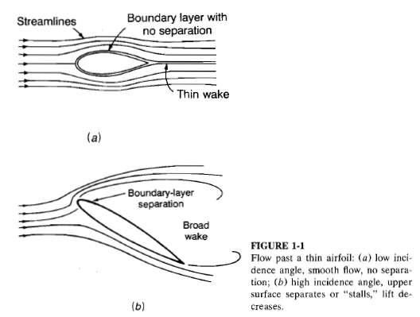
Other examples of viscous flows
Flow pass thin airfoil

Slide 21
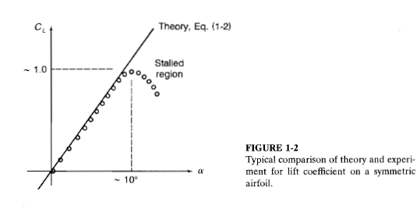

Lift coef vs. angle of attack
升力系数 和 攻角 的关系

Slide 22
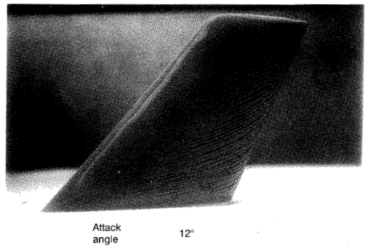
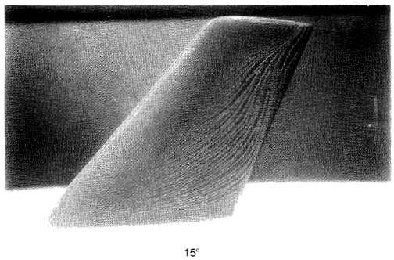
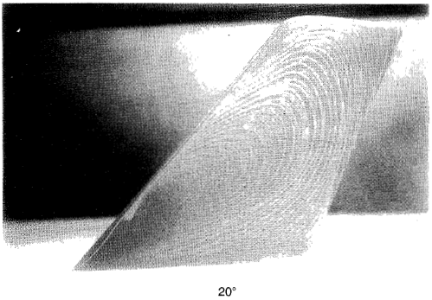
Oil film visualization on the upper surface of an airfoil
12度
15度
20度

Slide 23


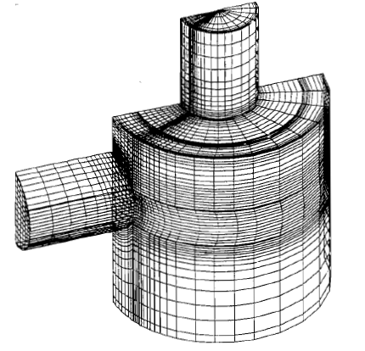
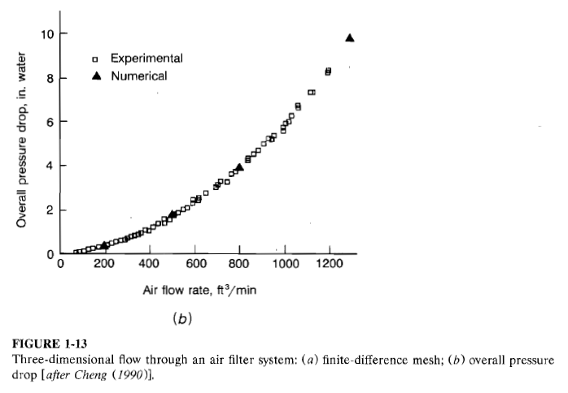
Method to solve viscous flow
Navier-Stokes equation

Slide 24
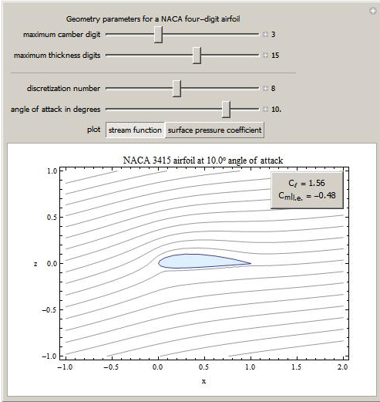
A few more words about the potential flow theory
Works well for some flows
Widely used in airfoil design
  Interesting example using Mathematica
  http://demonstrations.wolfram.com/PotentialFlowOverANACAFourDigitAirfoil/
Stilled used in ship design
and other fields

Slide 25
break

Slide 26
End for today

Slide 27
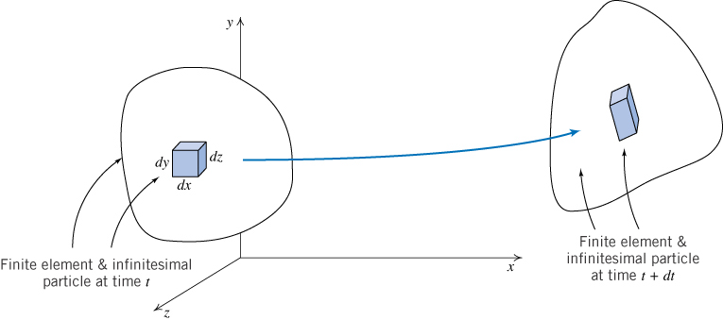
Kinematics
流场运动特性
Translation 平动
Rotation 转动
Strain 形变
  Extensional
  Shear

Slide 28
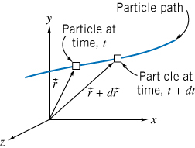







Translation
Particle velocity
Particle acceleration

Slide 29


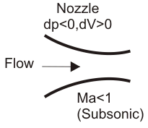

Translation
Acceleration
Particle acceleration
Expressed using Eulerian formulation
Substantial derivative, material derivative..

Slide 30
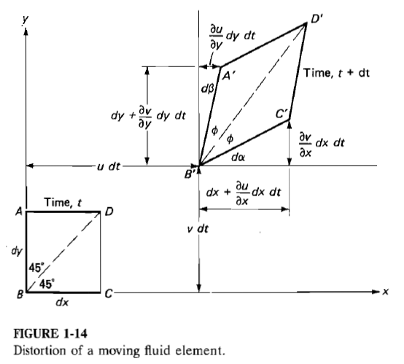

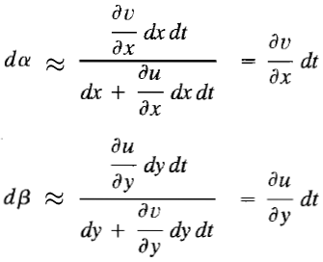

Rotation
Rotation of BD
Angular velocity BD

Slide 31
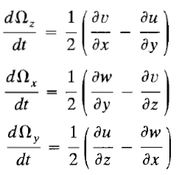

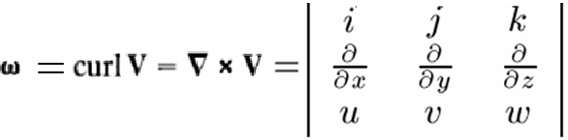
Rotation
Three components of angular velocity
Vorticity 涡量

Slide 32

Rotation
Vorticity vector is solenoidal

Slide 33
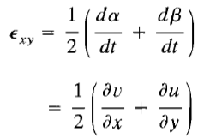
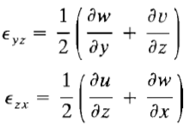
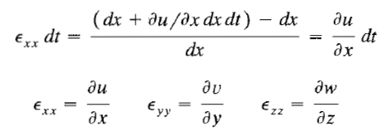
Strain
Shear strain rate
Extensional strain

Slide 34
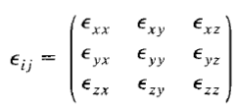
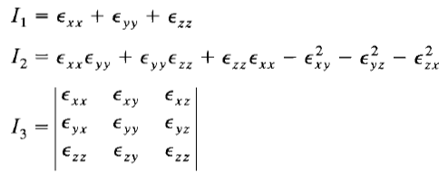
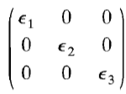
Strain tensor 形变张量
Strain tensor
  symmetric
  Value of each entry change when axes change
Three invariants 三个不变量
One and only one principle axes

Slide 35
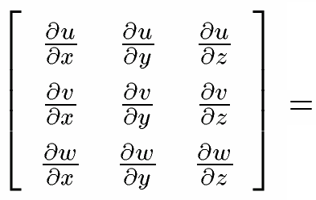
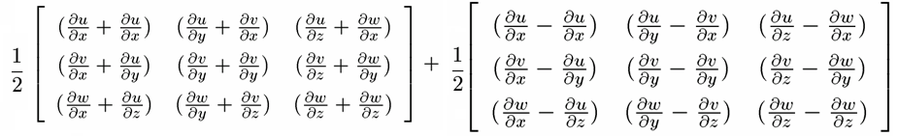

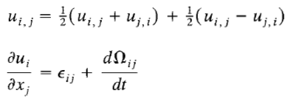
Velocity derivative=strain rate + angular velocity

Slide 36
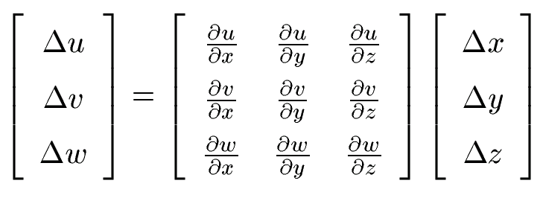
Velocity derivatives
A
B

