Slide 1
高等流体力学
Advanced fluid mechanics
2013-9-16

Slide 2
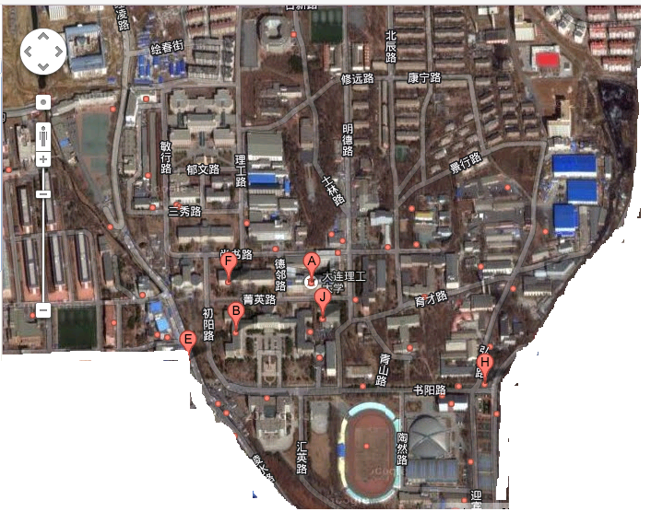
高南
航空航天实验室
137-9519-0354
gaonan@dlut.edu.cn

Slide 3
课程目标
帮助你们
  认识流动规律
  熟悉研究流动问题工具

Slide 4
考核 Evaluation
40%: 作业
60%: 期末考试

Slide 5


课本 Textbook
中文课本
English Textbook

Slide 6
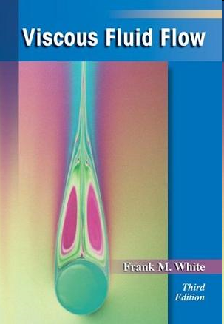
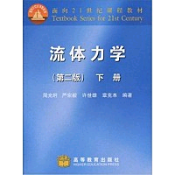
其他参考材料 Suggested readings
周光炯等
Frank White

Slide 7
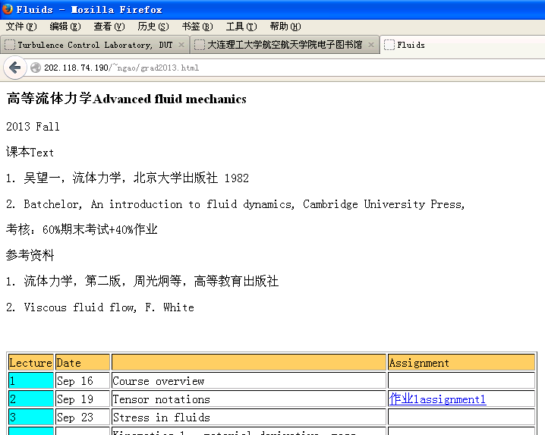
Website
http://202.118.74.190/~ngao/grad2013.html

Slide 8
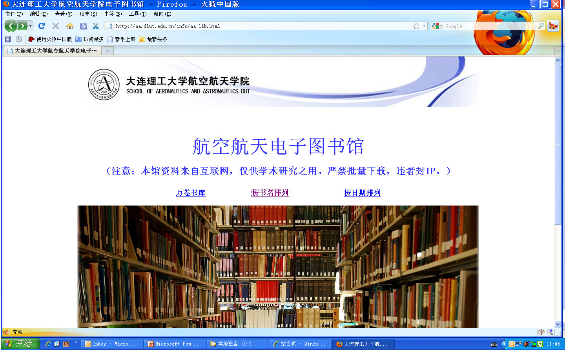
E-library
http://aa.dlut.edu.cn/info/aa-lib.html

Slide 9
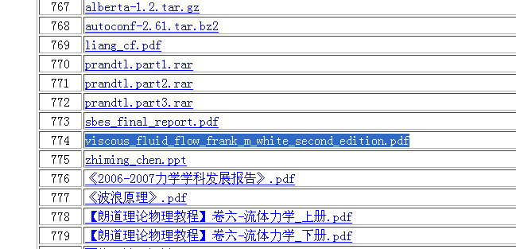
Download your materials
 | viscous_fluid_flow_frank_m_white_second_edition.pdf

Slide 10
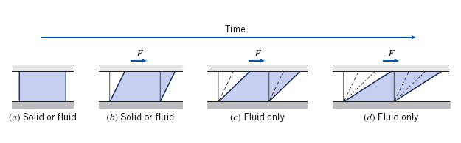
在课程开始以前。。。。
流体的特性

Slide 11
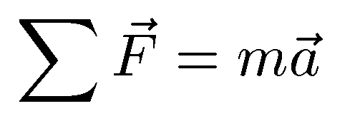
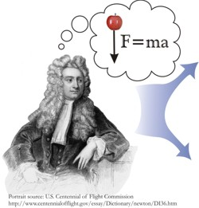
流体运动也遵循牛顿第二定律
需要我们找到合适的应用方法

Slide 12
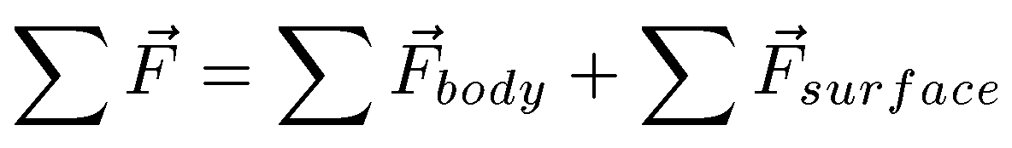

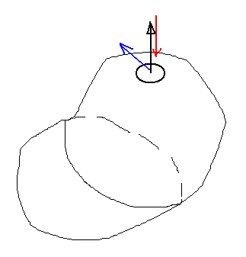
流体微团受到的力
n
和粘性相关的表面力
dA
压强引起的表面力

Slide 13
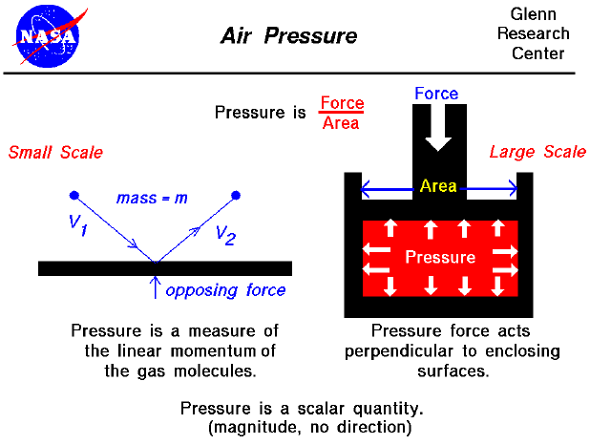

Slide 14


关于压强。。
理想气体
静水压强

Slide 15
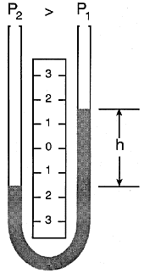
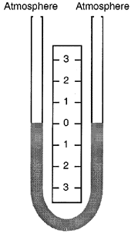
测压计 Manometer
With both legs of a U-tube
manometer open to the
atmosphere or subjected to the
same pressure, the liquid
maintains the same level in
each leg, establishing a zero
reference.
With a greater pressure applied to the left side of a U-tube manometer, the liquid lowers in the left leg and rises in the right leg.
The liquid moves until the unit weight of the liquid, as indicated by h, exactly balances the pressure.

Slide 16
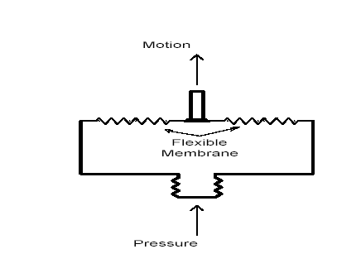
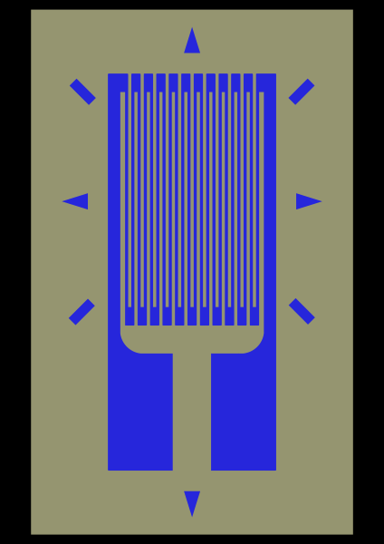
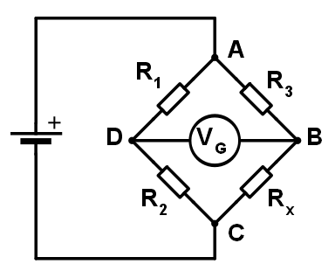
压强测量装置Pressure Measuring Devices
腔体-膜片-应变片
Principles: ∆ P → ∆ Resistance → ∆ Voltage
Applications: Sensors for internal combustion engines, automotive, research etc.

Slide 17
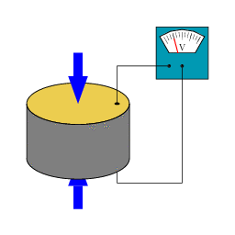
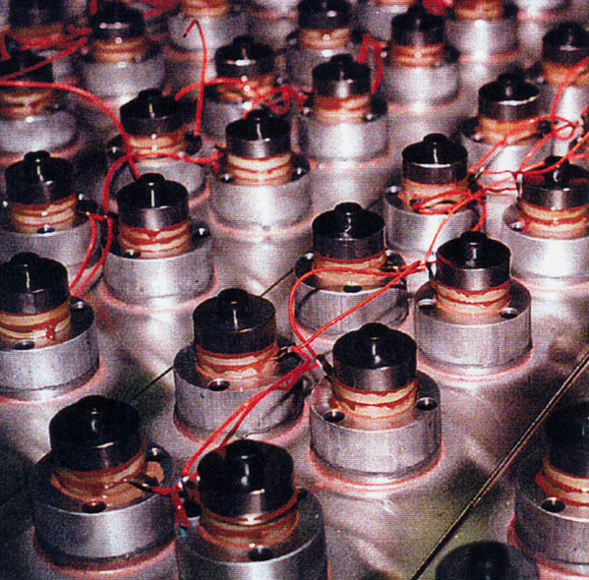
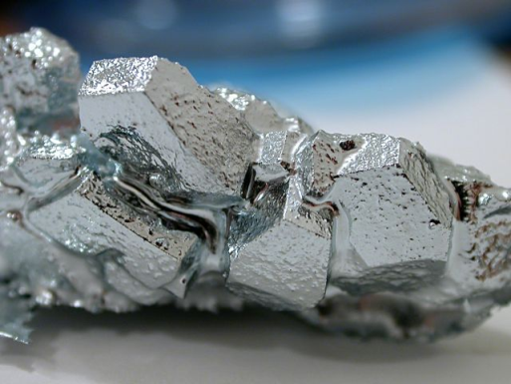
压强测量装置Pressure Measuring Devices
石英体 Quartz Gage
Piezoelectric transducers
http://www.ransohoff.com/images/systems/transducerlgr.jpg
http://upload.wikimedia.org/wikipedia/commons/c/c4/SchemaPiezo.gif
Principles: ∆ Pressure → ∆ Charge → ∆ Voltage
Applications: measurements with high accuracy, good repeatability, high resolution.
e g. Quartz Clock
CE319F - Elementary Mechanics of Fluids - Laboratory
UT Austin

Slide 18
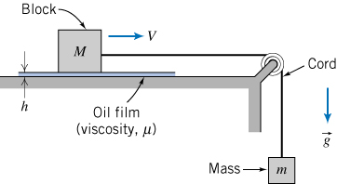
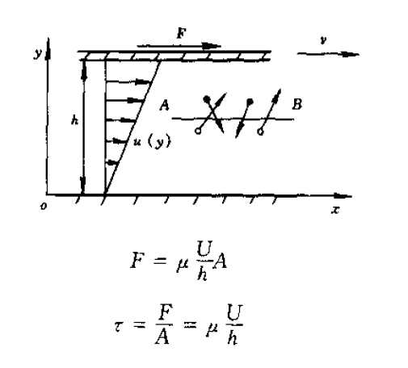
粘性

Slide 19
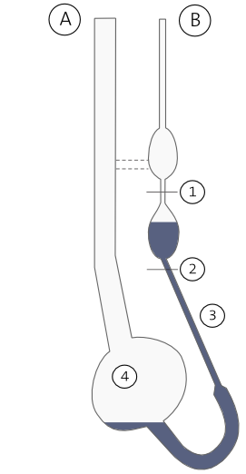
毛细管粘度计

Slide 20
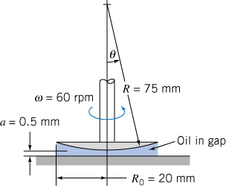
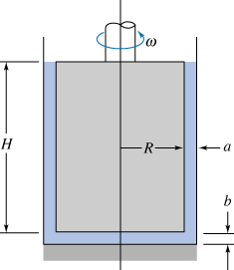
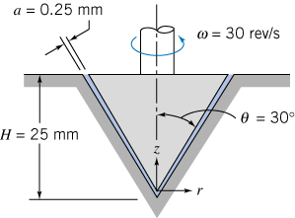
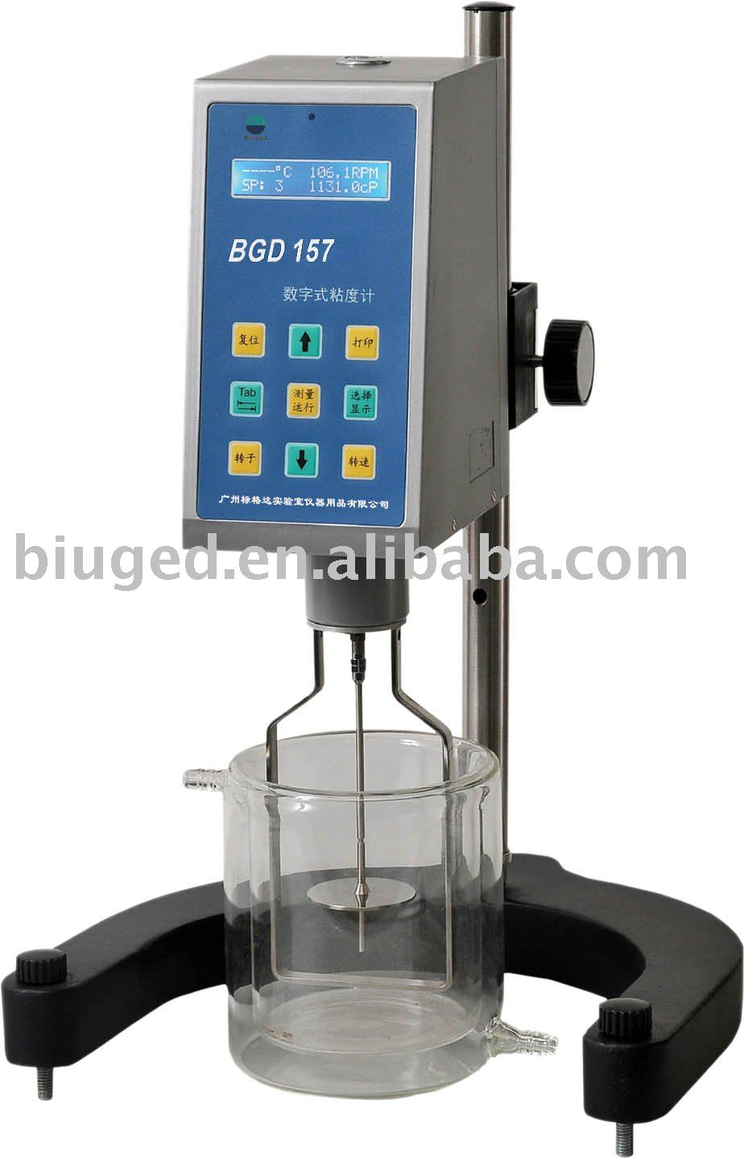
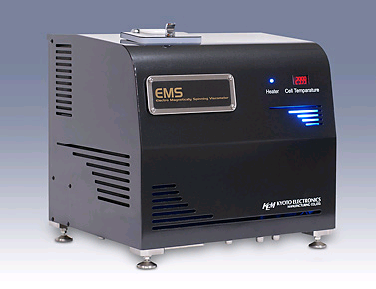
旋转式粘度计

Slide 21
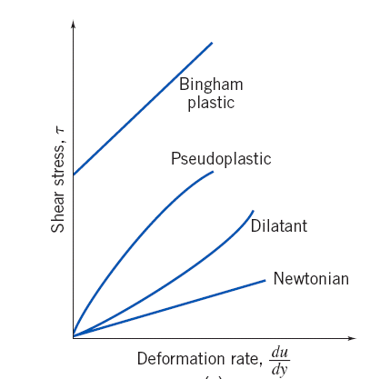
切应力~剪切率

Slide 22
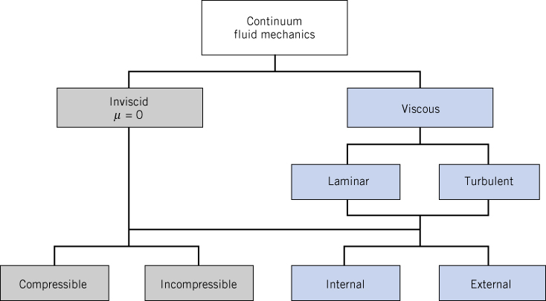
进度安排
流体内部的应力
流体的运动
建立方程
简化方程、分析若干经典问题
以粘性力为主的流动特点
粘性力可以忽略的流动特点
变密度条件下流动特点

