Slide 1
Index notation
2010-10-8
Gao Nan
DUT

Slide 2
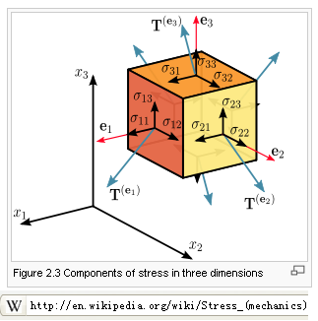
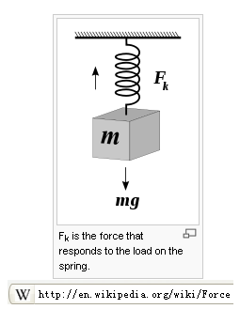

Scalar, vector, tensor
标量、矢量、张量
Scalar: Temperature, density
Vector: velocity, force
Tensor: stress

Slide 3



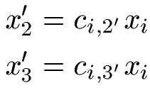

Rotation of axes
x’3
x3
P(x1,x2,x3)
Axes rotates
  scalars do not change
  Vector, tensor change
x’2
o
x2
x1
x’1
Einstein summation convention

Slide 4
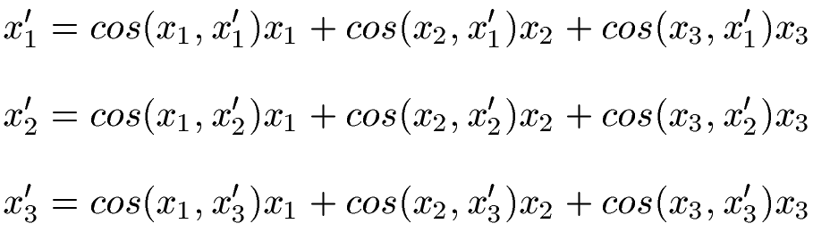

Index notation rules
Any index may appear once or twice in any term in an equation
A index that appears just once is called a free index.
  The free indices must be the same on both sides of the equation.
  Free indices take the values 1, 2 and 3
A index that appears twice is called a dummy index.
  Summation Convention: Dummy indices are summed over from 1 to 3
  The name of a dummy index is not important. Could be i, j, k,l,m,n,p,q

Slide 5






Different notations
Gibbs notation or
symbolic notation
Index notation or
Cartesian notation
or

Slide 6

Kronecker delta
a function of two variables, usually integers, which is 1 if they are equal, and 0 otherwise
The Kronecker Delta is symmetric.
If one index on ij is free and the other dummy then
is to substitute the dummy index with the free index

Slide 7
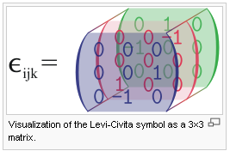
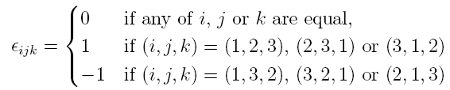

Alternating tensor
Also called: the permutation tensor
The Alternating Tensor is antisymmetric:
The Alternating Tensor is invariant under cyclic permutations of the indices:

Slide 8
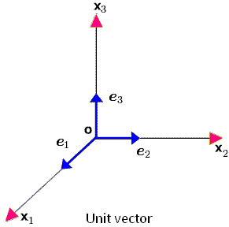

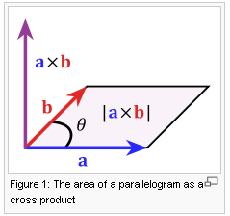

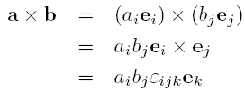

Alternating tensor

Slide 9





Kronecker Delta and Alternating Tensor
Free index: i,j,p,q
Free index: i,p
No free index

Slide 10



Algebra with vectors

Slide 11




Algebra with tensors

Slide 12


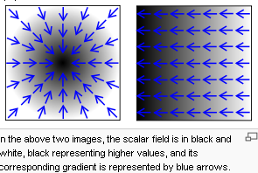


Gradient 梯度
Derivative in a scalar field f,
Symbolic
notation
Index
notation

Slide 13






Divergence 散度
Divergence of vector field : “outgoingness”
  Divergence of velocity
Divergence of tensor (stress,strain..)
Symbolic
notation
Index
notation

Slide 14
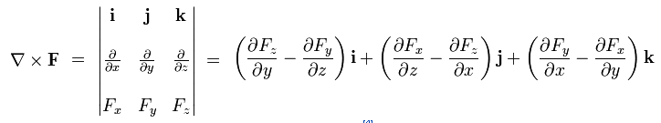

Curl 旋度
Curl of a vector field: “rotation”
Symbolic
notation
Index
notation

Slide 15
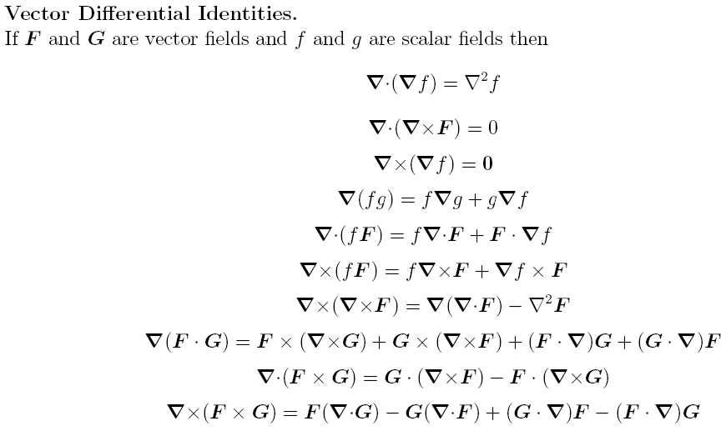

Slide 16
Reference
Vectors, Tensors, And The Basic Equations Of Fluid Mechanics - Aris R.djvu
A_Course_in_Fluid_Mechanics_with_Vector_Field_Theory-D._Prieve.pdf
and many more, if you search ‘vector’ in E-libary

