Slide 1
Kinematics
again….

Slide 2

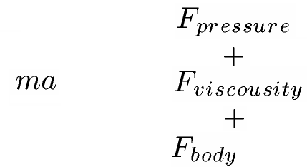
Force and motions
Force determines motions, motions also affect force
Viscous force is directly related to shear strain
  Shear stress ~ shear strain

Slide 3
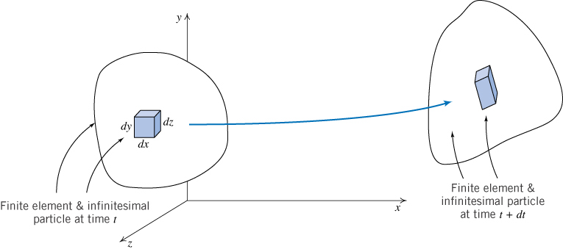
Kinematics
流场运动特性
Translation 平动
Rotation 转动
Strain 形变
  Extensional
  Shear

Slide 4


Translation
Acceleration
Substantial derivative, material derivative..

Slide 5
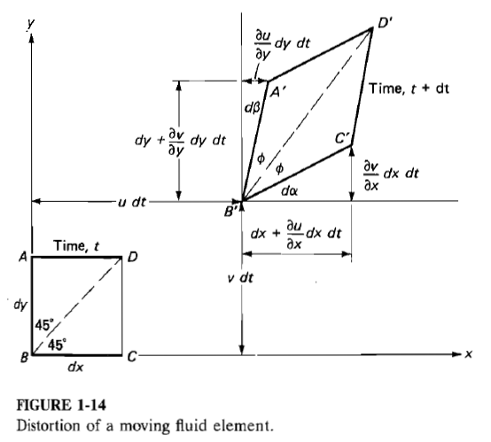


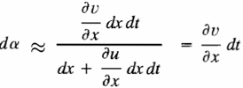
Rotation
Difference in vertical velocity between B and C
Difference in horizontal velocity between A and B
Angle

Slide 6

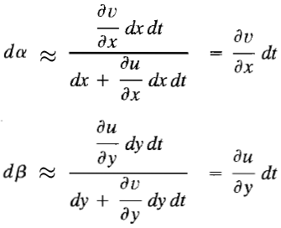

Rotation
Rotation of BD
Angular velocity BD

Slide 7
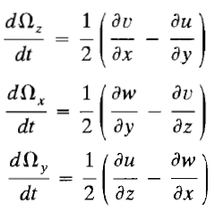

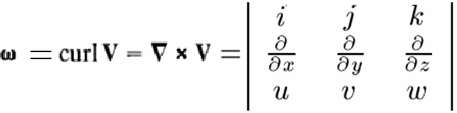
Rotation
Three components of angular velocity
Vorticity 涡量

Slide 8
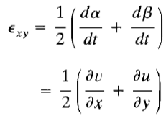
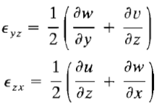
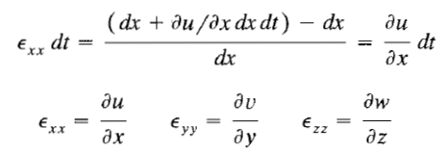
Strain
Shear strain rate
Extensional strain

Slide 9
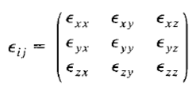
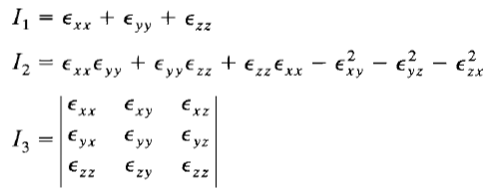
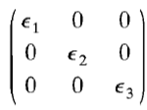
Strain tensor 形变张量
Strain tensor
  symmetric
  Value of each entry change when axes change
Three invariants 三个不变量
One and only one principle axes

Slide 10
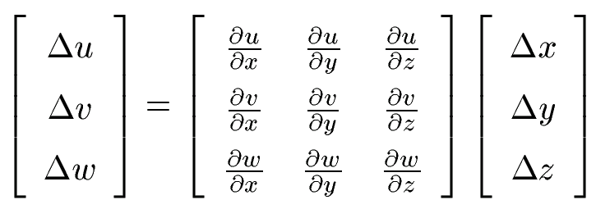


Velocity derivatives
A
B

Slide 11
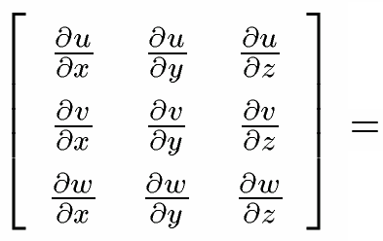
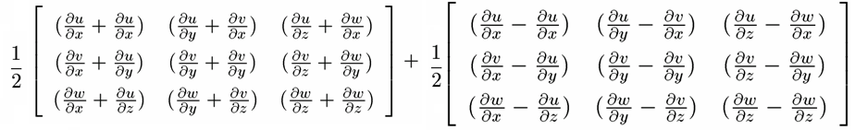

Velocity derivative=strain rate + angular velocity

Slide 12
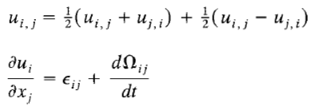
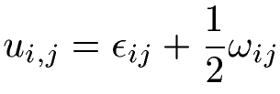
Velocity derivative=strain rate + angular velocity

Slide 13



stress and motions
Shear stress
  Related to shear strain
  Rotation do not cause shear stress
  Shear stress causes rotation

Slide 14

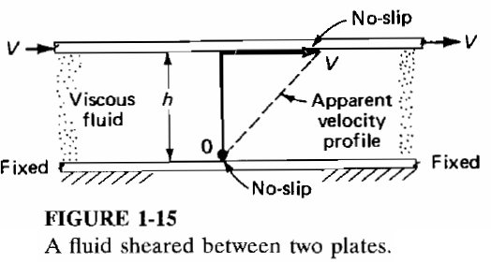

Shear stress and shear strain

Slide 15
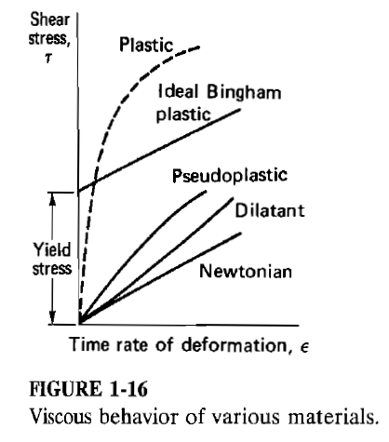



Slide 16
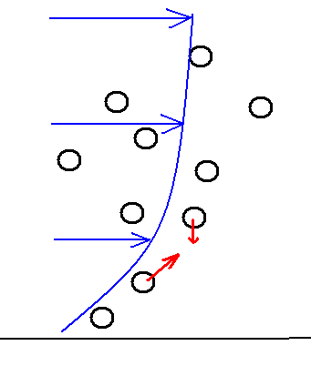

Molecular level
Faster particle push/drive slower particle
Slower particle drag faster particle
Capability of transporting momentum
Mean velocity
Molecular velocity

Slide 17
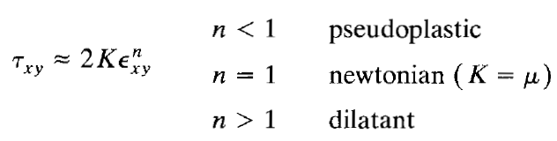
Non-Newtonian fluids
Shear thinning
  Plastic and pseudo-plastic
Shear thickening
  Dilatant

Slide 18
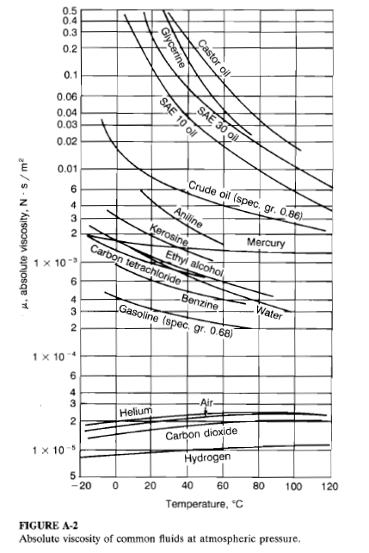

Slide 19
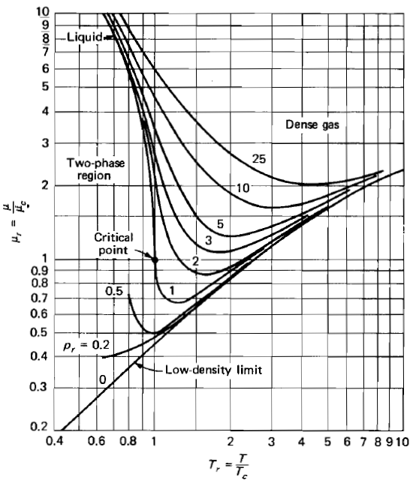
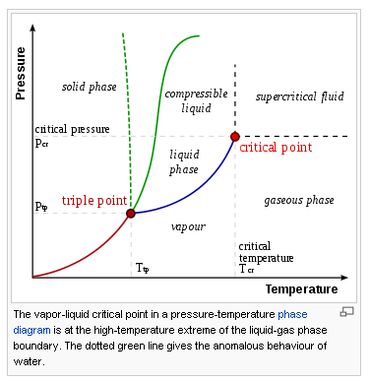

Viscosity ~ temperature and pressure

Slide 20


Low density gases
Density
mean free path
speed of sound
For simple calculations

Slide 21
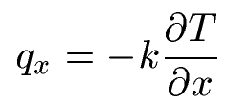
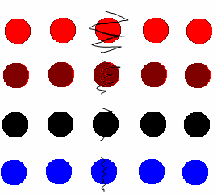



Conduction of heat
Heat flux proportional to temperature gradient
K :thermal conductivity
Stratified air 分层空气
Temperature deceases

Slide 22
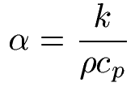

Thermal diffusivity
capability to transport heat

Slide 23
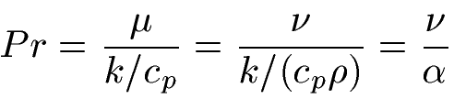
Prandtl number
Capability of transporting momentum
Capability of transporting heat
Pr: Prandtl number, comparison between the capability of transporting momentum and heat

Slide 24
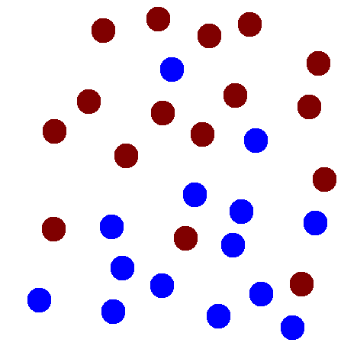



Mass diffusion
Air is moving
Transportation of mass
Diffusion velocity
D: coef. of mass diffusivity
Concentration changes

Slide 25




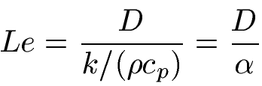
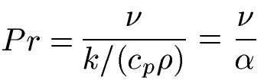
Diffusions of momentum, heat and mass
Momentum
Heat
Mass
ratios

