Slide 1
Thermodynamics
2010-10-15

Slide 2
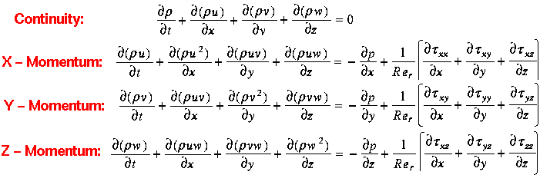
Properties constant
  Density is constant, incompressible flow

Slide 3
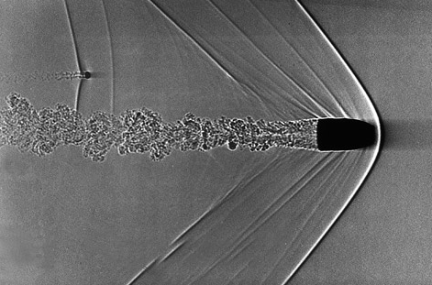
Properties sudden change
Shock wave around a bullet

Slide 4
Equation for
Property of gases
Look at “energy” of gases

Slide 5
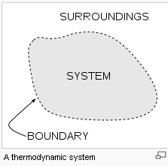
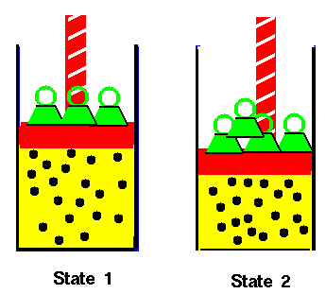
System, process and equilibrium
System
Q
Process

Slide 6
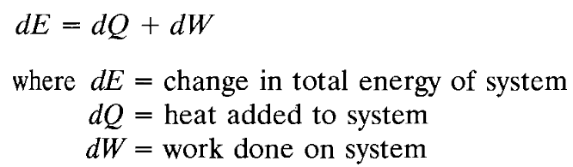
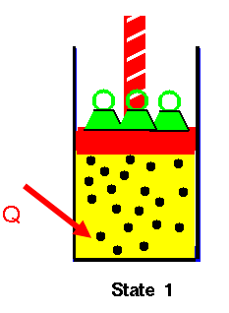
1st Law of Thermodynamics

Slide 7
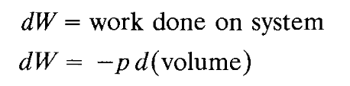


Work
dx

Slide 8


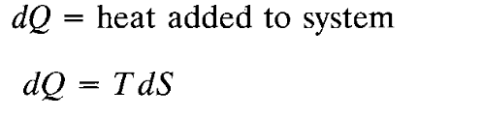

Heat
Reversible process
Entropy
  a measure of the microscopic disorder within the system
  obtain entropy of a certain state by integration from the zero state
dQ

Slide 9
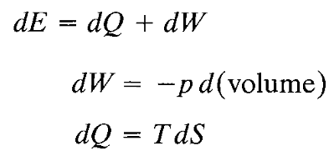



Slide 10



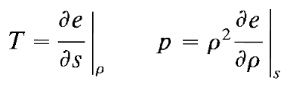
Energy e is a function of a few variables
Only 2 variables are independent

Slide 11
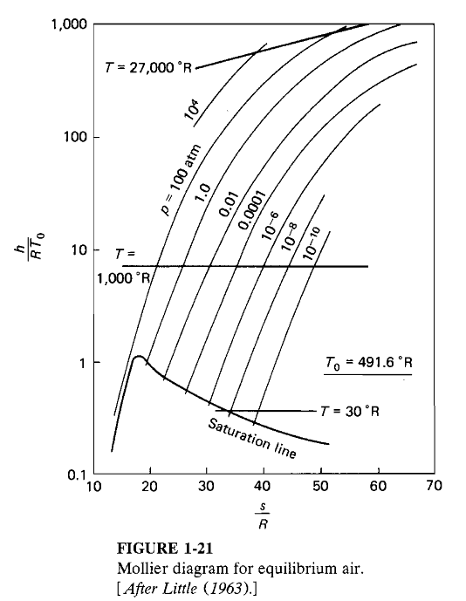



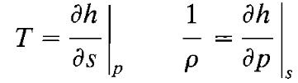
Enthalpy
Usable energy of a system

Slide 12







?
?
Specific heats

Slide 13
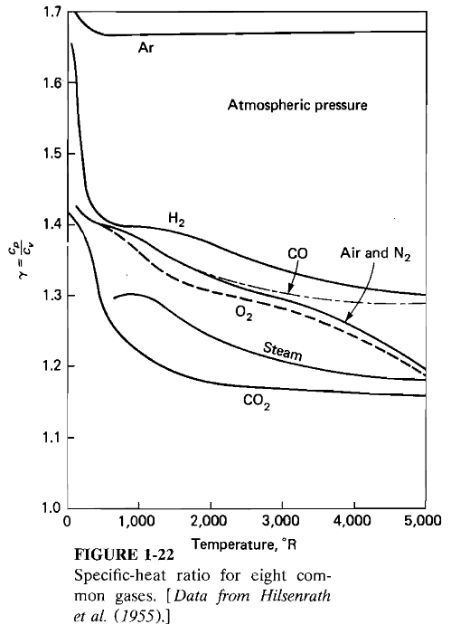

Ratios of specific heat

Slide 14
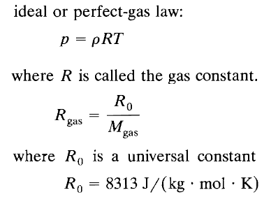




Simpler case: ideal gas
For real gases
For ideal gases

Slide 15




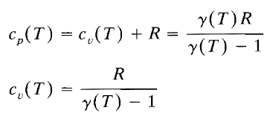


Ideal gas

Slide 16

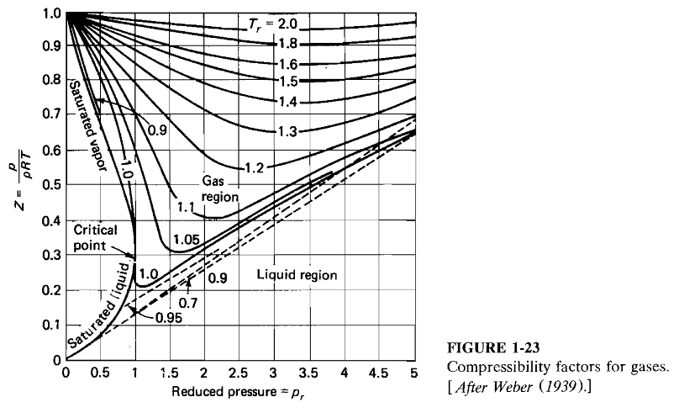
How ideal?

Slide 17

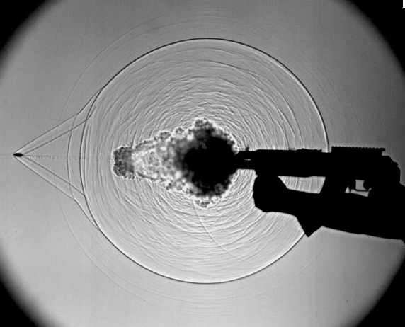

Speed of sound in ideal gas

Slide 18




Bulk modulus
Pressure/density relationship
Important for wave propagation
Sound speed

Slide 19
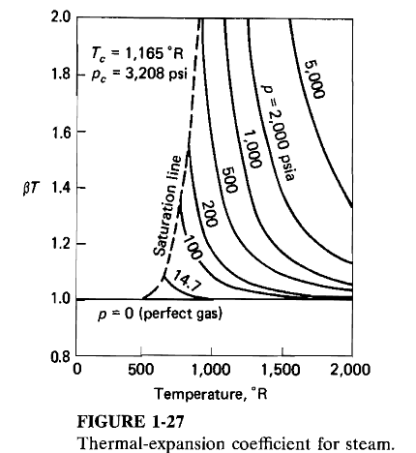



Thermal expansion

