Slide 1
Governing equations
2010-10-20

Slide 2
Equations
Continuity equation 连续性方程
Momentum equation 动量方程
Energy equation 能量方程

Slide 3

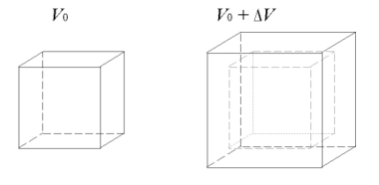
Dilatation
The dilatation (the relative variation of the volume) is the trace of the tensor:
http://en.wikipedia.org/wiki/Infinitesimal_strain_theory

Slide 4
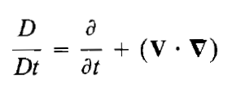

随体导数 substantial derivative
More in John D. Anderson, Computational_Fluid_Dynamics-The_Basics_with_Applications.djvu

Slide 5






Mass of a system

Slide 6


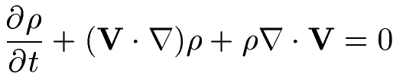
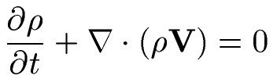

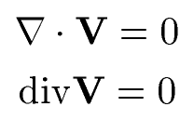
Continuity equation

Slide 7


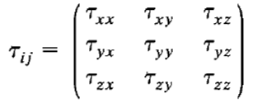

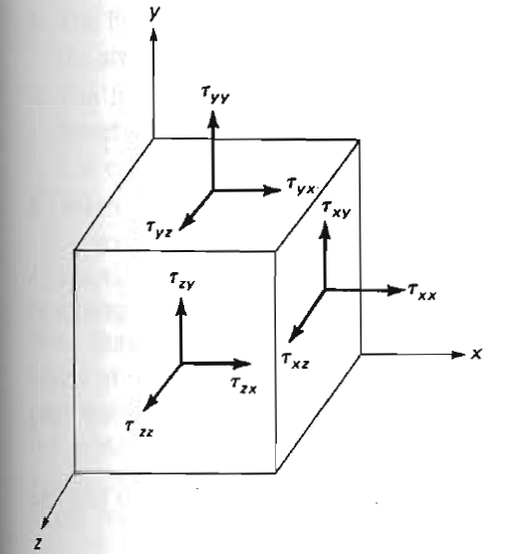


Forces on the front side of a fluid particle

Slide 8





Forces on a fluid particle
Stress on the back side
Net force in x direction, front+back
Surface forces
Momentum equation

Slide 9

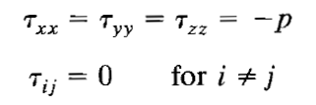
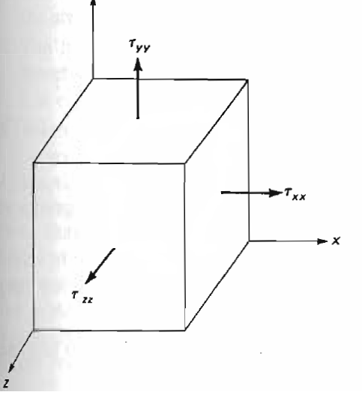
Fluid at rest (no motion)
Surface stresses

Slide 10







Fluids in motion
Stokes assumptions
Linear function
Normal stress
Shear stress

Slide 11


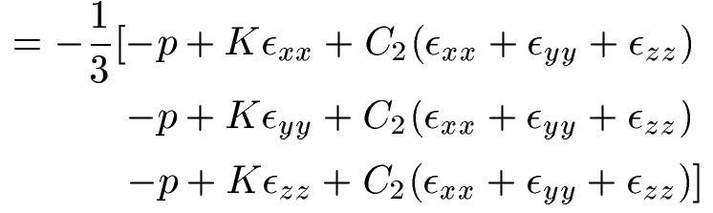
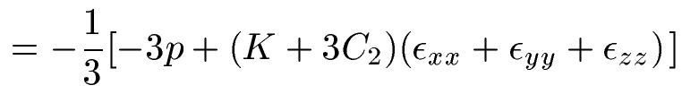

Stress
Stokes defined
Mechanical pressure (the mean pressure)
Assuming invariant
Thermodynamic pressure
(the pressure)

Slide 12



When shall we neglect bulk viscosity \lamda

Slide 13
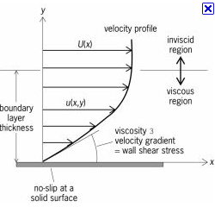
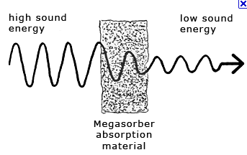


When shall we neglect bulk viscosity \lamda
Compressible Boundary layer normal stresses are small can be neglected
Normal shock wave, can not be neglected

Slide 14

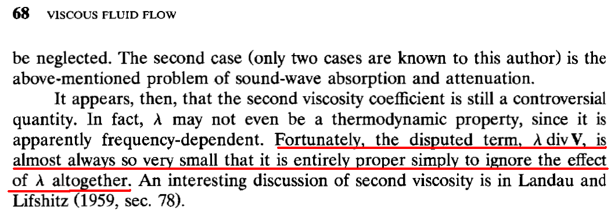
When shall we neglect bulk viscosity \lamda
It is proper to ignore the effect of altogether

Slide 15
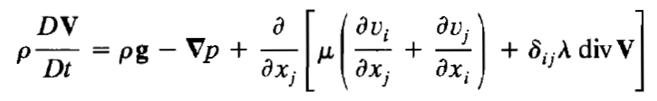
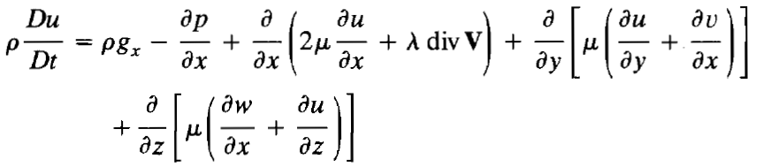
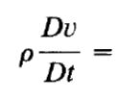

Momentum equation
…….
…….

Slide 16
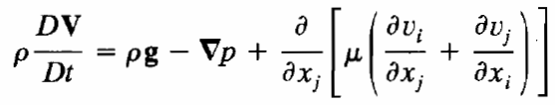
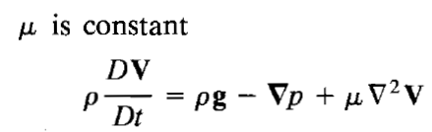
Momentum equation
Bulk viscosity neglected

Slide 17
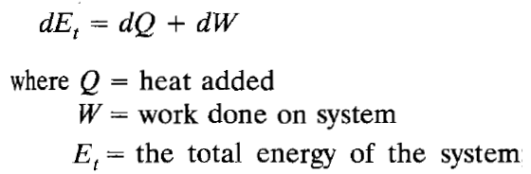
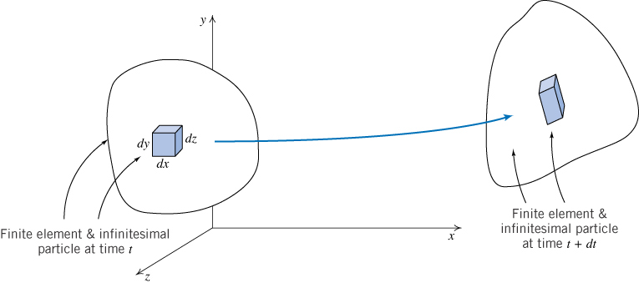
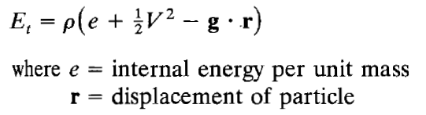


Energy equation
能量=内能+动能+势能

Slide 18
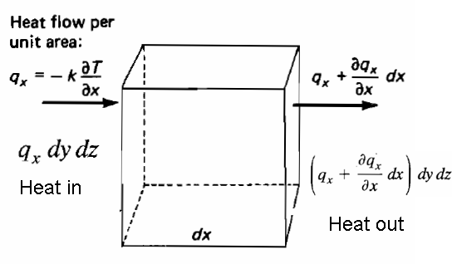



Net heat transfer to this element
Per unit volume

Slide 19
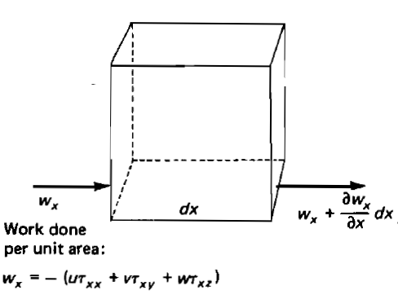
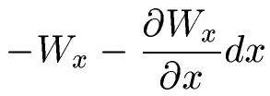
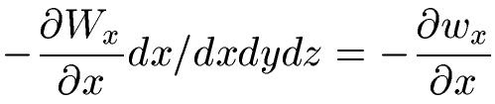
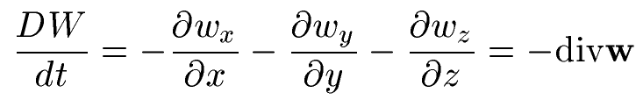
Work done on left surface
Work done on right surface
Net work done
Net work done per unit volume

Slide 20
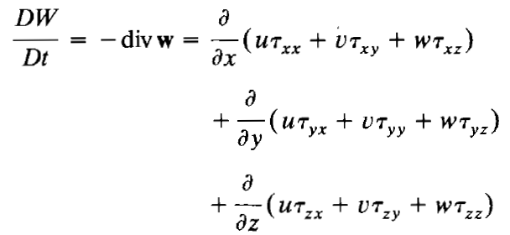


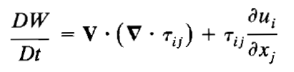

Net work done per unit volume
Momentum equation

Slide 21






Energy equation

Slide 22



Energy equation

Slide 23
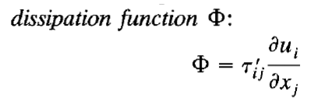

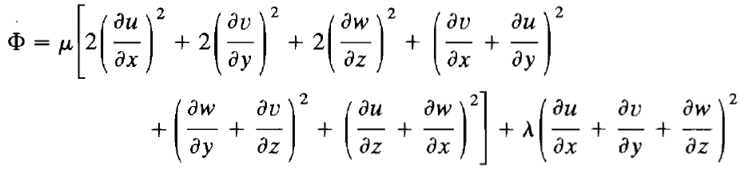

Dissipation always positive
粘性耗散

Slide 24
Enthalpy changes for a system系统焓的变化
Pressure changes压强变化
Heat conduction热传导
Viscous dissipation粘性耗散

Slide 25
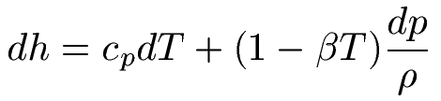

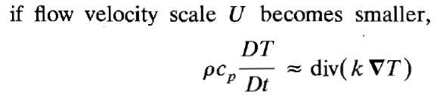
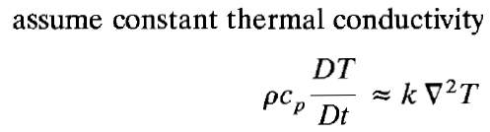
Moran and Shapiro, Fundamentals of Thermodynamics 6th edition, Page 592

Slide 26
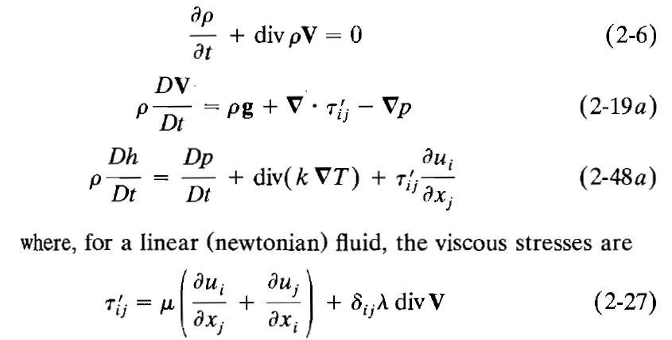
Summary

Slide 27
Assumptions

