Slide 1
Governing equations II
2010-10-22
Gao,Nan

Slide 2
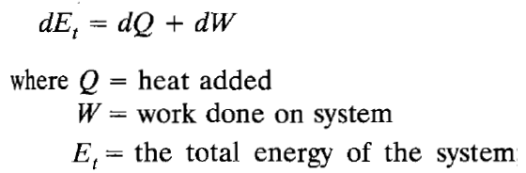
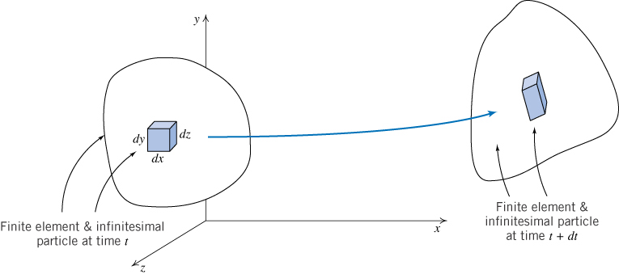
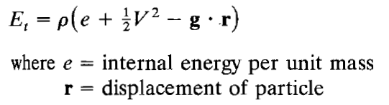


Energy equation
能量=内能+动能+势能

Slide 3
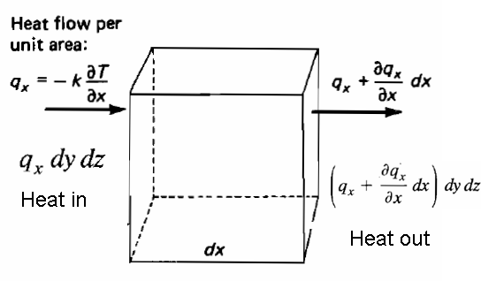



Net heat transfer to this element
Per unit volume

Slide 4
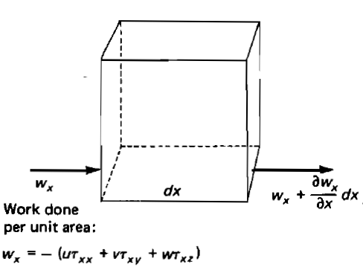
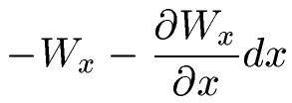
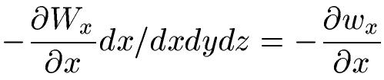
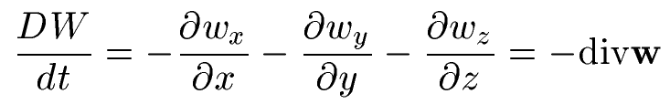
Work done on left surface per unit time
Work done on right surface per unit time
Net work done per unit time
Net work done per unit volume per unit time

Slide 5
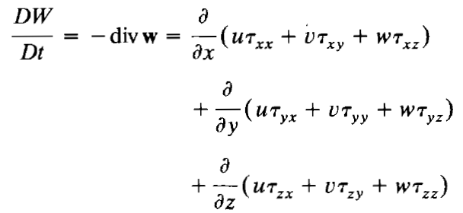


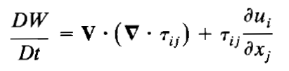

Net work done per unit volume
Momentum equation

Slide 6







Energy equation

Slide 7



Energy equation

Slide 8
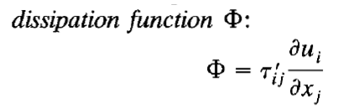

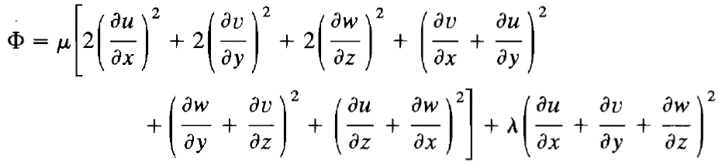

Dissipation always positive
粘性耗散
Final form

Slide 9
Energy equation, final form
Enthalpy changes for a system系统焓的变化
Pressure changes压强变化
Heat conduction热传导
Viscous dissipation粘性耗散

Slide 10
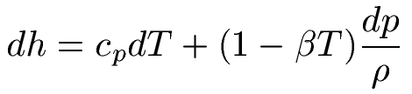

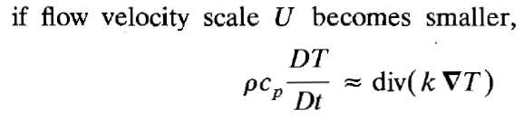
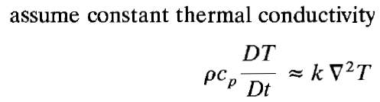
Thermodynamic relations*
Beta is thermal expansion coef.
*Moran and Shapiro, Fundamentals of Thermodynamics 6th edition, Page 592

Slide 11
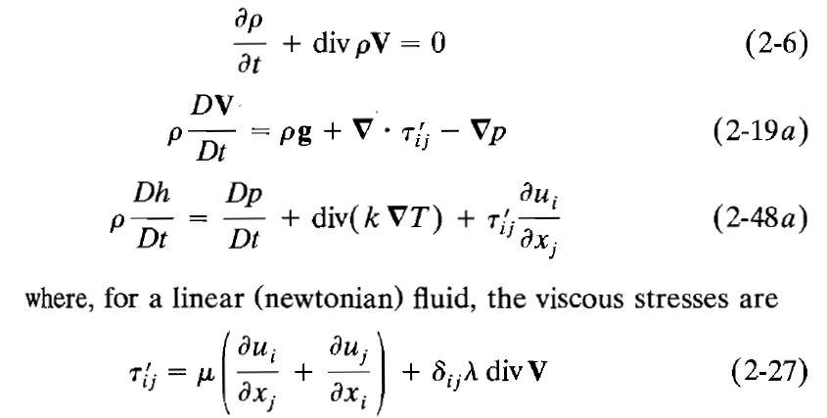
Summary

Slide 12
Assumptions

Slide 13
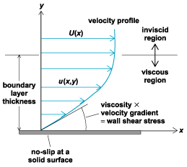

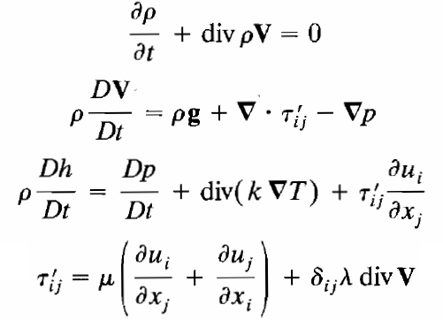
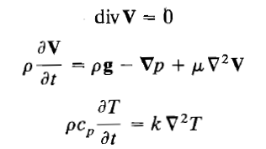
Zero convective derivatives
Boundary layer

Slide 14




Boundary layer

Slide 15


Diffusion of heat and momentum

Slide 16

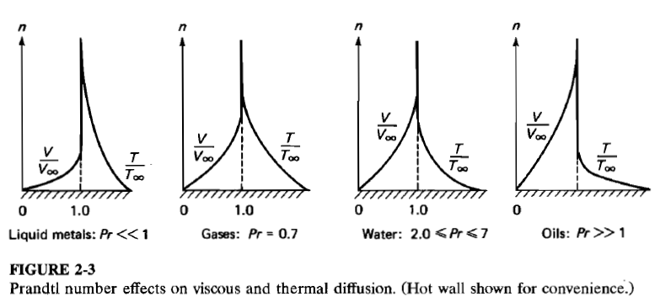
Prandtl number

Slide 17






Other dimensionless number
Diameter L
Reynolds number
Nondimensionalized momentum equation

