Slide 1
Project IV: SOCKS4 Server
指導教授 : 吳毅成

Slide 2
Architecture (1/3)
Browser
SOCKS
SERVER
HTTP
SERVER
HTTP REQUEST
HTTP REQUEST
REPLY
HTML
REPLY
HTML
Notes:
Connect mode: with browser
寫好 socks server + connect mode

Slide 3
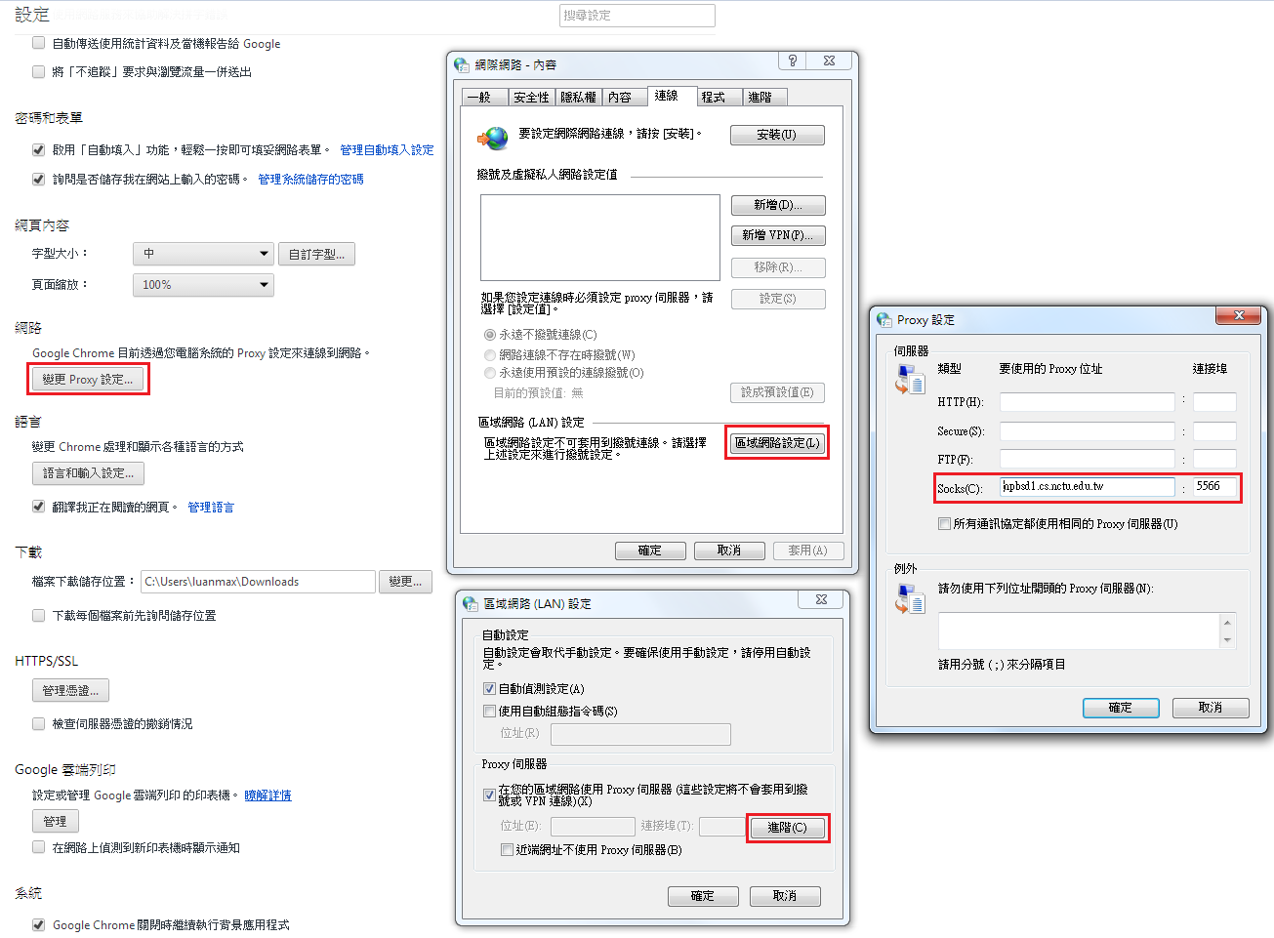
Architecture (1/3): Browser Setting

Slide 4
Architecture (2/3)
COMMAND
COMMAND
Browser
HTTP
SERVER
CGI
SOCKS
SERVER
RAS
RESULT
RESULT
COMMAND
RESULT
Notes:
Connect mode: Last project
改好CGI 去讀 form_get2.htm Remind:
Given form_get2.htm
送出 -> 教起你們cgi給參數
Cgi 要改成去 connect socks server
Non-blocking connect with socks server
送request
CGI 改完記得命名為 hw4.cgi
SOCKS server 和 RAS 也是 nonblocking

Slide 5
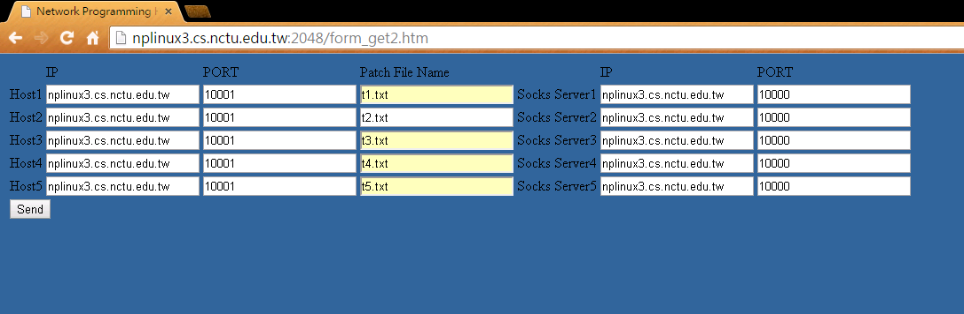
Architecture (2/3): Demo

Slide 6
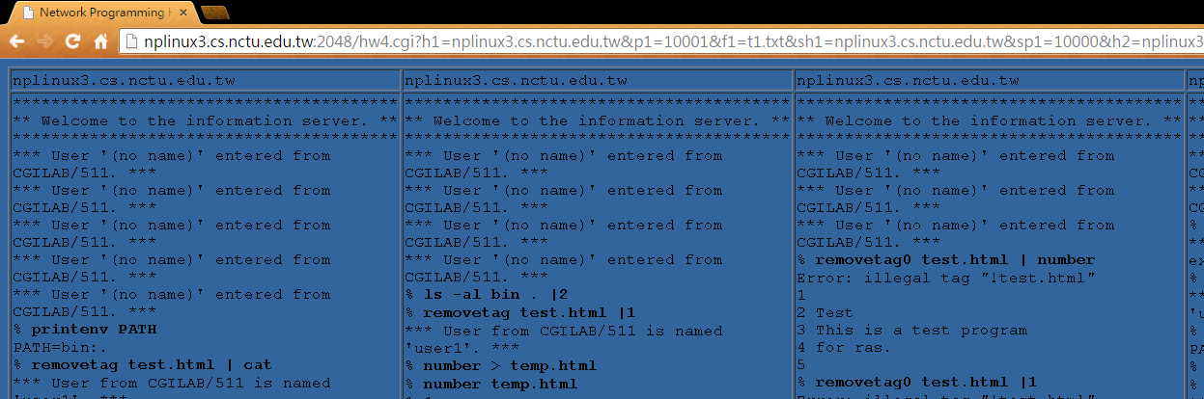
Architecture (2/3): Demo

Slide 7
Architecture (3/3)
FTP
CLIENT
SOCKS
SERVER
FTP
SERVER
FTP REQUEST
FTP REQUEST
REPLY
REPLY
DATA
DATA
DATA
DATA
Notes:
寫好 socks server + bind mode

Slide 8
Architecture (3/3): FlashFXP
測試請不要用FileZilla
建議使用FlashFXP

Slide 9
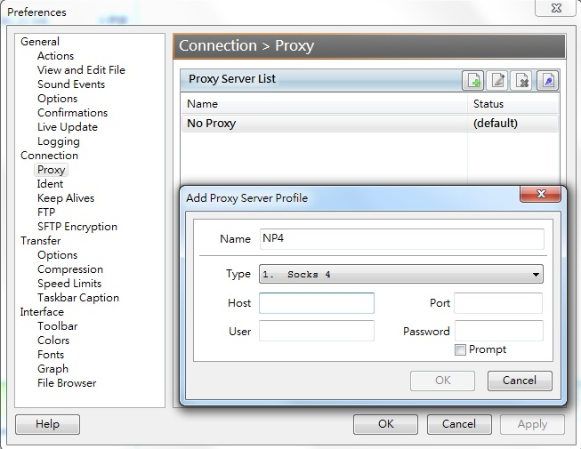
Architecture (3/3): FlashFXP
Options → Preferences→Connection→Proxy
Add entry
Socks4, Host/Port

Slide 10
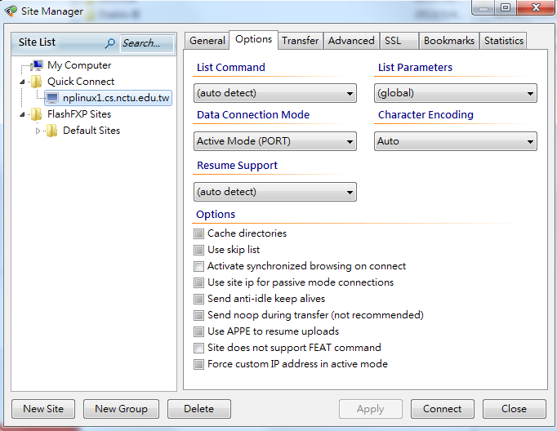
Architecture (3/3): FlashFXP
Sites → Site Manager→Option→ Data Connection Mode
Change to Active Mode(PORT)

Slide 11
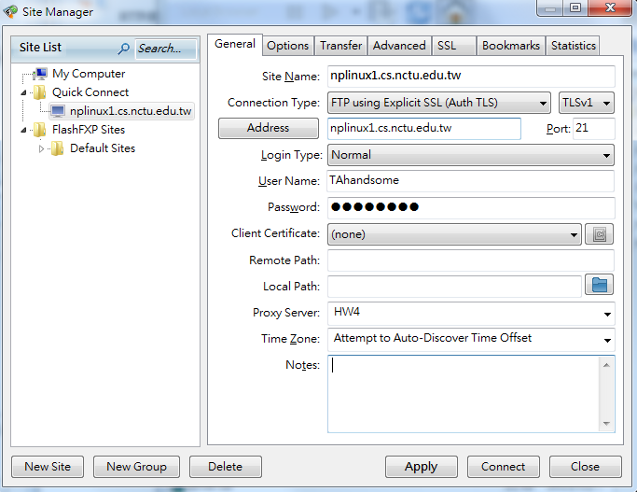
Architecture (3/3): FlashFXP
Sites → Site Manager→General → Apply
Connect

Slide 12
Architecture (3/3): FlashFXP
需要一個 FTP Server 來測試 Bind mode
網路上申請可當FTP server上傳/下載的空間
可以在 http://5gbfree.com/ 申請一個 5GB的空間
假設你申請的帳戶名為: UserName
Server: ftp.UserName.5gbfree.com:21
Account: UserName
或是自行在自己電腦架設 FTP server
可參考: http://goo.gl/UjrFwy
整體流程:
下載&設定好FlashFXP
透過Socks server 使用active mode連線
連線至FTP server
開始上傳和下載資料

Slide 13
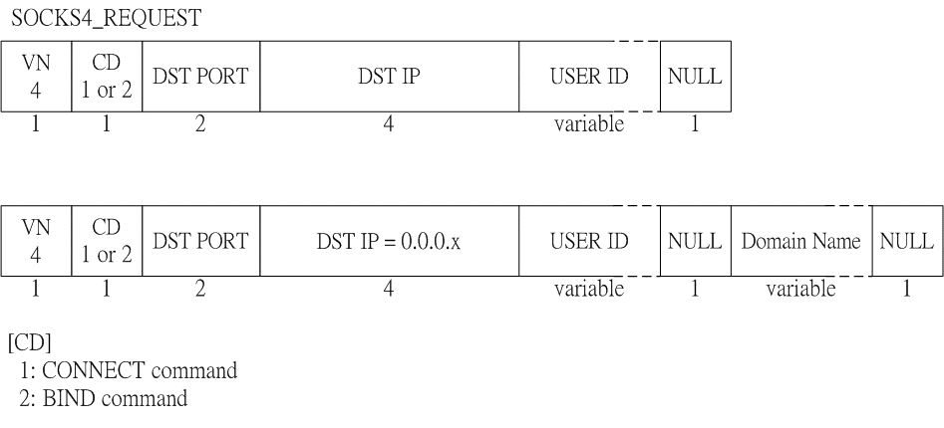
Implementation

Slide 14
Implementation
Request
read(sock, buffer, size);
unsigned char VN = buffer[0] ;
unsigned char CD = buffer[1] ;
unsigned int DST_PORT = buffer[2] << 8 |
buffer[3] ;
unsigned int DST_IP = buffer[4] << 24 |
buffer[5] << 16 |
buffer[6] << 8 |
buffer[7] ;
char* USER_ID = buffer + 8 ;

Slide 15
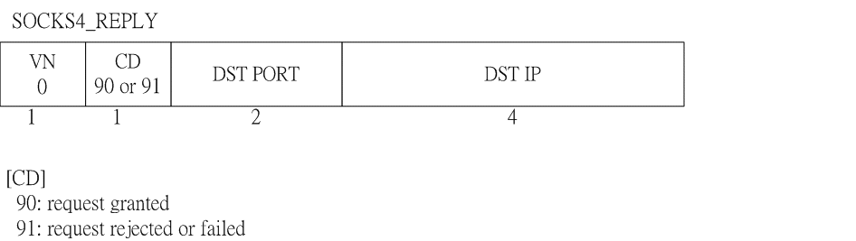
Implementation

Slide 16
Implementation
Reply
package[0] = 0;
package[1] = (unsigned char) CD ; // 90 or 91
package[2] = port / 256;
package[3] = port % 256;
package[4] = ip >> 24;
// ip = ip in SOCKS4_REQUEST for connect mode
// ip = 0 for bind mode
package[5] = (ip >> 16) & 0xFF;
package[6] = (ip >> 8) & 0xFF;
package[7] = ip & 0xFF;
write(sock, package, 8);

Slide 17
Protocol
Connect mode
Bind mode

Slide 18
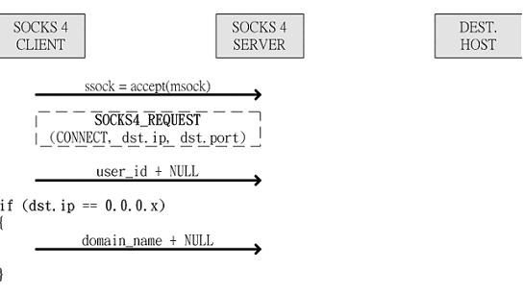
Connect mode

Slide 19
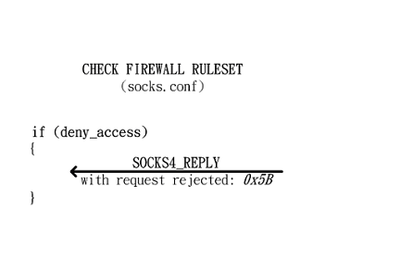
Connect mode
Notes:
讀自己寫的 socks.conf檔案 空的就代表都可以連 permit 140.113.*.* 就只能連交大

Slide 20
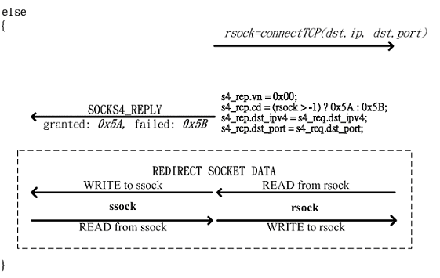
Connect mode

Slide 21
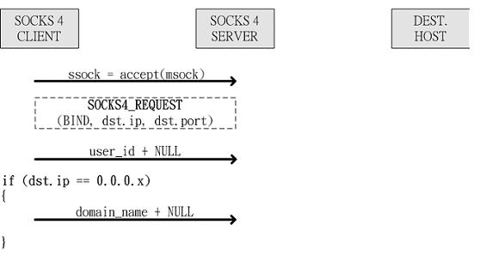
Bind mode

Slide 22
Bind mode

Slide 23
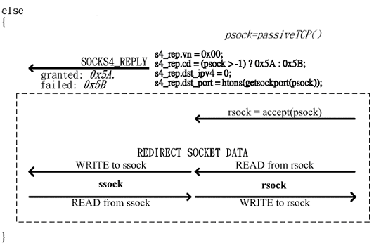
Bind mode

Slide 24
END

