Slide 1
Optimization of the Gridding program on heterogeneous computing platform
Team: Hello World
Member : 李振皓、陳敬憲、楊鈞皓、林宗俊
2015/9/10

Slide 2
Outline
Motivation
Introduction
Performance
Conclusion

Slide 3
Motivation
HSA
In order to achieve the convenience of transferring computing workload to other devices, HSA is a good choice
OpenCL
However, not all machine supports HSA
OpenCL can be a good alternative
Grid Problem
Optimization of the Gridding program on heterogeneous computing platform

Slide 4
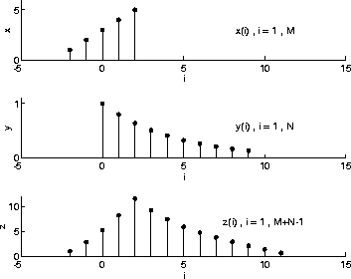

Introduction
Convolution
OpenCL parallelism
Advantage of computing convolution, which is independent of time
Profiling the workload with Intel Vtune
(f＊g)(t)

Slide 5

Introduction
Image Processing
convolutional filtering
Digital Data Processing
Analytical chemistry
Acoustic Processing
DSP、electronic music
Resource: https://en.wikipedia.org/wiki/Convolution

Slide 6
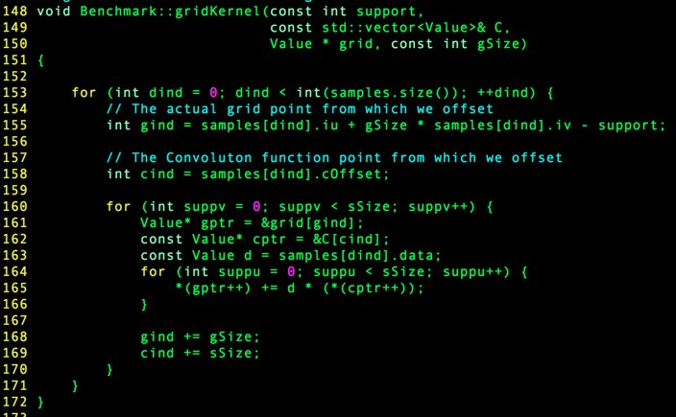
Original kernel code

Slide 7
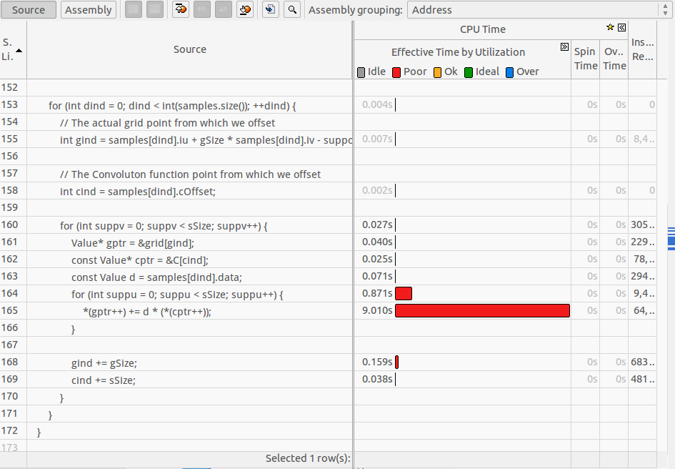
Profiling with Intel Vtune

Slide 8
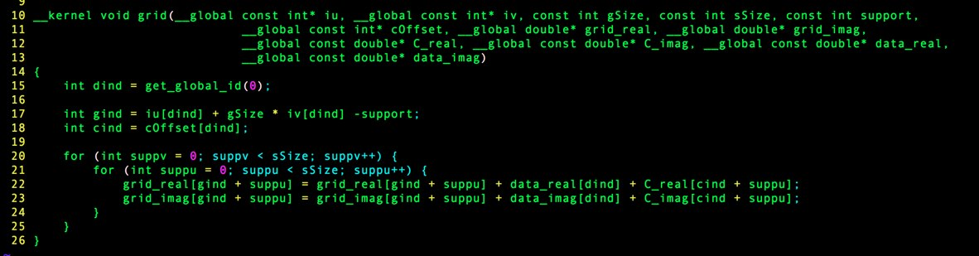
OpenCL Kernel code

Slide 9
Environment
CPU : Intel Core i5-4200H 2.8Ghz
Memory : 12GB
Nvidia Geforce 820M 2G
OS: Ubuntu 14.04 LTS

Slide 10
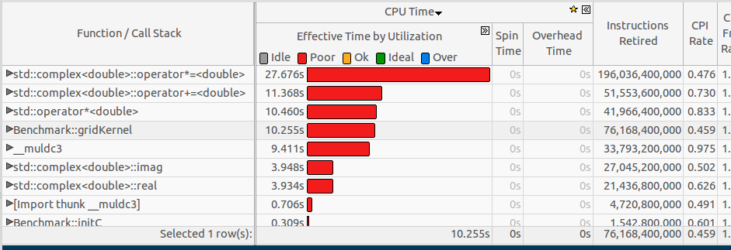
Profiling with Intel Vtune
Small1 original

Slide 11
Profiling with Intel Vtune

Slide 12
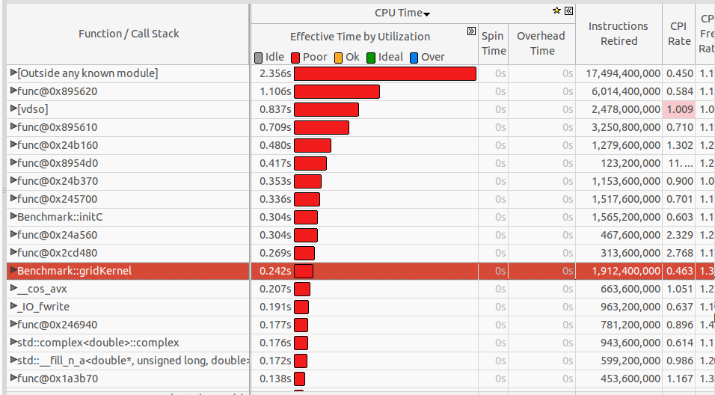
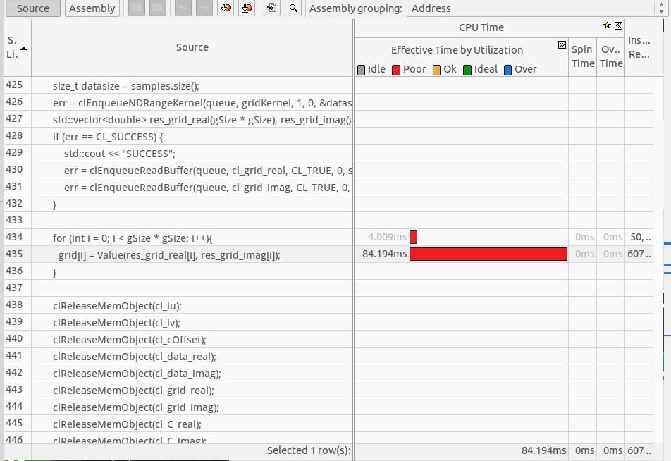
Small1 Accelerated

Slide 13
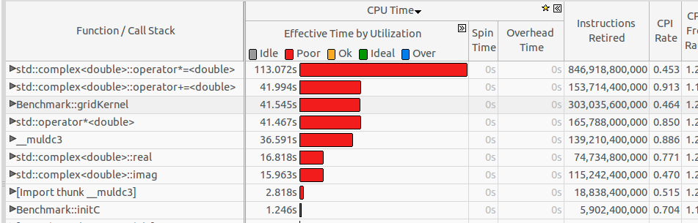
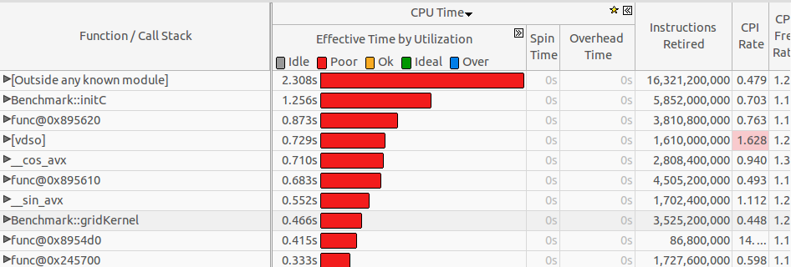
Small2 original
Small2 Accelerated

Slide 14
Performance
 | Original (s) | Accelerated(s) | Speed up
Small1 | 82.799 | 10.972 | 7.55
Small2 | 321.435 | 49.047 | 6.55

Slide 15
Conclusion
Parallel programming
Pros
Fast
Energy-efficient
Cons
Hard to debug
Not intuitive
Memory locality / memory latency

