Slide 1
alcohol abuse in New York state
Ting Chien Meng, Henan Liu, Haoran Zhang

Slide 2
Motivation
Health Department, Substance Users
An estimated 95,000 people die from alcohol-related causes annually, making alcohol the third leading preventable cause of death in the United States. (Source: CDC)
We want to analyze alcohol abuse problem in New York State.

Slide 3
Data source
Treatment Episode Data Set Admissions (TEDS)
Year: 2000~2018
Data size: 5.5G
Description: Contains records on admissions aged 12 or older, and includes information on admission (age, sex, race/ethnicity, employment status, etc.) and substance abuse characteristics (substances used, age at first use, route of use, frequency of use, number of prior admissions, etc.).
62 columns represents 62 personal info

Slide 4
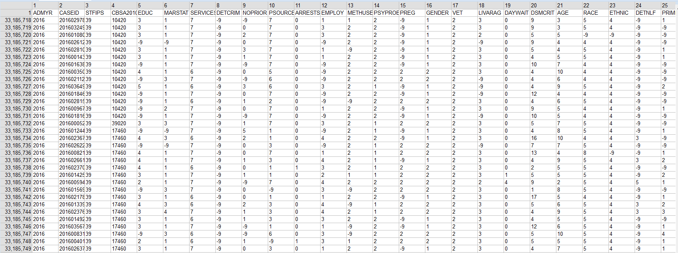
Data Sample

Slide 5
DATA source
Educational attainment dataset - U.S. census bureau
Annual Homeless Assessment Report - hudexchange.info
Unemployment dataset - U.S. Bureau of Labor Statistics
Crime dataset - FEDERAL BUREAU OF INVESTIGATION
Mental health dataset - SAMHDA
Average Wage dataset - Governor.NY.gov

Slide 6
Tool
JAVA MapReduce – Clean and Profile
Hive - Store
SPARK - Analysis
Tableau – Visualization

Slide 7
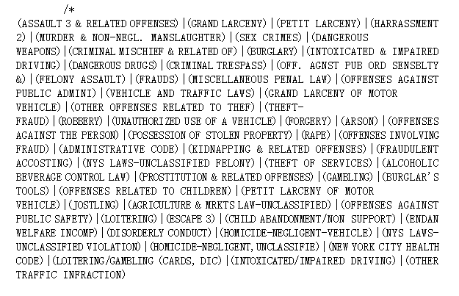
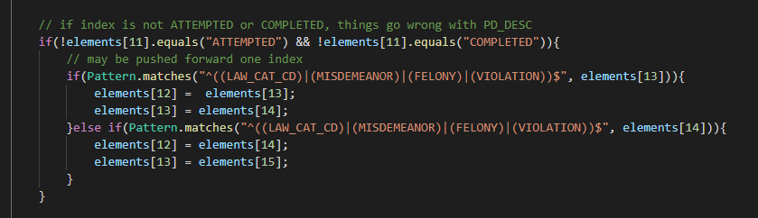
Code Challenge
Data is collected and audited by human. Human error makes some data unusable
Automation cannot solve all issues

Slide 8
Alcohol abuser in New York state
 | Total admissions in NY | alcohol abuse | Percent
2000 | 300536 | 229956 | 77%
2001 | 301194 | 228207 | 76%
2002 | 312621 | 236196 | 76%
2003 | 308939 | 227665 | 74%
2004 | 285231 | 202827 | 71%
2005 | 314242 | 222516 | 71%
2006 | 308266 | 215094 | 70%
2007 | 308607 | 214935 | 70%
2008 | 314589 | 214405 | 68%
2009 | 313639 | 210676 | 67%
2010 | 311436 | 206393 | 66%
2011 | 304862 | 197900 | 65%
2012 | 294600 | 186320 | 63%
2013 | 285754 | 173064 | 61%
2014 | 283882 | 167463 | 59%
2015 | 281830 | 160595 | 57%
2016 | 279879 | 154517 | 55%
2017 | 278705 | 153776 | 55%
2018 | 277249 | 156363 | 56%

Slide 9
Analyze secondary substance abuse
Alcohol abuse patients are likely to have some other substance abuse problems (53%).
Main secondary abuse problems of the alcohol abusers are cocaine /crack, marijuana and heroin.

Slide 10
Analyze frequency
 | correlation of frequency
COCAINE/CRACK | 0.72
MARIJUANA/HASHISH | 0.65
HEROIN | 0.69
NON-PRESCRIPTION METHADONE | 0.65
OTHER OPIATES AND SYNTHETICS | 0.66
PCP | 0.51
OTHER HALLUCINOGENS | 0.72
METHAMPHETAMINE | 0.61
OTHER AMPHETAMINES | 0.7
OTHER STIMULANTS | 0.22
BENZODIAZEPINES | 0.65
OTHER NON-BENZODIAZEPINE TRANQUILIZERS | 0.45
BARBITURATES | 0.21
OTHER NON-BARBITURATE SEDATIVES OR HYPNOTICS | 0.59
INHALANTS | 0.78
OVER-THE-COUNTER MEDICATIONS | 0.52
OTHER | 0.33
Alcohol abusers whose frequency of drinking is higher may also use other substances more frequently.

Slide 11
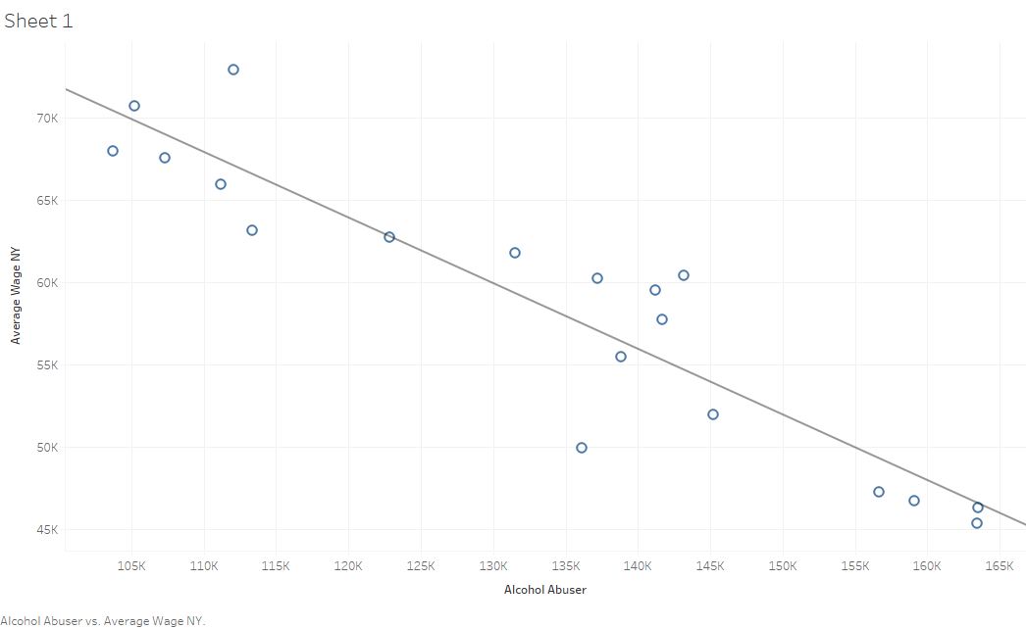
Average wage & Alcohol Abuser
Time series: 2000~2018
Income may affect alcohol abuse

Slide 12
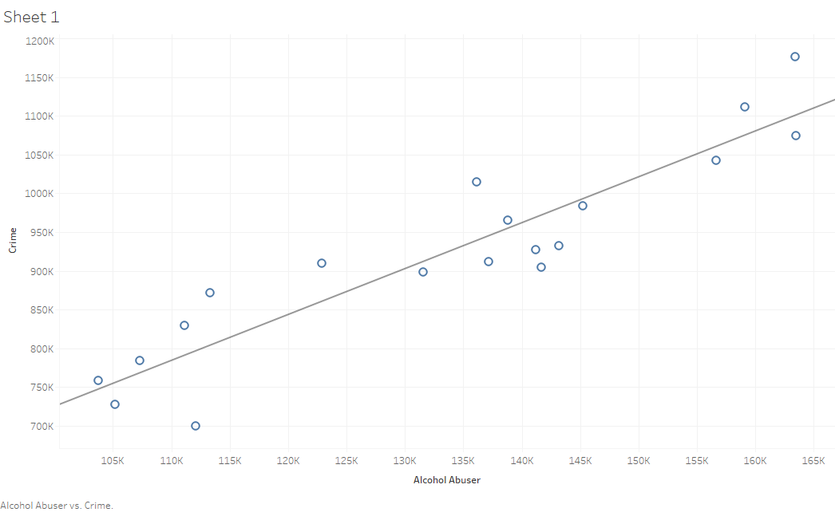
Crime & alcohol abuser
Time series: 2000~2018
Criminality maybe accompany alcohol abuse

Slide 13
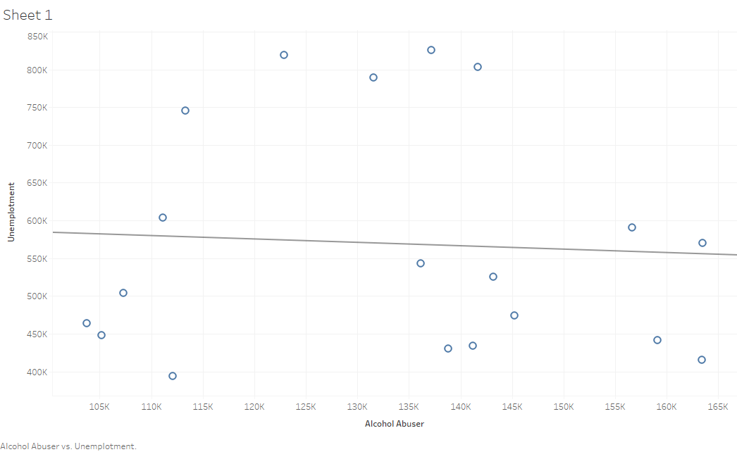
unemployment & alcohol abuser
Time series: 2000~2018

Slide 14
Prediction Model
We are trying to predict the type of service and treatment setting in which the client is placed at the time of admission by using some features given in the TEDS.
The data used for training the model is TEDS records in New York state in 2015.

Slide 15
Prediction-service
Value | Service Type | SERVSETA Value
1 | DETOXIFICATION | DETOX, 24 HR, HOSPITAL INPATIENT
 |  | DETOX, 24 HR, FREE-STANDING RESIDENTIAL
 |  | AMBULATORY, DETOXIFICATION
2 | REHABILITATIONRESIDENTIAL | REHAB/RES, HOSPITAL (NON-DETOX)
 |  | REHAB/RES, SHORT TERM (30 DAYS OR FEWER)
 |  | REHAB/RES, LONG TERM (MORE THAN 30 DAYS)
3 | AMINEAMBULATORY | AMBULATORY, INTENSIVE OUTPATIENT
 |  | AMBULATORY, NON-INTENSIVE OUTPATIENT

Slide 16
How to Choose features for prediction
We choose some potiential features which may have impact on the intensity of alcohol abuse.
Age of abusers
Education level
Employment Status
Frequency of use
Number of arrests in 30 days prior to admission
......
The correlation of the intensity of alcohol abuse and some features
Age | Arrest | Education | Employment status | Frequency of alcohol use
-0.242 | 0.017 | 0.126 | 0.373 | -0.636

Slide 17
Prediction-frequency
1: NO USE IN THE PAST MONTH
2: 1-3 TIMES IN THE PAST MONTH
3: 1-2 TIMES IN THE PAST WEEK
4: 3-6 TIMES IN THE PAST WEEK
5: DAILY

Slide 18
Prediction-age
2:12-14
3:15-17
4:18-20
5: 21-24
6: 25-29
7: 30-34
8: 35-39
9: 40-44
10: over45

Slide 19
Prediction-employment
1:FULL TIME OR PART TIME
2:UNEMPLOYED
3:NOT IN LABOR FORCE

Slide 20
Prediction IN NY
Size of data: 107123
Features: Age, employment, frequency.
Accuracy: 70%
The prediction result reflects the intensity of alcohol abuse and offers a reference for clients about which service is suitable for them.

Slide 21
Prediction IN Northeastern
Size of data: 195906
Features: Age, employment, frequency, crime, mental health, education, homeless
Accuracy: 71%
The prediction result reflects the intensity of alcohol abuse and offers a reference for clients about which service is suitable for them.

Slide 22
Future work
Try to use some high-level machine learning models to make more accurate predictions.
Extend the model to the United States
......

Slide 23
Thank you for listening!

