Slide 1
Predicting
Customer Turnover
----
And How We See It Coming
Tim McAleer

Slide 2
The Problem
SyriaTel, a communications company, wants to identify customers who leave their services.
Preferably, before they leave.
Given a database of 3,333 customers detailing many characteristics include call details, payments, and whether or not that customer retained services, develop a model to identify customers who are likely to leave and note the significant identifiers.

Slide 3
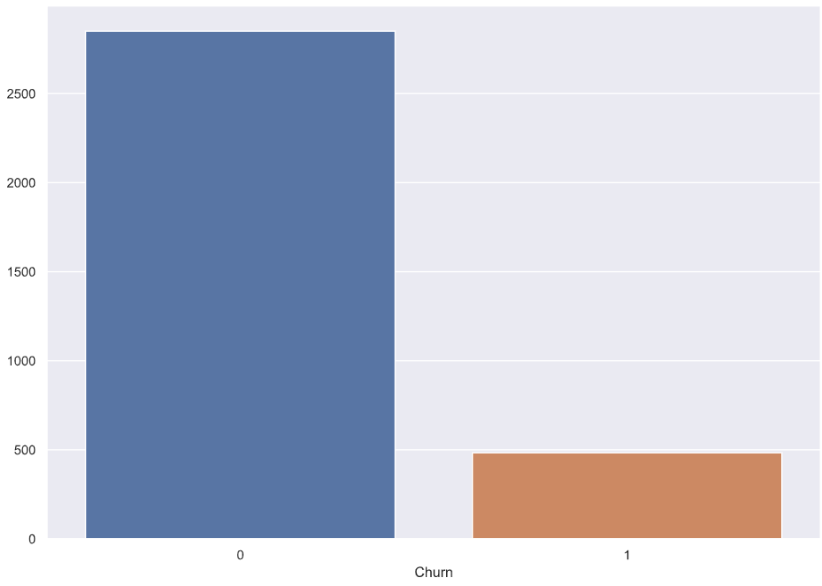
The Obstacle
Class Imbalance
2850
483

Slide 4
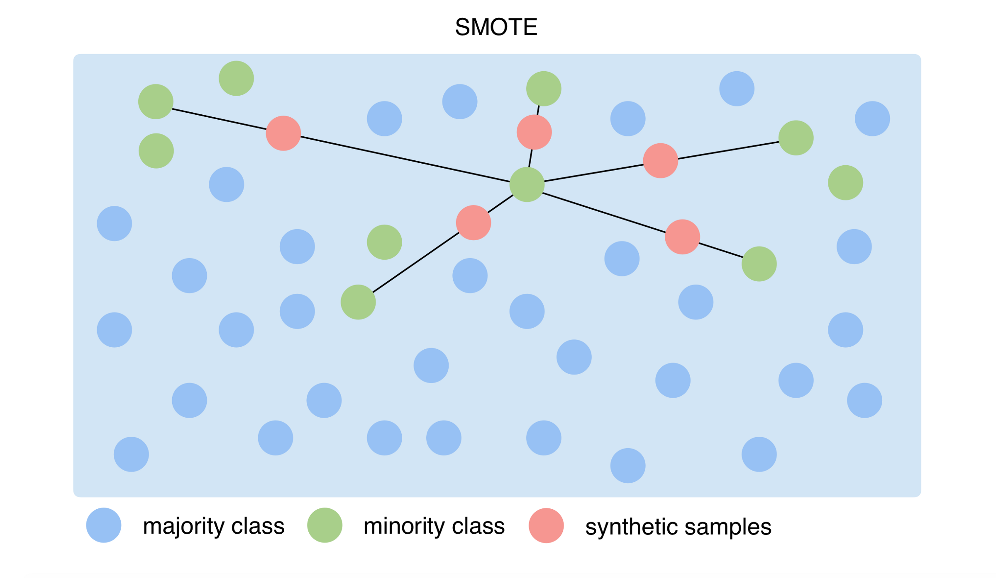
Dealing With Imbalance
Oversampling
Undersampling
VAE
SMOTE

Slide 5
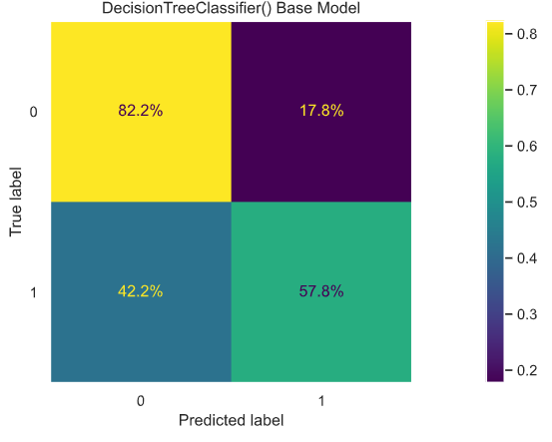
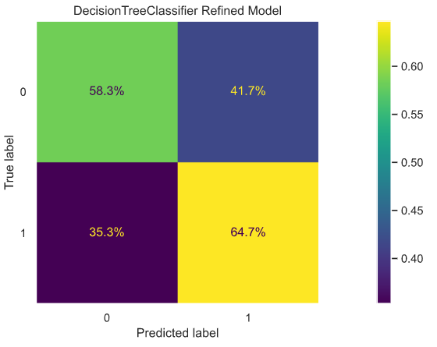
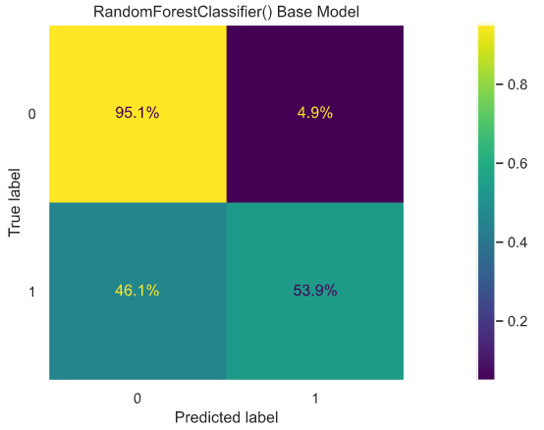
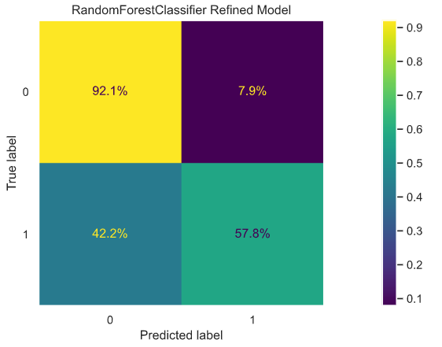
Choosing a Model

Slide 6
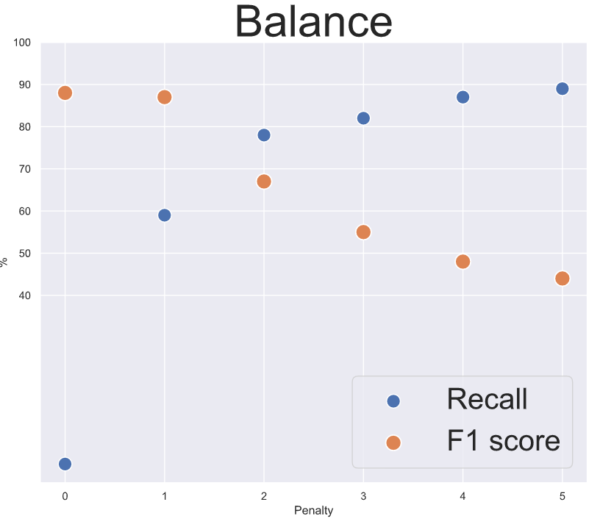
XGBoost – Recall vs F1

Slide 7
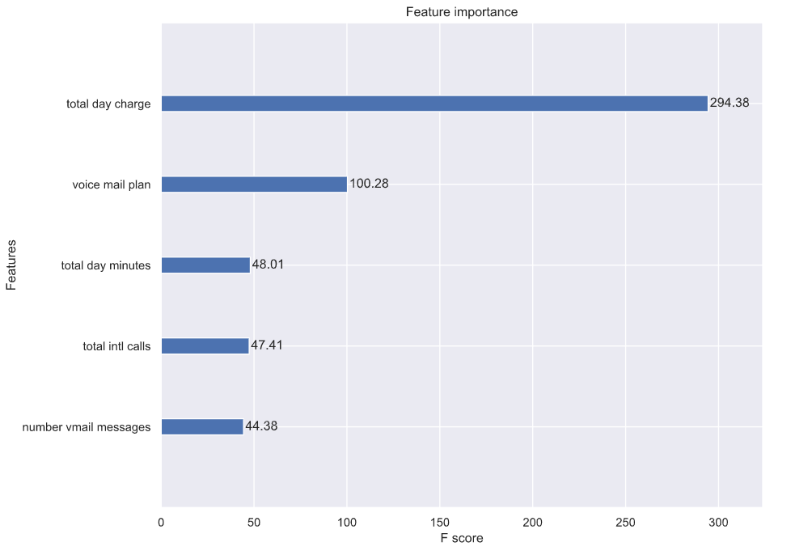
Customers Who Leave
Have These Features

Slide 8

Thanks for listening!
Contact me! I prefer compliments. tcmcaleer@gmail.com
Check out the work!https://github.com/tcmcaleer/SyriaTel-Customer-Retention
Thanks to Flatiron for their support!
Thanks to all of you!

