Slide 1

Recursion

Slide 2
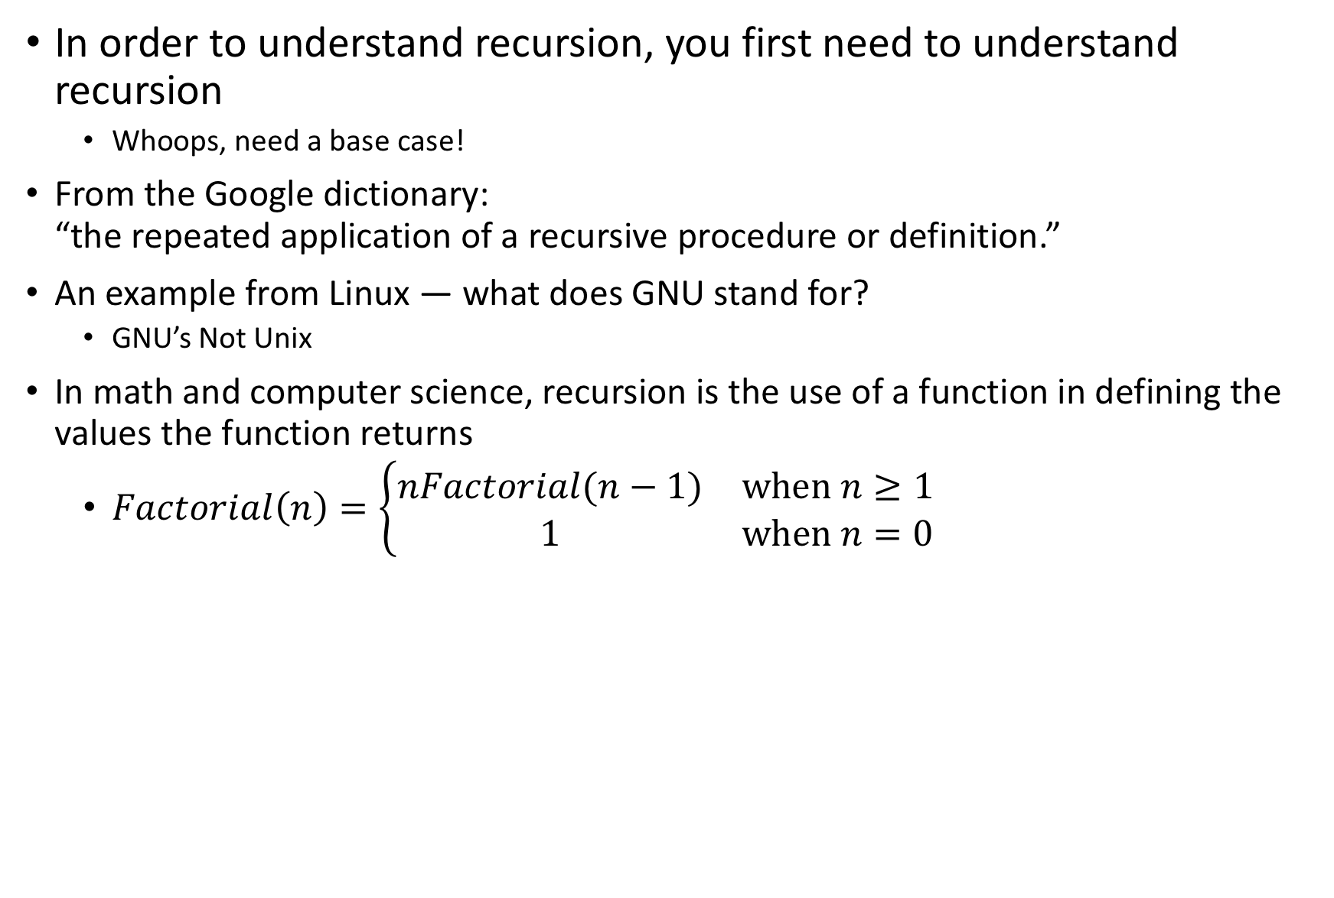
What is recursion?
In order to understand recursion, you first need to understand recursion
Whoops, need a base case!
From the Google dictionary: “the repeated application of a recursive procedure or definition.”
An example from Linux — what does GNU stand for?
GNU’s Not Unix
In math and computer science, recursion is the use of a function in defining the values the function returns
$Factorial\left(n\right)=\left\{\begin{matrix}nFactorial(n−1) & \text{when} n≥1 \\ 1 & \text{when} n=0\end{matrix}\right.$

Slide 3
https://www.smbc-comics.com/comic/2011-08-02

Slide 4
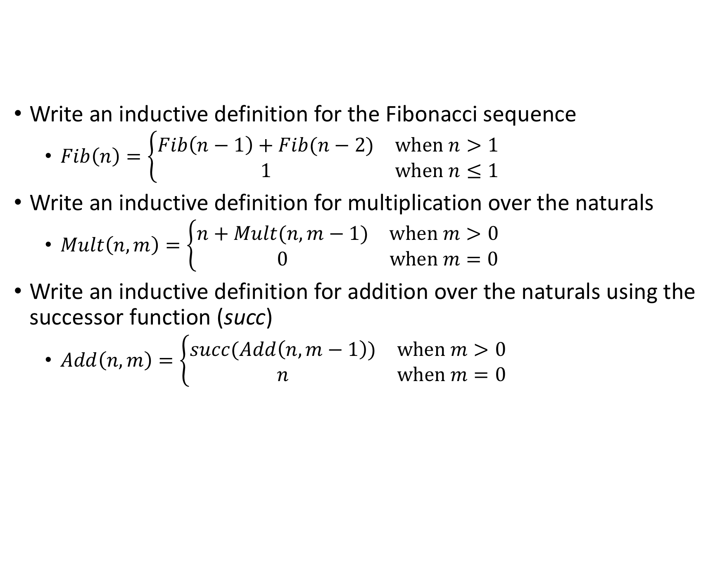
Exercise
Write an inductive definition for the Fibonacci sequence
$Fib\left(n\right)=\left\{\begin{matrix}Fib\left(n−1\right)+Fib(n−2) & \text{when} n>1 \\ 1 & \text{when} n≤1\end{matrix}\right.$
Write an inductive definition for multiplication over the naturals
$Mult\left(n, m\right)=\left\{\begin{matrix}n+Mult(n,m−1) & \text{when} m>0 \\ 0 & \text{when} m=0\end{matrix}\right.$
Write an inductive definition for addition over the naturals using the successor function (succ)
$Add\left(n,m\right)=\left\{\begin{matrix}succ(Add\left(n,m−1\right)) & \text{when} m>0 \\ n & \text{when} m=0\end{matrix}\right.$

Slide 5
Booleans
Definition of the booleans — see Lean file

Slide 6
Naturals
An inductive definition of the natural numbers — see Lean file

Slide 7
Definition
inductive mynat : Type
| zero : mynat
| succ : mynat → mynat
Base case: mynat.zero
Inductive case: mynat.succ
def zero := mynat.zero
def one := mynat.succ zero
def two := mynat.succ one …
#reduce two -- mynat.succ (mynat.succ mynat.zero)

Slide 8
Predecessor function
def pred (n : mynat) :=
match n with
-- define pred mynat.zero to be zero
| mynat.zero := zero
-- define pred (succ n’) to be n’
| mynat.succ n' := n'
end
#reduce pred three -- mynat.succ (mynat.succ mynat.zero)
Compare with definition of mynat:
inductive mynat : Type
| zero : mynat
| succ : mynat → mynat
Two cases in definition of mynat → two cases in definition of pred (typically)

Slide 9
Addition function
def add_mynat: mynat → mynat → mynat
-- base case
| mynat.zero m := m
-- recursive case: invokes add_mynat
| (mynat.succ n') m :=
mynat.succ (add_mynat n’ m)
-- (n' + 1) + m = (n' + m) + 1
-- or, n + m = (n – 1 + m) + 1
-- stops when n gets to base case (zero)
#reduce add_mynat three two

Slide 10
Exercises
We just implemented addition as the recursive (iterated) application of the successor function. Now you are to implement multiplication as iterated addition.
def mul_mynat: mynat → mynat → mynat | mynat.zero m := zero | (mynat.succ n') m := add_mynat m (mul_mynat n' m)
Implement exponentiation as iterated multiplication.
def exp_mynat: mynat → mynat → mynat | mynat.zero m := zero | (mynat.succ n') m := mul_mynat m (exp_mynat n' m)
Take this pattern one step further. What function did you implement? How would you write it in regular math notation?
def tet_mynat: mynat → mynat → mynat | mynat.zero m := zero | (mynat.succ n') m := exp_mynat m (tet_mynat n' m)

Slide 11
Left identity for adding zero
For our naturals, we can prove 0 + m = m
theorem zero_left_id:
∀ m : mynat,
add_mynat mynat.zero m = m
:=
begin
intro m,
apply rfl,
-- simp [add_mynat],
end

Slide 12
Proof by induction
How do we prove ∀m:P(m) is true?
Prove that P(m) is true for the base case (e.g., P(0)).
Prove that if P(m) is true, then P(succ(m)) is true — e.g., P(m) → P(m+1)
Why is this proof valid?

Slide 13
Right identity for adding zero
We can also prove that m + 0 = m, but we need to use induction and simp (or some other similar tactic)
theorem zero_right_id :
∀ m : mynat,
add_mynat m mynat.zero = m
:=
begin
intro m,
induction m with m’ h,
-- base case
apply rfl,
-- inductive case
simp [add_mynat],
assumption,
end

Slide 14
Another induction example
Prove n + (m + 1) = (n + m) + 1
lemma add_n_succ_m :
∀ n m : mynat,
add_mynat n (mynat.succ m) =
mynat.succ (add_mynat n m) :=
begin
intros n m,
induction n with n' h,
apply rfl, -- base case
simp [add_mynat], -- inductive casex`
assumption,
end

Slide 15
Yet another induction example
example : ∀ m n : mynat, add_mynat m n = add_mynat n m :=
begin intros m n, -- by induction on m induction m with m’ h, --base case: m = zero simp [add_mynat], rw zero_right_id,
-- inductive case: if true for m then true for succ m simp [add_mynat], rw add_n_succ_m, -- rewrite using induction hypothesis! rw h, end

Slide 16

Fin

