Slide 1

∃xistentialism (Existential Quantification)

Slide 2
What is Existential Quantification?
An existentially quantified proposition asserts that there is some value of some type for which some proposition involving that value is true. Here are a couple of examples:
∃ m ∈ ℕ, m + m = 8
∃ m ∈ ℕ, m > 10
∃ m ∈ ℕ, m - m = 3
In Lean, we might write:
def anExistsProp :=
exists m, m + m = 8
Or:
def anotherExistsProp :=
exists m, m > 10
def yetAnotherExistsProp :=
exists m, m - m = 3

Slide 3
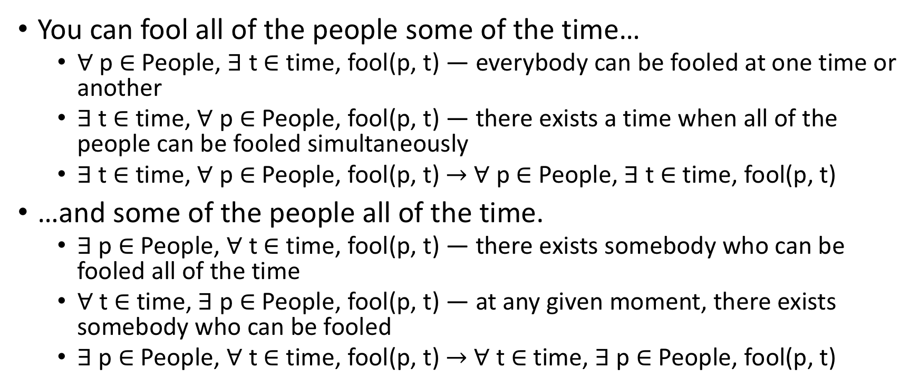
A Familiar Theme
You can fool all of the people some of the time…
∀ p ∈ People, ∃ t ∈ time, fool(p, t) — everybody can be fooled at one time or another
∃ t ∈ time, ∀ p ∈ People, fool(p, t) — there exists a time when all of the people can be fooled simultaneously
∃ t ∈ time, ∀ p ∈ People, fool(p, t) $→$ ∀ p ∈ People, ∃ t ∈ time, fool(p, t)
…and some of the people all of the time.
∃ p ∈ People, ∀ t ∈ time, fool(p, t) — there exists somebody who can be fooled all of the time
∀ t ∈ time, ∃ p ∈ People, fool(p, t) — at any given moment, there exists somebody who can be fooled
∃ p ∈ People, ∀ t ∈ time, fool(p, t) $→$ ∀ t ∈ time, ∃ p ∈ People, fool(p, t)

Slide 4
Existential Proofs
Existential proofs have two components
Witness: value for which the sub-proposition holds (e.g., 4)
We only need a single witness, even if multiple are available
Proof that the sub-proposition holds for the specified witness
The introduction rule for existential quantifiers is:
(T : Type) (pred: T → Prop) (w : T) (e : pred w)
-----------------------------------------------
∃ a : T, pred a

Slide 5
Deconstructing exists.intro
def existsIntro
(T: Type)
(pred: T → Prop)
(w : T)
(e : pred w)
: exists w, pred w
:= exists.intro w e

Slide 6
Abstract Example
variable T : Type
variable witness : T
variable predicate : T → Prop
variable proof : predicate witness
def pf : ∃ m, predicate m :=
⟨ witness, proof ⟩
def examplePredicate: ℕ → Prop :=
λ(x: ℕ), x + x = 8

Slide 7
Concrete Example
def isEven (n : nat) : Prop :=
exists m : nat, m + m = n
def eightEven := isEven 8
#check eightEven
#reduce eightEven
lemma pf8is4twice : 4 + 4 = 8 := rfl
theorem even8 : eightEven :=
exists.intro 4 pf8is4twice

Slide 8
Concrete Example (2)
theorem even8' : eightEven :=
⟨ 4, pf8is4twice ⟩
theorem even8'' : isEven 8 :=
begin
unfold isEven, -- not necessary
exact ⟨ 4, pf8is4twice ⟩
end

Slide 9
Exercise
Construct a proof, isNonZ, of the proposition that there exists a natural number n such that 0 ≠ n.
theorem isNonZ : exists n : nat, 0 ≠ n :=
exists.intro 1 (λ pf : (0 = 1),
nat.no_confusion pf)
theorem isNonZ' : exists n : nat, 0 ≠ n :=
begin
have pf0isnt1: (0 ≠ 1),
apply nat.no_confusion,
exact ⟨ 1, pf0isnt1 ⟩
end

Slide 10
Existential Elimination
If one assumes that there exists an x such that P(x) is true, then one can assume there is an arbitrary value, w, such that P(w) is true. If one can then show, without making additional assumptions about w, that some conclusion, Q that does not depend on w, follows, that one has shown that Q follows from the mere existence of a w with property P, and thus from ∃ x, P x.

Slide 11
Existential Elimination Inference Rule
Q: Prop; T: Type; P: (T → Prop); ∃(x: T), P x; (∀(a: T), P a) → Q
----------------------------------------------------------------------
Q
This rule says that we can conclude that any proposition, Q, is true, if
T is any type of value;
P is any property of values of this type;
there is some value, x, of this type that has property P; and
from any such value, w, Q then follows.

Slide 12
Deconstructing Existential Elimination
def existsElim
{ Q : Prop }
{ T : Type }
{ P : T → Prop }
( ex : exists x, P x)
( pw2q : ∀ w : T, P w → Q)
: Q
:= exists.elim ex pw2q

Slide 13
Existential Elimination Example
theorem forgetAProperty :
(exists n, P n ∧ S n) → (exists n, P n) :=
-- here Q, the conclusion, is (exists n, P n)
begin
assume ex,
show ∃ (n : ℕ), P n,
from
begin
apply exists.elim ex, -- give one arg, build other
assume w Pw, -- assume w and proof of P w
show ∃ (n : ℕ), P n,
from exists.intro w Pw.left,
end,
end

Slide 14
Exercise
Assuming n is a natural number and P and S are properties of natural numbers, prove that (∃ n, P n ∧ S n) → (∃ n, S n ∧ P n).

Slide 15
Answer to exercise
theorem reverseProperty :
(exists n, P n ∧ S n) → (exists n, S n ∧ P n) :=
begin
assume ex,
show ∃ (n : ℕ), S n ∧ P n,
from
begin
apply exists.elim ex, -- give one arg, build other
assume w Pw, -- assume w and proof of P w
show ∃ (n : ℕ), S n ∧ P n,
from exists.intro w ⟨ Pw.right, Pw.left ⟩
end,
end

Slide 16
Exercises
Express the property, of natural numbers, of being a perfect square. For example, 9 is a perfect square, because 3 is a natural number such that 3 * 3 = 9. By contrast, 12 is not a perfect square, as there does not exist a natural number that squares to 12.
def isASquare: ℕ → Prop :=
λ n, exists m, n = m ^ 2
Prove the proposition that 9 is a perfect square
theorem isPS9 : isASquare 9 :=
begin
unfold isASquare,
exact exists.intro 3 (eq.refl 9)
end

Slide 17
Fooling All of the People Again
Remember this claim:
∃ t ∈ time, ∀ p ∈ People, fool(p, t) → ∀ p ∈ People, ∃ t ∈ time, fool(p, t)
Let's look at a general proof
theorem existsforall_impl_forallexists:
∀ (S T: Type) (pred: (S → T → Prop)),
(∃ (t: T), ∀ (p: S), pred(p)(t)) →
(∀ (p: S), ∃ (t: T), pred(p)(t)) :=
begin
…
end

Slide 18
Negating Existential and Universal Quantifiers
What happens when you negate an existential quantifier?
What does this mean:
¬(∃ t ∈ time, fool(me, t)) — there does not exist a time when you can fool me
∀ t ∈ time, ¬fool(me, t) — at any time, you will not fool me
Are these equivalent?
How about this:
¬(∀ t ∈ time, fool(me, t)) — you cannot fool me all of the time
∃ t ∈ time, ¬fool(me, t) — there exists a time when you cannot fool me
Are these equivalent?

Slide 19
Proof of Existential Negation (1 of 2)
theorem not_exists_t_iff_always_not_t:
∀(T: Type) (pred: (T → Prop)),
(¬(∃ t: T, pred(t))) ↔
∀ t: T, ¬pred(t) :=
begin
assume T pred,
apply iff.intro,
assume pf_not_exists_t,
assume t,
assume Q,
have pf_exists_t := exists.intro t Q,
exact (pf_not_exists_t pf_exists_t)…

Slide 20
Proof of Existential Negation (2 of 2)
-- proof that ∀ t: T, ¬pred(t) implies
-- ¬(∃ t: T, pred(t))
assume pf_forall_t_not,
assume pf_not_exists_t,
apply exists.elim pf_not_exists_t,
assume a pf_a,
have pf_not_a := pf_forall_t_not a,
exact pf_not_a pf_a
end

Slide 21
Satisfiability
Satisfiability is about finding values for sub-propositions such that a larger proposition is true
Applies to propositional logic, not predicate logic and assumes the axiom of the excluded middle to be true
Typically, we like to phrase the larger proposition in what is referred to as Conjunctive Normal Form, or CNF
E.g., (x1 ∨ x2 ∨ ¬x3 ∨ x4) ∧ (¬x1 ∨ x2 ∨ ¬x3)
Do there exist values for propositions P and Q such that:
(P or Q) and (¬P or ¬Q)
See proof

Slide 22
Exercises
Do there exist values for P and Q such that: (P ∨ Q) ∧ (¬P ∨ ¬Q) ∧ (¬P or Q) is true? If so, prove it.
Do there exist values for P and Q such that: (P ∨ Q) ∧ (¬P ∨ ¬Q) ∧ (¬P ∨ Q) ∧ (¬Q) is true? If so, prove it.

Slide 23
3-SAT
3-SAT is a special kind of satisfiability (SAT) problem where each of the disjunctions have no more than 3 terms in each disjunction
E.g., (P ∨ Q ∨ R) ∧ (¬P ∨ ¬Q ∨ ¬S) ∧ (¬P ∨ Q ∨ T) ∧ …
3-SAT is SAT, and 2-SAT is 3-SAT
All SAT problems can be reduced to 3-SAT problems
3-SAT (and hence SAT) is NP-complete

Slide 24
Exercise
Do there exist values for P, Q, and R such that: (P ∨ Q ∨ R) ∧ (¬P ∨ ¬Q ∨ ¬R) ∧ (¬P ∨ Q ∨ R) ∧ (¬Q ∨ ¬R) is true? If so, prove it.

Slide 25

Fin

