Slide 1
GENI Operations: Monitoring
Monitoring with distributed sources and collection points
Ryan Irwin, GPO
GEC19: March 18, 2014

Slide 2
Motivations
Number of teams participating in GENI is growing
Teams have interest in collecting operational data from different sources for different purposes
Teams need a unified way for publishing data and for others to have access to it
Need an approach that scales with additional aggregates and has fewer bottlenecks
Previous design did not specify use of common tools in a collaboratively monitored system

Slide 3
Overview of Approach
Data sources and collection points are distributed
Main requirement: aggregates have data about their aggregate accessible through an interface
Collection points access data sources pertaining to their supported use case(s) and monitoring domain
Enables a diverse set of operator-preferred tools to be used in a coordinated fashion
Extensible to new aggregates and monitoring metrics
Current implementation will transition to the GENI community
Notes:
Lowest common denominator in terms of software development, ease of future maintainability, and ease of using different tools
We want to transition to others. Can we transition this to others?
Main requirement of design, multiple types of
Design we had didn’t allow for that because specific tools

Slide 4
Overview of Architecture
Alerts
Reports
Visualization
Outputs
Collectors:
Polls only select Local Datastores for select information depending on jurisdiction and use case
…
…
Every Collector uses a standardized interface to reach Local Datastores
…
Local Datastores:
Publishes information only for Collectors,
Populated with local data
…
Time-series data
Relational data
Inputs
Notes:
Started with polling mechanism with REST, simple to define, simple to implement, getting something working to monitor diverse set of aggregates was a priority. This provides an essential set of building blocks for getting a standard access/retrieval method of data
Many others already have polling infrastructure (Internet2), so this avoids having those who are already collecting data
Pub-sub or a push-based model requires more requires more work and requirements
Did not want to specify pushing every event to avoid notifications for every measurement event or the proper queuing or bulk transactions needed
What we have now provides a lot of bang for buck. The design is simple. The reference implementation uses standard tools in standard ways (thus easy to implement)

Slide 5
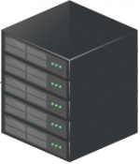
Implementation in GENI
Monitoring Group
Monitoring Group
Monitoring Group
Alerting
Alerting
Visualization
Reports
Reports
Collector
Collector
Collector
Config:
AMs,
Operators
Clearing House
Local DS
Local DS
Local DS
Local DS
Network
Aggregate
Rack Aggregate
Rack Aggregate
Notes:
Explain not a full set of arrows
Configuration may not be a local DS, configuration for

Slide 6
REST and JSON Based Framework
Two types of REST calls to the local datastores
Info about local datastore collections
Pointers to objects with in the local datastore through object IDs
Implemented examples: ID’s of nodes, interfaces, vlans
Examples of things to come: slice, sliver, user
Data about measurements or time-series data
Query a set of object IDs and measurements
Implemented examples: Utilization statistics (cpu_util, rx_bps)
Example of things to come: AM availability, OF statistics
Both types of data support alerting, reporting, and visualizations
Notes:
Maybe an extra slide on history

Slide 7
Info REST Calls
A collector gets information about the contents of the local datastore
Response contains references to get info on the aggregate’s resources and slivers
Response contains a reference to get time-series data
Ex: http://datastore.utah.geniracks.net:5001/info/aggregate/utah-ig
A collector makes successive info calls to gather all the info of interest at a local datastore
Like a web-crawler that gathers info
Saves object IDs for making time-series data calls
Ex: http://datastore.utah.geniracks.net:5001/info/node/utah.geniracks.net_node_pc3

Slide 8
Data REST Calls
Then, the collector makes periodic data queries for object id’s gathered from info queries
http://datastore.utah.geniracks.net:5001/?q=<filters_dictionary>
Filters dictionary contains:
Event types (i.e., cpu_util, rx_bps)
Timestamp window
Object IDs of a single type (i.e., node or interface)
Object IDs match those used in info calls
JSON response is an array of length num_event_type x num_object_id
Time window is an implementation design point
Notes:
15 minutes ok, 1 hour
Tradeoff in frequency of check
GENI operations as a consumer needs a minimum to set

Slide 9
Implement to a standard
Aggregates required to have local datastores
Local datastores are validated
Required to follow the api and have consistent data (i.e., consistent object IDs)
Validation tools
json-schema validation similar to UNIS (Martin Swany)
Custom validation tools

Slide 10
Local DS and Collector Reference Implementation
Standard PostgreSQL and MySQL DBs
Python programs for:
Transforming REST calls to SQL queries and JSON response creation
Crawling local datastores for info (called by CRON)
Fetching time-series data (CRON)
Apache, Python-Flask, and WSGI for hardened, multi-threaded, webfacing servers
Code: http://trac.gpolab.bbn.com/ops-monitoring/wiki
Docs: http://groups.geni.net/geni/wiki/OperationalMonitoring
Notes:
Make distinction for what pieces are required and which pieces are not. Which tools
View

Slide 11
Deployment Status
Local Datastores:
Rack teams:
IG @ UTAH
EG @ RENCI,WVNET
Network aggregates:
AL2S
Internet2 (mesoscale)
ION
MAX (regional access to ION)
Collectors:
UK is visualizing networking data from networking aggregate and Utah IG local datastores (see demo)
GPO is alerting on multiple resources using Nagios
Reference implementation enables new collectors

Slide 12
ExoGENI Info Call
https://wvn-hn.exogeni.net/ops-monitoring/info/node/exogeni.net:wvnvmsite+node+wvn-w7
{"selfRef": "https://wvn-hn.exogeni.net/ops-monitoring/info/node/exogeni.net:wvnvmsite+node+wvn-w7",
"urn": "urn:publicid:IDN+exogeni.net:wvnvmsite+node+wvn-w7",
"ts": 1395163151000000,
"id": "exogeni.net:wvnvmsite+node+wvn-w7",
"$schema": "http://unis.incntre.iu.edu/schema/20120709/node#",
"properties": {"ops_monitoring": {"mem_total_kb": 1586307072}},
"ports": [{"urn": "urn:publicid:IDN+exogeni.net:wvnvmsite+interface+wvn-w7:eth3",
"href": "https://wvn-hn.exogeni.net/ops-monitoring/info/interface/ exogeni.net:wvnvmsite+interface+wvn-w7:eth3"},
…
{"urn": "urn:publicid:IDN+exogeni.net:wvnvmsite+interface+wvn-w7:eth0", "href": "https://wvn- hn.exogeni.net/ops-monitoring/info/interface/ exogeni.net:wvnvmsite+interface+wvn-w7:eth0"}]}

Slide 13
AL2S Data Call
http://aj-dev6.grnoc.iu.edu/geni-local-datastore/data/al2s.net.internet2.edu/?q={ "filters":
{"eventType":["ops_monitoring:tx_bps","ops_monitoring:rx_bps"],
"ts":{"gte":1391192225475202,"lt":1391192326480000},
"obj":{"type":"interface","id":["sdn-sw.atla.net.interne2.edu:100GigabitEthernet1/1","sdn-sw.atla.net.internet2.edu:100GigabitEthernet1/2"] } } }
[
{"eventType":"ops_monitoring:rx_bps",
"subject":"http://aj-dev6.grnoc.iu.edu/geni-local-datastore/info/interface/al2s.net.internet2.edu/sdn-sw.atla.net.internet2.edu/100GigabitEthernet1/2",
"id":"rx_bps:al2s.net.internet2.edu+interface+sdn-sw.atla.net.internet2.edu:100GigabitEthernet1/2",
"description":"bits per second received on this interface",
"units":"float",
"$schema":"http://www.gpolab.bbn.com/monitoring/schema/20140131/data#",
"tsdata":[{"ts":1391192220000000,"v":47856109814.4}, … ,{"ts":1391192330000000,"v":49359791877.12}]}
,
{"eventType":"ops_monitoring:tx_bps",
"subject":"http://aj-dev6.grnoc.iu.edu/geni-local-datastore/info/interface/al2s.net.internet2.edu/sdn-sw.atla.net.internet2.edu/100GigabitEthernet1/2",
"id":"tx_bps:al2s.net.internet2.edu+interface+sdn-sw.atla.net.internet2.edu:100GigabitEthernet1/2",
"description":"bits per second sent on this interface",
"units":"float",
"$schema":"http://www.gpolab.bbn.com/monitoring/schema/20140131/data#",
"tsdata":[{"ts":1391192220000000,"v":35551686048.64}, … ,{"ts":1391192230000000,"v":36441987075.2}]}
]
condensed
condensed

Slide 14
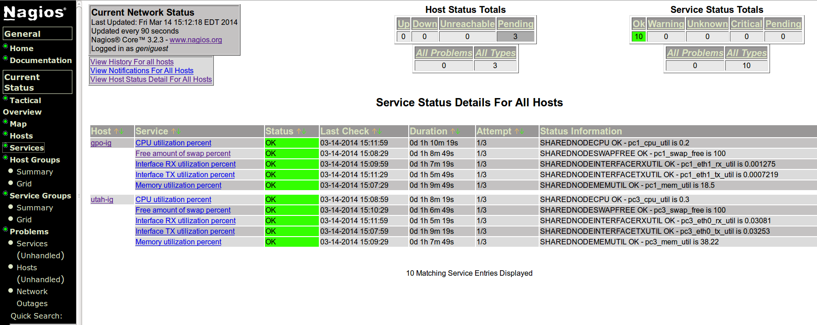
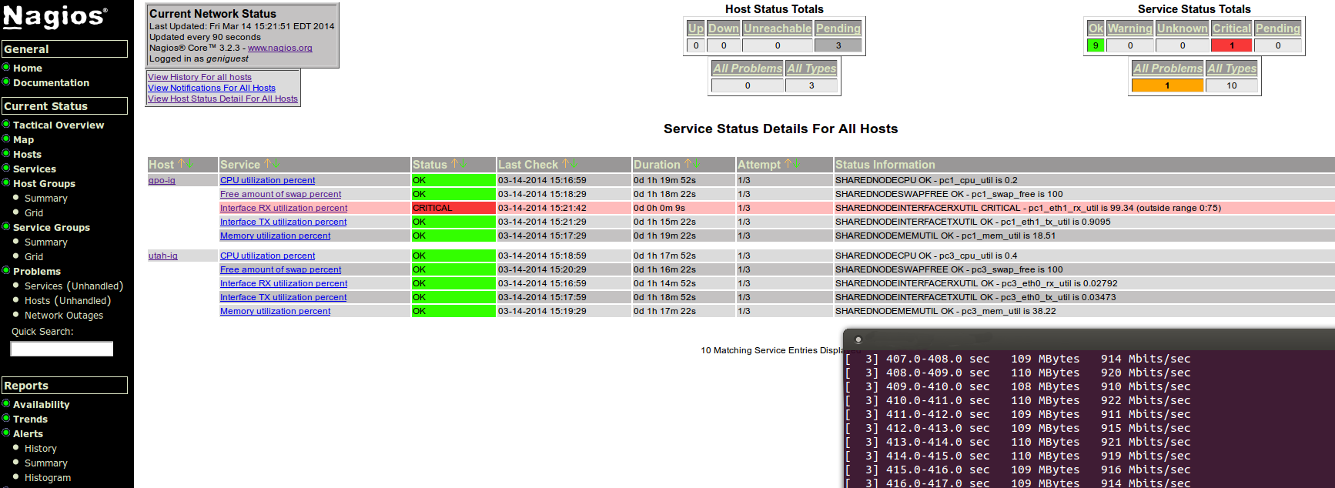
OK
iperf test caused 99% util of interface
Notes:
Both of these are enabled by the simple new architecture.

Slide 15
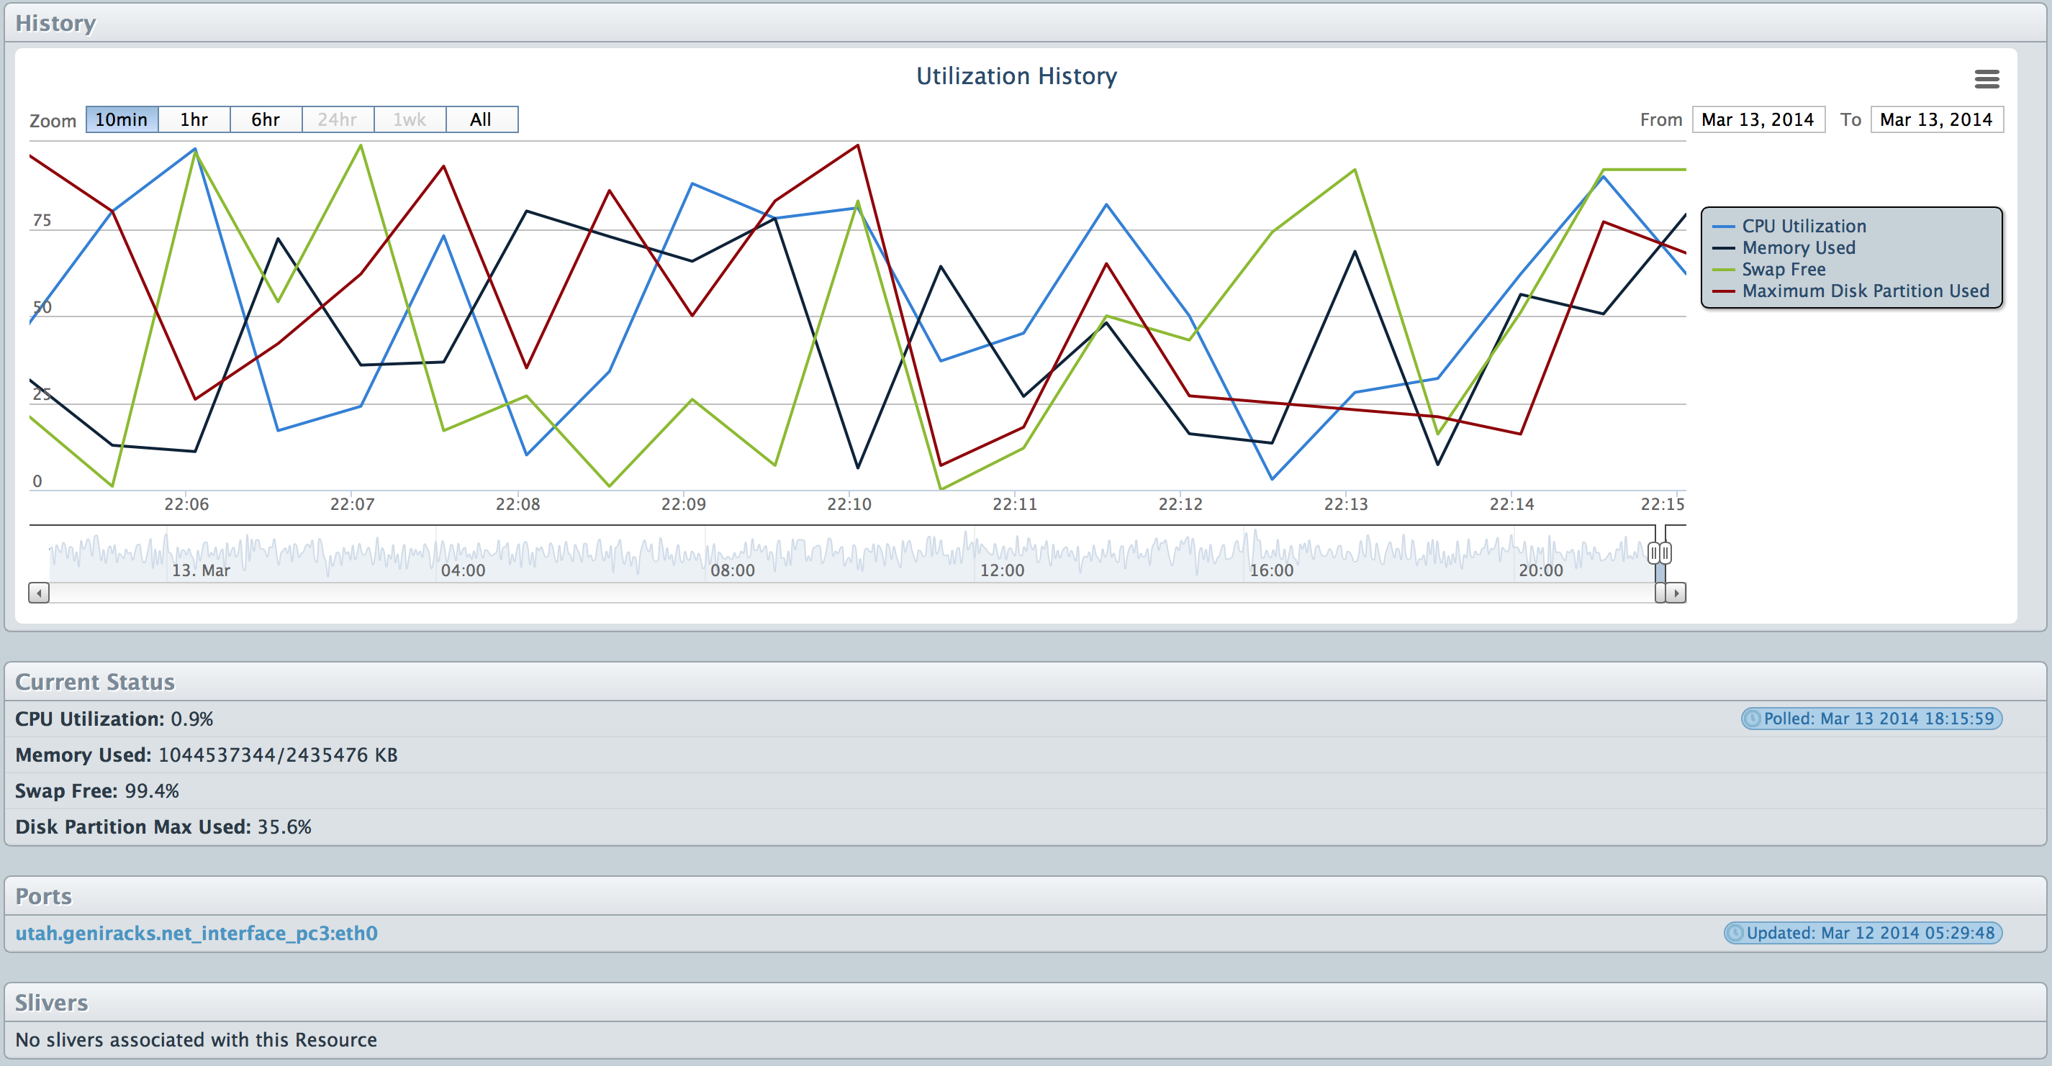
University of Kentucky Monitoring
Dashboard of Collector
Notes:
ION openflow mesoscale
Emphasize different use case under common simple architecture

Slide 16
Thanks!
Many thanks for taking this from design to deployment between GEC18 and GEC19
ExoGENI: Jonathan Mills
GRNOC: AJ Ragusa, Mitch McCracken
InstaGENI: Gary Wong
MAX: Tom Lehman and Xi Yang
UK: Cody Bumgardner, Caylin Hickey, and Ray Hyatt
GPO: Chaos Golubitsky, Tim Upthegrove, and Heidi Picher Dempsey
And others who have participated on the design decision-making process

Slide 17
Join Us at the Coding Sprint
Wednesday at 1:30
Resources -
Head wikipage:
http://groups.geni.net/geni/wiki/OperationalMonitoring
Use cases:
http://www.gpolab.bbn.com/monitoring/use_cases.html
Code:
http://trac.gpolab.bbn.com/ops-monitoring/wiki
Monitoring email/IRC:
monitoring@geni.net
#geni-monitoring on irc.freenode.net.
Notes:
Atach ppt

