Slide 1
GENI Operations: Monitoring
David P. Wiggins, GPO
GEC20: June 23, 2014

Slide 2
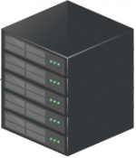
Monitoring Architecture Overview
Alerting
Alerting
Visualization
Reports
Reports
Collector
Collector
Collector
Polling REST calls
Internet
(Control Plane)
JSON responses
Local DS
Local DS
Local DS
Local DS
Local DS
Network
Aggregate
Network
Provider
Clearing House
External
Checks
Compute Aggregate
Not a GENI aggregate!
Notes:
Explain not a full set of arrows
Configuration may not be a local DS, configuration for

Slide 3
Monitored Objects
Aggregates
Slices
Slivers
Users
Authorities
Nodes
Interfaces
Interface-VLANs
Links

Slide 4
What is a link?
Compute Aggregate 1
Local DS
AM
Node 1
Network Aggregate
Switch
Local DS
Node 2
Node 3
Switch
Compute Aggregate 2
= endpoint of a link represented by an interfacevlan, which must then reference a valid interface. The vlan must be the same on both sides of a link.

Slide 5
Progress
Release 1.0 ops-monitoring software on May 1
Now at 1.1 patch 2
Many datastores and collectors are coming online
Working through issues with
the API
the implementation
the data coming back from the datastores

Slide 6
Deployments
Instageni |  | ExoGENI | Network/Other | Collector
_{utah-ig} _{utahddc-ig} _{uky-ig} _{princeton-ig} _{kansas-ig} _{nyu-ig} _{max-ig} _{nysernet-ig} _{illinois-ig} _{missouri-ig} _{rutgers-ig} _{stanford-ig} _{cornell-ig} _{lsu-ig} _{cwru-ig} _{moxi-ig} | _{nps-ig} _{idaho-ig} _{ucla-ig} _{osu-ig} _{umkc-ig} _{uchicago-ig} _{ohmetrodc-ig} _{northwestern-ig} _{gpo-ig} _{kettering-ig} _{gatech-ig} _{clemson-ig} _{sox-ig} _{wisconsin-ig} _{utah-pg} | rcivmsite bbnvmsite uva-nlvmsite osfvmsite slvmsite ucdvmsite uflvmsite wvnvmsite ncsuvmsite uhvmsite fiuvmsite nictavmsite | al2s.net.internet2.edu ion.internet2.edu of.internet.edu externalcheck/gpo ch.geni.net | GPO U Kentucky

Slide 7
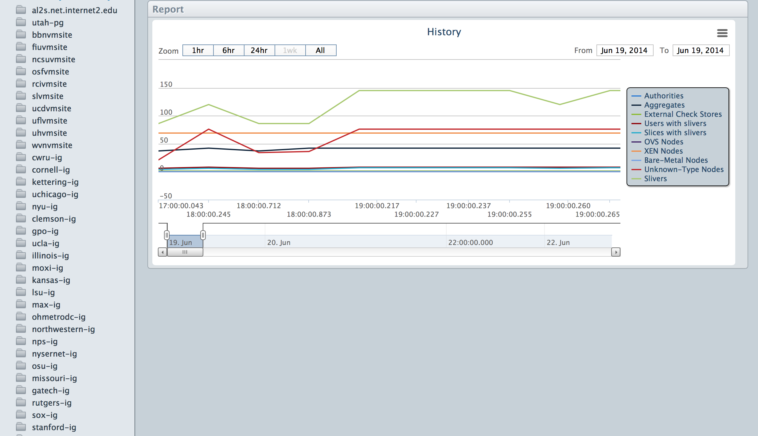
Global Report Plot

Slide 8
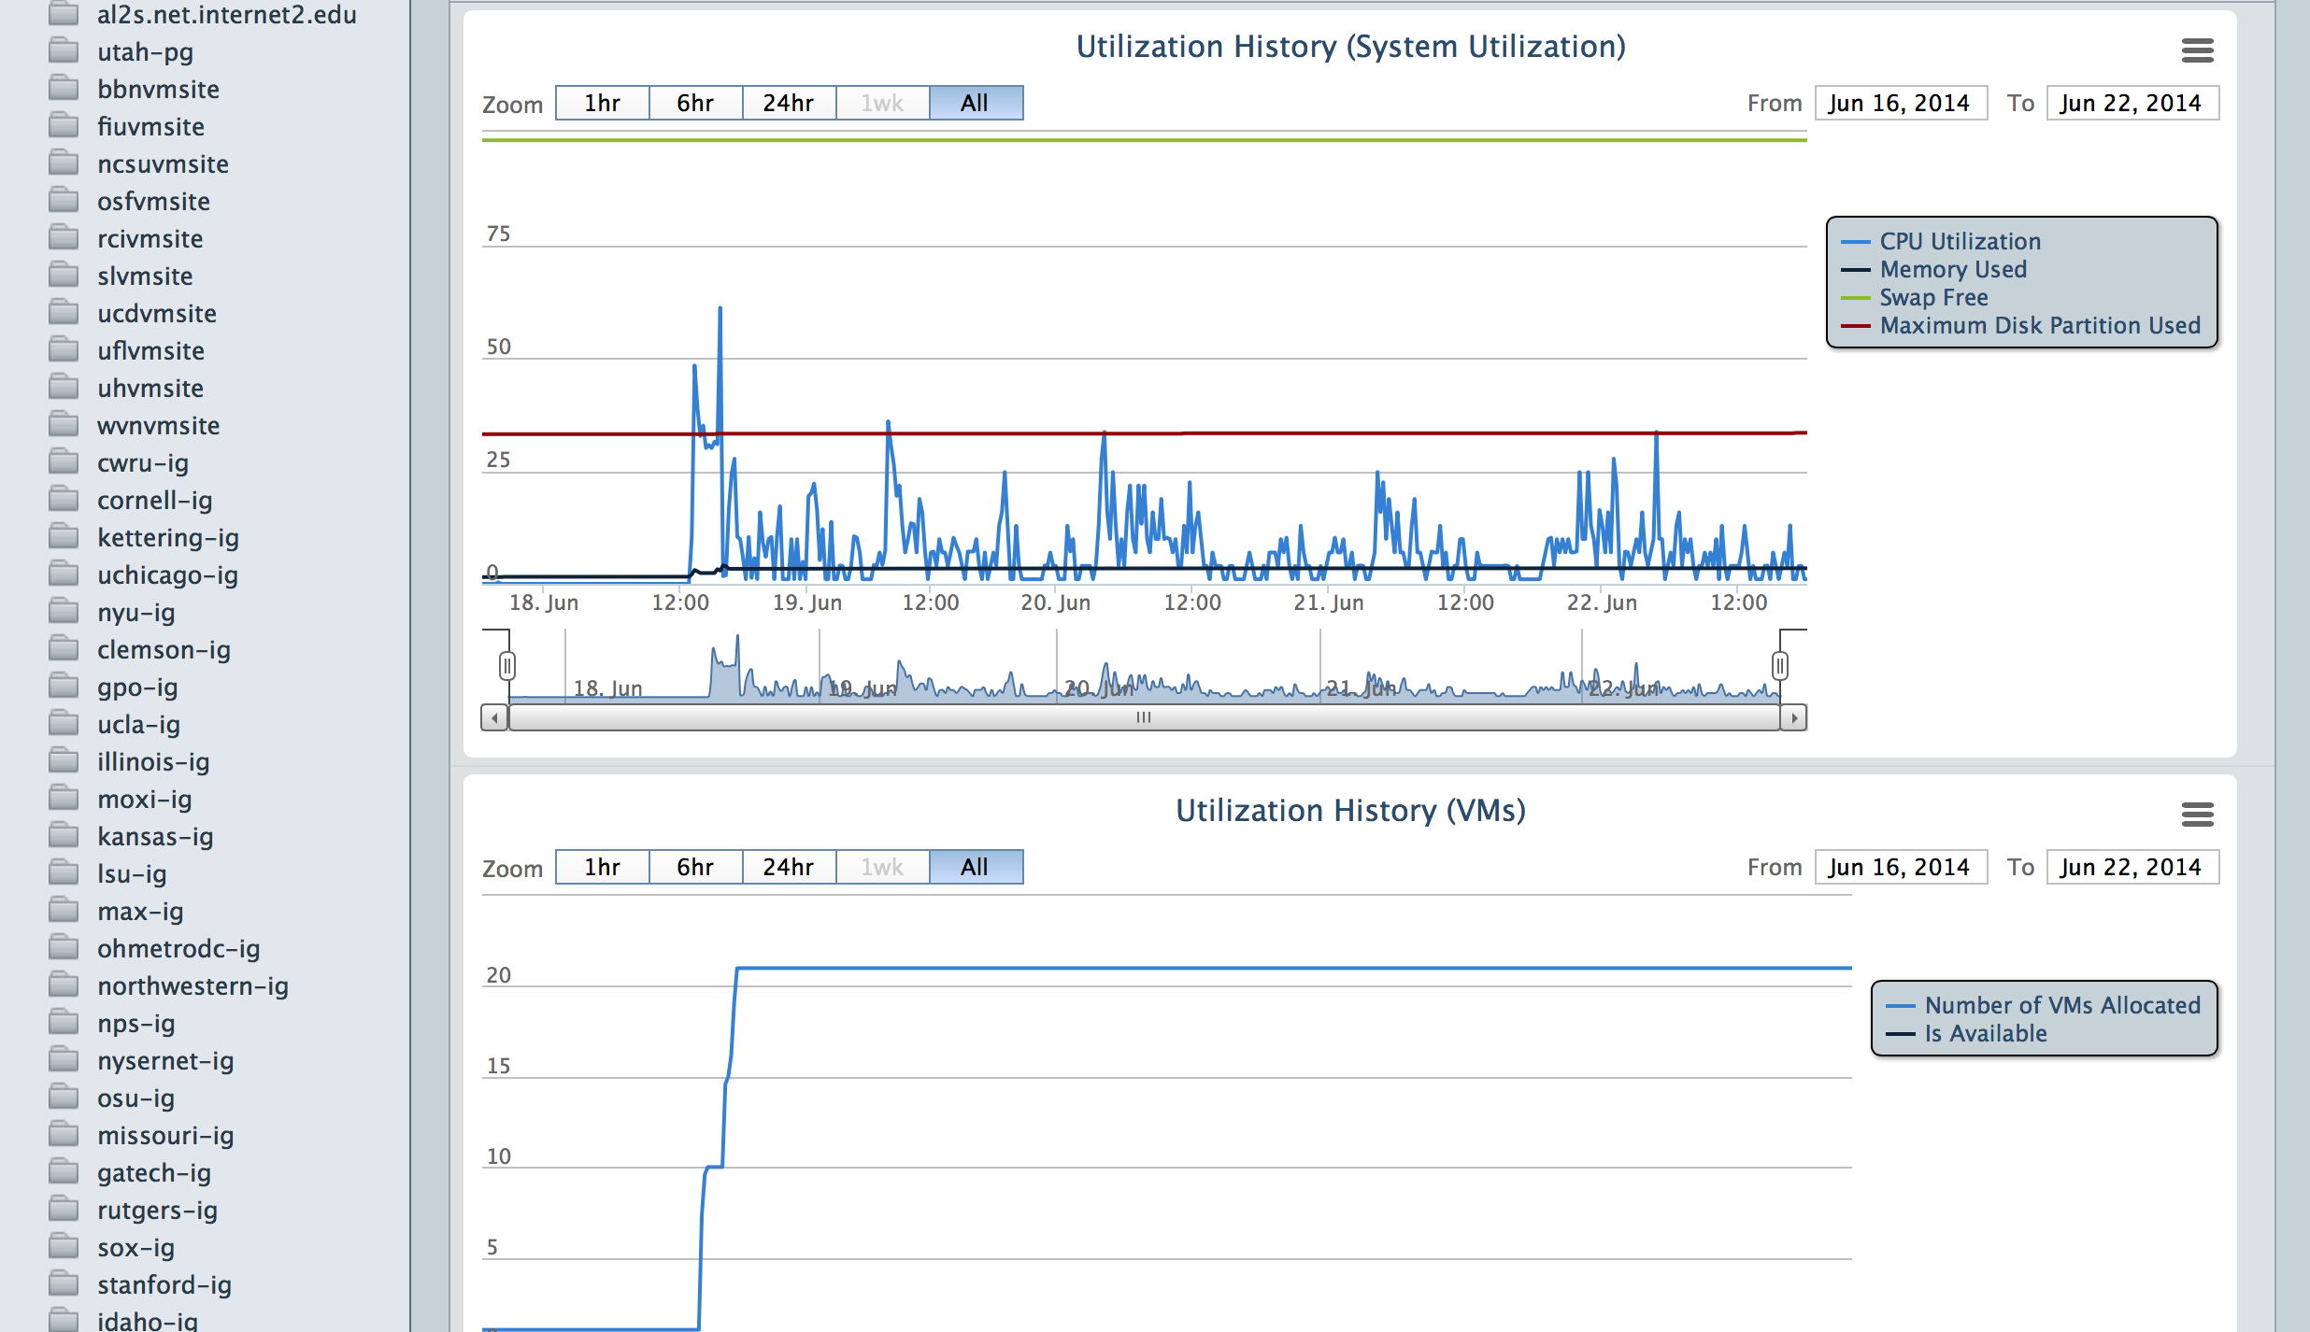
Plot of Node Stats

Slide 9
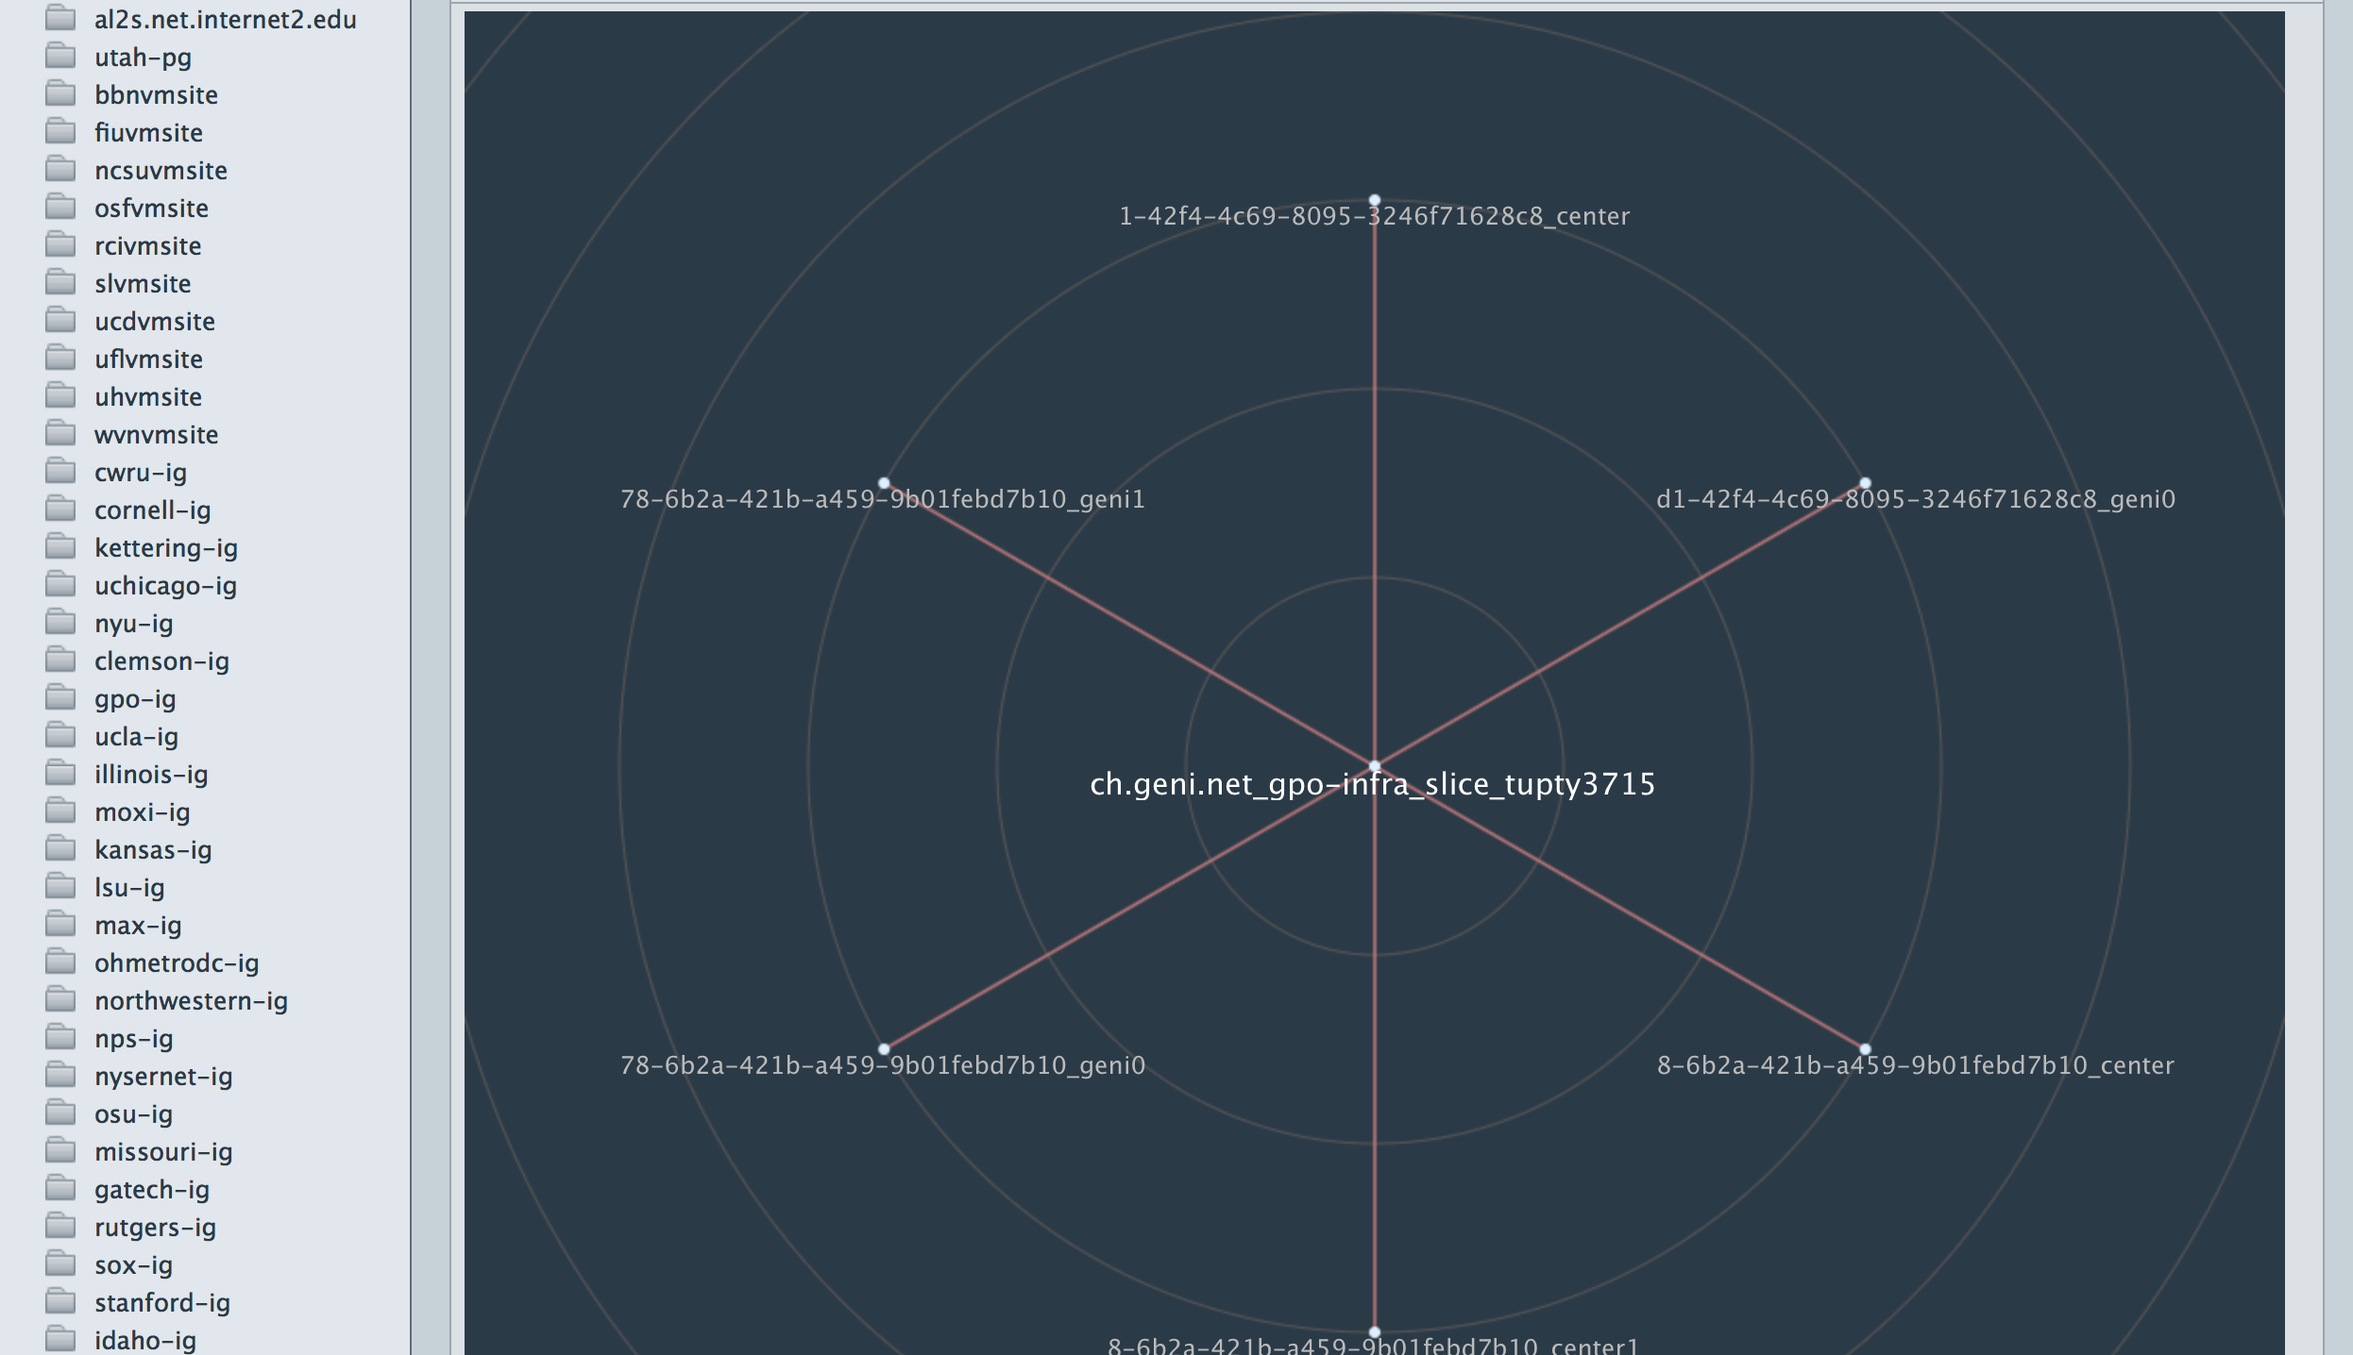
Plot of Slice/Sliver Association

Slide 10
Future Work
Improve API (REST/JSON) specification
Scalability/performance
Consistency
Semantic clarity
Support additional measurements
Improve the reference implementation
Datastore robustness
Collector completeness, scalability, ease of use
Wider production deployment

Slide 11
Thanks!
ExoGENI: Jonathan Mills, Victor Orlikowski, Ilya Baldin
Internet2: A.J. Ragusa
GMOC: Chad Kotil
InstaGENI: Gary Wong, Leigh Stoller
MAX: Tom Lehman, Xi Yang
UKY: Cody Bumgardner, Caylin Hickey
GPO: Ryan Irwin, Stéphane Blais, Ali Sydney, Heidi Picher Dempsey

Slide 12
Backup slides
Backup slides

Slide 13
What is a link?
Both the compute AM and the network AM advertise this link. Each side must know the exact URN of the interface and interface-vlan of the other side.
Compute Aggregate 1
Local DS
Interface on the node (may be a VM)
AM
Node 1
Network Aggregate
Switch
Local DS
Node 2
egress interface from rack to the outside world. Ingress/egress are from the point of view of traffic going from Compute Aggregate 1 to 2.
Switch
Node 3
ingress interface into the network aggregate
Compute Aggregate 2
Compute Aggregate 1 must advertise this link. We omit the physical port on the switch to which the node is directly connected.
If there are transit networks on this path that do not run GENI monitoring, they are either omitted or expressed as an L2 (layer 2) path. Transit networks that do run GENI monitoring will appear as link endpoints.
egress interface from the network aggregate
This switch connects the rack to the outside world. Rack AMs such as this compute AM must advertise this switch as a node so that we have a place to put its interfaces and interface-vlans.
The network AM advertises this link. It is strongly encouraged to include an L2path giving the details of the path between the ingress and egress interfaces.
= endpoint of a link represented by an interfacevlan, which must then reference a valid interface. The vlan must be the same on both sides of a link.
Only dataplane links are reported, i.e., links that are part of an experiment and thus can carry experiment traffic. Endpoints of such links are not usually reachable from the arbitrary places on the Internet, in contrast to the control plane.

Slide 14
Sample Collected Data
collector=> select id, urn from ops_link_interfacevlan where link_id = 'ion.internet2.edu-100021' ;
id | urn
------------------------------------------------------------+-------------------------------------------------------------------------
ion.internet2.edu/rtr.salt.ion.internet2.edu/ge-10/2/7/885 | urn:publicid:IDN+ion.internet2.edu+interface+rtr.salt:ge-10/2/7:protogeni:885
ion.internet2.edu/rtr.newy.ion.internet2.edu/xe-0/2/2/305 | urn:publicid:IDN+ion.internet2.edu+interface+rtr.newy:xe-0_2_2:*:305
(2 rows)
collector=> select tag, interface_urn from ops_interfacevlan where id = 'ion.internet2.edu/rtr.salt.ion.internet2.edu/ge-10/2/7/885' ;
tag | interface_urn
-----+---------------------------------------------------------------------------
885 | urn:publicid:IDN+ion.internet2.edu+interface+rtr.salt:ge-10/2/7:protogeni
(1 row)
collector=> select id, properties$role, properties$max_bps from ops_interface
where urn = 'urn:publicid:IDN+ion.internet2.edu+interface+rtr.salt:ge-10/2/7' ;
id | properties$role | properties$max_bps
--------------------------------------------------------+-----------------+--------------------
ion.internet2.edu/rtr.salt.ion.internet2.edu/ge-10/2/7 | transport | 1000000
(1 row)
This demonstrates tracing from a link to its interfacevlans to its interfaces.

