Slide 1
Clustering OTUs using U/VSEARCH
By Jonathan Palko and Thomas Coard

Slide 2
USEARCH
“Extreme high-throughput sequence analysis. Orders of magnitude faster than BLAST.” [4]
Usearch includes many utilities that are useful for analyzing read information.
The code is not open source and is mostly written by one person, Robert Edgar.

Slide 3
USEARCH Sequence Analysis Pipeline

Slide 4
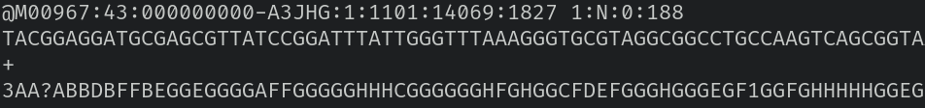
Background: FASTQ Format
This is the output from the sequencing machines [5].
A FASTQ file normally uses four lines per sequence.
Line 1 begins with a '@' character and is followed by a sequence identifier and an optional description (like a FASTA title line).
Line 2 is the raw sequence letters.
Line 3 begins with a '+' character and is optionally followed by the same sequence identifier (and any description) again.
Line 4 encodes the quality values for the sequence in Line 2, and must contain the same number of symbols as letters in the sequence.

Slide 5
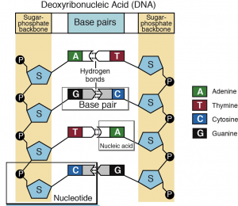
Background: DNA Strands
Dna is made of two strands that are connected by nucleic acids.
Adenine and Thymine pair together.
Cytosine and Guanine pair together.
The strands are sequenced individually and are read in opposite directions.

Slide 6
Merge Pairs
This command will match all of the positive strand reads in the R1 files with the negative strand reads in the R2 files.
In the example on the right, AGTC would pair with GACT.
The output would be a new fastq that has the reads combined and averaged quality data for the read.

Slide 7
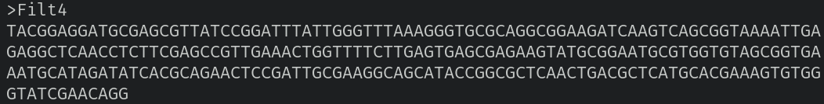
Discard Low Quality Reads
This command calculates the expected number of errors in the read and throws out any that are expected to have one or more error.
The output of this is a FASTA formatted file, which has a very similar format to FASTQ files, except FASTA files do not have read quality information.
Example:

Slide 8
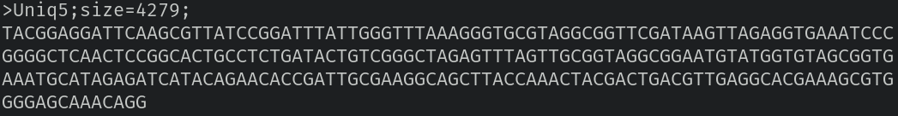
Combine Unique Reads
This command removes all duplicate reads and adds the total number of duplicate reads to the read header.
Example output sequence:

Slide 9
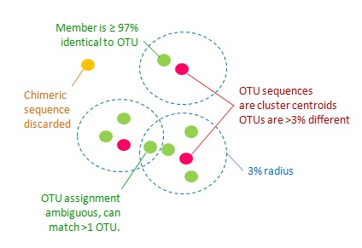
Clustering OTUs
This command clusters the reads into OTUs with ≥97% sequence similarity.
When choosing OTU sequences, USEARCH’s clustering algorithm takes into account the abundance of the sequence.

Slide 10
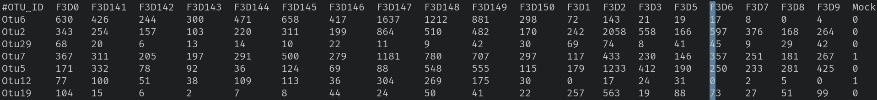
OTU Table
This command generates an OTU table.
The Y axis is the OTUs generated and the X axis is the samples sequenced.

Slide 11
USEARCH Exercises/Examples

Slide 12
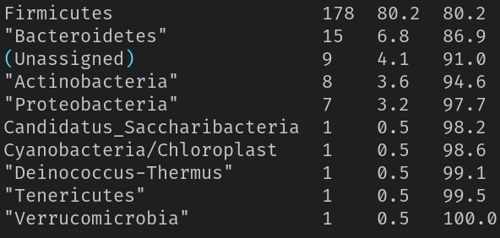
USEARCH Exercise 1
Use the sintax command to predict taxonomy for OTU sequences

Slide 13
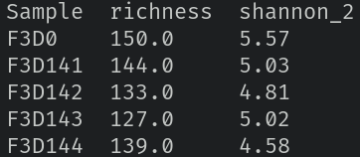
USEARCH Exercise 2
Uses the alpha_div command to calculate richness and Shannon metrics
  Uses base 2 (bits) for Shannon
What is richness and Shannon diversity of mock sample?
  Richness: 30
  Shannon metric: 4.01

Slide 14
USEARCH Exercise 3
Uses the otutab_norm command to normalize all the samples to 5000 reads and calculate the richness and Shannon diversity on the now normalized OTU table
Besides rounding errors, this should not change our output because normalizing doesn't change whether an OTU is present (richness) or its frequency (Shannon).

Slide 15
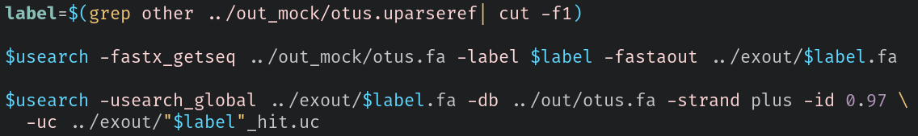
USEARCH Exercise 4
Uses the otus.uparseref file in misop/out_mock directory
  Which OTU doesn’t match a reference sequence from the mock community?
Make a FASTA file with this non matching sequence
Use the usearch_gloabl command to find the same sequence in the OTU file for all samples combined (out/otus.fa)
  Which is the corresponding OTU?
  Why is this unexpected sequence found in reads for the mock sample?
Otu20 in out_mock/otus.fa is identical to Otu107 in out/otus.fa, likely due to cross-talk or a contaminant.

Slide 16
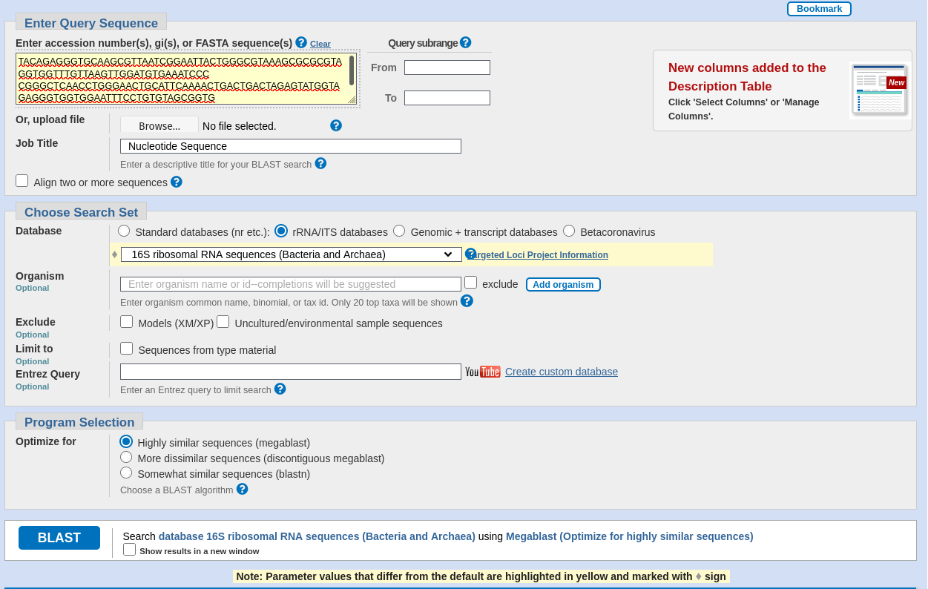
USEARCH Exercise 5
Runs the OTU sequence from Exercise 4 using NCBI BLAST
  Which species (singular or plural) have BLAST hits with 100% identity?
We find 100% matches with many species in the Pseudomonas genus. We found many more than when the tutorial was originally written.

Slide 17
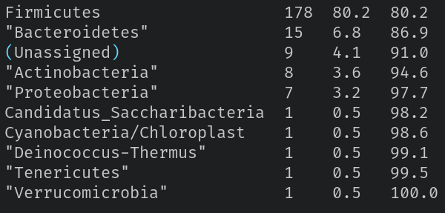
USEARCH Exercise 6
Uses the sintax_summary command for phylum ranking
  Which is the most common phylum in the OTUs?

Slide 18
VSEARCH

Slide 19
VSEARCH Overview
Free, 64-bit open-source multithreaded sequence analysis tool
Meant to be an alternative to USEARCH (which is proprietary)
Functionality of VSEARCH is similar to USEARCH versions 7 and 8 in addition to unique functions
This includes the following:
  Searching based on exact or global alignment
  Clustering by similarity (using length pre-sorting, abundance pre-sorting or user-defined order)
  Chimera detection (referenced-based or de novo)
  Dereplication (full length or prefix)
  Pairwise alignment
  Reverse complementation
  Sorting
  Subsampling
  FASTQ file processing (format detection, filtering, read quality statistics, and merging of paired reads)

Slide 20

Unique VSEARCH Features
VSEARCH has the following unique functions and features:
  Shuffling
  Re-replication
  Masking of low-complexity sequences with the DUST algorithm (by Tatusov and Lipman)
    The DUST algorithm focuses on masking of simple repeats and low-complexity nucleotide sequences
    Full Code Algorithm: https://ftp.ncbi.nlm.nih.gov/pub/tatusov/dust/version1/src/dust.c
  Ability to choose among different similarity definitions
  FASTQ file format conversion
Uses pairwise alignments computed in parallel via vectorization over multiple threads
Notes:
Similarity definitions - Adjustable similarity threshold applied on reads based on the # of identical words in both the database and query sequences

Slide 21
VSEARCH Searching Process
VSEARCH’s Searching Process Has Two Phases:
  1st Phase: Initial heuristic filtering based on shared words
    Creates an index of 4^{k} possible distinct words, and stores the info about which database sequences each distinct word appears in (k is the number of consecutive nucleotides of a sequence, which is set to 8 by default)
  2nd Phase: Optimal alignment of the query with the most promising candidates
    Considers the database sequences starting with the sequence that has the largest # of words in common with the query sequence
    Comparison between the query sequence and database sequence is done by computing the optimal global alignment (Needleman & Wunsch algorithm)
    This optimal alignment has HUGE memory requirements when aligning long sequences (>5000 base pairs)
      If the two sequences have a product of their length greater than 20 million than an alternative method described by Hirschberg (1975) and Myers & Miller (1988) is used
        This alternative methods is MUCH SLOWER but only uses a linear amount of memory
  Computing the optimal pairwise alignment is each case is more computationally demanding but will provide more accurate results
Notes:
1st Phase: For extremely frequent words the set of database sequences is represented by a bitmap, otherwise the set is stored as a list
2nd Phase:
(If two sequences have the same # of words in common the shortest sequence is considered first)
(Alignment is done using multi-threaded and vectorized full dynamic programming algorithm adapted from SWIPE (Rogness, 2011))

Slide 22
VSEARCH Clustering
VSEARCH performs de novo clustering using greedy and heuristic centroid based algorithms with an adjustable sequence similarity threshold (which is specified with the id option)
  The input sequences are used as a query in a search against an initially empty database of centroid sequences
    The input sequences may be processed in any of the following orders:
      Processed in user supplied order (cluster_smallmem)
      Processed after being pre-sorted based on length (cluster_fast)
      Processed after being pre-sorted based on abundance (cluster_size)
  The input query sequence is clustered with the 1st centroid sequence found with similarity equal to or above the threshold (includes the sequence searching described previously)
    If no matches are found, the query sequence becomes the centroid of a new cluster and is added to the database
  By default the query is clustered with the centroid presenting the highest sequence similarly (distance-based greedy clustering, DGC)
    If sizeorder option is ON then the centroid with the highest abundance is used (abundance-based greedy clustering)

Slide 23
USEARCH and VSEARCH Comparison
USEARCH | VSEARCH
Free 32-bit, max 4 Gb RAM version available | Free 64-bit, no maximum RAM version available
Only offers single-thread support | Supports multi-threading
Faster when performing chimera detection and clustering (see graphs) | More accurate when performing some chimera detection and clustering (see graphs)
USEACH and VSEARCH have similar searching and subsampling speeds | More accurate when performing some searching and subsampling (see graphs)
About the same accuracy as VSEARCH when dealing with paired-ends read merging | About the same accuracy as USEARCH when dealing with paired-ends read merging, but with faster speed
Ineffective dereplication for shorter sequences | 40-50% faster when performing de-replication
Notes:
USEARCH 7 is faster than USEARCH 8

Slide 24
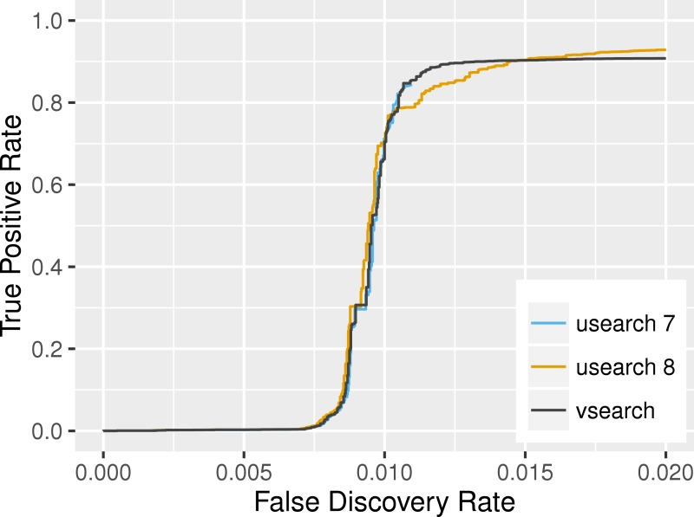
USEARCH and VSEARCH Search Comparison
Search accuracy on the RFAM v11 dataset ^{[2]}
Notes:
Time to Search the RFAM Database:
USEARCH version 7: avg 5 min 29 s for the search
USEARCH version 8: avg 5 min 57 s for the search
VSEARCH: avg 5 min 26 s for the search

Slide 25
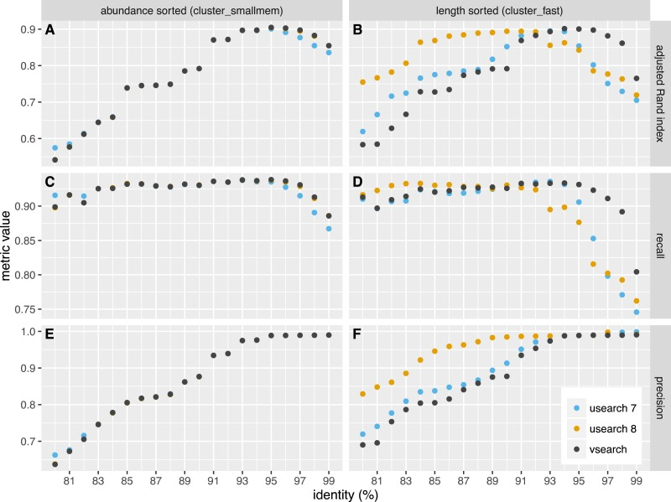
USEARCH and VSEARCH Clustering Comparison
Clustering accuracy using abundance sorting (A, C, E) and using length sorting (B, D, F)^{[2]}

Slide 26
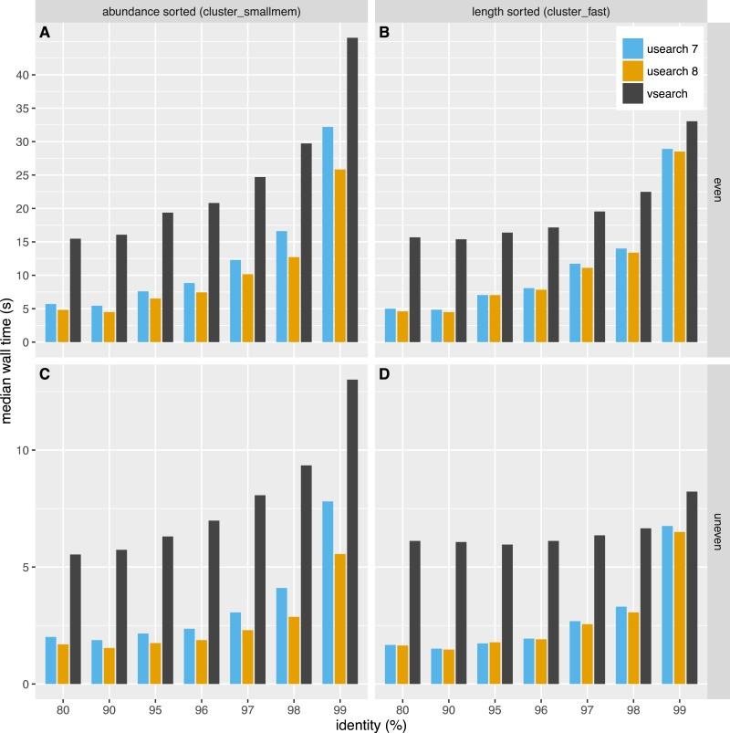
USEARCH and VSEARCH Clustering Comparison
Clustering median time for even and uneven on the even dataset ^{[2]}

Slide 27
References
[1] https://www.researchgate.net/figure/Flow-chart-of-the-dust-detection-algorithm-The-number-associated-with-each-dust-test_fig2_216791182
[2] https://www.ncbi.nlm.nih.gov/pmc/articles/PMC5075697/
[3] https://ftp.ncbi.nlm.nih.gov/pub/tatusov/dust/version1/src/
[4] https://drive5.com/usearch/
[5] https://en.wikipedia.org/wiki/FASTQ_format
[6] https://en.wikipedia.org/wiki/Needleman%E2%80%93Wunsch_algorithm

