Slide 1
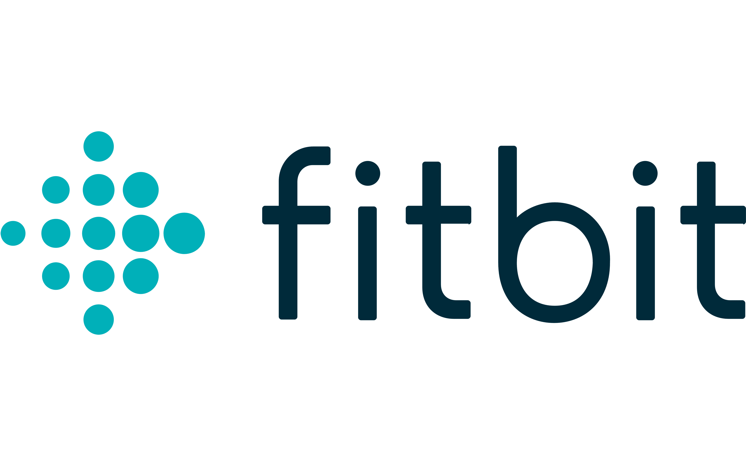
Fitbit Analysis
A comprehensive analysis made by Fistani Gianmarco and Colangelo Thomas

Slide 2
Scope
In this comprehensive analysis of device usage data, we delved into various aspects of user behavior, ranging from daily activity patterns to sleep metrics. The analysis aimed to look for trends and identifying potential pattern recognition among users.
The dataset we used contains health data concerning 30 users, specifically: daily activity, heart rate, sleep monitoring and more.
Our goal is to analyze the athlete’s routine to recognize patterns and trends in their activities

Slide 3
Table of Contents
The project is divided in 4 parts:
Data Import
Data Cleaning
Data Analysis
Conclusion

Slide 4
Analyses
For brevity’s sake, we have chosen to only report our main analysis in this presentation.
Daily Average Analysis
Different Metrics Comparison
Users Classification By Intensity Level
Users Classification By Activities & Sleep
Heartrate & Calories

Slide 5
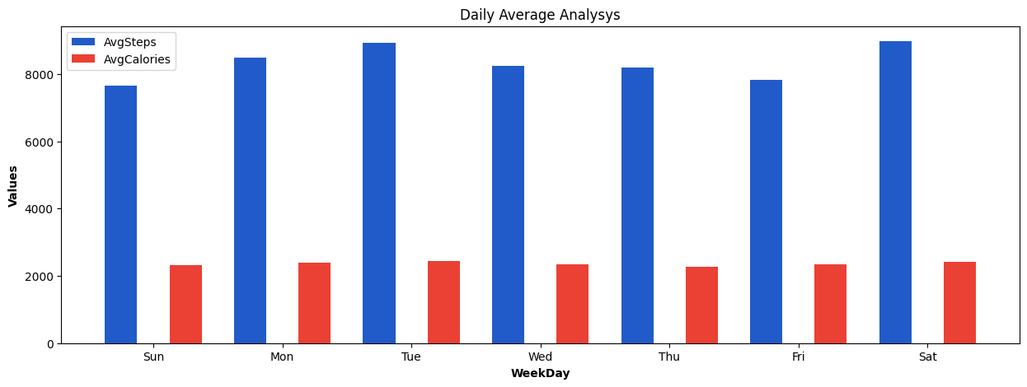
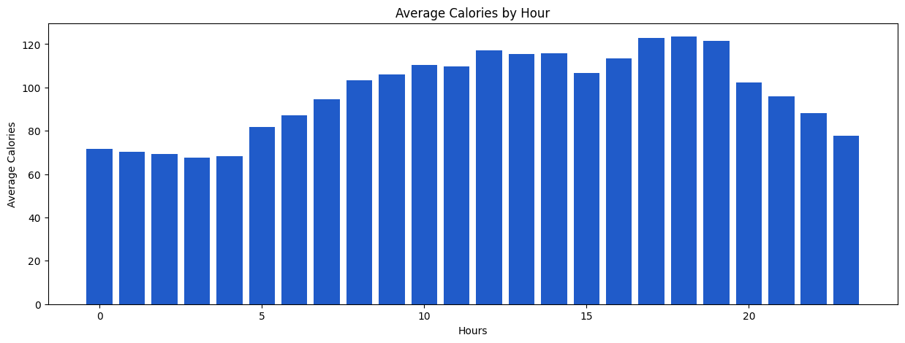
1. Daily Average Analysis
With this analysis we want to calculate, for each day, the average values for the main metrics:
Average steps
Average distance
Average calories (burned)
Our findings suggest that while there isn’t much difference in activity levels for different days of the week, users are most active from 8:00 to 19:00, with a clear peak at 17:00, 18:00 and 19:00.

Slide 6
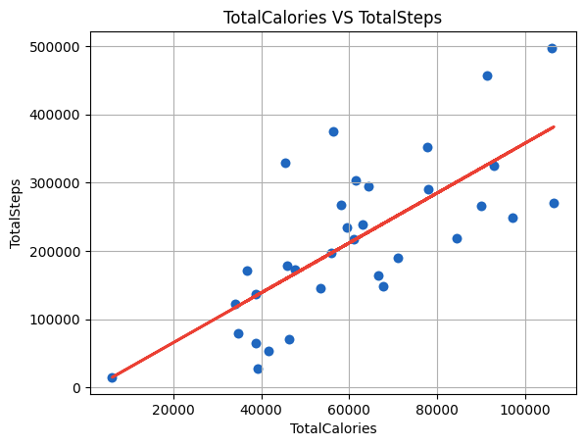
2. Different Metrics Comparison
With this analysis our aim was to calculate the duration of each activity and number of calories burned for every user
The following chart shows how as the steps increase the number of calories burned also increases.
Note that the total steps vary significantly across users, ranging from 12000 to 500000, indicating diverse levels of physical activity among users.

Slide 7
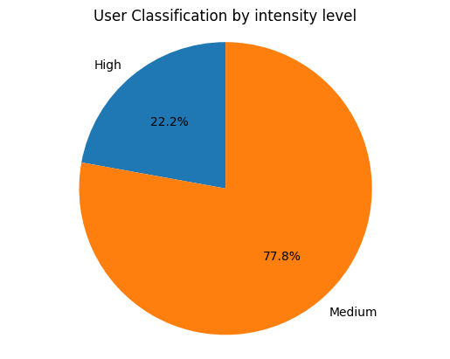
3. Users classification By Intensity Levels
In this analysis we aim to classify users based on their activity level, by analyzing the intensity of physical activities and correlate it with other metrics like steps, distance, and calories burned. To do so we are using METs, which are a measure of the energy expenditure of physical activities.
Here's how we segmented our user base:
Low Intensity, users in this group has an average METs between 1 and 10.
Medium Intensity, users in this group has an average METs between 11 and 15.
High Intensity users in this group has an average METs higher than 15

Slide 8
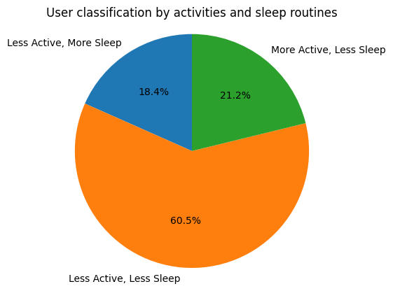
4. Users Classification By Activities & Sleep
In this analysis we are segmenting users based on their activities and sleep routines, in order to identify different user groups with distinct behaviors.
Here’s how we segmented our users:
More Active, More Sleep: Users in this group are both very active and good sleepers, as evidenced by a higher average step count and high minutes in bed.
More Active, Less Sleep: Users in this group are very active, as evidenced by a higher average step count, but they have a relatively shorter average sleep duration.
Less Active, Less Sleep: Users in this group have lower average steps, indicating a less active lifestyle. They also have a shorter average sleep duration.
Less Active, More Sleep: This group has lower average steps but a longer and presumably better sleep duration.

Slide 9
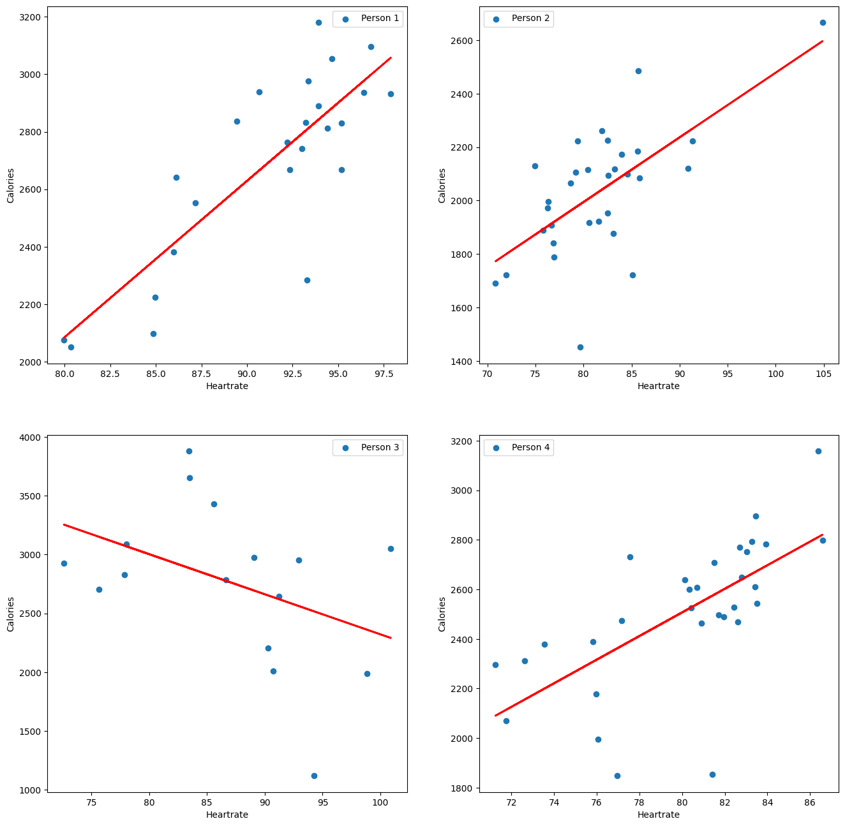
5. Heartrate & Calories
This analysis is aimed at finding a correlation between heartrate and calorie consumption.
We can see from the graphs that while all users present a positive correlation between calorie consumption and a high heartrate, one of our sample users does not.
In fact, it seems they consumed more calories while maintaining a lower heartrate.
By comparing the user’s activities, we can note that this user prefers low intensity exercise and that they burn the most calories doing low intensity activities.
This suggests that not all individuals respond the same way to the same workout.

Slide 10
Conclusions
These are the patterns we discovered by analyzing our FitBit dataset:
Daily Activity
Users tend to be more active during the morning and early afternoon, with a peak in steps between 8:00 AM and 7:00 PM.
The distribution of the main metrics such as steps, distance, and calories burned varies over time.
Users Classification by Intensity Level
Users were classified into intensity levels based on the average METs, finding as "Medium Intensity" the most popular among the users.
METs distribution provided insights into the range of activity intensities recorded by the devices.
Users Classification by Activites And Sleep Routines
Users were classified based on their activity and sleep routines. The segments include: "Less Active, Less Sleep" (most popular among our users), "Less Active, More Sleep", "More Active, More Sleep”, "More Active, Less Sleep",
Analysis of the correlation between sleep metrics and calories burned pointed the variations in sleep duration and calorie expenditure during activities.
Heartrate and Calories
In some individuals, high heartrate does not always mean higher calorie consumption. We should strive to recommend tailored training for each user, based on their own metabolism, to maximize calorie expenditure.

