Slide 1
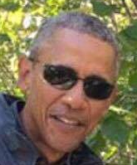
Presidential Speech Generator By Alex Lassalle, Josh Pikovsky, Tim Contois
Dataset: 750,000 words of Obama speeches
Method: n-gram Markov model with minor templating
No topic: “Hello. Please have a seat. You see, in a fair shot at success. The truth is, the debate becomes more urgent. No debate is the example of what seems possible. For the fact that we’re extracting natural gas is just another sovereign nation, but our eyes fixed on the drilling rig, we were able to pass a budget, we forged a lasting partnership with people who don't have to tell Congress it's time for change both large and small, across this country, we’ve navigated tougher times before. Thank you!”
Foreign Policy: “Thank you, everybody. In fact, they helped develop many of the Islamic Republic of Iran, which saw its strategic position strengthened by the Russian people -- innocent, hardworking Americans to terrorism at the time it was first notified of this great nation. God bless you. God bless America.”

