Slide 1
Tim Text Gen 1
By
Alex Lassalle, Tim Contois, and Joshua Pikovsky

Slide 2
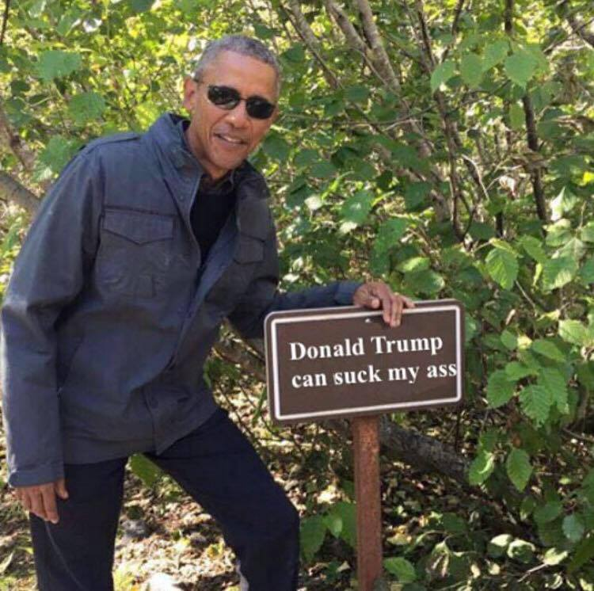
Tim Text Gen
Obama quote:

