Slide 1
Starting a State Government
Open Source Project
  “Officers of government are trustees and servants of the
  people and it is in the public interest to enable any person
  to review and criticize their decisions even though such
  examination may cause inconvenience or embarrassment.” 1 V.S.A. § 315
  Tom Cort <tom.cort@state.vt.us>
  Systems Developer II
  Vermont Department of Taxes

Slide 2

What is Open Source Software?
Free Redistribution
Source Code
Derived Works
Integrity of The Author's Source Code
No Discrimination Against Persons or Groups
No Discrimination Against Fields of Endeavor
Distribution of License
License Must Not Be Specific to a Product
License Must Not Restrict Other Software
License Must Be Technology-Neutral

Slide 3
What is State Government Software?
Software that could potentially be released as open source.
Developed and maintained “in house” by one or more state agencies or departments.
Developed and maintained by state employees or state contractors
Used by one or more state agencies or departments.
“Owned” by the state (no 3rd party copyright / patent claims).
Development and maintenance funded with public money (taxes).

Slide 4
What is the Gateway Project?
Implements Streamlined Sales Tax web services.
Provides a web interface.
Provides client applications.
Designed to be an extensible framework upon which future tax software can be built.
Modernized eFile (MeF) coming soon!
Project Website: http://gateway.sf.net/

Slide 5
Where to begin
Like IT infrastructure changes, development process changes are usually rolled out gradually.
Be realistic about expectations.
Start out small with one project and see how it goes.
Some people may have never heard of OSS. How you handle this will influence how they think and feel about open source software.
Educate everyone on the team about what open source is and what it means. See ProducingOSS.com for a free eBook.
Try to get at least one person on the project team who has open source experience.
Be prepared for skepticism and criticism.

Slide 6
What kind of project makes a good candidate for open source?
Not written in a proprietary language like VB.net. Do compilers exist for GNU/Linux?
Does not depend solely on proprietary tools like Visual Studio. Can it be developed and built with open source tools?
Does not depend on proprietary libraries. Are all the dependencies open source?
Does not depend on proprietary software to run. Are there any closed databases or closed apps that are needed to run the software?
Generally useful. Would at least 3 other people find some or all of the software useful?

Slide 7
In the beginning...
Gateway started out as a closed source application.
Built using open source tools (subversion, eclipse, apache axis, saxon, mysql, etc).
Small development team.
Rumors that one day the code might be open.

Slide 8
Getting approval vs just do it
You can either ask management for permission to release the code as open source software or you can just release it on your own and hope no one gets mad or fires you.
Both ways work!
Getting formal approval is best for business critical applications.
Just releasing the code is best for “one off” projects and patches.
The gateway was approved by management.

Slide 9
Arguments for the Gateway
Cost - It takes very little effort and doesn't cost the state anything to publish the source code, we use a free service called Source Forge. If we receive source code contributions from outside developers it will actually result in a savings because the contributed code is code that Vermont didn't have to pay developers to write.

Slide 10
Arguments for the Gateway
To be a good Neighbor - Many states are implementing Streamlined Sales Tax and other XML-based electronic return systems. Sharing the code with fellow states would be a nice thing to do because it helps them accomplish their goals while reducing their costs. Additionally, other Vermont agencies and departments could adapt and enhance the code to meet their needs.

Slide 11
Arguments for the Gateway
Education - Vermonters who are studying Java software development could learn by studying our code. Our code has a lot of interesting pieces in it that aren't directly related to taxes (our event logging system, authentication system, unit test setup, etc). Developers of open source software could legally copy and use the code in their projects.

Slide 12
Arguments for the Gateway
Better Software - With more people using our code and more developers looking at our code, bugs would be more easily spotted and fixed. Sharing the code with the transmitters who send us data allows them to test changes to their software and debug problems more easily. They could examine exactly what our code does with their input and setup their own private testing environment.

Slide 13
Security Concerns
Open source code means anyone can download, inspect, and test your software for security vulnerabilities.
Anyone could help you fix a problem and anyone could exploit a problem.
Both closed source and open source applications have security holes that can be found and exploited by anyone.
IMHO, neither methodology is “better” or more secure. Always code with security in mind.
If the software is internet accessible, think about
what data lives on that server.

Slide 14
Security Disclosure Policy
Decide on what your security disclosure policy will be before you find out about a security issue.
Full Disclosure
Full Disclosure with Patch
Staggered Disclosure
Limited Disclosure
Silent Fix

Slide 15
Choosing a license
Open Source Initiative http://OpenSource.org
Free Software Foundation
http://www.fsf.org/licensing/licenses/index_html
Read all of the licenses!
Figure out what you want the license to do (copyleft or not, notice files or not, GPL compatible or not, etc).
Look at what other like software uses for its license. (Example, Java usually is Apache 2.0)
Stop license proliferation, choose an existing license that meets your criteria.
Don’t start a war over the license.

Slide 16
Determine copyright information
Find out the exact text to use for the copyright line.
“Vermont”, “State of Vermont”, “VT Tax Dept” or “Vermont Department of Taxes”
Usually the website for your department or agency has a copyright message you can copy.
Decide if contributors must assign copyright or make a written statement that his/her contributions are legal.

Slide 17
Choosing a development model
How will you deal with outside contributors?
Core team
Committers and contributors
Voting/Polling
Benevolent Dictator
Define your own?
Document this for later. It is important that external devs know how to submit patches. Enable Participation!

Slide 18
Preparing the source code
Read every line of code.
Make sure there is a copyright header in every source file.
Make sure no passwords, private keys, host names, or other private/semi-private information exists in the code.
Make sure the code looks good (non-vulgar comments, indentation, no ugly hacks, etc)
Tip: use svn:externals in subversion to allow you to keep a set of private configuration and password files.

Slide 19
Version Numbering
A lot of numbering schemes exist.
Single number: udev-115
Major, Minor: gateway-3.0
A.B.C[.D]: linux-2.6.22.6
The exact scheme doesn’t matter
Pick one that you’ll stick to
Document the scheme on your download page
Make it clear what code is production ready and what is beta/alpha/rc.

Slide 20
Preparing the documentation
Must explain what the software is and what it does.
Must describe how to install and run the software.
Must explain how to build from source.
If possible, it should describe the source code (javadoc, doxygen).
Is best with screen shots, commands, and examples.

Slide 21
Preparing the website
You need a website!
Should include all documentation.
An FAQ to answer repeat questions.
A download page so people can get the software.
Project News so people know what’s happening.
A project road map so people know what’s going to happen.
A guide for people interested in contributing.
Links to other project resources (bug tracker, continuous integration, mailing lists, svn/cvs).
A clear point of contact for discussion, getting help/support, suggesting features/improvements and reporting bugs.

Slide 22
Preparing other services
IRC – chat room. May not be the best idea for state employees to be chatting. See Freenode.net
Mailing lists. Make sure all project members are subscribed and read the incoming mail.
Source control. Educate all of the developers on the best practices and common features. All developers should know how to add code, remove code, create a patch, apply a patch, revert a change, create a branch, merge code from two branches, and resolve a merge conflict.
Wiki. Be careful that it isn’t interpreted as the official
word of the state. Watch out for spam.

Slide 23
Preparing the first release
Make sure your copy of the code is up to date.
Make sure the documentation is up to date.
Create a source package with all of the source code.
Optionally create 1 or more binary packages.
Packages should be in standard formats (no 7z please). Windows installer should be .exe or .msi. Linux packages should be .rpm, .deb, .ebuild, etc. Linux sources should be .tar.gz or .tar.bz2. Windows sources should be .zip.
Test the software packages you just made and the documentation before uploading them.

Slide 24
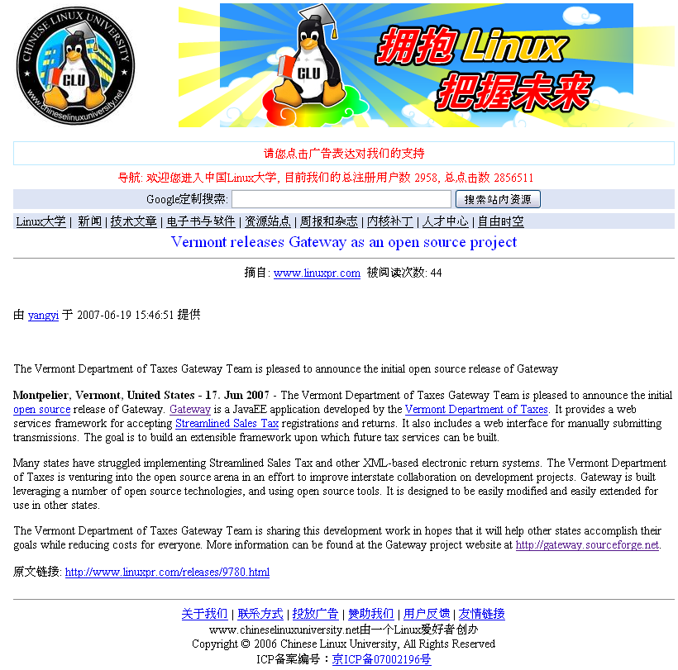
Write a Press Release
Get the word out to potential users and the general public.
http://gateway.sourceforge.net/local/GatewayInitialOpenSourceRelease.pdf

Slide 25
Finding a Project Hosting Provider
4 Options: current agency/dept website, self-managed infrastructure, canned OSS hosting, custom OSS hosting.
current agency/dept website is usually too limited or requires too much paper work to get setup.
self-managed infrastructure requires hardware and someone with enough time to maintain it.
canned hosting is free and gives you complete control over everything you need to run a project.
custom OSS hosting can be hard to get, but its much more flexible than the canned stuff.

Slide 26
Free Canned OSS Hosting
Source Forge - sourceforge.net
Savannah - savannah.nongnu.org
Gna! - gna.org
berliOS - berlios.de

Slide 27
Custom OSS Hosting
OSU Open Source Lab - osuosl.org
Universities with open source friendly admins.
Linux/Unix User Groups

Slide 28
Being a good community member
Report bugs and submit patches to other projects.
Join mailing lists and help people.
Develop in the open.
Acknowledge contributors and developers when they contribute. Add a note in the change log and commit log, thank them by e-mail or on a public mailing list, thank users for submitting bug reports, etc.

Slide 29
Implementing Open Standards
A standard exists for just about everything, you just have to look.
Search for standards before implementing new storage or data transfer functionality. IETF RFCs, ISO, ANSI, OASIS, etc.
Choose only open standards.
Implement all required parts of the standard correctly.

Slide 30
Donating Money to OSS Projects
Hard to get funding to pay for something that’s free.
FSF Associate Membership - http://member.fsf.org
OSU Rackathon - http://osuosl.org/contribute/rackathon
SF.net Subscription - http://sourceforge.net/subscribe/
Donating to a specific project.

Slide 31
Impressions and Surprises
Easier than expected to get upper level management on board.
Harder than expected to get other states involved.
We haven’t gotten a single patch, bug report, feature request or mailing list message from anyone outside the VT Tax Dept.
We got a lot of encouragement from the open source community and the tax community.
Enables state employees to work from home.
Many open source libraries lack complete documentation.
Being able to view source code helps.

Slide 32
Gateway Demo

Slide 33
Questions/Comments?
Gateway Project Website
http://gateway.sourceforge.net/
Gateway Demo Site
http://gateway-demo.osuosl.org/
Vermont Department of Taxes
http://tax.vermont.gov/

