Slide 1
Sprint 3 Demo

Slide 2
New Functionality
Displays a plain text HTML
Retrieves HTML via
  NetInf Node, i.e. the NRS
  Phone (Bluetooth)
  Database
Publishes BO after retrieving a HTML
Searches for HTML through keywords

Slide 3
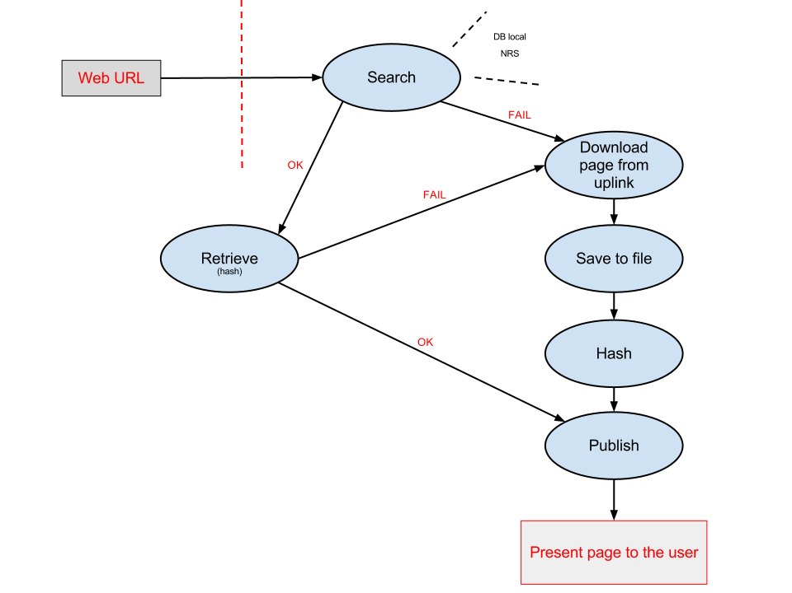
Application Flow

Slide 4
Search Flow
User requests a HTML using a URL
Checks for Local Resolution Service
Checks for Name Resolution Service
→ If search failed: Retrieve from up-link

Slide 5
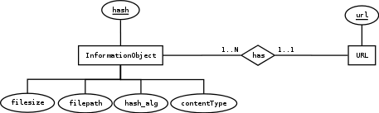
Database Design

