Slide 1


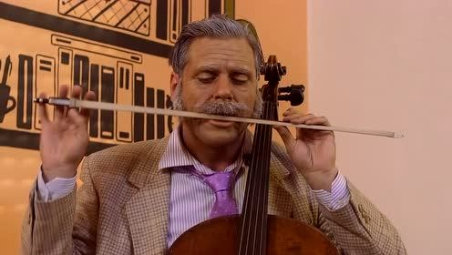
${Min f(x)}_{ }={(x_{1}−2)}^{2}+{(x_{2}−3)}^{4}+{(x_{3}−1)}^{2}+3$

Slide 2




${Min f(x)}_{ }={(x_{1}−2)}^{2}+{(x_{2}−3)}^{4}+{(x_{3}−1)}^{2}+3$
$$f(x)$$
2
2
1
$$4$$
1
3
4
$$13$$
5
3
3
$$16$$

Slide 3
${Min f(x)}_{ }={(x_{1}−2)}^{2}+{(x_{2}−3)}^{4}+{(x_{3}−1)}^{2}+3$
$$f(x)$$
2
2
1
$$4$$
1
3
4
$$13$$
5
3
3
$$16$$

Slide 4
${Min f(x)}_{ }={(x_{1}−2)}^{2}+{(x_{2}−3)}^{4}+{(x_{3}−1)}^{2}+3$
$$f(x)$$
1

Slide 5
${Min f(x)}_{ }={(x_{1}−2)}^{2}+{(x_{2}−3)}^{4}+{(x_{3}−1)}^{2}+3$
$$f(x)$$
2
2
1
$$4$$
1
3
4
$$13$$
5
3
3
$$16$$

Slide 6
${Min f(x)}_{ }={(x_{1}−2)}^{2}+{(x_{2}−3)}^{4}+{(x_{3}−1)}^{2}+3$
$$f(x)$$
1
2

Slide 7
${Min f(x)}_{ }={(x_{1}−2)}^{2}+{(x_{2}−3)}^{4}+{(x_{3}−1)}^{2}+3$
$$f(x)$$
2
2
1
$$4$$
1
3
4
$$13$$
5
3
3
$$16$$

Slide 8

${Min f(x)}_{ }={(x_{1}−2)}^{2}+{(x_{2}−3)}^{4}+{(x_{3}−1)}^{2}+3$
$$f(x)$$
1
2
3
$$9$$

Slide 9


${Min f(x)}_{ }={(x_{1}−2)}^{2}+{(x_{2}−3)}^{4}+{(x_{3}−1)}^{2}+3$
$$f(x)$$
2
2
1
$$4$$
1
3
4
$$13$$
1
2
3
$$9$$

Slide 10

${Min f(x)}_{ }={(x_{1}−2)}^{2}+{(x_{2}−3)}^{4}+{(x_{3}−1)}^{2}+3$
$$f(x)$$
1
2
3
$$4$$
+1
+1
-1

Slide 11

${Min f(x)}_{ }={(x_{1}−2)}^{2}+{(x_{2}−3)}^{4}+{(x_{3}−1)}^{2}+3$
$$f(x)$$
2
2
1
$$4$$
1
3
4
$$13$$
2
3
2
$$4$$

Slide 12

${Min f(x)}_{ }={(x_{1}−2)}^{2}+{(x_{2}−3)}^{4}+{(x_{3}−1)}^{2}+3$
$$f(x)$$
2
2
1
$$4$$
2
3
1
$$3$$
2
3
2
$$4$$

