Slide 1
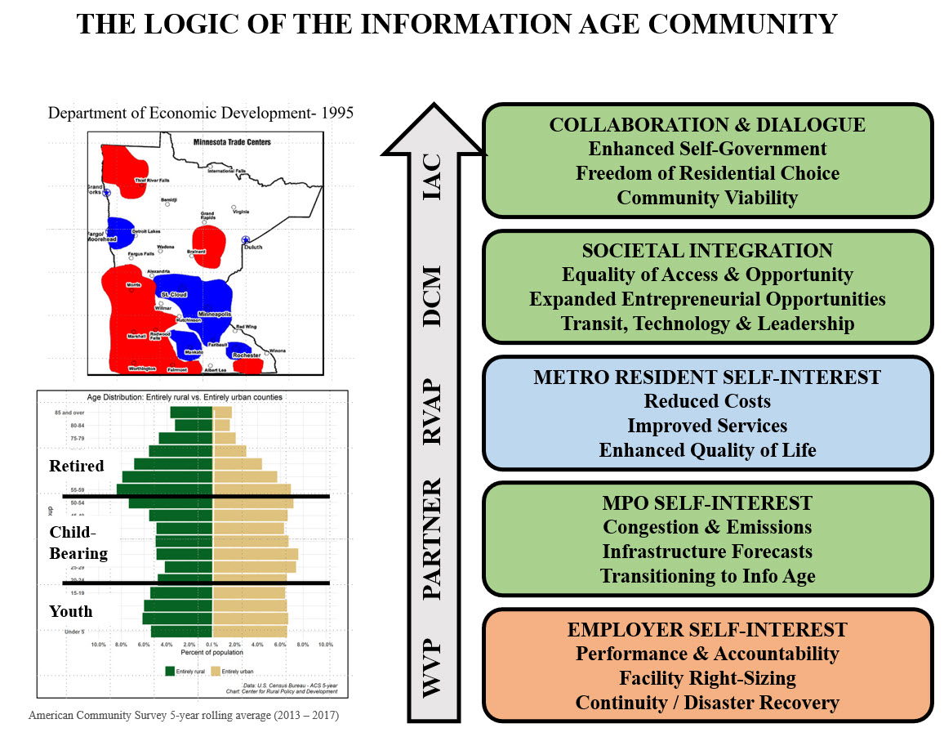
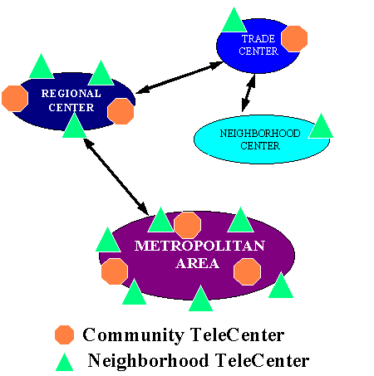
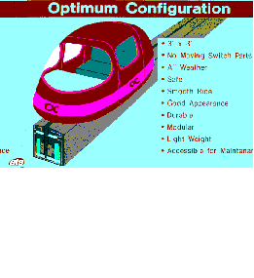
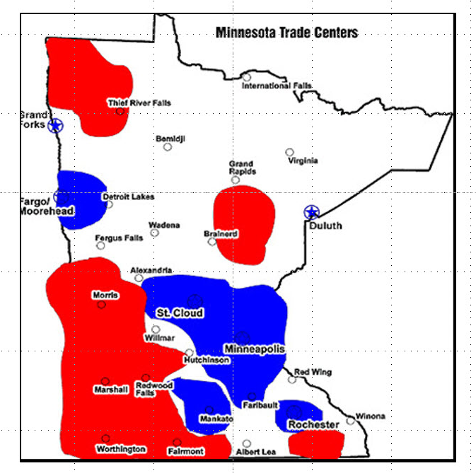
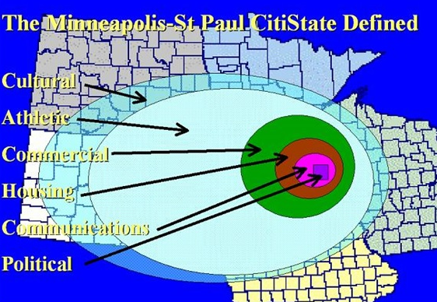
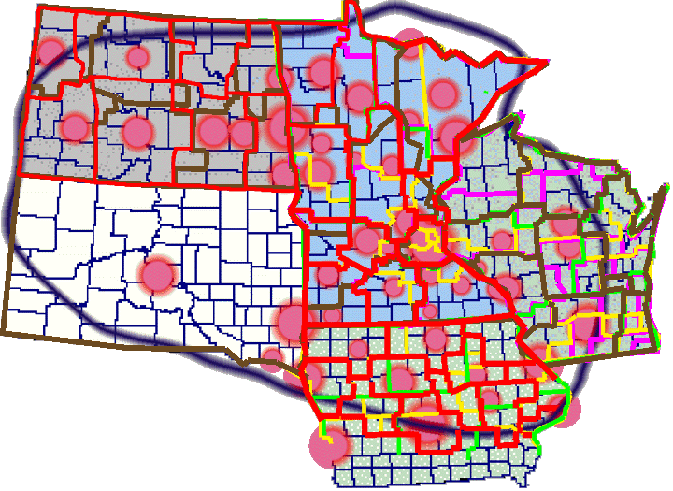
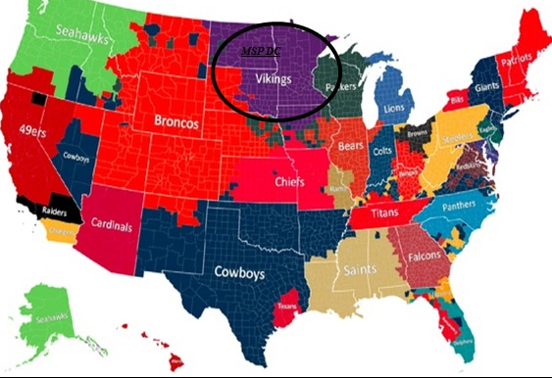
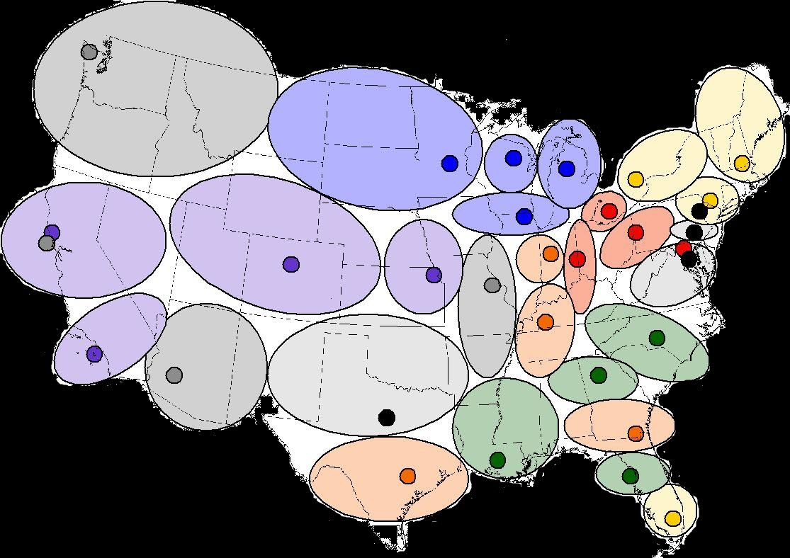
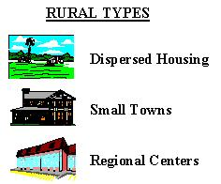
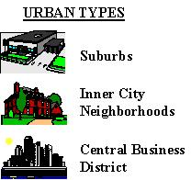
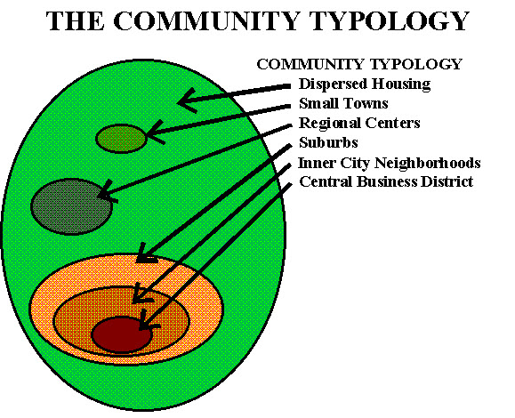
THE INFORMATION AGE COMMUNITY
A 30 Year Planning and Implementation Evolution
1995 MN Report
ThE PLAN
Beginning with a Basic Demographic Problem…
…applying Socio-economic data to define the “Community”!
Focus on Thousands of Jurisdictions or six Community Lifestyles?
And Ultimately, A National Prototype!
Revitalizing Small Town America
© Tele-Commuter Resources, Inc August, 2026

Slide 2
THE BUSH FOUNDATION’S GOAL
Support community-driven ideas
that change underlying systems —not just symptoms—
Create lasting, scalable improvements across the region.
Transform systems: address root causes and change how opportunities and outcomes are produced.
Build from community ownership: involve the people affected and create strong, collaborative solutions.
Create lasting, expandable impact: support ideas that can grow, spread, and make the region better for everyone.
Revitalizing Small Town America
© Tele-Commuter Resources, Inc August, 2026

Slide 3
The
FUNDAMENTAL ISSUE
How Can Society provide
Equitability for all Living Environments?
(TCR Doesn’t Believe Silos can Provide it!)
Revitalizing Small Town America
© Tele-Commuter Resources, Inc August, 2026

Slide 4
COLLABORATION?
Catalyst?
BUSH vs. ESMC?
Revitalizing Small Town America
© Tele-Commuter Resources, Inc August, 2026

Slide 5
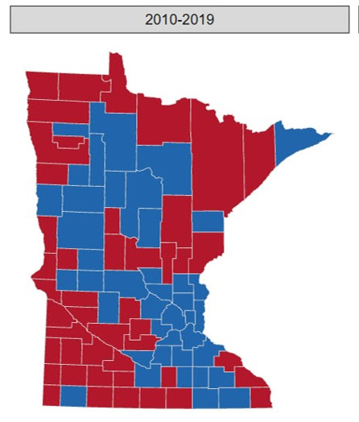
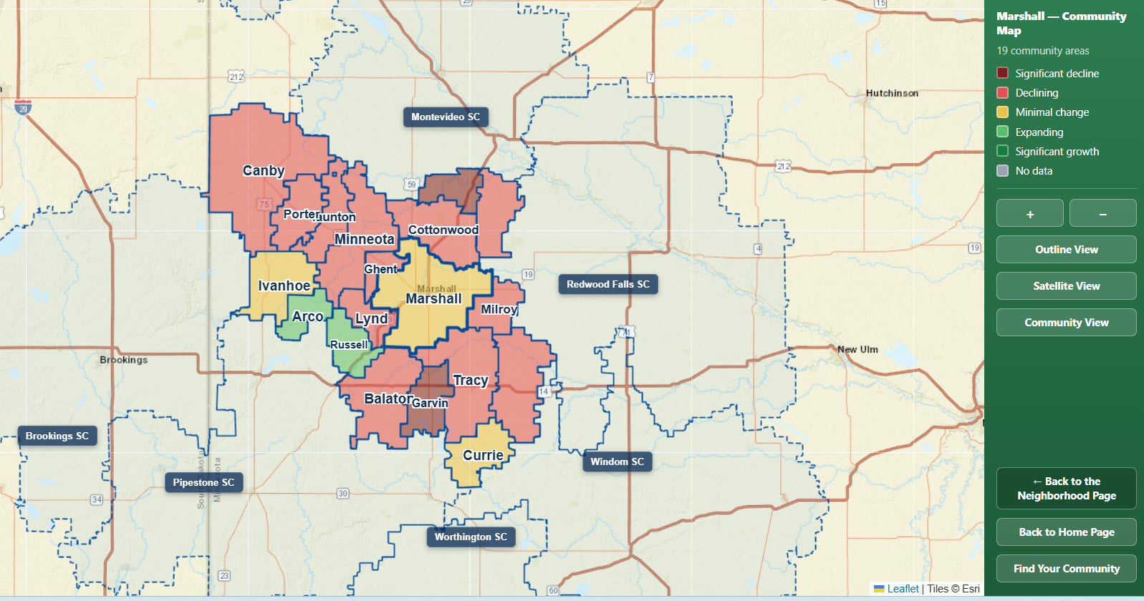
1. UNDERSTANDING REALITY
The Viability Index and its Geo Structure focus on understanding community at the zip code level and provides the tools to apply the information at three levels: Community, Project and Customized Analysis.
Revitalizing Small Town America
© Tele-Commuter Resources, Inc August, 2026
Discuss the Viability Index

Slide 6
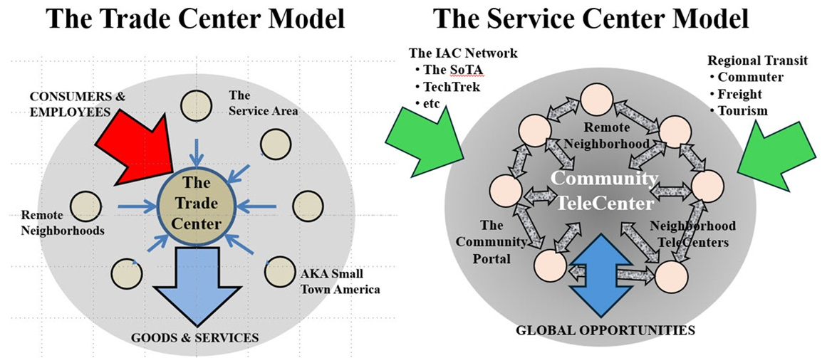
2. REFINING THE COMMUNITY HIERARCHY
THE TRADE CENTER MODEL THE COMMUNITY MODEL
Revitalizing Small Town America
© Tele-Commuter Resources, Inc August, 2026
Discuss Service Access

Slide 7
2. REFINING THE COMMUNITY HIERARCHY
__________THE IAC / Global Service Center Center
___________The Service Anchors
_____________The Service Centers
______________The Community
______________The Neighborhood
_______________Dispersed Housing
This is simply shifting from the political structure established by the pioneer surveyors to that of a the human relationships already established by the multiple market perspectives existent in every community.
Revitalizing Small Town America
© Tele-Commuter Resources, Inc August, 2026
Discuss the Database

Slide 8
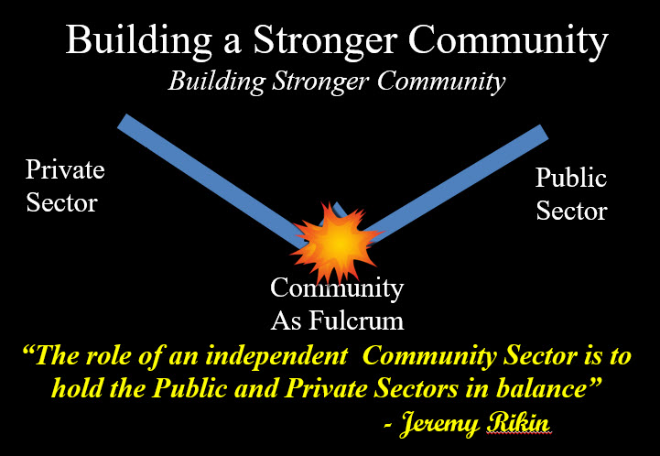
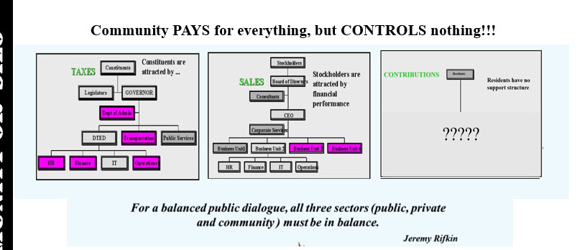
3. RESTORING THE COMMUNITY VOICE
INSTITUTIONAL CONFIDENCE *
Small Business 67%
Health Care 36%
Religion 32%
Banks 27%
Large Tech 20%
Presidency 19%
Media 16%
Courts 12%
Congress 8%
The Community Sector Pays For Everything But Has No Power Over Anything
* Gallup’s Annual Tracking Trends king Trends
Revitalizing Small Town America
© Tele-Commuter Resources, Inc August, 2026
Discuss the e-Consensus

Slide 9
4. DEPLOYING STRATEGIC INVESTMENTS
Agency & Foundation Approach
Budgeting for Community Results
Select their Special Interest
Determine Qualification Requirements
Determine Selection Criteria
Release an RFP ( Request for Proposal)
Award the Grants
Manage Grant Compliance
Publish Results-- Maybe
Annual Consensus Budgeting Cycle
E-Consensus Prioritizes the Issues
Viability Index Evaluates Top Priority Issues
Perform a CIA (Community Impact Analysis)*
Viability Index identifies those affected- form a Task Force
Apply e-Consensus, AI and Viability Index to reveal causes / sources of the problem
Fund the project via the Funding Collaborative
Develop a Workplan with the IAC Collaboratives including scaling it to variously impacted communities
Execute the plan
Facilitate Solution Implementation
Monitor Results with Viability Index
* THE COMMUNITY IMPACT ANALYSIS - uses the Viability Index to find common problems and common opportunities the solution of which would impact the greatest number of communities. The IAC provides the market-area intelligence, comparison, scale, and coordination needed to act where the opportunity or problem crosses local boundaries.
Revitalizing Small Town America
© Tele-Commuter Resources, Inc August, 2026

Slide 10
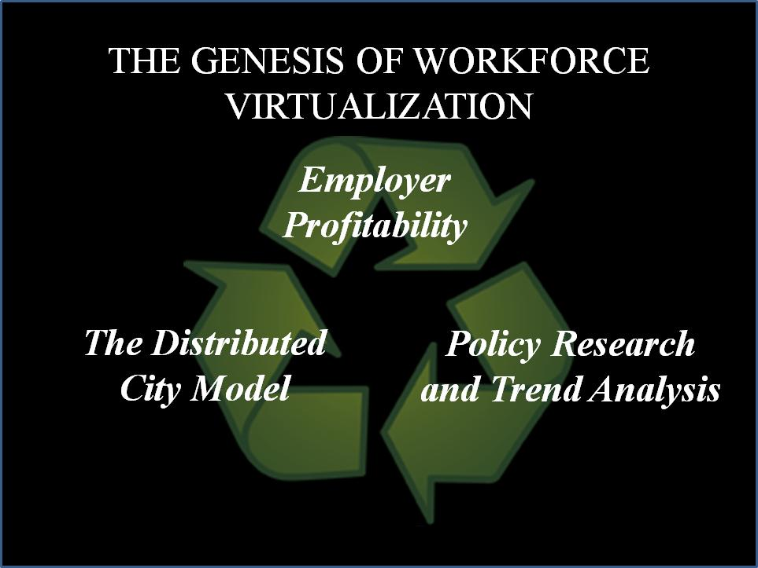
5. TELEWORK- THE FIRST VIRTUALIZATION
As part of Tele-Commuter Resources’ Information Age Community project , the WVP supports the Community, the Public and the Private Sector.
Revitalizing Small Town America
© Tele-Commuter Resources, Inc August, 2026
Discuss the WVP

Slide 11
6. THE SYNERGY OF TCR’S TOOLS
Leadership
Governance
Visioning
Visioning
Viability
Visioning
Reality Check
THE IAC
Strategic Direction
TeleCenters
Alliance
TeleCenters
Citizen Awareness
Physical Support
E-Consensus
Transit
Call to Action
Physical Connectivity
Workforce
The Lens
Relocation
Virtual Connectivity
Revitalizing Small Town America
© Tele-Commuter Resources, Inc August, 2026
Load the LENS

Slide 12

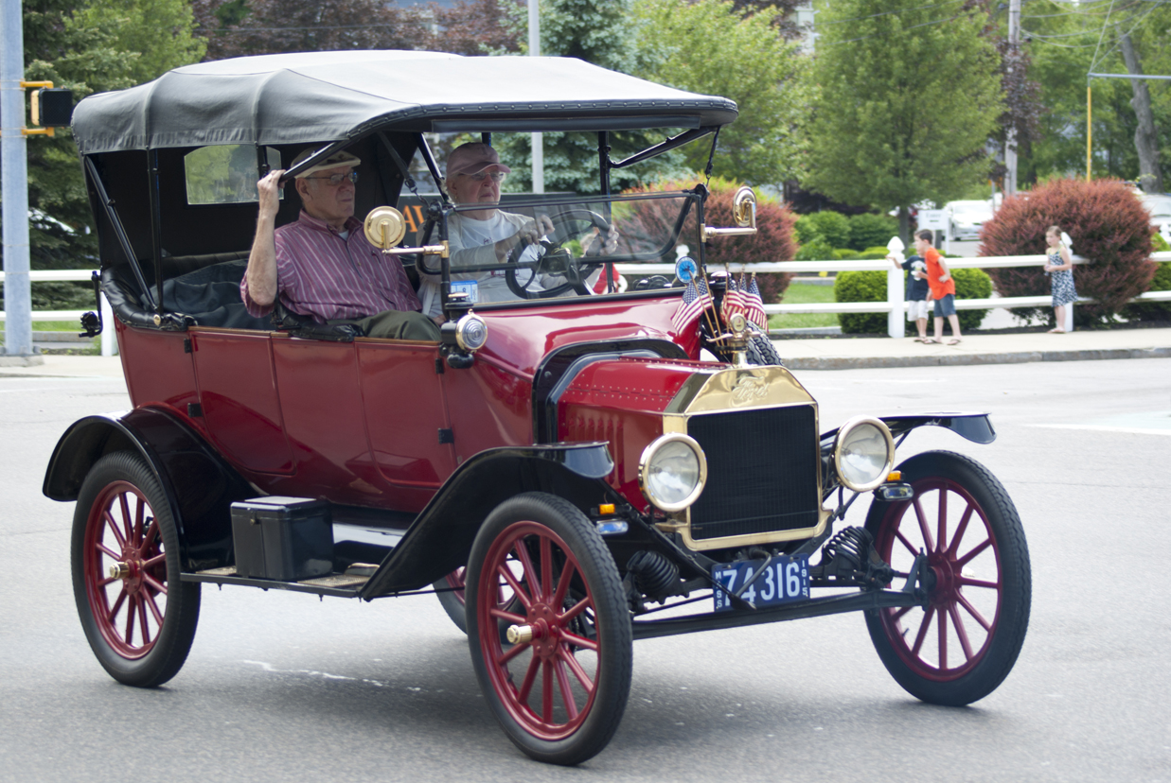
A. REFINING THE COMMUNITY HIERARCHY
Virtually or Physically, the Communities must have access to equitable services. Every Community has a TeleCenter / Lens to supplement the local with the virtual service.
SERVICE NEGOTIATION
GLOBAL
Service Center
Service Center
THE IAC
COMMUNITY
Revitalizing Small Town America
© Tele-Commuter Resources, Inc August, 2026
Back To Presentation
This Photo by Unknown Author is licensed under CC BY-NC-ND

Slide 13
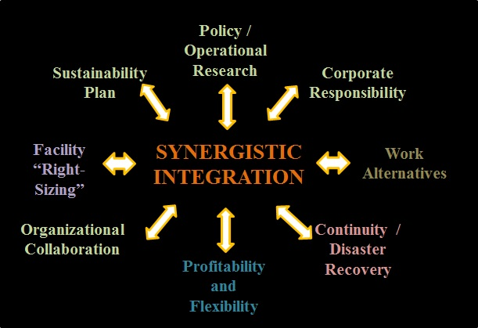
A. HYBRID SOLUTION- PLAN & IMPLEMENT Implement
All Sectors rely on silos, but TCR believes they are inefficient, ineffective and counterproductive. Accordingly, the WVP integrates ALL organizational stakeholders/departments to maximize fiscal and operational outcomes
Revitalizing Small Town America
© Tele-Commuter Resources, Inc August, 2026

Slide 14
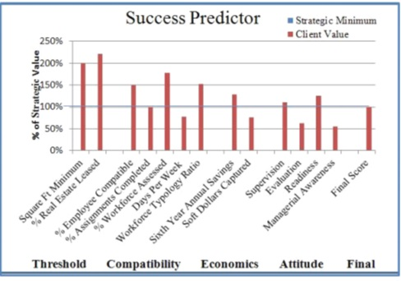
B. STRATEGIC- NOT AD HOC
After fifty years of telework, we still have no standards, no policy database no nothing.
Employers retain their legacy investments, fail to adequately develop a virtual culture or to create a comprehensive evaluation process.
THE WVP is designed to right-size facilities, enhance fiscal and operational performance while supporting MPO and Community Needs
Revitalizing Small Town America
© Tele-Commuter Resources, Inc August, 2026

Slide 15
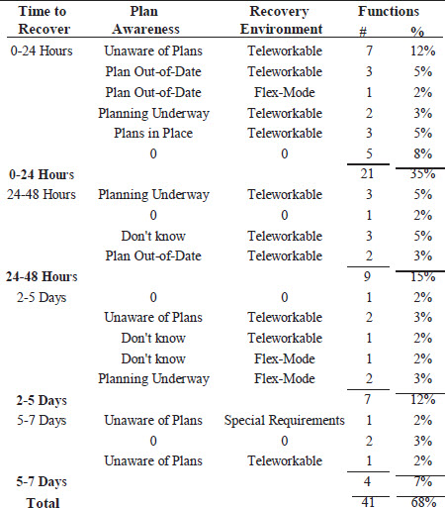
C. CONTINUITY & DISASTER RECOVERY BASED ROI
TCR’s Vulnerability Audit provides support to ensure your continuity workers are outside of the same threat area as their facility
The system is exercised daily
It saves money!, and
It allows continuity workers et.al. to relocate if that is their choice.
TCR’s Feasibility Assessment examines your staff’s awareness of their continuity roles, the requisite recovery environment and how much time they have to recover their activities before the challenge becomes a full-fledged crisis.
Revitalizing Small Town America
© Tele-Commuter Resources, Inc August, 2026
Back To Presentation

Slide 16
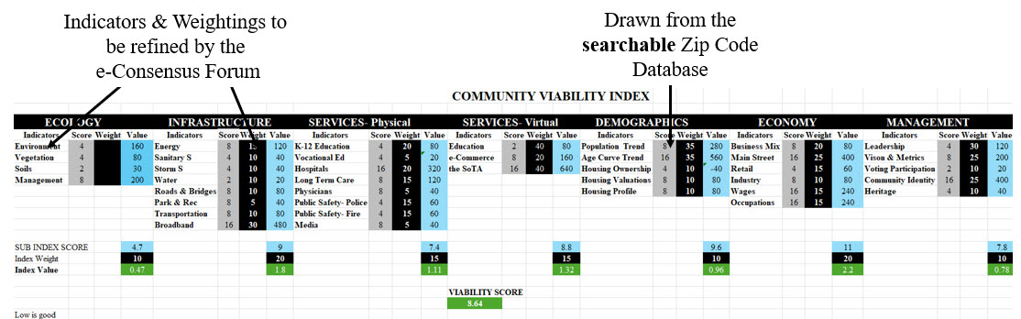
A. THE COMMUNITY WELLNESS AUDIT
Most importantly, the calculator allows the IAC to research common challenges, develop a solution to that condition and distribute it to all affected communities. This approach eliminates the agency / foundation approach of requiring each affected entity to compete for the funds to address a solution exclusively for their entity.
Revitalizing Small Town America
© Tele-Commuter Resources, Inc August, 2026

Slide 17
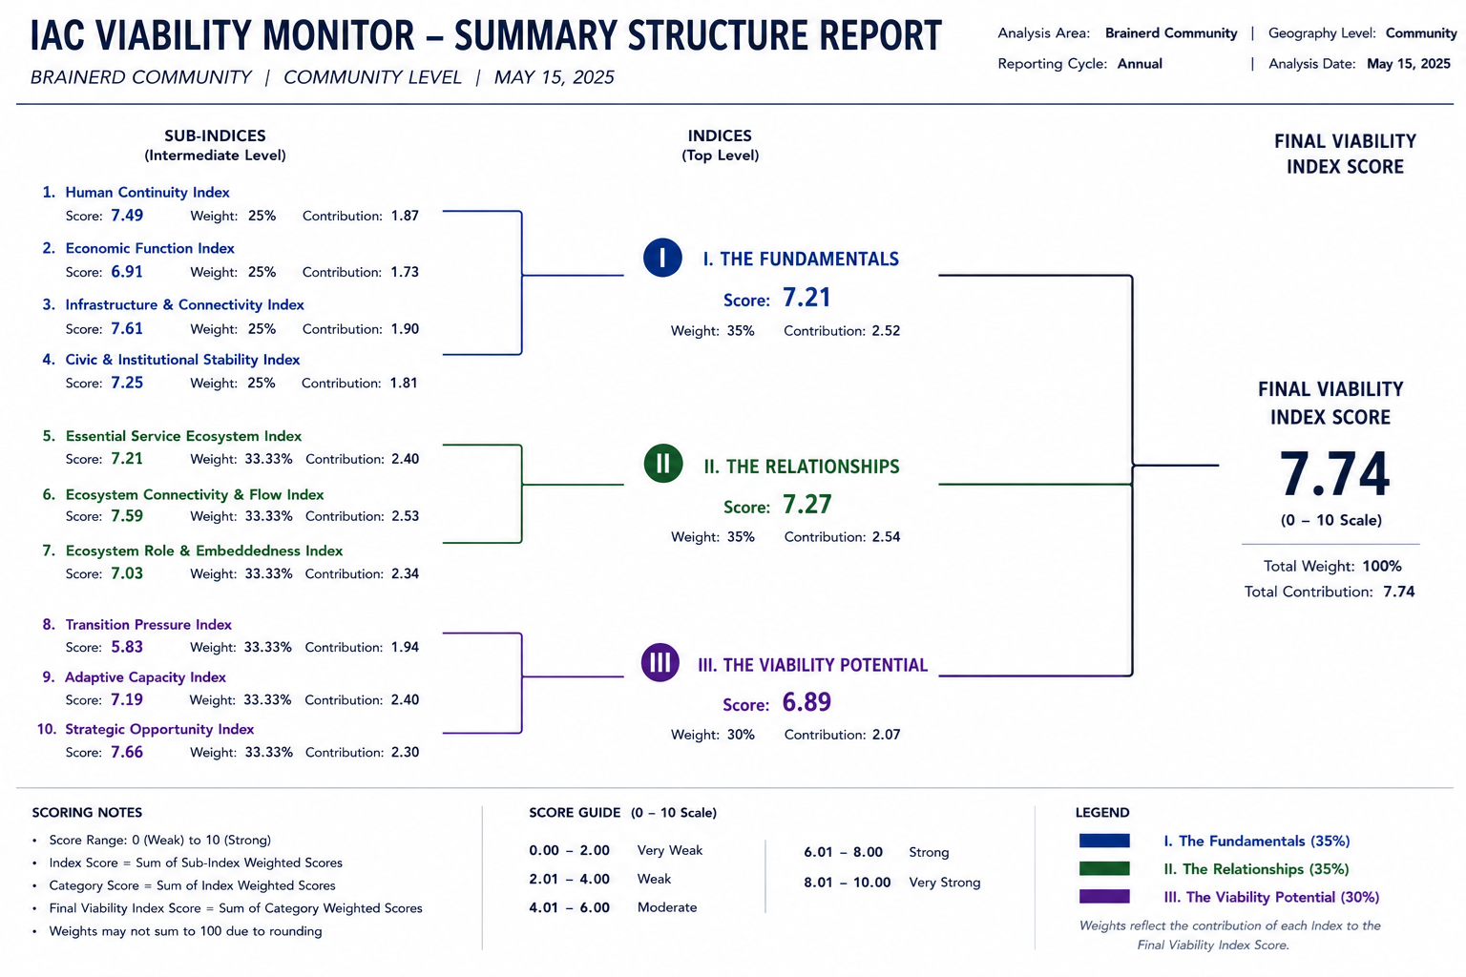
B. STRATEGIC ANALYSIS
THE CALCULATOR
Weighting System- built by e-Consensus,
Values- Researched by Viability Index,
Profiles- Developed by The Lens
Visualization- by Geo-Mapping
Explore the Viability Index
Revitalizing Small Town America
© Tele-Commuter Resources, Inc August, 2026

Slide 18
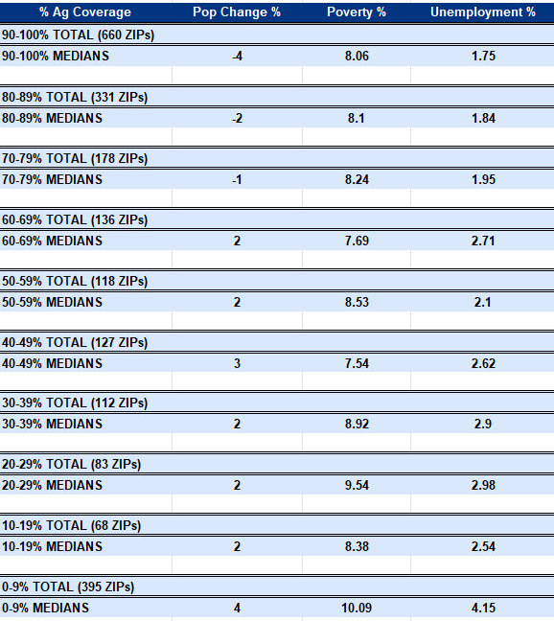
C. DISCOVERING ‘unknown’ PATTERNS
THE MORE AG LAND:
The Higher the Rate of Population Loss
BUT
The Lower the Unemployment Rate, and Maybe the Poverty Rate too
Revitalizing Small Town America
© Tele-Commuter Resources, Inc August, 2026
Back To Presentation

Slide 19
Shows where the community stands across Infrastructure, Services, Environment, Economy, Demographics, and Governance.
Summary Element | Purpose
Condition Summary | Shows where the community stands across Infrastructure, Services, Environment, Economy, Demographics, and Governance.
Strengths and Weaknesses | Identifies the strongest assets and weakest conditions, both locally and across the IAC market area.
Common Opportunities / Problems | Finds patterns shared by multiple ZIPs, Communities, Service Centers, or Major Trade Centers.
Vision Alignment | Tests whether a proposal advances the values, priorities, and long-term direction established through visioning and e-Consensus.
Strategic Fit | Shows whether an investment should be local, Service Center scale, Major Trade Center scale, or IAC-wide.
Action Readiness | Combines facts, confidence, partners, funding potential, and governance readiness to show whether a proposal can move forward.
E. AN AI PROJECT REVIEW
LEADERSHIP AI ENGINE FUNCTIONS RESULT
Submit Project Profile Form
Pulls known facts and puts them in context. Indicator Selection; ZIP Retrieval; Published Indicator; Benchmark; Trend; Map/Service Area; Identity/Context
Who Else Might it Benefit
Identify Synergistic Partners
Finds patterns shared by multiple ZIPs, Communities, Service Centers, or Major Trade Centers
Opportunities
for Leveraging
Define Alternative Scenarios
Tests whether a proposal advances the values, priorities, and long-term direction established through visioning and e-Consensus.
Project Optimizing based upon CIA
Convene Stakeholders
Identifies the strongest assets and weakest conditions, both locally and across the IAC market area.
Engage Partners
Finalize Proposal
Combines facts, confidence, partners, funding potential, and governance readiness to show whether a proposal can move forward.
Commit to Budget etc.
Make Sure Nothing is Missing-
Project Approval and Funding
Shows whether an investment should be local, Service Center scale, Major Trade Center scale, or IAC-wide.
Implement & Monitor
Revitalizing Small Town America
© Tele-Commuter Resources, Inc August, 2026

Slide 20
THE VIABILITY DATA STRUCTURE
CALCULATOR
TRENDS MASTER
CALCULATOR
Zip Code
Year
Value
Searcher Criteria
Weighting Value
Analytic Results
IAC
MASTER
INDICATOR MASTER
RESEARCHERS
Profile Data
Institutional Profile
Vision Statements etc
COMMUNITY MASTER
Source Year
Value
Source & Recurring Data
Profile Data
Institutional Profile
Vision Statements etc
JURISDICTION MASTER
INTERFACES / SUPPORTS
Lens Entity Database
Mapping Routines
Profile Data
Institutional Profile
Vision Statements etc
ZIP CODE MASTER
Coordinates
Landform
Revitalizing Small Town America
© Tele-Commuter Resources, Inc August, 2026
Back To Presentation

Slide 21
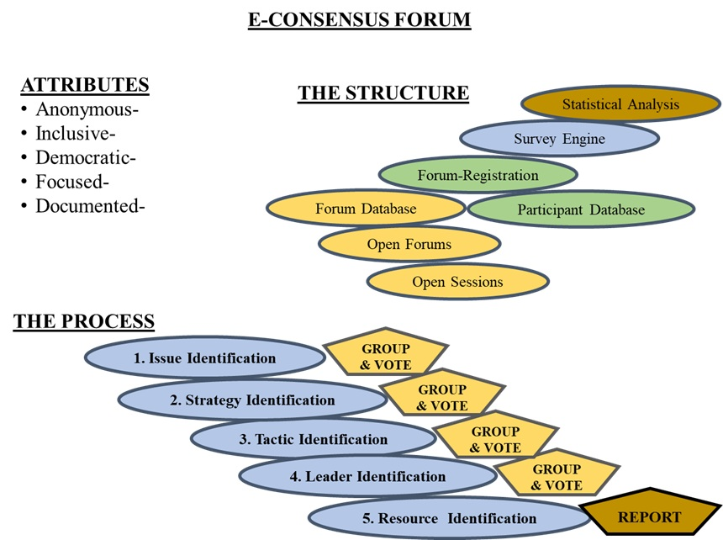
A. RESTORING THE COMMUNITY VOICE
“What does your community need to be viable in the Information Age?”
Community Dialogue Process
3. e-Consensus FORUm
Revitalizing Small Town America
© Tele-Commuter Resources, Inc August, 2026

Slide 22
B. DIALOGUE IN CONTEMPORARY SOCIETY
If I say “A” They will say “B”
The e-Consensus Forum
will find
“C”
(consensus)
3. e-Consensus FORUm
Revitalizing Small Town America
© Tele-Commuter Resources, Inc August, 2026

Slide 23

C. THE UBIQUITOUS e-CONSENSUS FORUM
1- Scheduled
e.g. Board Meetings, etc.
2- Ad Hoc
e.g. Community Concerns, etc.
THE LENS
INTAKE APP
STAFF
MONITOR
E-Consensus Forum
ACTION PLAN
Stakeholders
Citizens
3- Strategic
e.g. Visioning, Policy Development, Consensus Budgeting, Product / Service Specs Project Reviews, etc.
Revitalizing Small Town America
© Tele-Commuter Resources, Inc August, 2026

Slide 24
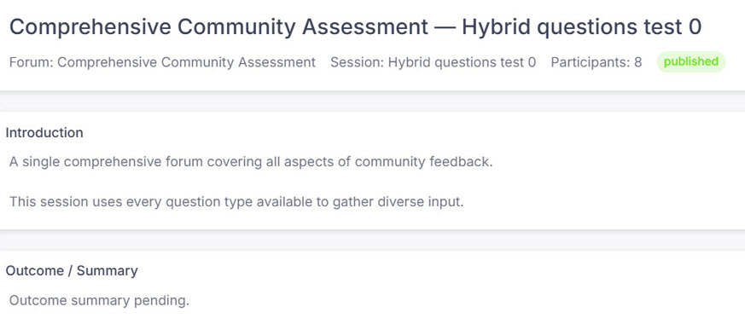
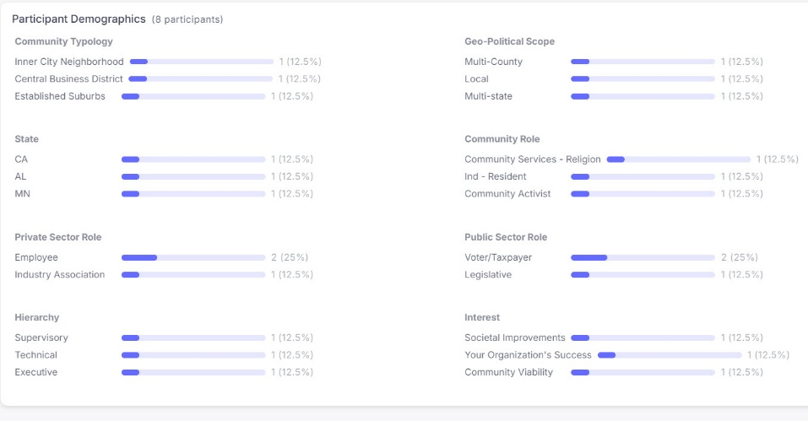
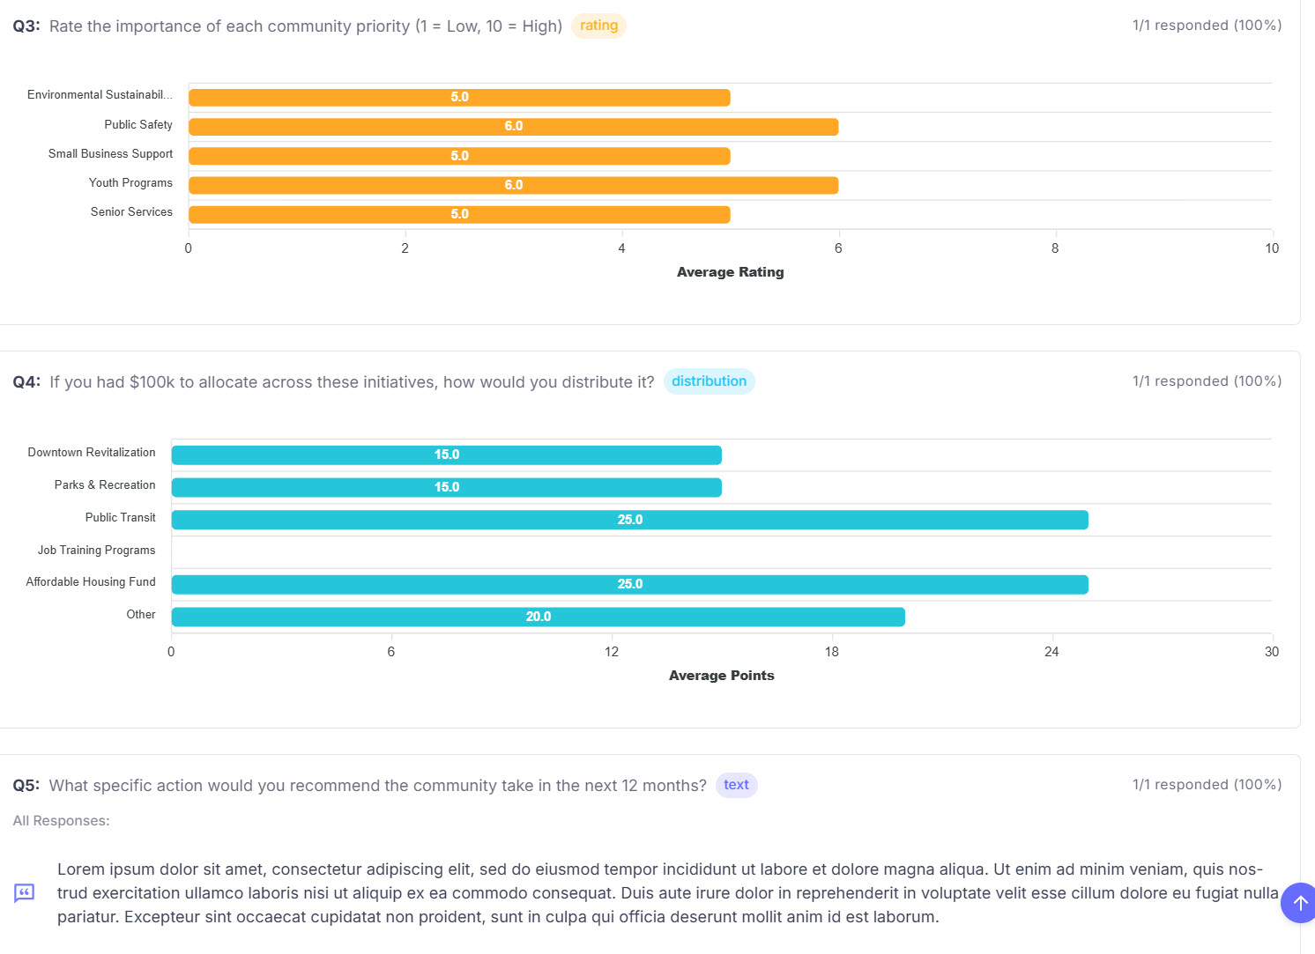
D. THE SESSION REPORT FORMAT
3. e-Consensus FORUm
Revitalizing Small Town America
© Tele-Commuter Resources, Inc August, 2026

Slide 25
E. APPLYING THE e-CONSENSUS FORUM
COLLABORATVIES:
College
Community Formation
Economic Development
Legal
Marketing
Political, and
Funding
Executive Committee
Executive Committee
IAC BOARD:
3 from each Community
(1 from old trade center & 2 from the small towns
COMMUNITY BOARD
3 from Trade Center and 1 from each of the “Neighborhoods”
All Volunteers
All Community First
IAC BOARD
IAC BOARD
TeleCenter Network
Transit Deployment
TeleCenter Network
SoTA Development
Visioning
SoTA Development
Service Center Coordination
Leadership
Service Center Coordination
Service Center
Service Center
Community Committees
Application Management
Distribution
Operations & Recruitment
Services Advisors
Technology
Regional Monitor
TechTrek
Metrix Tracking
Community Board
Sector Appointees
Revitalizing Small Town America
© Tele-Commuter Resources, Inc August, 2026
Back To Presentation

Slide 26
Geo-Structure
Q&A
Revitalizing Small Town America
© Tele-Commuter Resources, Inc August, 2026

Slide 27
The Viability Index
Revitalizing Small Town America
© Tele-Commuter Resources, Inc August, 2026

Slide 28
Viability Index
Q&A
Revitalizing Small Town America
© Tele-Commuter Resources, Inc August, 2026

Slide 29
The
e-Consensus
Forum
Revitalizing Small Town America
© Tele-Commuter Resources, Inc August, 2026

Slide 30

THE COMMUNITY DIALOGUE PROCESS
A Year-long example With 100 Participants- 1999
KEY ISSUES: Distributive Network
Critical Mass of Virtual Services
Viability Focus
SEVEN RECOMMENDATIONS:
Define Information Age Communities
Analyze Centralization vs Decentralization
Multi-State Regional Strategy
Integration of Public, Private and Community Sectors
Public-Private Content Delivery System
Assessment Tools- (ROI of SoTA)
Regulatory Review
3. e-consensus FORUm
TCR Has Accomplished
X
Government Has Made Worse
X
X
Revitalizing Small Town America
© Tele-Commuter Resources, Inc August, 2026

Slide 31
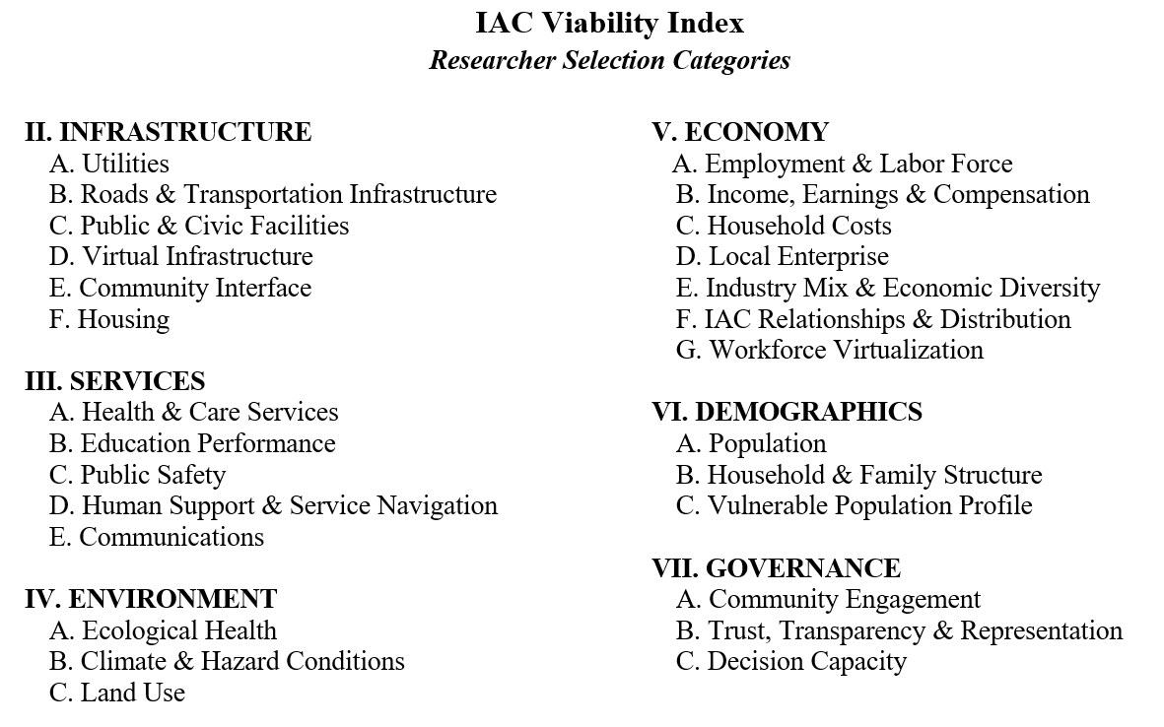
The Index
Revitalizing Small Town America
© Tele-Commuter Resources, Inc August, 2026

Slide 32
THE IAC TOOLKIT
WHAT’S OUR STORY
A Community does not emerge from the simple aggregation of its parts,
but rather, it emerges from their integration”
THE BUSH FOUNDATION’S GOAL
Support community-driven ideas that change underlying systems—not just symptoms—and can create lasting, scalable improvements across the region.
Transform systems: address root causes and change how opportunities and outcomes are produced.
Build from community ownership: involve the people affected and create strong, collaborative solutions.
Create lasting, expandable impact: support ideas that can grow, spread, and make the region better for everyone.
Revitalizing Small Town America
© Tele-Commuter Resources, Inc August, 2026

Slide 33
THE e-CONSENSUS FORUM REPORT
3. e-Consensus FORUm
Revitalizing Small Town America
© Tele-Commuter Resources, Inc August, 2026

Slide 34
e-Consensus
Q&A
Revitalizing Small Town America
© Tele-Commuter Resources, Inc August, 2026

Slide 35
WORKFORCE VIRTUALIZATION PROGRAM
Revitalizing Small Town America
© Tele-Commuter Resources, Inc August, 2026

Slide 36
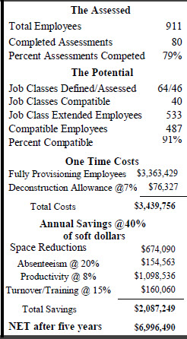
TEST FEASIBILITY TO ENSURE AN ROI
Don’t focus on the employee, focus on the occupation. First deploy your employees with continuity roles; and you don’t need 20 people doing the same job on site nor do you have to have everyone there just in case you have a question. Strategically deploy everyone on the basis on hierarchy, technology and the number of days per week that they can work remotely.

Slide 37
VERIFY IT WILL ACHIEVE YOUR GOALS
Focusing on key indicators, the WVP calculates the probability of success.
If many fail to meet the 100% minimum, the strategic process may not be appropriate and a recommendation is made o pursue the traditional ad hoc deployment approach.

Slide 38
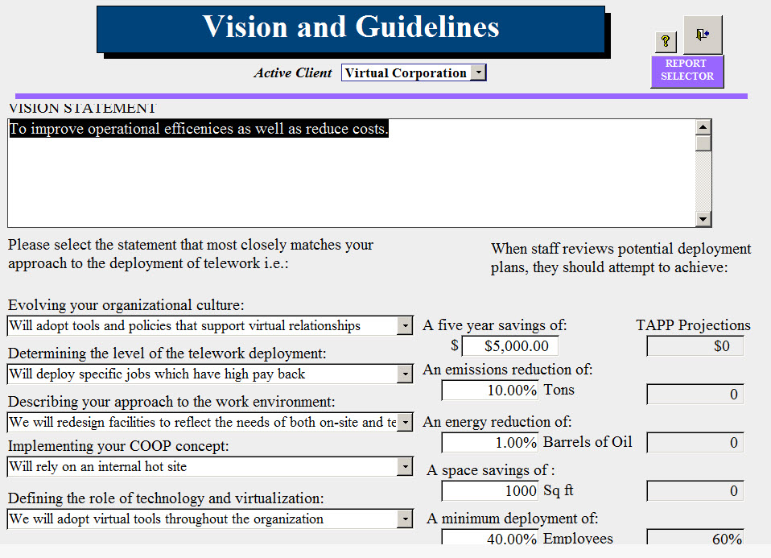
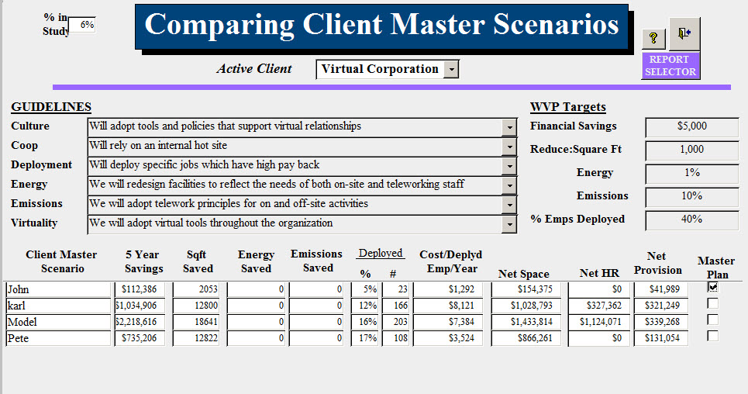
The C-Suite MUST set the Goals and Guidelines
The “Go-No GO” decision is a senior management decision- it is not an HR or transportation task.
TCR brings the management team together to define the programs Goals and Guidelines. it is the first step in implementing an entity –wide process of virtualization of accountability to enhance fiscal and operational performance .

Slide 39
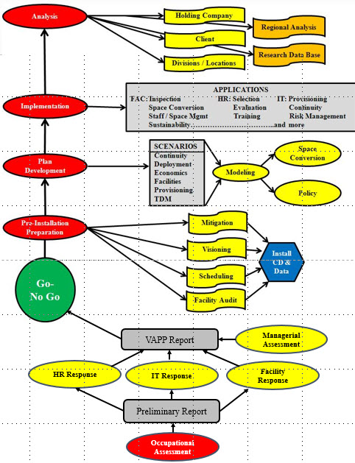
IMPLEMENT IT IN LOGICAL STEPS
The Process is simple:
FEASIBILITY
Make sure it makes cents.
OPTIMIZATION
Make sure it is efficient
SEQUENTIAL
Logic dictates schedule
ACCOUNTABLE
Policy updates are critical
PERFORMANCE
Support your organization and share its impacts with the community

Slide 40
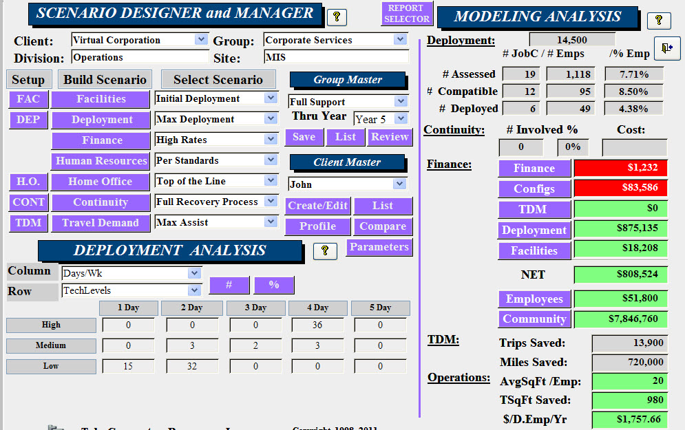
MITIGATE BARRIERS / OPTIMIZE DEPLOYMENT
Once the senior team has defined goals and expectations, The WVP employs modeling to determine which combination of scenarios will generate the greatest results.
And virtualization need to negatively impact culture or team development; it empowers innovation to maintain them.

Slide 41
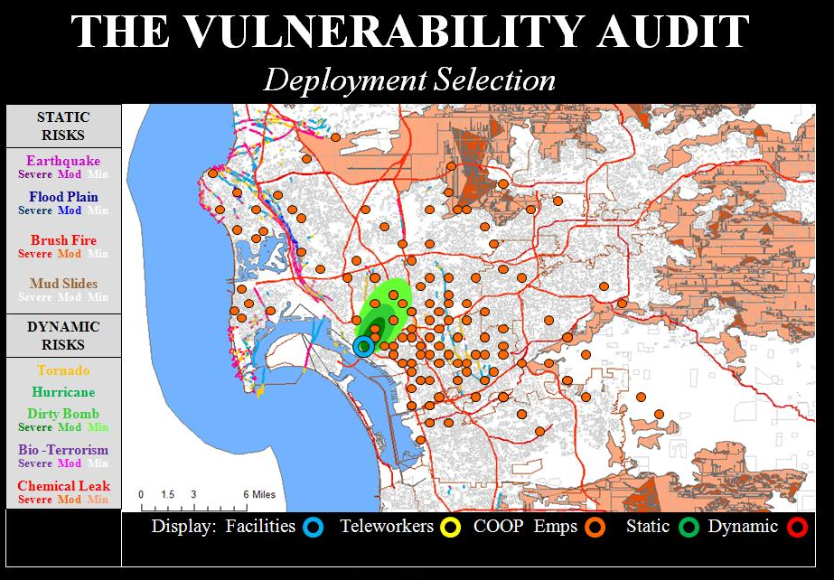
AND UNDERSTAND YOUR RISK ENVIRONMENT
A regional Viability Audit graphically defines which static or dynamic risks would impact your facilities.
Make sure your continuity workers are outside of the various impact zones plotted around your facilities. They are no good to you if they are impacted by the same event that impacts your facility.

Slide 42
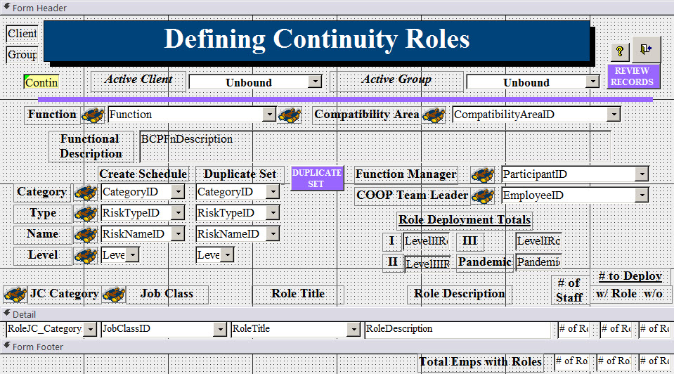
FOCUS ON VIABILITY
By deploying employees with specific continuity responsibilities, your Continuity program is tested daily- and a fraction of traditional methods.
All you have to do is identify “Continuity Roles” to secure your viability.

Slide 43
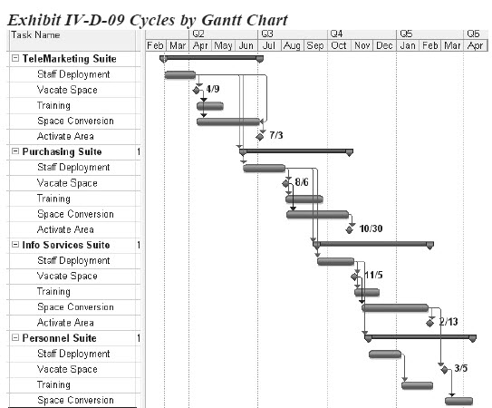
USE A CRITICAL PATH FOR ACCOUNTABILITY
The WVP employs a database menu system. This allows every phase of the program to be tracked by the Deployment Team.
Additional resources are applied when necessary to get back on schedule

Slide 44
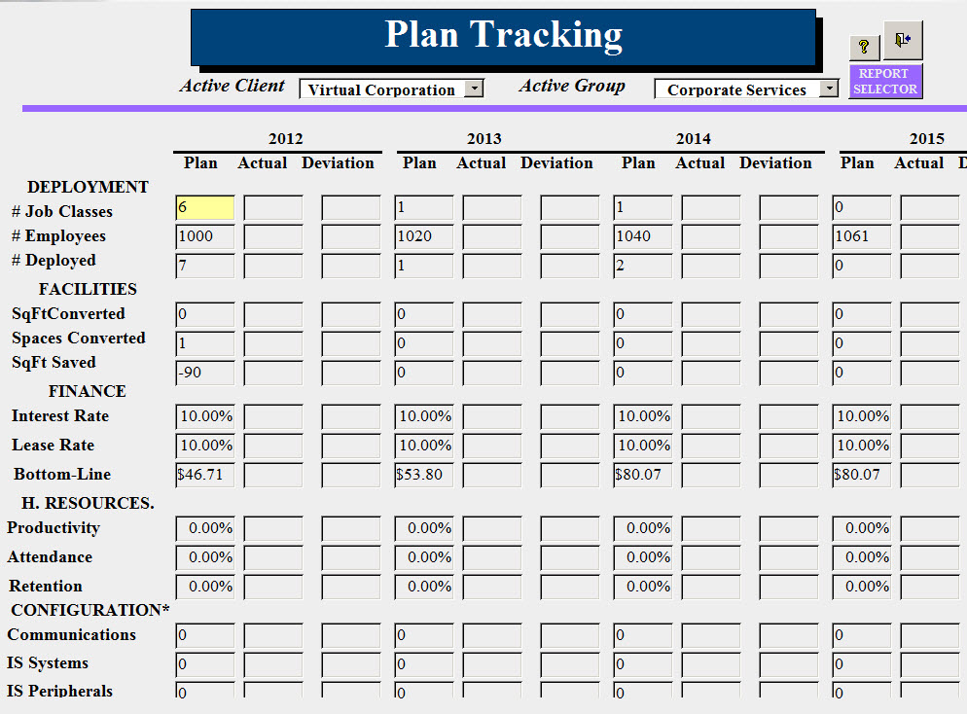
METRICS Are the Key to Plan Success
The Deployment Plan integrates the needs of all departments. It coordinates specific targets for each.
Statistics are embedded throughout the system to ensure it remains on a “critical path” to ensure the goals are achieved by the end of the five-year program.

Slide 45
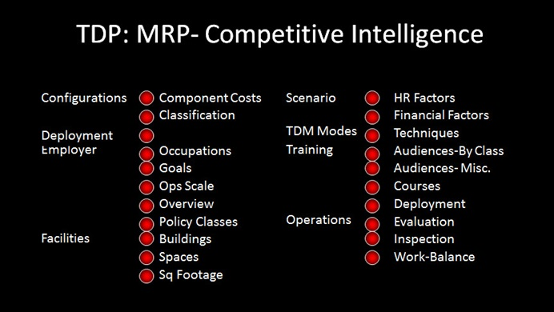
USE THE NATIONAL RESEARCH BASE TO ENHANCE
After 50 years, the ad hoc approach remains unable to provide meaningful statistics on how to deploy remote workers.
Because the WVP has been designed to customize the plan but maintain the structure, it can provide client’s operational and policy statistics for many topic areas.

Slide 46
WORKFORCE VIRTUALIZATION PROGRAM
Q & A
Revitalizing Small Town America
© Tele-Commuter Resources, Inc August, 2026

Slide 47
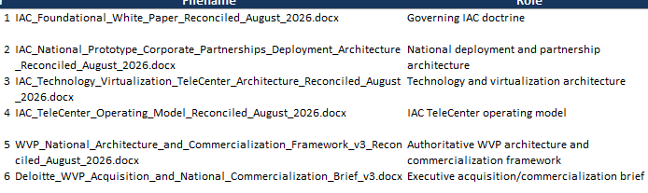
WHITE PAPERS
Revitalizing Small Town America
© Tele-Commuter Resources, Inc August, 2026

Slide 48
LOAD THE LENS
Revitalizing Small Town America
© Tele-Commuter Resources, Inc August, 2026

Slide 49
The
Lens
Revitalizing Small Town America
© Tele-Commuter Resources, Inc August, 2026

Slide 50
Open with Brainerd
Illustrate examples of apps on the three Menus
TeleCenter- Abin Report???
Directory- Restaurants
Engagement- Contributions/Vision/Sports???
Review “View our Neighborhood” clean up 3 zips
Demonstrate Pop change (or maybe the 6 indicator views)
Access Neighborhood Page
Back to Home Page wrong- s/b Brainerd not IAC Home Page
Review Our Profile Add more tables
Community Map--- head to Marshall verify Zip orientation on all 5
Brainerd
St Cloud
Willmar
Redwood Falls
Marshall
Revitalizing Small Town America
© Tele-Commuter Resources, Inc August, 2026

Slide 51
Lens
Q&A
Revitalizing Small Town America
© Tele-Commuter Resources, Inc August, 2026

Slide 52
The
Information Age Community
Revitalizing Small Town America
© Tele-Commuter Resources, Inc August, 2026

Slide 53
Back to Home Page
IAC Principles Nav to LRt; Logo from Community Page; Centroid City -- Global Service Center
Governance
Find Your Community
Brainerd
Investigate Service Center Map????
Revitalizing Small Town America
© Tele-Commuter Resources, Inc August, 2026

Slide 54
Information Age Community
Q & A
Revitalizing Small Town America
© Tele-Commuter Resources, Inc August, 2026

Slide 55
THE ASK?
Revitalizing Small Town America
© Tele-Commuter Resources, Inc August, 2026

Slide 56
Industry Conferences
Documentaries
TED Talks
THE IAC RESIDENT
Forums
Media
BUILDING AWARENESS and PERSPECTIVES

Slide 57
DEPLOYING THE TECHNOLOGY
THE SCALING CHALLENGE
Configuring the Regional TeleCenter
Scaling a Community Lens & TeleCenter
Developing a Technology Plan, with licensing, content and divide responsibilities for maintenance
Q&A
John Sanger, President, Tele-Commuter Resources, Inc.
jfsanger@telecommuter.org
651-486—8408
www.telecommuter.org
www.infoagecommunity.org (under development

Slide 58
DATA STRUCTURE
Data Structure: The Information Age Community maintains a database that supports those engine inquiries
Data Structure- The IAC data structure is designed to look back at historical data, integrate present data and forecast trends for future data. Using AI, it is being developed to integrate the relevant data to support community inquiries across all data sets. Developed at the zip code level, it not only profiles every small town but it also aggregates the data to the Community Level as this process is describing.
Infrastructure
Services
Health Care & Services
Community Coverage
Specialty Services
Preventative Care
Maternal & Child Health
Geriatric Care
Disability Support
Educational Performance
Public Safety
Human Support
Communications
ENVIRONMENT
ECONOMY
DEMOGRAPHICS
GOVERNANCE
Categories
A. Topics
1. Components
a) Clusters
Indicators
Based upon the implementation of the Research protocol, the final indicators will be defined.

Slide 59

GOVERNED BY THE COMMUNITY
COLLABORATVIES:
Educational
Formation
Economic Development
Legal
Marketing
Funding
Political Engagement
Executive Committee
IAC BOARD
THE STRATeGIC PLAN
TeleCenter Network
Transit Deployment
TeleCenter Network
TeleCenter Network
Leadership
Leadership
TeleCenter Network
Leadership
Leadership
Visioning
SoTA Development
Visioning
SoTA Development
SoTA Development
SoTA Development
Service Center Coordination
Service Center Committees
Application Management
Distribution
Operations & Recruitment
Services Advisors
Technology
Regional Monitor
TechTrek
Metrix Tracking
Service Center Board
Sector Appointees
Revitalizing Small Town America
© Tele-Commuter Resources, Inc August, 2026

Slide 60
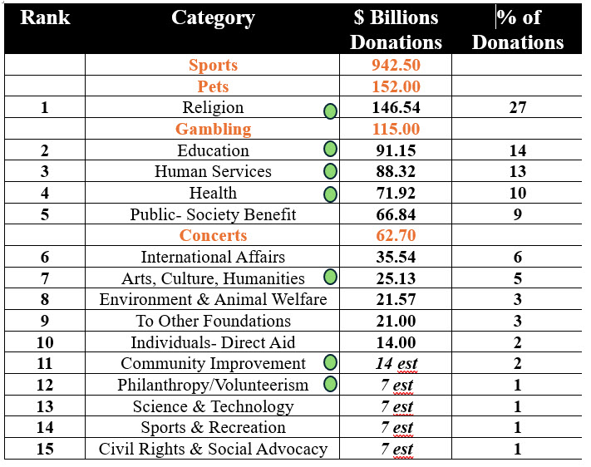
THE VIABILITY OF THE COMMUNITY SECTOR
DIVISIVE FUNDING COMPARATIVE MANAGEMENT

Slide 61
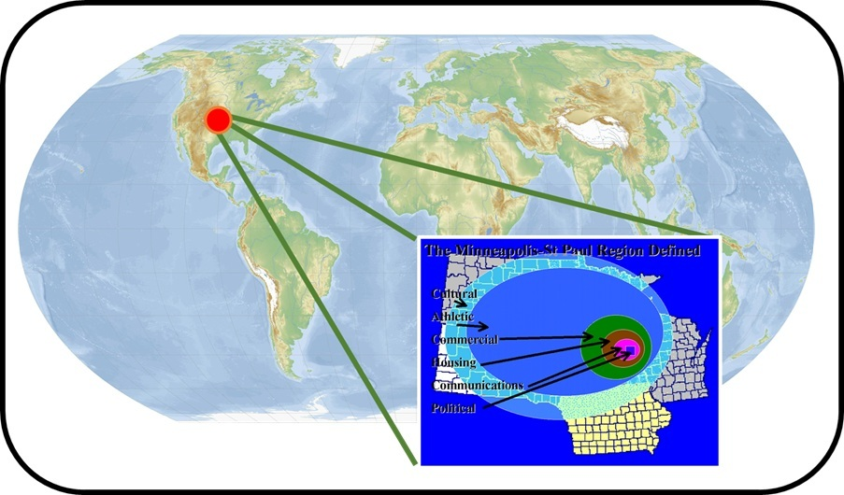
THE INFORMATION AGE COMMUNITY
The Minneapolis-St Paul IAC
Redefines Minneapolis-St Paul “Community”-
Restores Viability to six unique Living Environments
Restructures Community Hierarchy
Establishes 80 “Communities”
Restores the Community Voice
Empowers the Community Sector
Market-based- not political jurisdictions
National Prototype: 1 of 32 potential IACs
Supports AI based decision-making
Full, Rural-Urban, Economic Integration
Principles of Collaboration & Critical Mass
Assures Equal access to all services

Slide 62
6. APPLYING THE TOOLS
e-CONSENSUS
Convene, Explore, Resolve, Plan
Budget, Prioritize,
LENS
Convene, Explore, Resolve, Plan
Budget, Prioritize,
VIABILITY INDEX
Gather, Trend, Analyze,
Calculate, Profile
STRUCTURE
Convene, Explore, Resolve, Plan
Budget, Prioritize,
Annual Consensus Budgeting Cycle
E-Consensus Prioritizes the Issues
Viability Index Evaluates Top Priority Issues
Perform a CIA (Community Impact Analysis)*
Viability Index identifies those affected- form a Task Force
Apply e-Consensus, AI and Viability Index to reveal causes / sources of the problem
Fund the project via the Funding Collaborative
Develop a Workplan with the IAC Collaboratives including scaling it to variously impacted communities
Execute the plan
Facilitate Solution Implementation
Monitor Results with Viability Index
ZIP CODE DATABASE
Convene, Explore, Resolve, Plan
Budget, Prioritize,
Revitalizing Small Town America
© Tele-Commuter Resources, Inc August, 2026
Load the LENS

Slide 63
6. THE COMMUNICATION CHALLENGE
Funding Critical Mass Message & Sequence
Foundations and Agencies focus on:
Silo grants
Jurisdictional boundaries
Bush & Deloitte are supporting transformation funding
But their history is silos
None of the IAC components are familiar to them
The IAC is a Partnership
Technology- Starlink
Health Care- Mayo
Transit- Podways
The Alliance- Media?
Education- Modern States
Technology- many---
Regional TeleCenter
Community TeleCenters
E-Consensus
TCR
The IAC is comprehensive and integrated-
Must be designed
Must have partners
Must be Integrated
Must be understood
It will be the Community’s Choice
Must be credible
Must have buy-in
Must have Board
Must have collaboratives
The Need
The Solution
The Package
Credibility
The Structure
Funding vs Partners
Demo vs Request
Recruitment vs Package
Revitalizing Small Town America
© Tele-Commuter Resources, Inc August, 2026
Load the LENS

