Slide 1
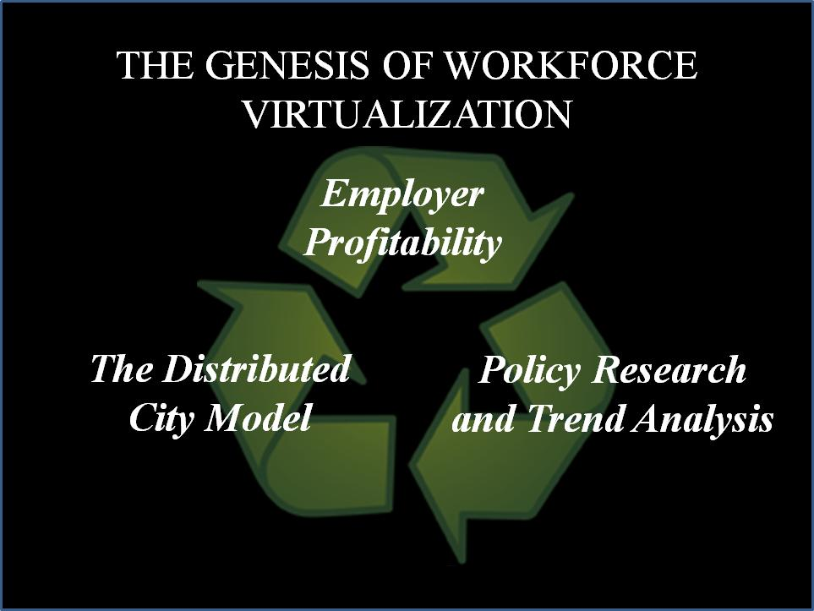
BEGIN WITH A CONCEPT
As part of Tele-Commuter Resources’ Information Age Community project , the WVP supports the Community, the Public and the Private Sector.

Slide 2
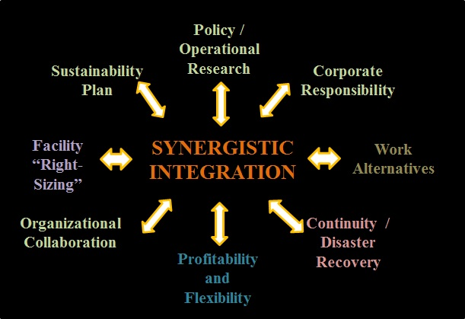
AN INTEGRATED AND HOLISTIC APPROACH
All Sectors rely on silos, but TCR believes they are inefficient, ineffective and counterproductive. Accordingly, the WVP integrates ALL organizational stakeholders/departments to maximize fiscal and operational outcomes

Slide 3
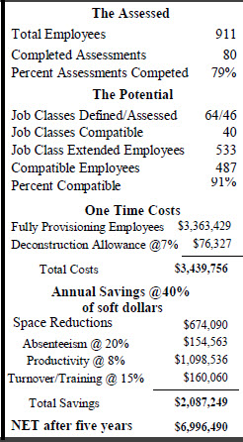
TEST FEASIBILITY TO ENSURE AN ROI
Don’t focus on the employee, focus on the occupation. First deploy your employees with continuity roles; and you don’t need 20 people doing the same job on site nor do you have to have everyone there just in case you have a question. Strategically deploy everyone on the basis on hierarchy, technology and the number of days per week that they can work remotely.

Slide 4
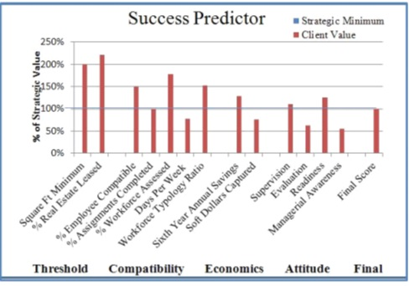
VERIFY IT WILL ACHIEVE YOUR GOALS
Focusing on key indicators, the WVP calculates the probability of success.
If many fail to meet the 100% minimum, the strategic process may not be appropriate and a recommendation is made o pursue the traditional ad hoc deployment approach.

Slide 5
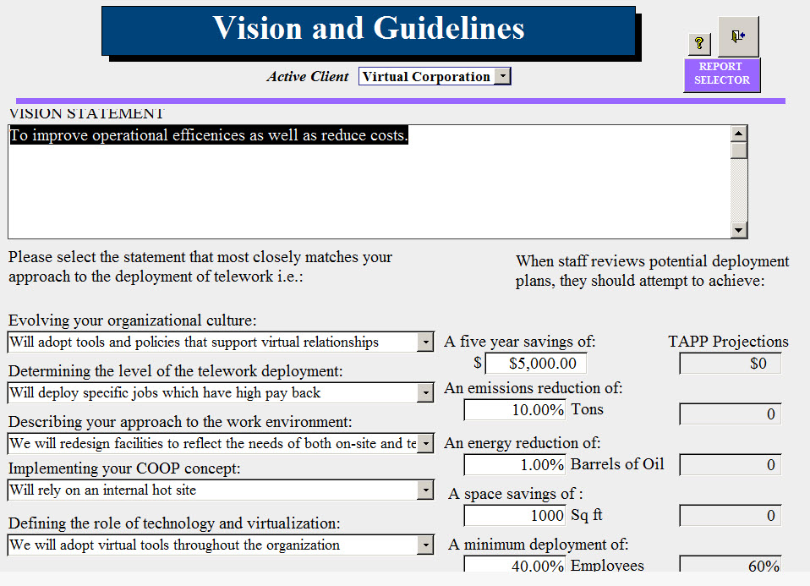
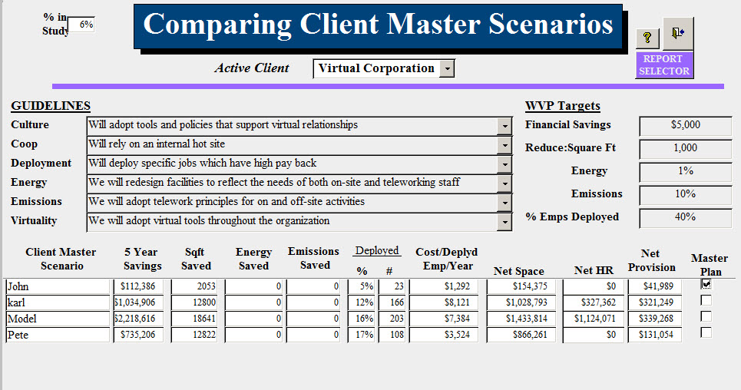
The C-Suite MUST set the Goals and Guidelines
The “Go-No GO” decision is a senior management decision- it is not an HR or transportation task.
TCR brings the management team together to define the programs Goals and Guidelines. it is the first step in implementing an entity –wide process of virtualization of accountability to enhance fiscal and operational performance .

Slide 6
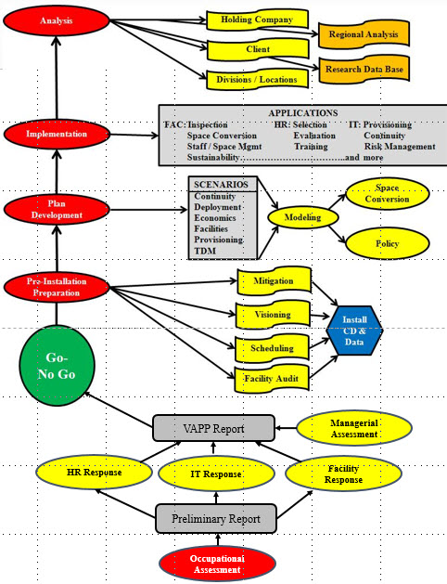
IMPLEMENT IT IN LOGICAL STEPS
The Process is simple:
FEASIBILITY
Make sure it makes cents.
OPTIMIZATION
Make sure it is efficient
SEQUENTIAL
Logic dictates schedule
ACCOUNTABLE
Policy updates are critical
PERFORMANCE
Support your organization and share its impacts with the community

Slide 7
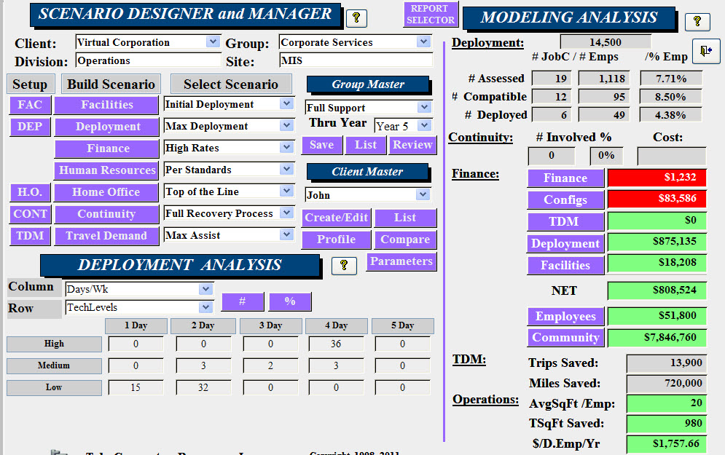
MITIGATE BARRIERS / OPTIMIZE DEPLOYMENT
Once the senior team has defined goals and expectations, The WVP employs modeling to determine which combination of scenarios will generate the greatest results.
And virtualization need to negatively impact culture or team development; it empowers innovation to maintain them.

Slide 8
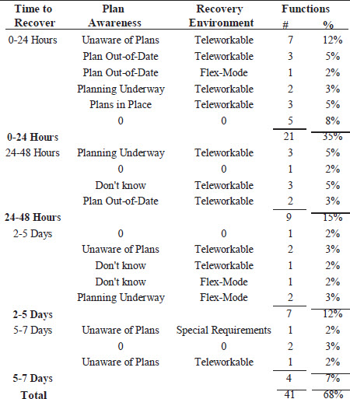
UNDERSTAND CONTINUITY & DISASTER RECOVERY
TCR’s Feasibility Assessment examines your staff’s awareness of their continuity roles, the requisite recovery environment and how much time they have to recover their activities before the challenge becomes a full-fledged crisis.

Slide 9
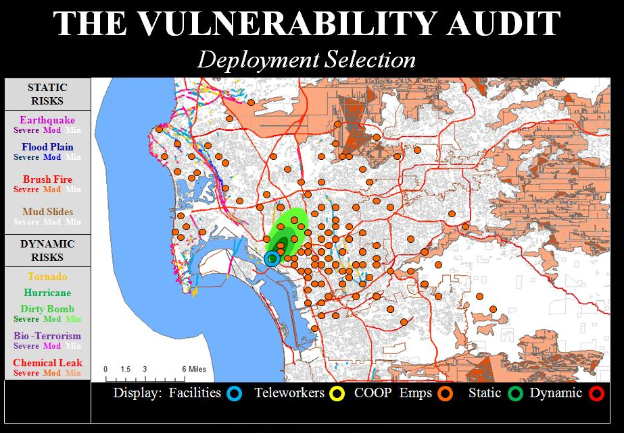
AND UNDERSTAND YOUR RISK ENVIRONMENT
A regional Viability Audit graphically defines which static or dynamic risks would impact your facilities.
Make sure your continuity workers are outside of the various impact zones plotted around your facilities. They are no good to you if they are impacted by the same event that impacts your facility.

Slide 10
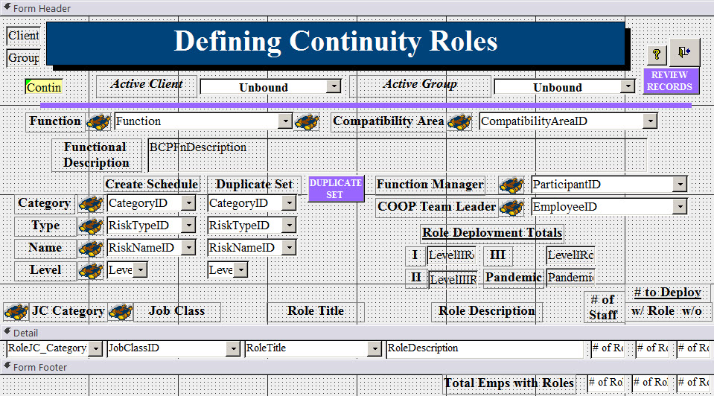
FOCUS ON VIABILITY
By deploying employees with specific continuity responsibilities, your Continuity program is tested daily- and a fraction of traditional methods.
All you have to do is identify “Continuity Roles” to secure your viability.

Slide 11
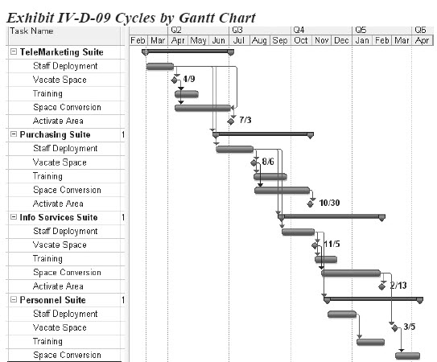
USE A CRITICAL PATH FOR ACCOUNTABILITY
The WVP employs a database menu system. This allows every phase of the program to be tracked by the Deployment Team.
Additional resources are applied when necessary to get back on schedule

Slide 12
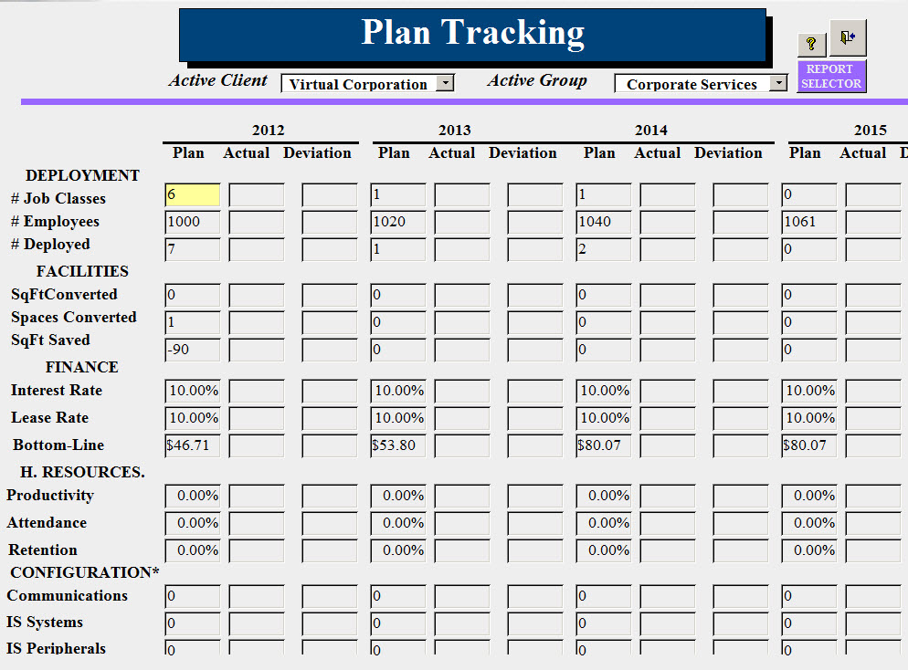
METRICS Are the Key to Plan Success
The Deployment Plan integrates the needs of all departments. It coordinates specific targets for each.
Statistics are embedded throughout the system to ensure it remains on a “critical path” to ensure the goals are achieved by the end of the five-year program.

Slide 13
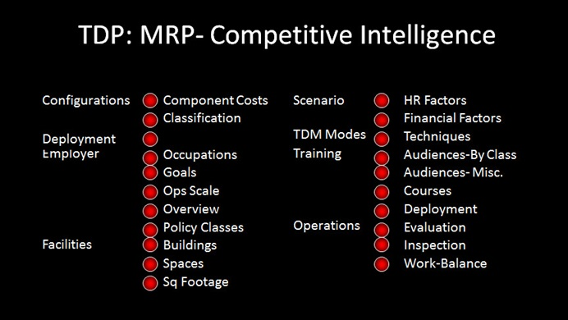
USE THE NATIONAL RESEARCH BASE TO ENHANCE
After 50 years, the ad hoc approach remains unable to provide meaningful statistics on how to deploy remote workers.
Because the WVP has been designed to customize the plan but maintain the structure, it can provide client’s operational and policy statistics for many topic areas.

Slide 14
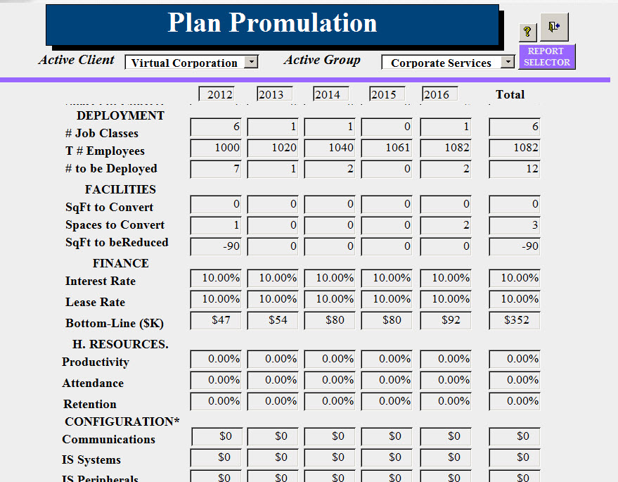
ADOPT A DEPLOYMENT PLAN
As part of Tele-Commuter Resources’ Information Age Community project , the WVP supports the Community, the Public and the Private Sector.

Slide 15
BEGIN WITH A CONCEPT

