Slide 1


Continuous Integration
and
Test Automation
How test automation works on real projects?
April 1, 2016

Slide 2
Agenda
Introduction
Continuous Integration
Continuous Delivery
Test Pyramid
Protractor
NodeJS
NPM
Grunt

Slide 3
Sequential development model
Planning
Analyses
Development
Test
Acceptance

Slide 4
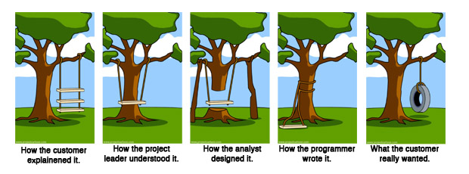
Sequential development model - problems

Slide 5
Solution: iterative development model - AGILE
Design
Build
Test
Release

Slide 6
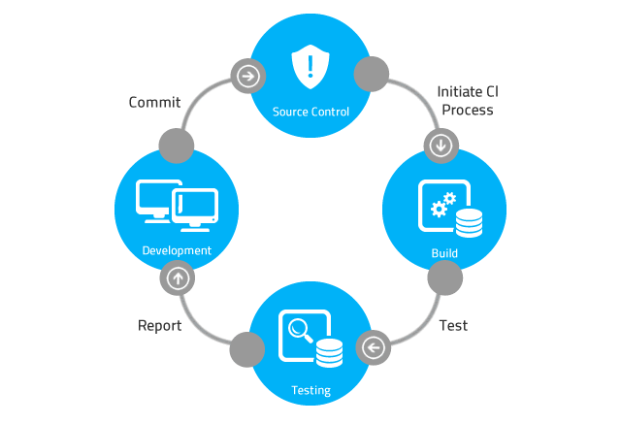
Continuous Integration
Notes:
http://www.martinfowler.com/articles/continuousIntegration.html

Slide 7
Continuous Delivery
Build
Deploy
Release
Test
Notes:
http://martinfowler.com/bliki/ContinuousDelivery.html

Slide 8
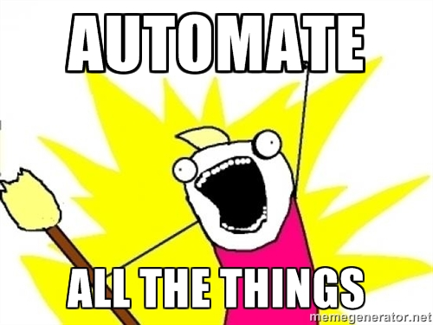
Let’s automate everything!

Slide 9
Test pyramid
E2E test
Integration test
Unit test
Notes:
http://martinfowler.com/bliki/TestPyramid.html

Slide 10
Continuous Integration vs. Continuous Delivery
Continuous Integration
Code done
Unit test
Integrate
Continuous Delivery
Code done
Unit test
Integrate
Acceptance test
Deploy to production
Manual

Slide 11




Key benefits of continuous delivery
Reduced cost
Higher quality
Improved time to market
Early ROI

Slide 12

Continuous Deployment
Continuous Delivery
Code done
Unit test
Integrate
Acceptance test
Deploy to production
Auto
Auto
Auto
Manual
Continuous Deployment
Code done
Unit test
Integrate
Acceptance test
Deploy to production
Auto
Auto
Auto
Auto
Notes:
Kitekintés …

Slide 13
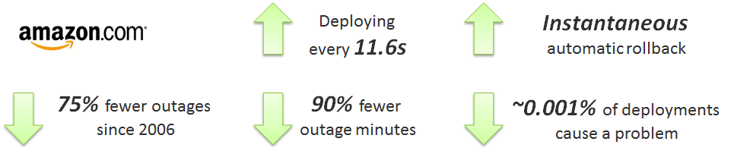
Key benefits of continuous deployment
Notes:
http://joshuaseiden.com/blog/2013/12/amazon-deploys-to-production-every-11-6-seconds/

Slide 14
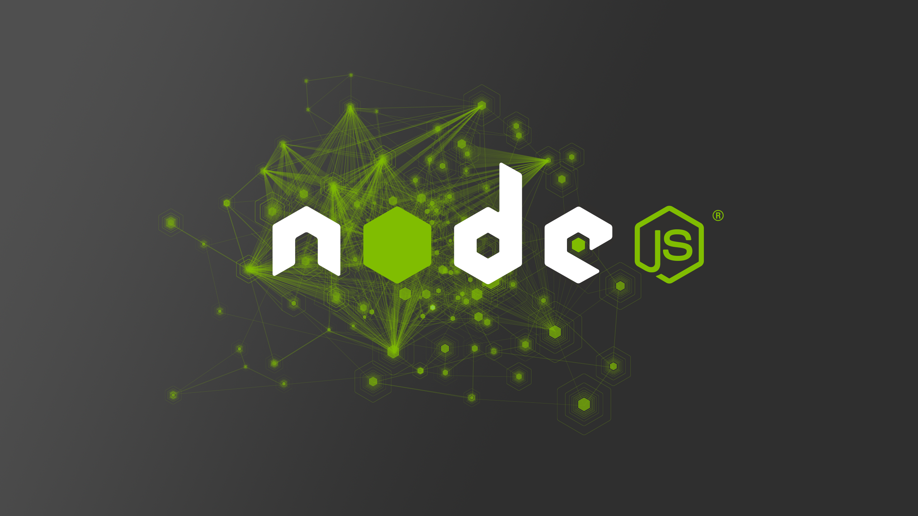
NodeJS
„Node.js® is a JavaScript runtime built on Chrome's V8 JavaScript engine. Node.js uses an event-driven, non-blocking I/O model that makes it lightweight and efficient. Node.js' package ecosystem, npm, is the largest ecosystem of open source libraries in the world.”
Notes:
https://nodejs.org/en/

Slide 15

NodeJS - NPM
„npm is the package manager for JavaScript. Find, share, and reuse packages of code from hundreds of thousands of developers — and assemble them in powerful new ways.”
Notes:
https://www.npmjs.com/

Slide 16
NodeJS - NPM
Install packages: npm install [-g] protractor
Get the version of packages: npm –v protractor
Uninstalling packages: npm uninstall [-g] protractor
Notes:
https://docs.npmjs.com/

Slide 17

Protractor
„Protractor is an end-to-end test framework for AngularJS applications. Protractor runs tests against your application running in a real browser, interacting with it as a user would.”
Test Like a User
Protractor is built on top of WebDriverJS, which uses native events and browser-specific drivers to interact with your application as a user would.
For AngularJS Apps
Protractor supports Angular-specific locator strategies, which allows you to test Angular-specific elements without any setup effort on your part.
Automatic Waiting
You no longer need to add waits and sleeps to your test. Protractor can automatically execute the next step in your test the moment the webpage finishes pending tasks, so you don’t have to worry about waiting for your test and webpage to sync.
Notes:
https://angular.github.io/protractor/#/
http://angular.github.io/protractor/#/infrastructure
webdriver-manager update
webdriver-manager start

Slide 18
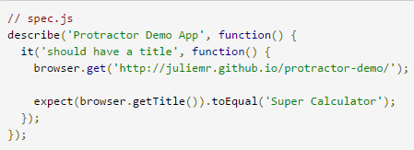
Protractor
Notes:
https://angular.github.io/protractor/#/
http://angular.github.io/protractor/#/infrastructure
webdriver-manager update
webdriver-manager start

Slide 19
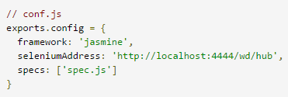
Protractor
Notes:
https://angular.github.io/protractor/#/
http://angular.github.io/protractor/#/infrastructure
webdriver-manager update
webdriver-manager start

Slide 20
Protractor
webdriver-manager update
webdriver-manager start
protractor conf.js
//conf.js
exports.config = {
framework: 'jasmine',
seleniumAddress: 'http://127.0.0.1:4444/wd/hub',
specs: ['spec.js'],
capabilities: {
'browserName': 'firefox'
}
}
Notes:
https://angular.github.io/protractor/#/
http://angular.github.io/protractor/#/infrastructure
webdriver-manager update
webdriver-manager start

Slide 21
Protractor
Create a simple scenario which does a search on the http://www.thomascook.com angularJS based website.
Test input data: From London City to Dundee, Scotland, travel date: 18-Apr-2016
Verify that we have at least one search result.
Notes:
https://angular.github.io/protractor/#/
http://angular.github.io/protractor/#/infrastructure
webdriver-manager update
webdriver-manager start

Slide 22

Grunt
Notes:
http://gruntjs.com/
http://adrianmejia.com/blog/2014/10/07/grunt-js-tutorial-from-beginner-to-ninja/

Slide 23
Useful Links
CI&CD
http://www.martinfowler.com/articles/continuousIntegration.html
http://martinfowler.com/bliki/ContinuousDelivery.html
http://martinfowler.com/bliki/TestPyramid.html
http://joshuaseiden.com/blog/2013/12/amazon-deploys-to-production-every-11-6-seconds/
Protractor
https://angular.github.io/protractor/#/
https://angular.github.io/protractor/#/tutorial
Grunt
http://gruntjs.com/
http://adrianmejia.com/blog/2014/10/07/grunt-js-tutorial-from-beginner-to-ninja/
https://www.credera.com/blog/technology-insights/java/testing-angularjs-part-5-protractor-grunt/

Slide 24

Tamas Csako, Ph.D. Lead Software Testing Engineer
Tamas_Csako@epam.com
Notes:
On a new project, with and without QA
On an existing project, with and without QA

