Slide 1
Welcome to the Presentation on Use Case Diagram
Represented by
Md.Taufiqur Rahman
Roll:385
Khaled Murshed Adnan
Roll:399

Slide 2
System name: Your Home Doctor
Discussion on software principles (in brief):
1. User has to click on some checkbox(es) assign with some symptom(s) of disease.
2.Now the user is to further checking it out. If the assignments are wrong ,then the user is to make it correct.

Slide 3
3. Then the user is to submit his assignments by clicking on a 'Submit' button.
4. After clicking on the 'Submit' button the user would immediately get the corresponding disease(s) name.
5. If there exits more than one symptoms of different diseases, then the software will mention the names of all those diseases.

Slide 4
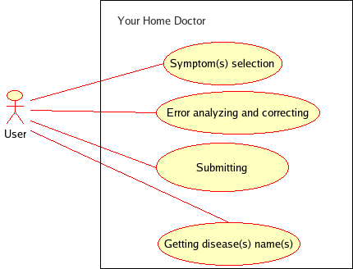
The Use Case Diagram

Slide 5
Use Case ID: YHD 01
Use Case Name: Symptom(s) selection
Actor: User
Description:
There are several checkboxes in the software interface assign with some symptoms of various diseases. The user who is going to use this software is to first select these checkboxes appropriately. Now there arises another two conditions that is another two use cases namely 'Single' and 'Multiple' as the user may choose single or multiple symptoms who are related to their parent use case with an extend relationship.

Slide 6
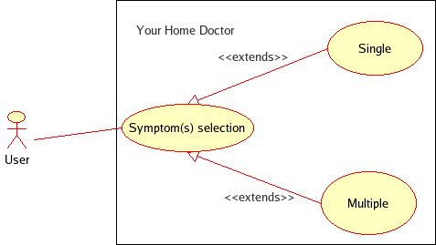
The Use Case Diagram
Fig: Illustration of the use case 'Symptom(s) selection'

Slide 7
Exception:
Wrong symptom(s) choosing.
Precondition:
1. Installing the software.
2. Run the software to open user interface.
Postcondition:
To go to the next part of the software.

Slide 8
Use Case ID: YHD 02
Use Case Name: Error analyzing and correction
Actor: User
Description:
If the user choose any incorrect symptoms he has to verify and correct it before submitting, otherwise the software will show the incorrect result. There happens two related child use cases 'Checking' and 'Correcting' who are related with their parent use case with the uses relationship.
Exception:
Incorrect choice or wrong verification

Slide 9
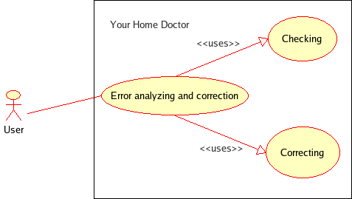
The Use Case Diagram
Fig: Illustration of the use case 'Error(s) analyzing and correction'

Slide 10
Precondition:
1. The user has to first go to the user interface.
2. The user has to make sure himself about the selection.
Postcondition:
To go to the submission part of the software.

Slide 11
Use Case ID: YHD 03
Use Case Name: Submitting
Actor: User
Description:
After choosing his symptom(s) the user has to submit his assignment by clicking on 'Submit' button. In that case there also arises two conditions that is two child use cases 'Submit' and 'Do not submit'. These two are associated with their parent use case with extends relationship.
Exception:
Submitting without choosing symptom(s).

Slide 12
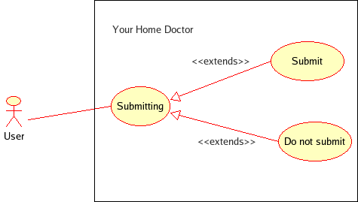
The Use Case Diagram
Fig: Illustration of the use case 'Submitting'

Slide 13
Precondition:
Choosing symptom(s) by clicking on checkbox(es).
Postcondition:
To get the corresponding disease name.

Slide 14
Use Case ID: YHD 04
Use Case Name: Getting disease(s) name(s)
Actor: User
Description:
After the submission that is after clicking on the 'Submit' button the user will immediately get the corresponding disease(s) name. If the user assigns more than one symptoms of different diseases the software will mention all those disease names. As a result there there there exists two child use cases namely 'Single name' and 'Multiple name'.
Exception:
Getting wrong answer as the input was wrong.

Slide 15
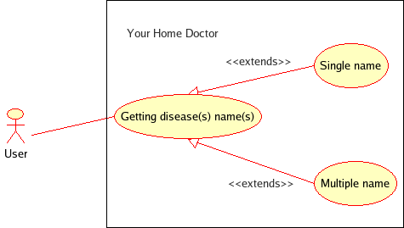
The Use Case Diagram
Fig: Illustration of the use case 'Getting disease(s) name(s)'

Slide 16
Precondition:
Clicking on the 'Submit' button with proper choosing.
Postcondition:
To get the final result.

Slide 17
Thank you
(The End)

