Slide 1
Description of the Sequence Diagram:
We are now having a discussion on the sequence diagram. For the flexibility of our discussion we are highlighting only two objects from corresponding two classes. Our first class is 'CheckBoxFrame',which is a public class. From this class we have created twenty two objects. For our consideration we are mentioning 'cb1' as our object. Similarly we have created another class 'CheckBoxHandler' which derived from the class 'ActionListener'.Its corresponding object is 'handler'.From the object 'cb1' to 'handler' there goes an asynchronous message name actionPerformed(ActionEvent event) .

Slide 2
It is an asynchronous message because the sender that is 'cb1' can perform multi task before the receiver that is 'handler' replies.

Slide 3
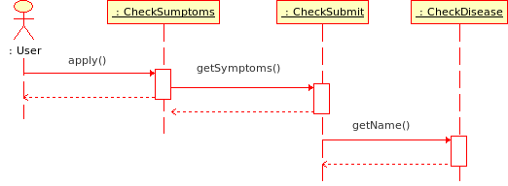
The sequence Diagram

Slide 4
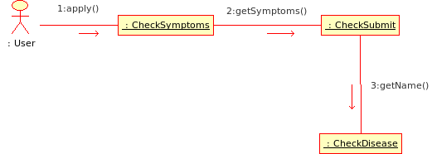
The Collaboration Diagram

Slide 5
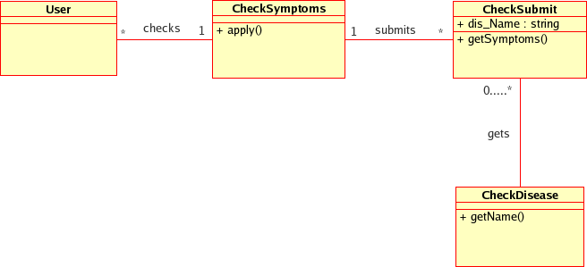
The Class Diagram

Slide 6
Thank you
(The End)

