Slide 1
Pharmacy drug utilization analysis
Thomas Simmons, SEPTEMBER 2025

Slide 2
Rundown
State Drug Utilization Data 2024, published by CMS and available on Data.gov
State-level Medicaid prescription data, entailing:
Drug codes
Prescription counts
Reimbursement amounts

Slide 3
Project scope / tasks completed
Data cleaning, filtering, structuring
Data visualizations
Exploratory data analysis
Working between R and Python

Slide 4
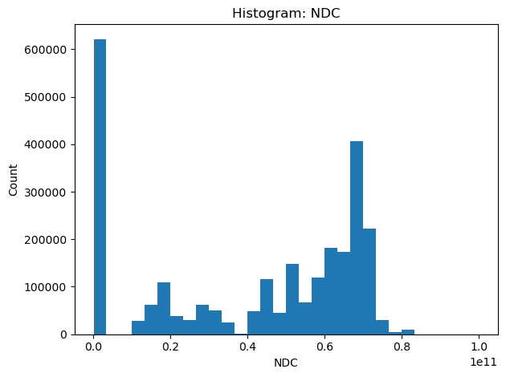
Visualizations

Slide 5
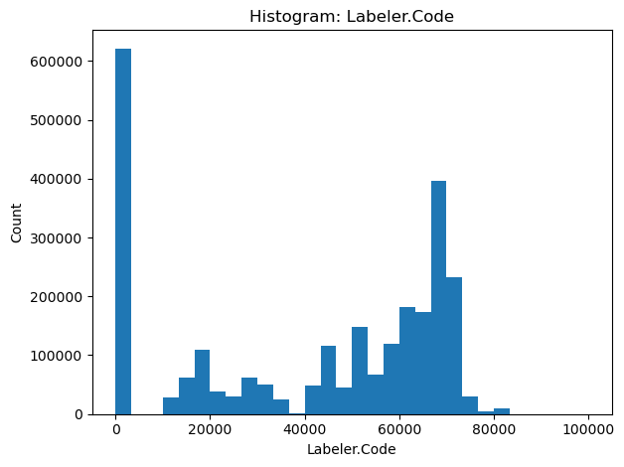

Slide 6
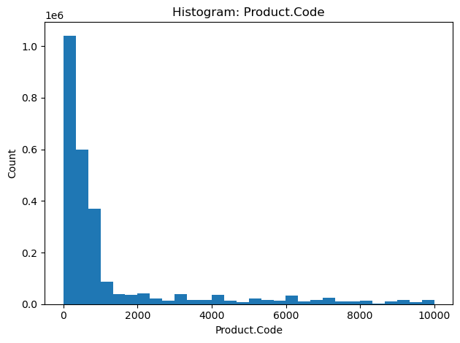

Slide 7
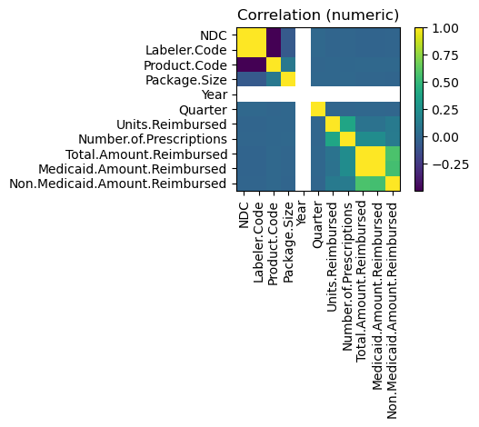

Slide 8
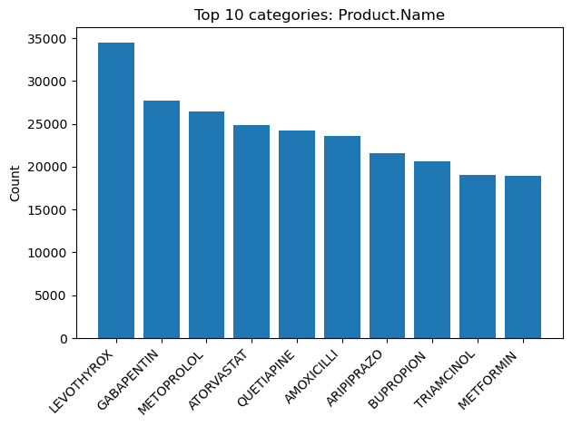

Slide 9
Takeaways
Concentration of drugs and manufacturers: A small set of medications (Levothyrox, Gabapentin, Metoprolol) and certain labelers dominate prescriptions and reimbursements, showing a strong long-tail pattern.
Strong metric correlations: Units reimbursed, number of prescriptions, and total/Medicaid reimbursements are highly correlated, meaning prescription volume directly drives costs.
Skewed distributions with anomalies: Product codes are heavily skewed to low values, while Labeler and NDC codes show large spikes near zero, hinting at possible missing or placeholder entries.

