Slide 1
MongoDB
Week 1, Day 2
Steve Chenoweth
CSSE Dept

Slide 2
Documents instead of SQL Rows
{ “greeting” : “Hello world”}
An ordered set of keys with values.
Thus, fits in with how Hadoop works, for example!
Most documents have multiple keys & values:
{ “greeting” : “Hello world”, “foo” : 3}
The “values” can be lots of different types!
But the keys are strings!
With a few restrictions (see p 8)
MongoDB is type and case sensitive.
Can’t duplicate keys in a single document.
The ordering is important.
This is “BSON”, like “JSON”.
Notes:
P 7 in MongoDB book.

Slide 3
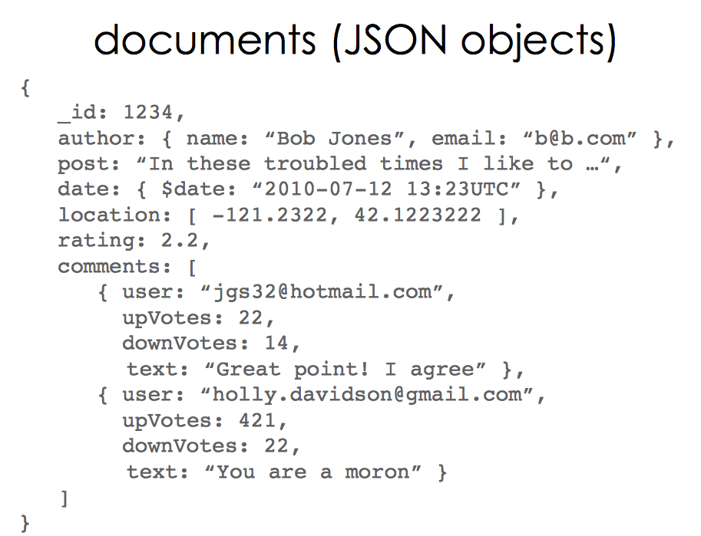
Notes:
From https://www-conf.slac.stanford.edu/xldb10/docs/xldb4_wed1615_lightning_8_mongodb.pdf

Slide 4
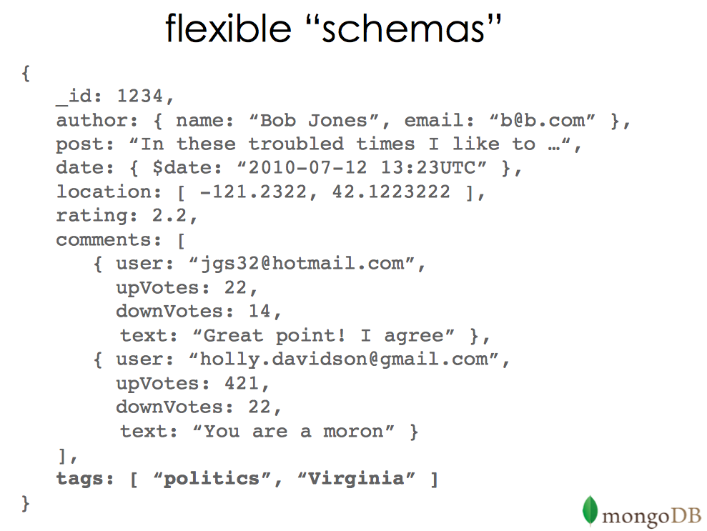
Notes:
From https://www-conf.slac.stanford.edu/xldb10/docs/xldb4_wed1615_lightning_8_mongodb.pdf

Slide 5
Collections instead of tables
With a dynamic schema.
Different kinds of documents can go in a single collection.
So why have multiple collections? (See p 9.)
The name of a collection is also a valid string.
You can make subcollections, like:
blog.post
But to MongoDB, these are all separate collections.
To create a new collection, do something like:
> db.createCollection("mycollection")
Notes:
Example of createCollection is from http://www.tutorialspoint.com/mongodb/mongodb_create_collection.htm

Slide 6
Databases
Like in relational systems,
A single instance of a DBMS can have many DB’s in it.
MongoDB databases also have string names.
And a max of 64 bytes long.
Databases also are used to save system stuff:
admin is the “root” database.
local puts things on a single server.
config saves info about “shards” in a shared server setup.

Slide 7
How to get & startup mongodb
pp 11-12
Widely considered to be “easy”.
Comes with a shell (p 13):
After starting mongoDB:
$ mongo
…
>
It’s a javascript interpreter.

Slide 8
Typical shell use
Pick your db:
> use foobar
Pick your collection:
> db.baz
Do something to it, like CRUD:
> post = {“title” : “My Blog Post”,
… “content” : “Here’s my blog post”,
… “date” : new Date()}
- at which point the shell repeats the data, filling in the date -
Then, to insert it,
> db.blog.insert(post)
Notes:
pp 14-16

Slide 9
More typical CRUD ops
> db.blog.find() or
> db.blog.find(query)
> db.blog.findOne()
> db.blog.remove({title : “My Blog Post”})
> post.comments = []
> db.blog.update({title : “My Blog Post”}, post)
Adds a key for “comments” to this document.
Lots more on this in Ch 3.
More on querying in Ch 4

Slide 10
Basic data types
All the JSON types, plus a few more:
Null
Boolean
Number (floating or integer)
String
Date
Regular expression
Array
Embedded document
Object id – every document has a 12-byte “_id” key.
Unique within a collection.
Binary data
Code (arbitrary JavaScript)

Slide 11
Examples
Arrays
{“things” : [“pie”, 3.14])
Embedded documents – see slide 4
ObjectIds
Created by the machine. The 12 bytes are:
0 1 2 3 | 4 5 6 | 7 8 | 9 10 11
Timestamp Machine PID Increment
Created client-side with a document.
Notes:
pp 19 - 21

Slide 12
More on the shell
Can connect to other mongod’s
Help – includes typing functions to see how they work. (JavaScript)
Can pass .js scripts to the shell.
Shortcuts built-in, like:
show collections - for
db.getCollectionNames()
Startup file – .mongorc.js
Customized prompts
Can only edit current line!
For more complex entries – use an editor.
Notes:
Pp 22 - 28

