Slide 1
Lambda & Streams - Overview
• Functional programming in Java
• Introduced in Java 8
• Enables concise, declarative code

Slide 2
Why Lambda?
• Less boilerplate
• Readable code
• Works naturally with Streams

Slide 3
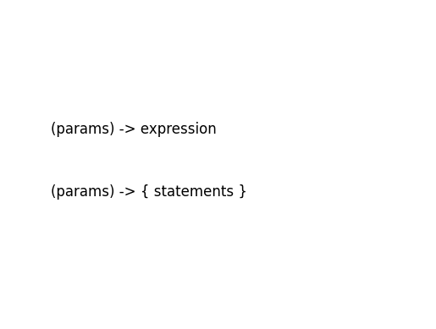
Lambda Syntax
(params) -> expression
(params) -> { statements }

Slide 4
Functional Interface
• Exactly one abstract method
• Example: Runnable, Callable, Predicate

Slide 5
Built-in Functional Interfaces
Predicate<T>
Function<T,R>
Consumer<T>
Supplier<T>

Slide 6
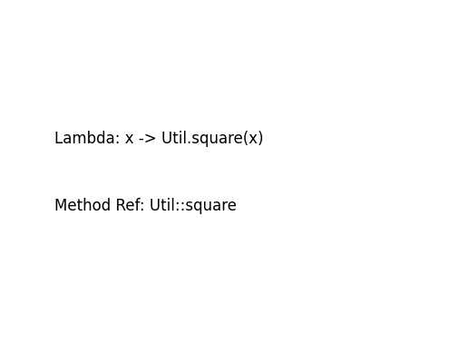
Method References ::
• Static: Class::method
• Instance: obj::method
• Constructor: Class::new

Slide 7
Collections Before Lambda
Traditional loops and iterators

Slide 8
Collections With Lambda
list.forEach(System.out::println)

Slide 9
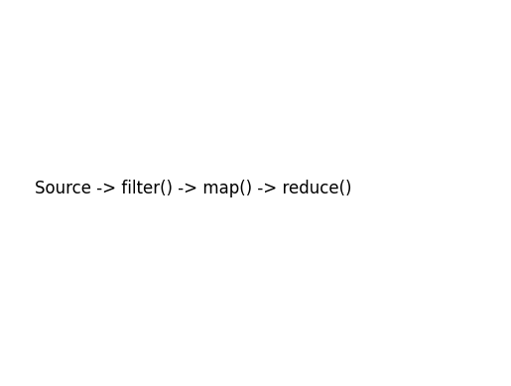
Streams Introduction
• Sequence of elements
• Supports functional operations

Slide 10
Stream Pipeline
Source → Intermediate → Terminal

Slide 11
filter() Operation
stream.filter(x -> x > 10)

Slide 12
map() Operation
stream.map(String::toUpperCase)

Slide 13
reduce() Operation
stream.reduce(0, Integer::sum)

Slide 14
Parallel Streams
stream.parallel() for parallel processing

Slide 15
Banking Case Study
Process transactions using Streams

Slide 16
Advantages of Streams
• Readable
• Declarative
• Easy parallelism

Slide 17
Common Pitfalls
• Streams are single-use
• Side effects in lambdas

Slide 18
Best Practices
• Prefer method references
• Keep lambdas simple

Slide 19
Interview Tips
• Know map vs filter
• Know lazy vs terminal ops

Slide 20
Conclusion
Lambda + Streams = Modern Java

