Slide 1
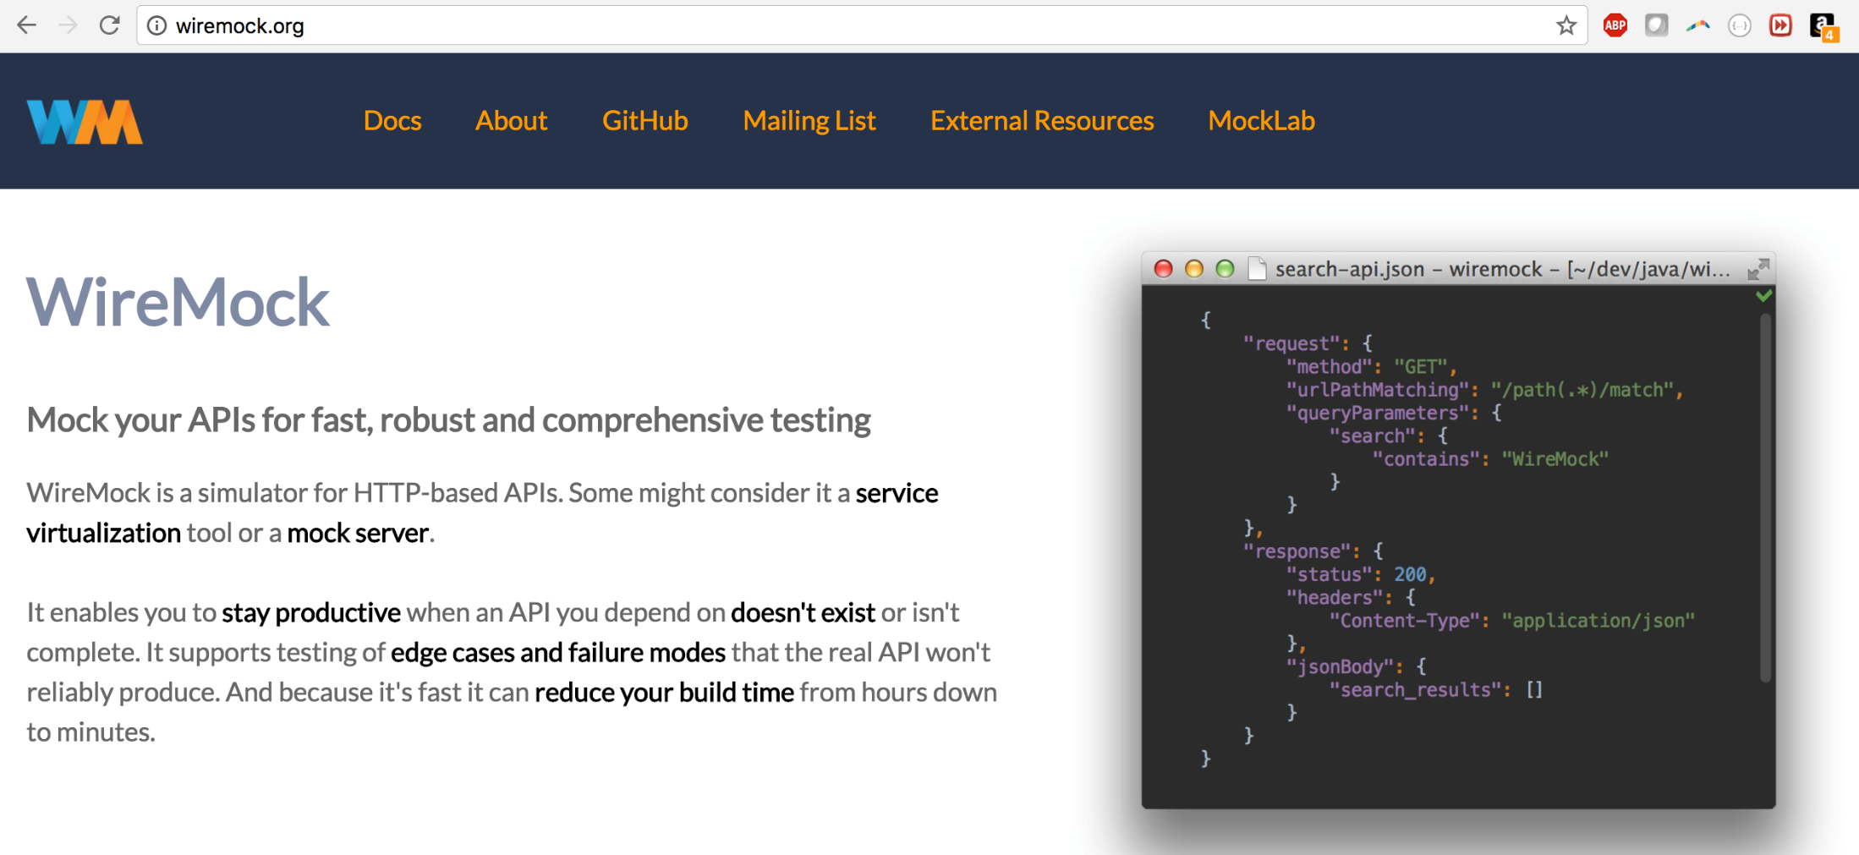

Slide 2
Use cases
REST API contract is ready, but not yet implemented
Services are down (e.g. in test)
You are offline
Notes:
iOS centric

Slide 3
Use cases
REST API contract is ready, but not implementation
Services are down (e.g. in test)
You are offline
Development
Exploratory testing
Automated testing: frontend and backend
Notes:
More broadly

Slide 4
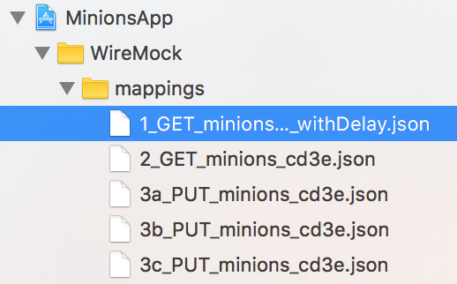
Use cases
Ways to configure
REST API contract is ready, but not implementation
Services are down (e.g. in test)
You are offline
Java API
JSON

Slide 5
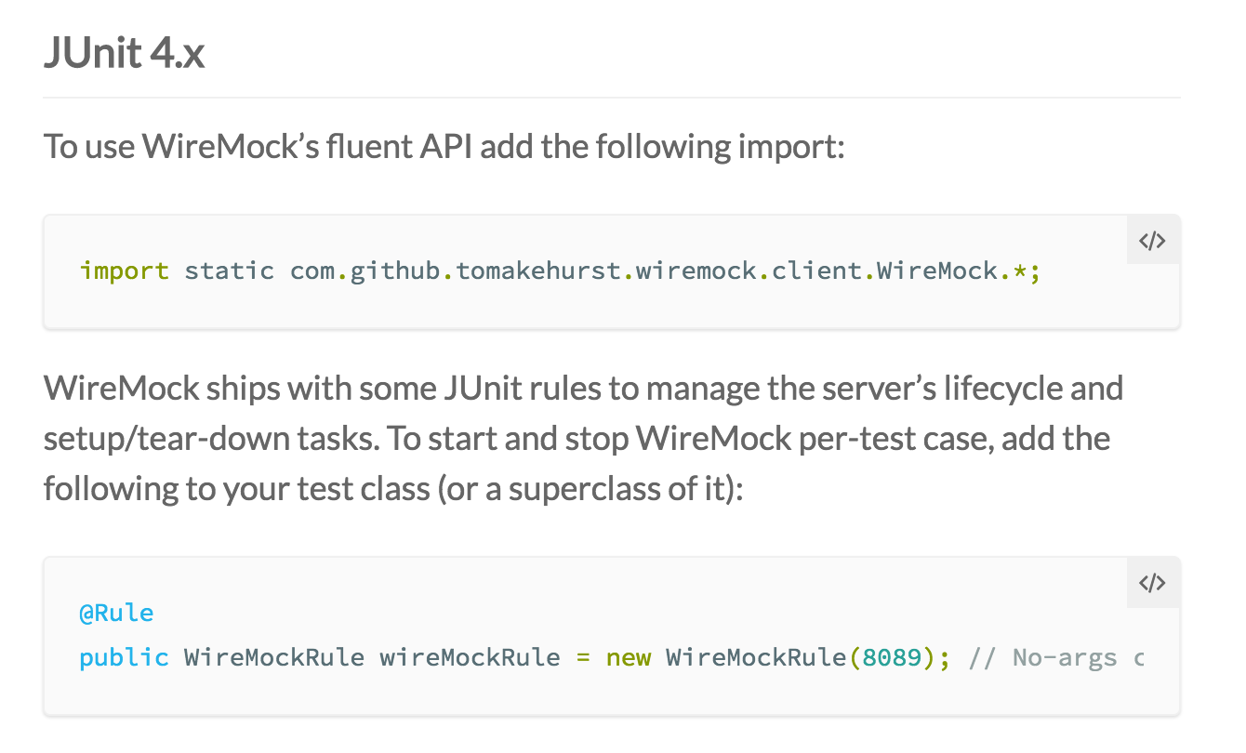
Java API microservices
Notes:
Java API

Slide 6
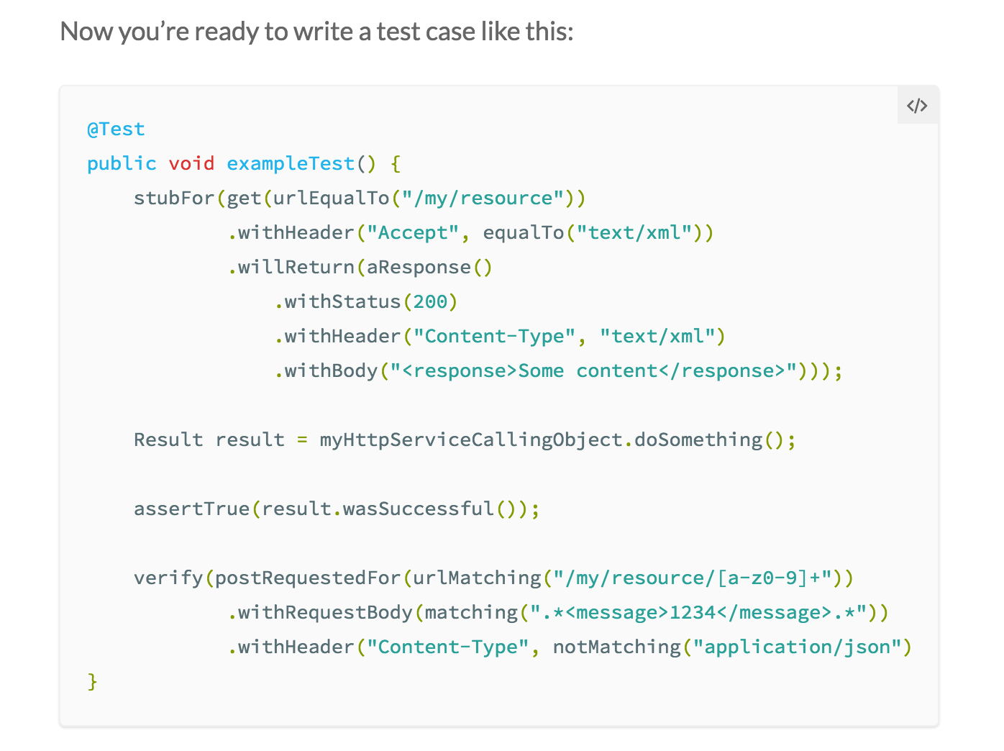
Java API microservices

Slide 7
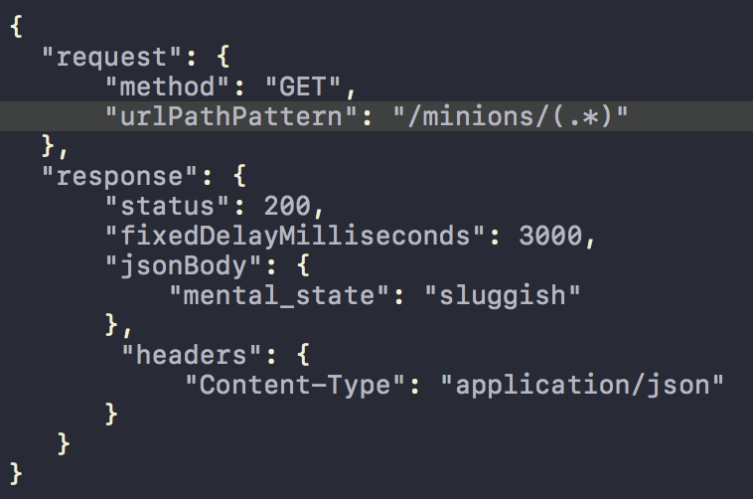
Mocking GET /endpoint/* with a delay

Slide 8
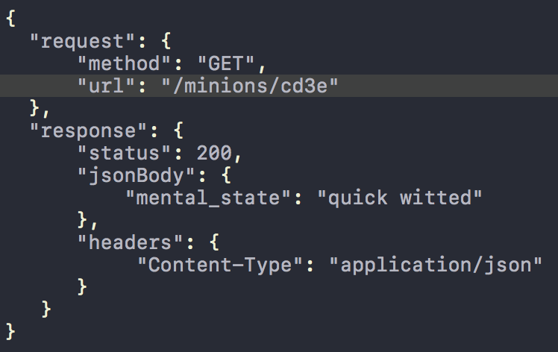
Mocking GET /endpoint/cd3e, no delay

Slide 9
Mocking stateful behavior
“ready”
“set”
“go”
PUT /endpoint/:id

Slide 10
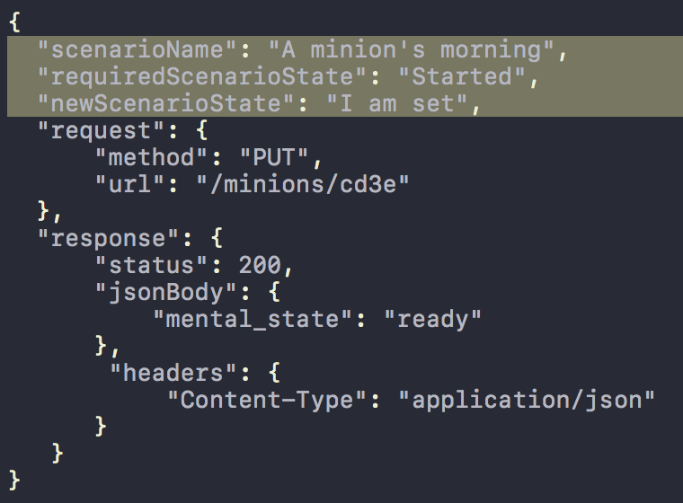
Mocking stateful behavior

Slide 11
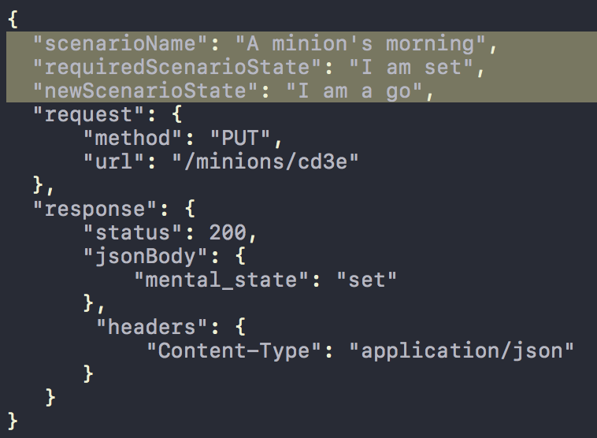
Mocking stateful behavior

Slide 12
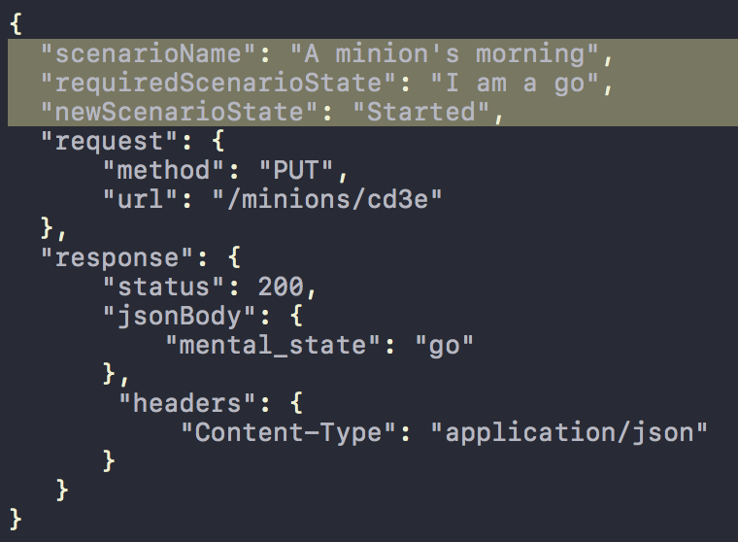
Mocking stateful behavior

Slide 13

As a standalone
Run as a standalone process:
(a) need JRE
(b) download wiremock jar file
(c) download shell launch script
Who can run it?
You
Xcode, as a test “pre-action”
Jenkins
CI/CD!

Slide 14
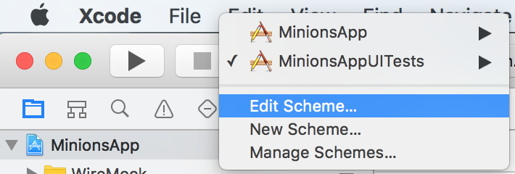
As a standalone from Xcode

Slide 15
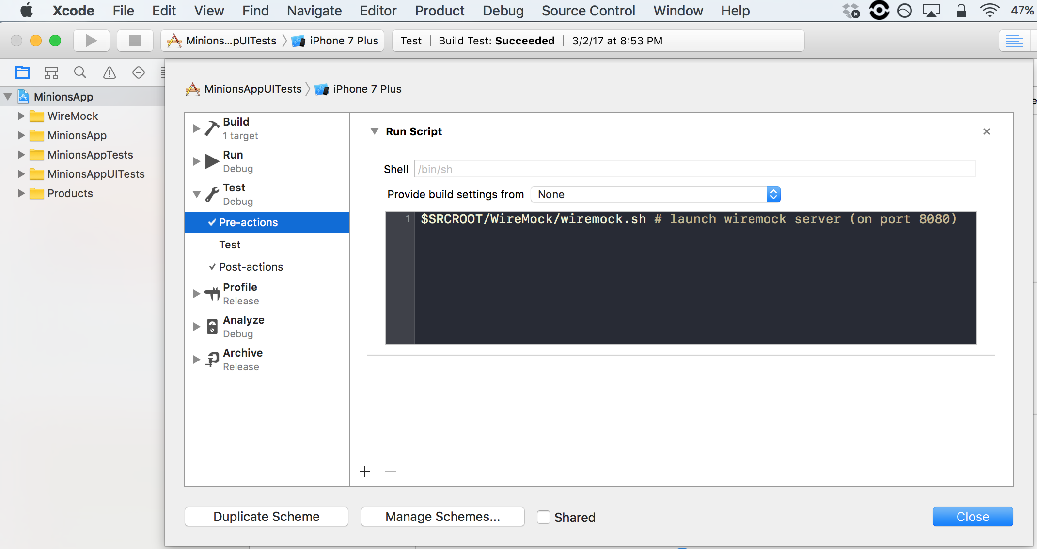
As a standalone from Xcode

Slide 16
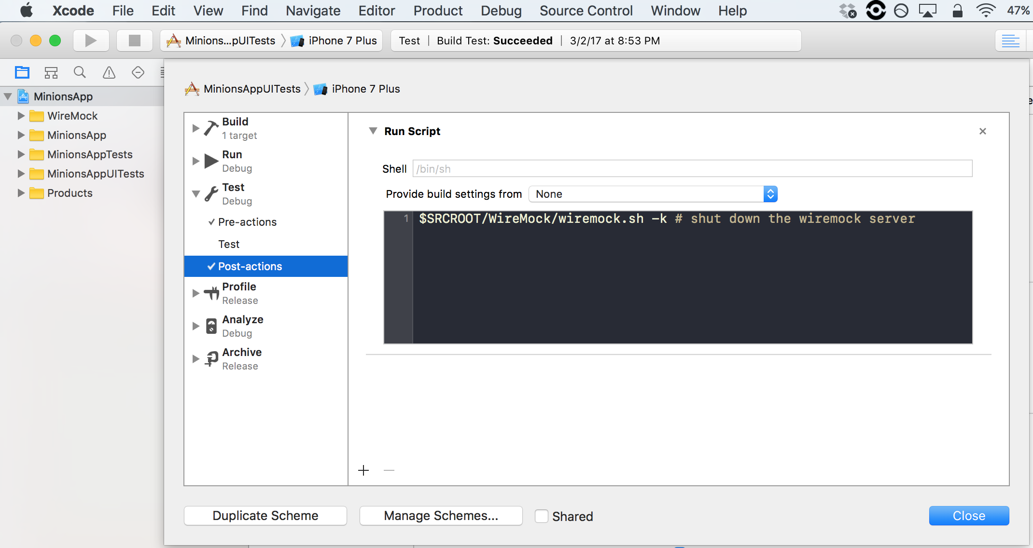
As a standalone from Xcode

Slide 17
These slides,
short demo lab ☺
https://github.com/wbraynen/wiremock

Slide 18
bon
appetit

