Slide 1

MedLift-3D: Click-to-3D Lung Nodule Mass and Growth Assessment from Low-Dose Chest Tomosynthesis with Calibrated Uncertainty
Presented by
Jubair Ahmed (011222136), Foyez A. Naeem (011222011), Motasim Billah (011222016)
Supervisor
Mir Moynuddin Ahmed Shibly
Assistant Professor-On Leave,
Dept. of CSE
Course Teacher
Dr. A.K.M. Muzahidul Islam
Professor, Dept. of CSE
Final Defense · 2 November 2026
Notes:
(0:30) Good morning. We are presenting MedLift-3D. In one sentence: a doctor clicks on a nodule in a low-dose chest tomosynthesis image, and our system returns the nodule's 3D mass and volume, each with an honest, calibrated uncertainty. In the next fifteen minutes we explain the problem, the physics insight behind our design, what we built, what we found (including what did not work), and why.

Slide 2
Table of contents
1. Introduction & Motivation
1-6
• The importance of focusing on lung cancer
• The existing problem: radiation vs. depth
• Key insight and objectives
2. Literature Review
7
• Domain comparison among reviewed papers
3. Project Design
8-14
• Context diagram and methodology
• Dataset, diffusion prior, Gaussians and conformal calibration
• Project plan and work allocation
4. Implementation & Results
15-21
• Application and 3D reconstruction
• Achievements, uncertainty, explainability, accuracy
5. Challenges, Limitations & Conclusion
22-23
• Root causes and fixes
• Contributions and future work
6. References
24
Notes:
(0:20) Our talk has six parts: the motivation, the literature, the design of MedLift-3D, the implementation and results, the challenges and conclusion, and the references.

Slide 3
Introduction & Motivation
Notes:
(0:05) We start with why lung nodules matter.

Slide 4
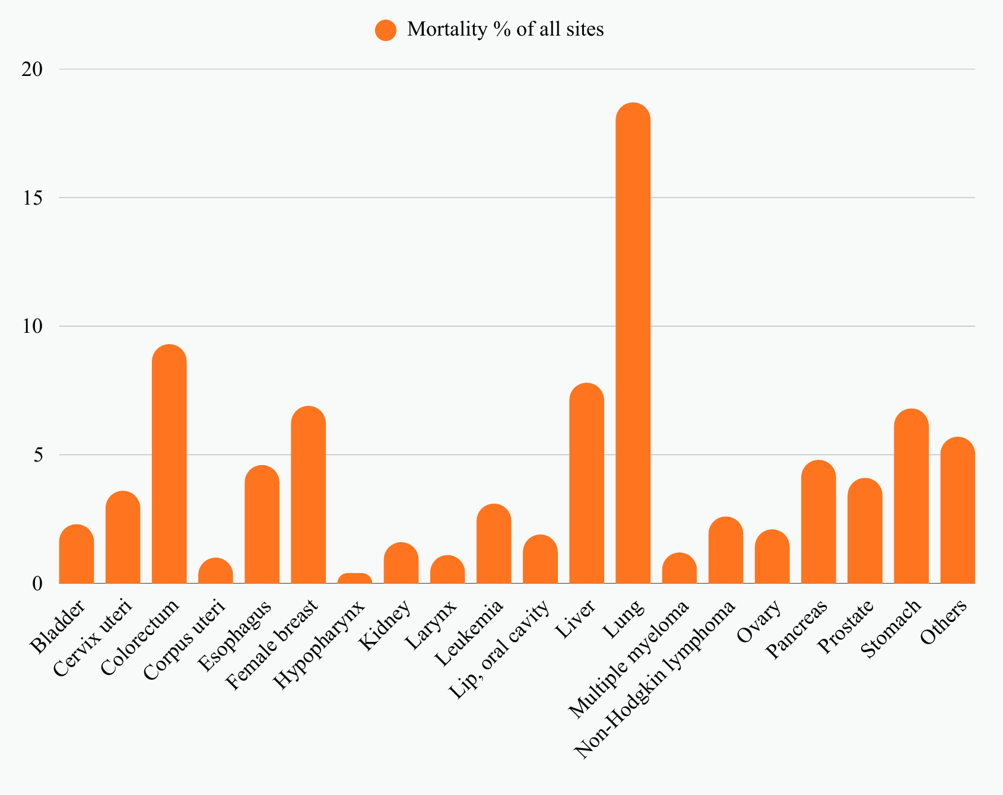
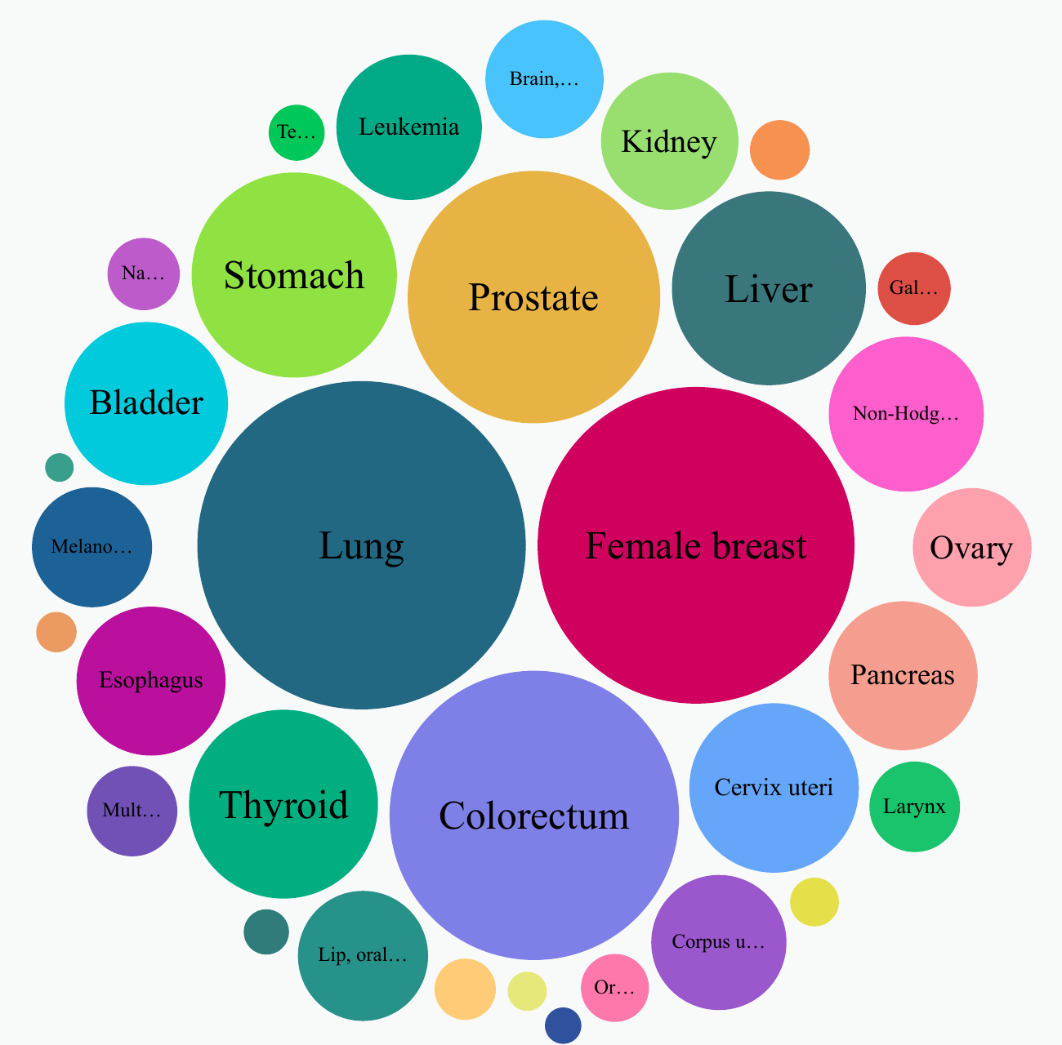
Introduction & Motivation
The Importance of Focusing on Lung Cancer
Fig 1: Distribution of Cancer Mortality by Site (%)
Fig 2: Relative Size of New Cases Across Cancer Types
1
Notes:
(0:35) Lung cancer is the leading cause of cancer death: about 1.8 million deaths in 2022, close to one in five cancer deaths, as the left chart shows. It is also among the most common cancers by new cases. That is why we focus on lung cancer.

Slide 5
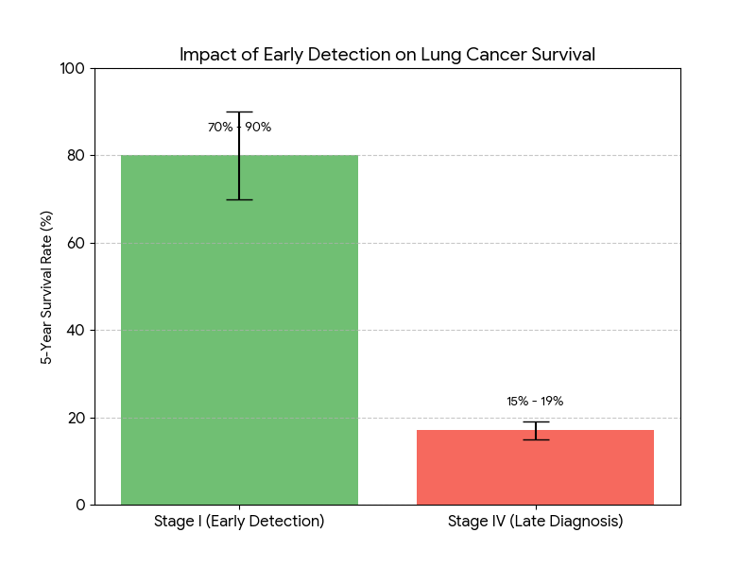
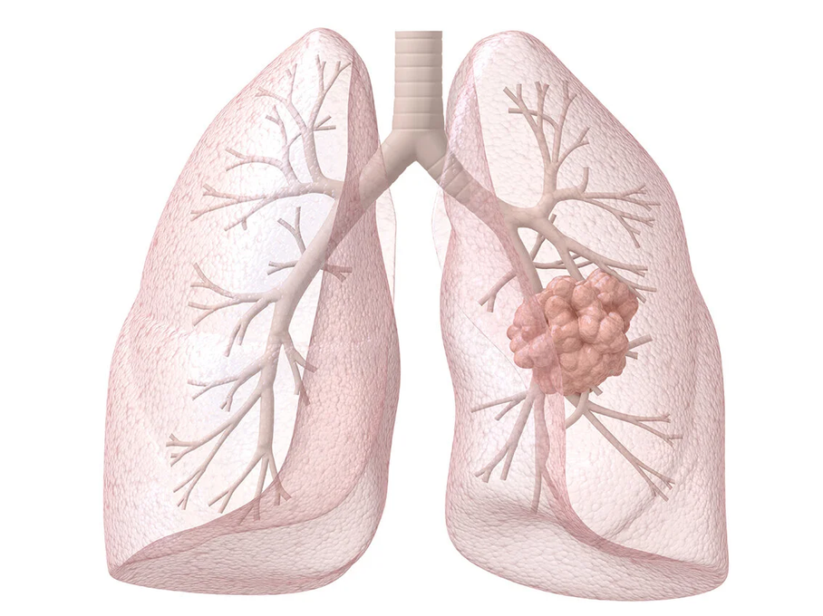
Introduction & Motivation
Why early detection of lung cancer is necessary
Lung Nodule
Fig 3: Impact of Early Detection on Lung Cancer Survival
Fig 4: Lung with nodule
2
Notes:
(0:35) Survival depends on the stage: 70 to 90 percent at stage one, only 15 to 19 percent at stage four. Early cancer appears as a nodule, but most nodules are benign, so doctors follow them over months and measure growth. Today that means repeated CT.

Slide 6
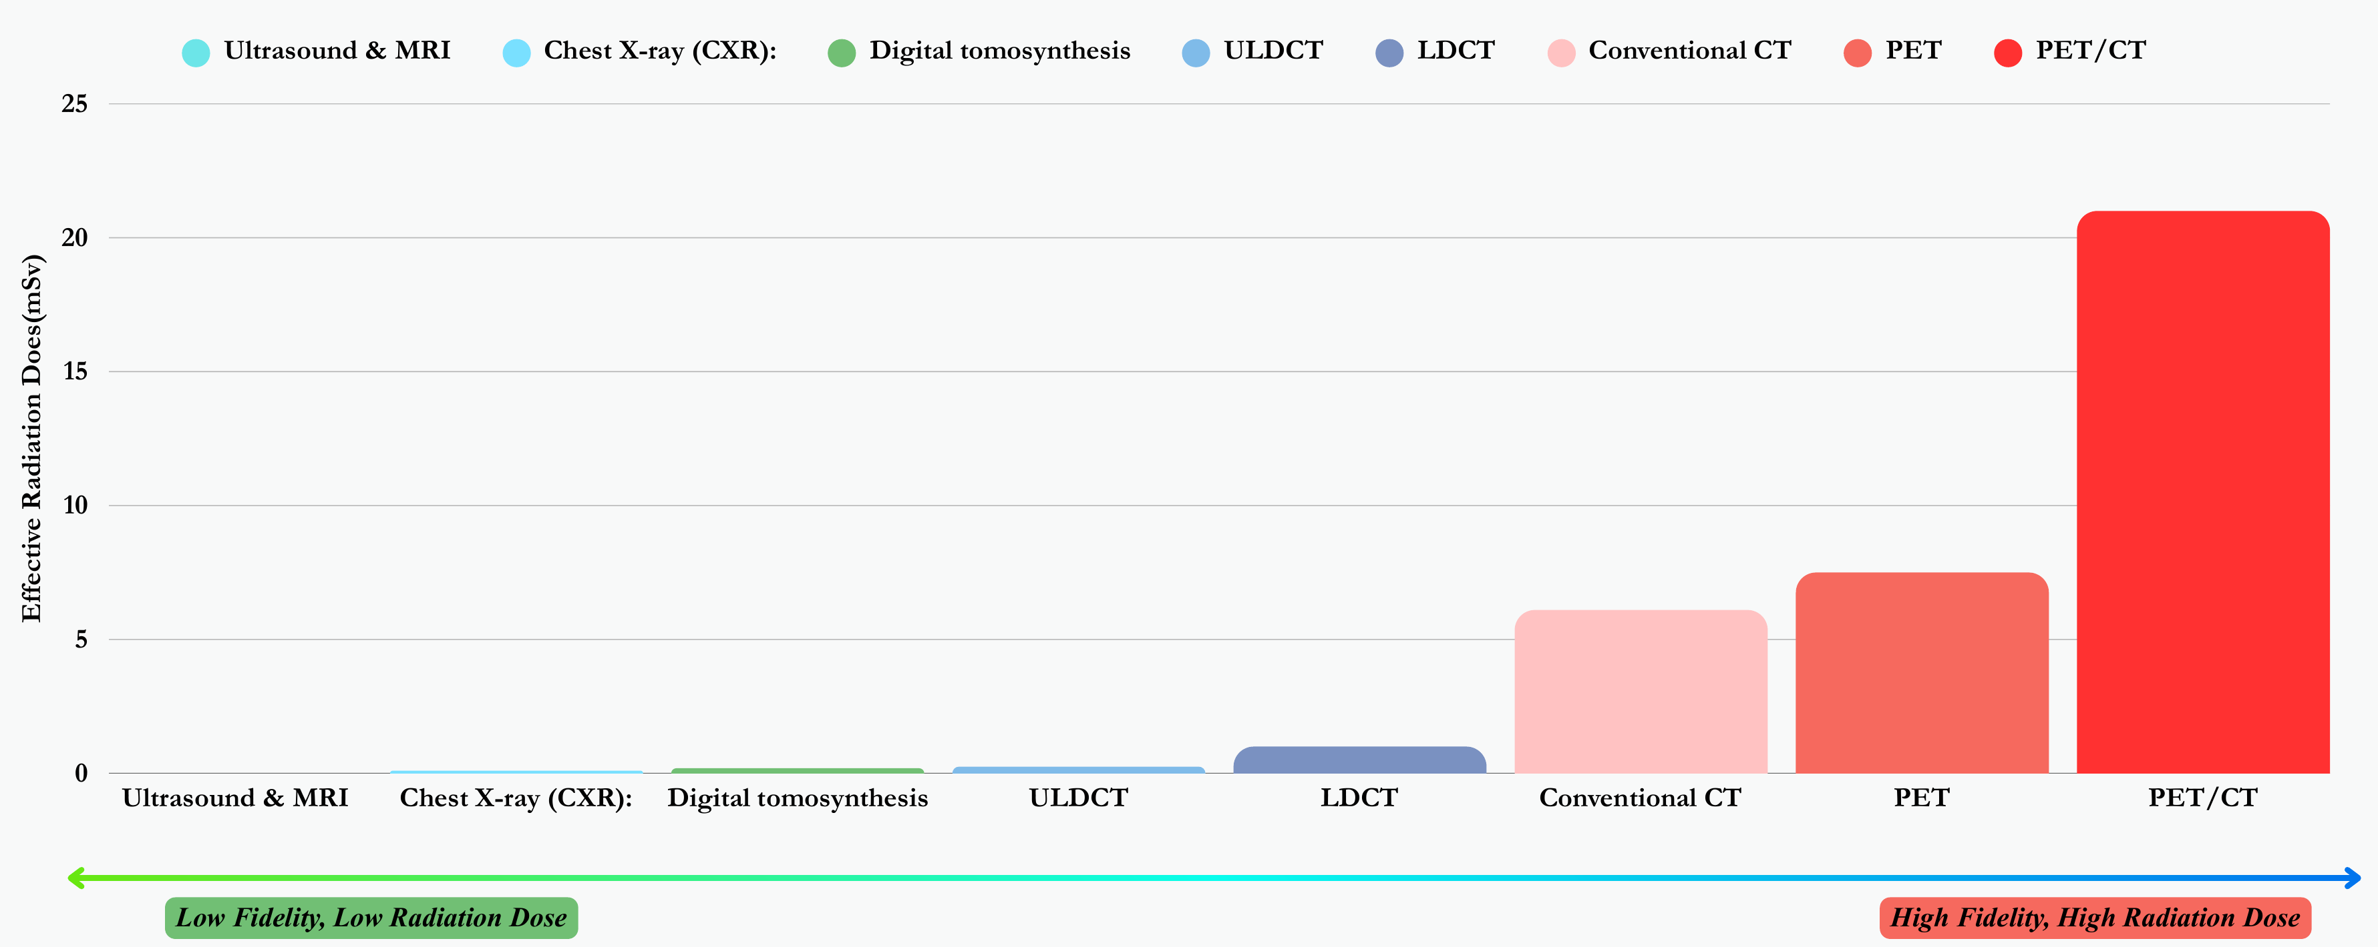
Existing Problem
That actually motivates us
Fig 5: Comparison of radiation doses in medical imaging
3
Notes:
(0:35) Every CT follow-up costs several millisieverts of radiation, money and travel; in Bangladesh CT is concentrated in big cities. Digital chest tomosynthesis, in green on the left, gives a fraction of the dose at much lower cost. The catch: it cannot see depth, so it gives no trustworthy 3D size. That is the gap we address.

Slide 7
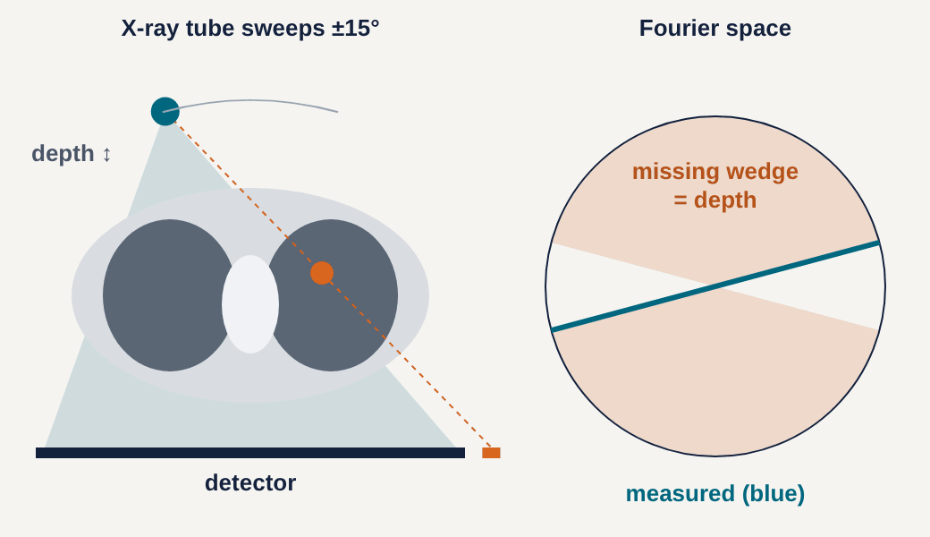
Existing Problem
Why tomosynthesis cannot measure depth: the missing wedge
Depth from a shift
The nodule’s shadow moves on the detector as the tube sweeps ±15°; that shift is the only depth information.
A thin fan in Fourier space
Fifteen views fill a narrow fan; the depth directions are never measured.
Result
A nodule smears 3–5× longer in depth (median 3.5 on LIDC).
Fig 6: DTS acquisition (left) and the measured fan in Fourier space (right)
4
Notes:
(0:50) This animation shows how tomosynthesis works. On the left, the X-ray tube sweeps over plus or minus 15 degrees. Watch the nodule's shadow on the detector move as the tube moves; that small shift is the only depth information we get. On the right is the same thing in Fourier space: each view measures one line, so fifteen views fill only a thin fan. The orange region, the depth frequencies, is never measured: the missing wedge. In practice a nodule reconstructed from DTS is smeared three to five times longer in depth than in-plane.

Slide 8
Key Insight
What DTS can measure: projection moments
Zeroth moment = mass
∬ pθ(x, v) dx dv = M
Identical in all 15 views, independent of depth. Verified numerically to 0.03%.
Second moment = depth extent
∝ sin²θ
1 / sin²15° ≈ 15× worse conditioned. Volume needs depth extent; mass does not.
Design consequence: report mass first, fill depth with a learned prior that must agree with the X-rays, and attach a calibrated uncertainty to every number.
5
Notes:
(0:55) This is the idea our design is built on. We asked what DTS can measure, not just what it can show. If we take moments of each projection: the zeroth moment, the total signal on the detector, equals the nodule's mass in every single view, no matter how deep it is. We verified this numerically to 0.03 percent. But the depth extent, which you need for volume, enters through sine squared of the tube angle; at 15 degrees that is about 15 times worse conditioned. So: mass first, a learned prior for depth that must agree with the X-rays, and calibrated uncertainty on everything.

Slide 9
Objective
Research objectives of MedLift-3D
We aim to measure lung nodules in 3D from safe, low-dose chest tomosynthesis: one click returns the nodule’s mass, volume and growth, each with a calibrated uncertainty and an explanation.
01
Mass first
Measure nodule mass, the quantity DTS captures best
02
Learned prior
Fill the missing depth with a diffusion model and 3D Gaussians
03
Uncertainty
Give every number a calibrated 90% interval
04
Growth
Measure growth as mass and volume doubling time
05
Risk
Give calibrated probabilities of the clinical size categories
06
Explainability
Show what the X-rays saw and what the prior filled in
6
Notes:
(0:35) We set six objectives. Measure mass first, because that is what tomosynthesis captures best. Fill the missing depth with a learned diffusion prior and 3D Gaussians. Give every number a calibrated 90 percent interval. Measure growth as mass and volume doubling time. Give calibrated probabilities of the clinical size categories. And explain every result by showing what the X-rays saw and what the prior filled in. All of this inside a usable click-to-3D application with a learned detector, running on low-cost cloud hardware.

Slide 10
Literature Review
Notes:
(0:05) How does this compare with existing work?

Slide 11
Domain Comparison among Reviewed Papers
References | DTS geometry | Learned prior | Data consistency | Gaussian mass | Clinical biomarker | Calibrated UQ | Seen / unseen
[1] Li et al., 2025 | ✗ | ✗ | ✓ | ✗ | ✗ | ✗ | ✗
[2] Zha et al., 2024 | ✗ | ✗ | ✓ | ✗ | ✗ | ✗ | ✗
[3] Chung et al., 2023 | ✗ | ✓ | ✓ | ✗ | ✗ | ✗ | ✗
[4] Zhang et al., 2025 | ✗ | ✓ | ✓ | ✗ | ✗ | partly | ✗
[5] Bhadra et al., 2021 | ✗ | ✗ | n/a | ✗ | ✗ | ✗ | ✓
[6] de Hoop et al., 2010 | ✗ | ✗ | n/a | ✗ | ✓ | ✗ | ✗
Ours: MedLift-3D | ✓ | ✓ | ✓ | ✓ | ✓ | ✓ | ✓
Each element exists somewhere; MedLift-3D is the only system among these to combine all seven for DTS nodule measurement, with a mass-first design and a truth-checked evaluation.
7
Notes:
(0:40) Where does MedLift-3D stand against the closest published work? We compared seven elements: built for tomosynthesis geometry, a learned prior, data consistency with the X-rays, closed-form Gaussian mass, a clinical biomarker as output, calibrated uncertainty, and a seen-versus-unseen explanation. Gaussian tomography methods such as Li and Zha have data consistency but no learned prior. Diffusion methods such as Chung and Zhang have a prior, but are not built for tomosynthesis and do not output a clinical number. Bhadra defined the null-space analysis of hallucinations, and de Hoop established nodule mass as a biomarker in CT. Of these, only MedLift-3D brings all seven together for low-dose tomosynthesis nodule measurement. To be precise about our claim: each element exists on its own; our contribution is the combination, the mass-first design, and a calibrated, truth-checked evaluation.

Slide 12
Project Design
Context, methodology, data and plan
Notes:
(0:05) Now the design of the system.

Slide 13
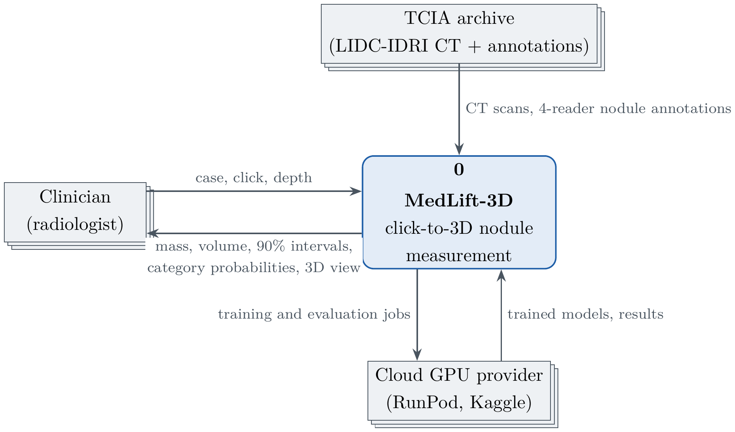
Project Design
Context Diagram
Fig 7: Context Diagram (DFD level 0)
8
Notes:
(0:25) The context diagram. The clinician sends a case and a click and receives mass, volume, 90 percent intervals, category probabilities and a 3D view. Training data comes from the TCIA archive, LIDC-IDRI CT with four-reader annotations, and the heavy training runs on a cloud GPU provider.

Slide 14
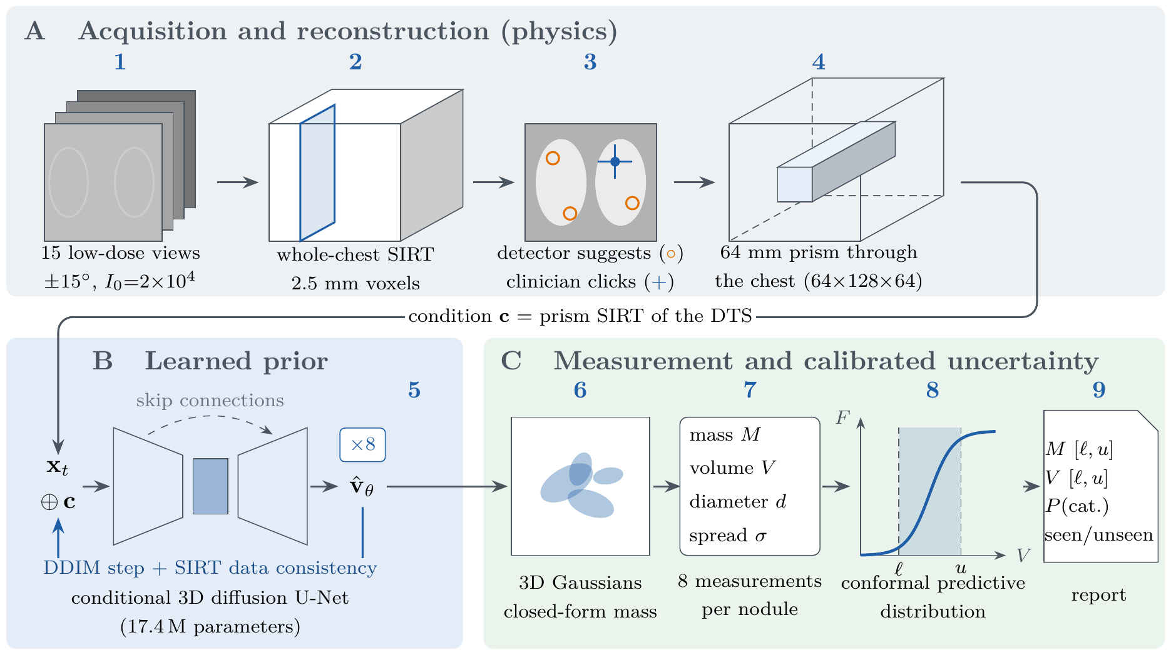
Project Design
Methodology: from one click to a 3D measurement with uncertainty
Fig 8: MedLift-3D pipeline: physics (A), learned prior (B), measurement and calibrated uncertainty (C)
9
Notes:
(1:00) Here is the full pipeline, which I'll build up step by step. One: we simulate the DTS scan, 15 low-dose views, reconstructed with SIRT. Two: the clinician clicks, helped by a learned 3D detector. Three: we reconstruct a 64 millimetre prism, a column through the whole chest around the click. Four: a conditional 3D diffusion model generates eight CT-like hypotheses of that prism, and inside the sampler we keep pulling each one back to agree with the X-rays. Five: we fit 3D Gaussians, which give the mass in closed form. Six: conformal prediction turns the spread into calibrated intervals and size-category probabilities. Seven: we split every result into what the X-rays saw and what the prior filled in. Grey is physics, blue is learned, green is measurement and trust. Everything runs as 18 verified steps.

Slide 15
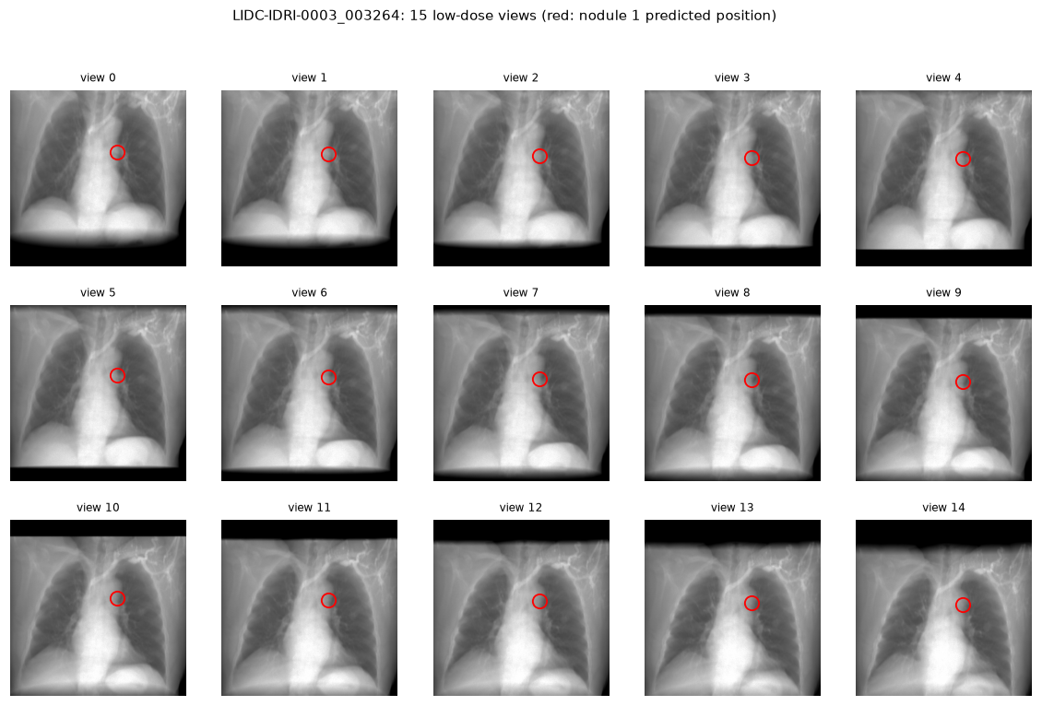
Project Design
Dataset: real patient CT, simulated low-dose DTS
583
LIDC-IDRI patients (TCIA, CC BY 3.0)
1,144
nodules of 4–30 mm marked by ≥3 of 4 radiologists
60 / 20 / 20
train / calibration / test, split by patient
2,522
training pairs; 150 nodules measured (76 cal, 74 test)
Fig 9: Fifteen simulated low-dose DTS views of one LIDC-IDRI patient
10
Notes:
(0:45) No public dataset has chest DTS together with CT ground truth, so we ran a virtual clinical trial. We took 583 real patients from LIDC-IDRI, 1,144 nodules between 4 and 30 millimetres that at least three of four radiologists marked, and simulated 15-view low-dose DTS from each CT with realistic Poisson noise. On the left are the fifteen simulated views of one patient; the red circle marks the nodule. We split by patient, 60/20/20, so no test patient is ever seen in training or calibration. The diffusion prior trained on 2,522 pairs; 150 nodules were measured with every method.

Slide 16
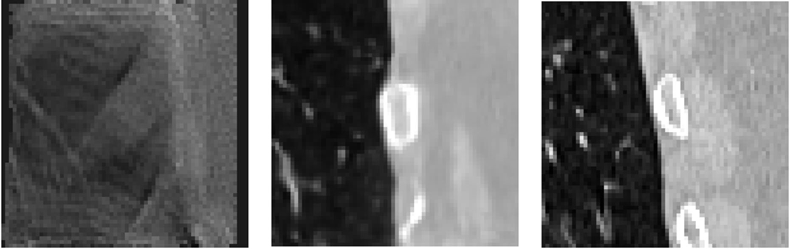
Project Design
Learned prior: a conditional 3D diffusion model fills the missing wedge
DTS input (condition)
Diffusion sample
CT truth
17.4 M
parameter 3D U-Net, v-prediction, DDIM
SIRT
steps inside the sampler keep samples X-ray consistent
27,610
training steps in 6 hours on 2,522 pairs
+3.35 dB
held-out nodule PSNR, 11.88 → 15.23 dB
11
Notes:
(0:55) The core learned component is a conditional 3D diffusion model with 17.4 million parameters. It is conditioned on the blurry DTS reconstruction of the prism and generates CT-like volumes. To stop it from inventing anatomy, we insert SIRT data-consistency steps inside the sampler, so every sample must still reproduce the measured X-rays. Here is a held-out example: left the DTS input, middle our sample, right the real CT; the sample recovers sharp ribs and vessels. It trained for 27,610 steps in six hours, and on held-out patients raised nodule-region PSNR from 11.88 to 15.23 dB. Fit checks showed no memorisation of inputs, but it is still under-trained.

Slide 17
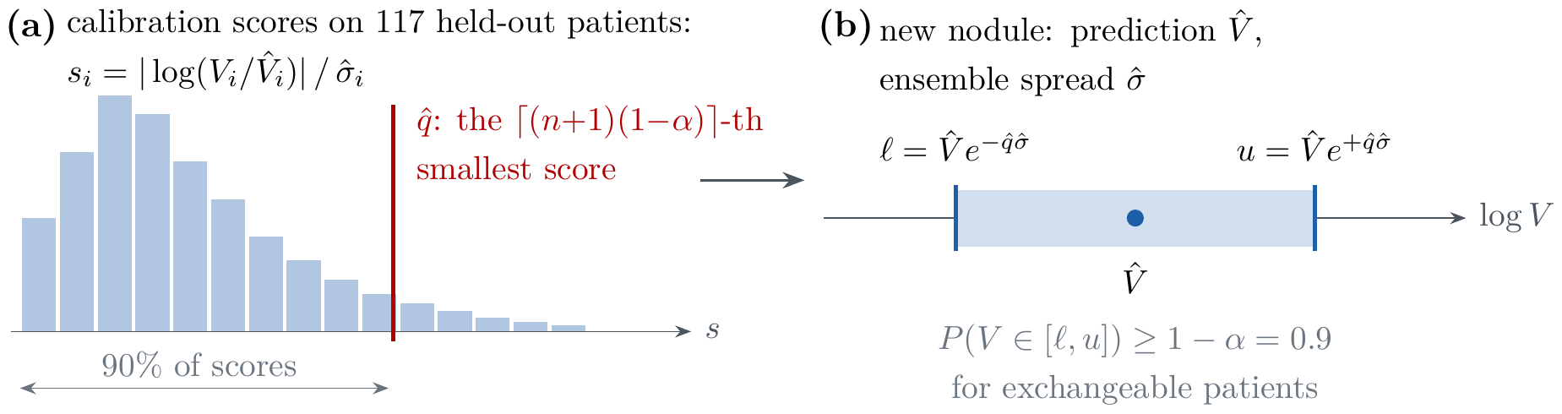
Project Design
Measurement: 3D Gaussians for mass, conformal prediction for intervals
3D Gaussians
Conformal calibration
Each diffusion sample is fitted with anisotropic Gaussians. The nodule’s mass is a closed-form sum: amplitude × (2π)^(3/2) × s₁ s₂ s₃, with no voxel counting.
Errors on 76 calibration nodules set the 90% quantile; every new estimate gets that interval and calibrated probabilities of the clinical size categories.
12
Notes:
(0:50) Each diffusion sample is fitted with anisotropic 3D Gaussians. The nice property is that the integral of a Gaussian is known exactly, so the nodule's mass is a closed-form sum, no voxel counting. For trust, we use split conformal prediction: we measure the errors on 76 calibration nodules from patients never used in training, take the 90 percent quantile, and that becomes the interval for every new nodule. This gives a coverage guarantee without assuming any error distribution. We also produce calibrated probabilities of the clinical size categories, below 100, 100 to 300, and above 300 cubic millimetres.

Slide 18
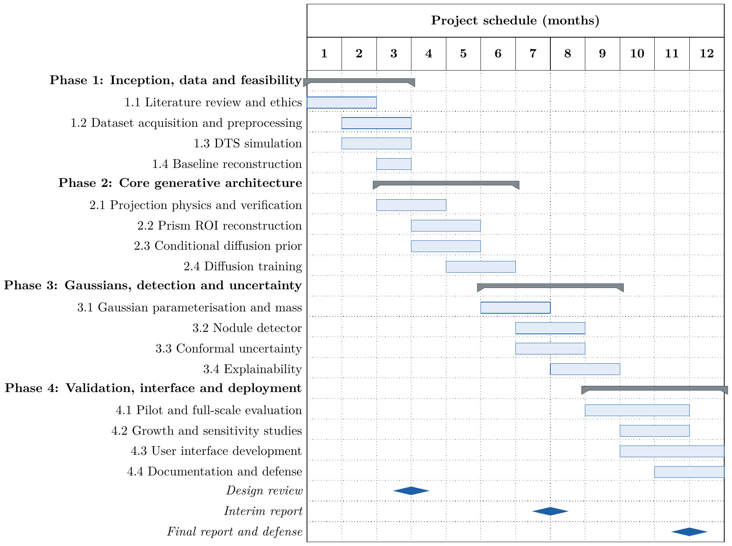
Project Design
Project Plan (12 months)
Fig 11: Project schedule: four phases over twelve months
13
Notes:
(0:30) Our twelve-month plan had four phases: inception, data and feasibility; the core generative architecture; Gaussians, detection and uncertainty; and validation, interface and deployment. The milestones were the design review in month four, the interim report in month eight and the final report and defense in month twelve.

Slide 19
Project Design
Work Allocation
Team member | Role | Responsibilities
Jubair Ahmed 011222136 | Lead AI architect | Projection-moment analysis · conditional diffusion prior (v-prediction, DDIM) · SIRT data consistency · conformal intervals and category probabilities
Foyez A. Naeem 011222011 | Systems engineer | Differentiable DTS projector and prism reconstruction · GPU optimisation · 3D Gaussian mass · nodule detector · RunPod/Kaggle infrastructure and the full run
Motasim Billah 011222016 | Full-stack developer | LIDC-IDRI curation and preprocessing · click-to-3D interface with 3D view · evaluation, growth and explainability outputs · HTML report
All members |  | Literature review, verification of every PASS/FAIL step, report writing and presentation
14
Notes:
(0:25) Work was split by strength. Jubair led the theory and the learned prior and calibration; Foyez the physics engine, GPU optimisation, Gaussian mass, detector and cloud infrastructure; Motasim the data, the application and the evaluation outputs. All of us reviewed every verification step.

Slide 20
Implementation & Results
Held-out patients never seen in training
Notes:
(0:20) Now the results. Everything we show is measured on held-out patients that the models never saw during training. In short: the whole system works end to end, every component met its own target, our physics insight was confirmed on real data, and where accuracy still falls short, we found exactly why and how to fix it.

Slide 21
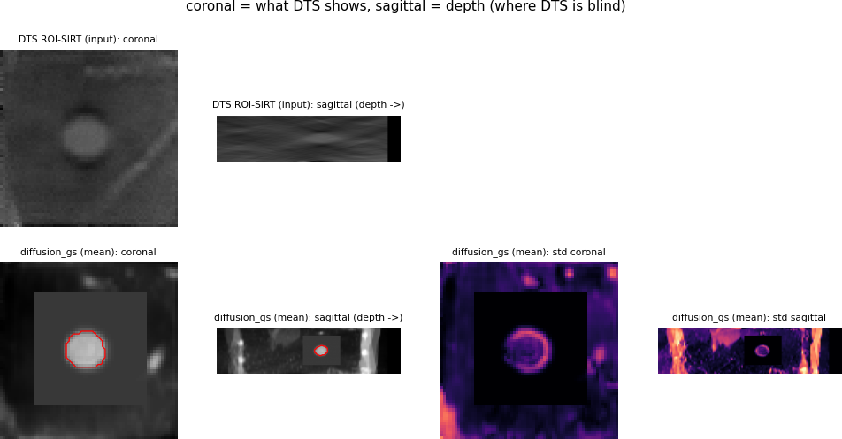
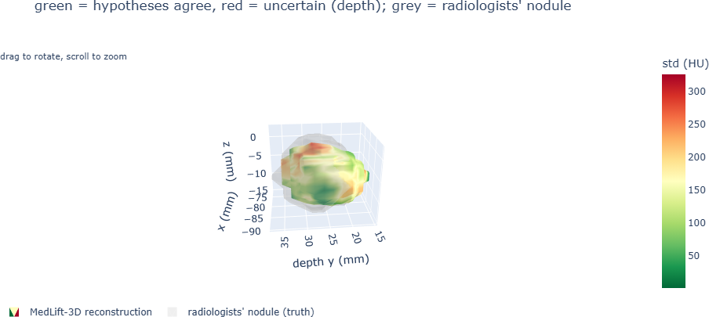
Implementation & Results
User Interface: click a nodule, get its 3D measurement in under a minute
Fig 13: Interactive 3D view coloured by uncertainty
Returns mass, volume and EUPS category with intervals and probabilities, plus a low-confidence flag. Runs on a free Kaggle GPU.
Fig 12: Prism views: DTS input and reconstruction with segmentation and sample spread
15
Notes:
(0:50) This is the working application. The clinician picks a patient, the detector suggests nodules, and one click runs the whole pipeline. On the left are the prism views: the blurry DTS input on top, and below our reconstruction with its segmentation in red and the spread of the eight samples. The spread is highest in the depth view, exactly as the physics predicts. On the right, the interactive 3D view: green where the samples agree, red where they disagree, and the radiologists' nodule in grey for comparison. It returns mass, volume, the EUPS category with probabilities, and a low-confidence flag that tells the doctor when to order a CT instead. It runs on a free Kaggle notebook.

Slide 22
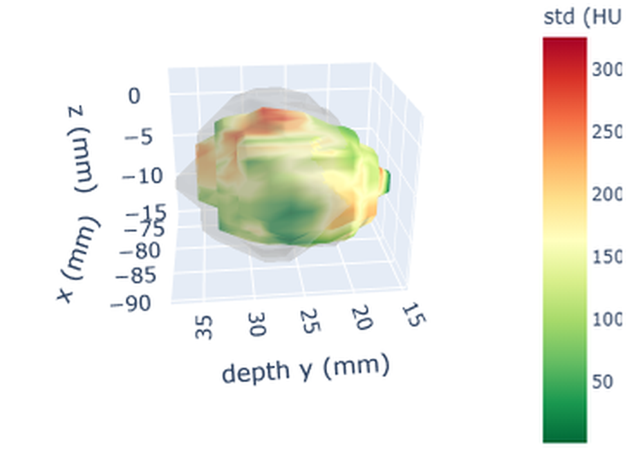
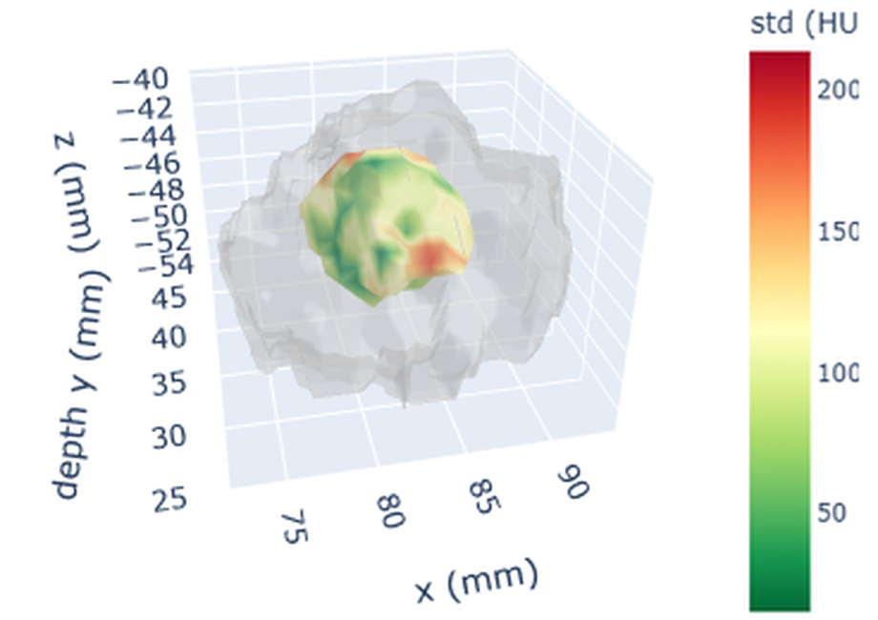
Implementation & Results
3D nodule reconstruction, coloured by certainty
(a) Match. The reconstruction fills the radiologists’ nodule; red patches sit at the depth edges.
(b) Under-estimate. Smaller than the radiologists’ nodule: the gap our next step closes.
Fig 14: Colour = disagreement of the 8 samples (green agree, red uncertain); grey shell = radiologists’ nodule
16
Notes:
(0:40) Here is what the reconstruction looks like in 3D, from the application on two test nodules. The surface is our reconstructed nodule, coloured by how much the eight diffusion samples disagree: green where they agree, red where they do not. The grey shell is the radiologists' nodule, the ground truth. On the left the reconstruction fills the true nodule well, and the uncertainty sits at the front and back, the depth direction, exactly where tomosynthesis is blind. On the right the reconstruction is smaller than the truth; this under-estimation is the gap our root-cause analysis addresses later.

Slide 23
Implementation Verification & Results
Every component met its own specification
Diffusion prior
+3.35 dB
nodule PSNR on held-out data, 11.88 → 15.23 dB
Learned detector
17× better
CPM 0.298 vs 0.017 for a training-free baseline
Conformal intervals
95% coverage
target 90%; raw ensemble spread covered only 28%
Size-category risk
0.54 → 0.17
Brier score for P(volume ≥ 100 mm³), a 68% reduction
17
Notes:
(0:50) Our achievements. The diffusion prior improved nodule-region image quality on held-out patients by 3.35 dB. The learned detector is 17 times better than a training-free detector by the standard CPM score. Our conformal intervals reached 95 percent coverage on new patients, above the 90 percent target, while the raw spread of the samples covered only 28 percent; so calibration is what makes our uncertainty trustworthy. And calibrated probabilities cut the Brier score for "is this nodule at least 100 cubic millimetres" from 0.54 to 0.17, a 68 percent reduction.

Slide 24
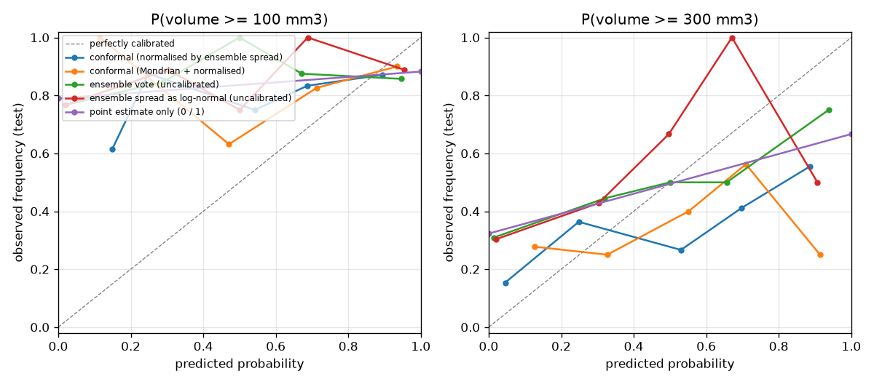
Implementation & Results
Calibrated uncertainty: our intervals keep their guarantee on new patients
Coverage met
95–96% for the 90% target.
Risk calibrated
ECE 0.58 → 0.12; right category 38% vs 26%.
Next step
Narrower intervals once failed reads are handled separately.
Fig 15: Reliability of the size-category probabilities
Insight: raw sample spread is not a safe uncertainty (ρ = −0.52 with error), which is exactly why we calibrate.
18
Notes:
(0:50) Uncertainty is where MedLift-3D differs from typical generative imaging. Our conformal intervals kept their guarantee on new patients: 95 to 96 percent coverage for a 90 percent target. The calibrated size-category probabilities are reliable too: at the 100 cubic millimetre threshold the calibration error fell from 0.58 to 0.12, and the most likely category was right 38 percent of the time instead of 26. The next step is width: when a reconstruction finds nothing at the click, that zero measurement widens the intervals a lot, so we will report those cases separately. And one insight for the field: the raw spread of generated samples correlates negatively with the error, so uncalibrated spread is not a safe uncertainty. Calibration is essential.

Slide 25
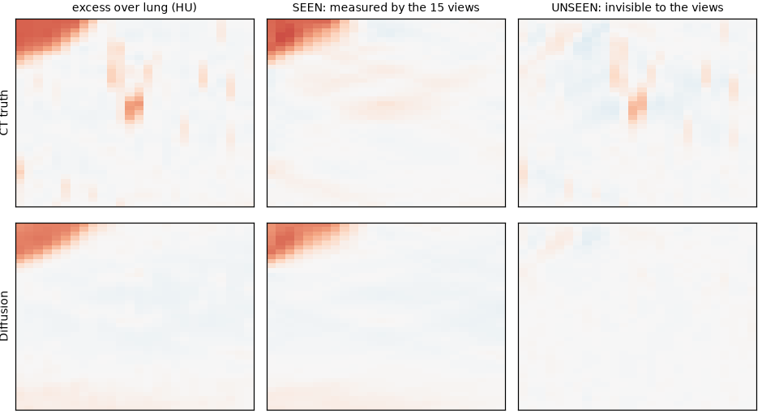
Implementation & Results
Explainability: what the X-rays saw and what the AI filled in
0.3%
of nodule mass is unseen: the X-rays measure mass, as the physics predicts
+0.22
unseen skill of the prior vs truth [0.14, 0.36]: it recovers, not invents
0.09
skill left after Gaussian fitting: that step discards what the prior found
Fig 16: Null-space split of one test nodule (top: CT truth, bottom: diffusion prior)
19
Notes:
(0:50) Explainability. Using a conjugate-gradient null-space decomposition we split every 3D result into the part the fifteen X-rays actually measured, the seen part, and the part they cannot see, which only the prior can supply. The table of numbers on the right is the result over 30 test nodules. Only 0.3 percent of a nodule's mass is in the unseen part, which confirms our physics argument: the X-rays do measure mass. The prior's unseen content has a positive skill of 0.22 against the real CT, so it recovers missing depth rather than inventing structure. But after Gaussian fitting the skill falls to 0.09, so the Gaussian step throws away much of what the prior recovered. That points directly to a fix.

Slide 26
Implementation & Results
Accuracy benchmark: volume from DTS is hard for every method
Volume error, median absolute % (lower is better; a failure counts as 100%)
Best of six
Our diffusion prior had the lowest error and the fewest failures (3%).
2D diameter → sphere
88.0
Coarse DTS SIRT
100
Prism ROI-SIRT
91.2
Hard for all
Even the clinical 2D standard errs by 88%.
Physics-only Gaussians
87.7
Our diffusion prior
74.5 (best)
Open challenge
Learned methods under-estimate size; the cause is found.
Diffusion + Gaussians
94.6
20
Notes:
(0:55) This is our accuracy benchmark: six methods on 74 test nodules, median volume error, lower is better, and a failed reading counts as 100 percent. Volume from tomosynthesis is hard for every method: even the clinical standard, the 2D diameter, is off by 88 percent. Our diffusion prior, in green, had the lowest error of all six methods, 74.5 percent, and the fewest failures, 3 percent. Adding the Gaussian step raised the error to 94.6, so the full pipeline did not yet beat physics-only reconstruction. The learned methods under-estimate size, and we traced exactly why, which I will show shortly. The lesson: sharper images alone are not enough; the measurement step must preserve the nodule.

Slide 27
Implementation Verification & Results
The complete system at a glance
583
patients processed end to end, 1,144 nodules
18
scripted steps, each with automatic PASS/FAIL checks
69
unit tests covering physics, models and measurement
15 h
full study on one rented L40S GPU, about US$20
17.4 M
parameter 3D diffusion model, trained in 6 hours
45.5 s
median per nodule, all five reconstruction methods
21
Notes:
(0:40) Beyond the research results, this is a complete engineering system. We processed 583 patients and 1,144 nodules end to end. The pipeline has 18 scripted steps, each ending in automatic PASS/FAIL checks, and 69 unit tests cover the physics, the models and the measurement. The full study ran in about 15 hours on one rented L40S GPU for about 20 US dollars. The diffusion model has 17.4 million parameters and trained in 6 hours. And measuring one nodule with all five reconstruction methods takes a median of 45.5 seconds; the application itself runs on a free Kaggle GPU.

Slide 28
Challenges, Limitations & Conclusion
Notes:
(0:05) Finally, what limits the system today and what comes next.

Slide 29
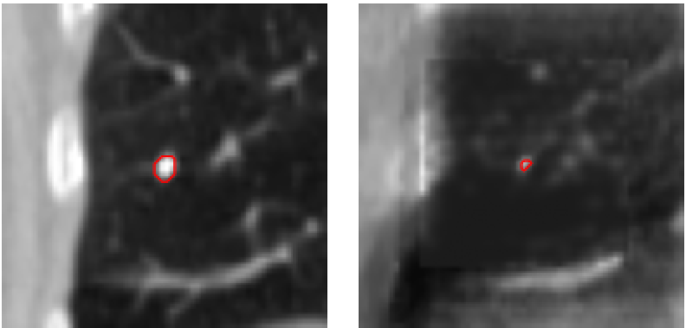
Implementation Challenges & Limitations
Every gap traced to a cause and a concrete fix
Challenge 1: Faint nodules get shrunk
Fix: Condition the prior on the click and oversample nodule pairs.
Challenge 2: Mass read from the image
Fix: Read it from the projections, where 99.7% of mass is measured.
Fig 17: 6.8 mm test nodule: CT truth (left), reconstruction shrunk (right)
Limitations
• Simulated DTS from CT; real scanners not yet tested
• 15 views, 30° sweep; one acquisition geometry
• 150 measured nodules and 40 growth pairs
Challenge 3: Failed reads widen intervals
Fix: Report “not measurable” separately and calibrate the rest.
22
Notes:
(0:55) A strength of our pipeline is that it tells us why. Our analysis traced every gap to a specific cause, each with a concrete fix. First, faint nodules get shrunk: the prior was not told a nodule is present at the click, so for faint ones it draws normal lung. Here is a 6.8 millimetre nodule, clear in CT and almost erased in the reconstruction. The fix is to condition the prior on the click. Second, we read mass from the reconstructed image, so segmentation errors leaked in, even though our explainability analysis shows the X-rays themselves measure 99.7 percent of the mass. The fix is to read mass directly from the projections. Third, failed readings widen the intervals; the fix is to report them as their own outcome. All three fixes are within reach of the existing system.

Slide 30
Conclusion
MedLift-3D turns one click on a low-dose chest tomosynthesis image into a 3D lung nodule measurement with calibrated, explainable uncertainty. We showed that DTS measures nodule mass in every view, built an X-ray-consistent diffusion prior with closed-form Gaussian mass, and validated the complete click-to-3D system on 583 patients for about US$22.
Future work
• Click-conditioned, nodule-preserving prior and projection-domain mass measurement
• Failure-aware calibration for narrower intervals
• Real DTS + CT data with a hospital partner; Bangla interface and PACS integration
23
Notes:
(0:45) To conclude. We delivered a physics result, that tomosynthesis measures mass but not depth extent; a diffusion prior kept consistent with the X-rays, with closed-form Gaussian mass; calibrated, decision-level uncertainty; a truth-referenced test of what a generative prior adds; and a verified 18-step pipeline with a working click-to-3D application. The next steps follow directly from our root-cause analysis: a click-conditioned prior, mass read from the projections, failure-aware calibration, and real DTS data with a hospital partner. MedLift-3D shows that low-dose, click-to-3D nodule assessment with calibrated and explainable uncertainty is buildable, for about 22 US dollars. Thank you.

Slide 31
References
[1] Y. Li, X. Fu, H. Li, S. Zhao, R. Jin, and S. K. Zhou, “3DGR-CT: Sparse-view CT reconstruction with a 3D Gaussian representation,” Medical Image Analysis, vol. 103, p. 103585, 2025.
[2] R. Zha, T. J. Lin, Y. Cai, J. Cao, Y. Zhang, and H. Li, “R²-Gaussian: Rectifying radiative Gaussian splatting for tomographic reconstruction,” in Proc. NeurIPS, 2024.
[3] H. Chung, J. Kim, M. T. Mccann, M. L. Klasky, and J. C. Ye, “Diffusion posterior sampling for general noisy inverse problems,” in Proc. ICLR, 2023.
[4] S. Bhadra, V. A. Kelkar, F. J. Brooks, and M. A. Anastasio, “On hallucinations in tomographic image reconstruction,” IEEE Trans. Med. Imaging, vol. 40, no. 11, pp. 3249–3260, 2021.
[5] B. de Hoop et al., “Pulmonary ground-glass nodules: increase in mass as an early indicator of growth,” Radiology, vol. 255, no. 1, pp. 199–206, 2010.
[6] S. G. Armato III et al., “The Lung Image Database Consortium (LIDC) and Image Database Resource Initiative (IDRI),” Medical Physics, vol. 38, no. 2, pp. 915–931, 2011.
[7] J. Ho, A. Jain, and P. Abbeel, “Denoising diffusion probabilistic models,” in Proc. NeurIPS, 2020.
[8] B. Kerbl, G. Kopanas, T. Leimkühler, and G. Drettakis, “3D Gaussian splatting for real-time radiance field rendering,” ACM Trans. Graphics, vol. 42, no. 4, 2023.
[9] V. Vovk, J. Shen, V. Manokhin, and M. Xie, “Nonparametric predictive distributions based on conformal prediction,” Machine Learning, vol. 108, pp. 445–474, 2019.
[10] J. T. Dobbins III and D. J. Godfrey, “Digital x-ray tomosynthesis: current state of the art and clinical potential,” Phys. Med. Biol., vol. 48, no. 19, pp. R65–R106, 2003.
[11] F. Bray et al., “Global cancer statistics 2022: GLOBOCAN estimates of incidence and mortality worldwide,” CA Cancer J. Clin., vol. 74, no. 3, 2024.
24
Notes:
(0:05) Our main references; the full list of more than seventy is in the report.

Slide 32

Thank you.
We welcome your questions.
Notes:
Likely questions and short answers. Why simulated DTS? No public chest DTS dataset with CT ground truth exists; simulation from real CT gives exact ground truth. Why only 15 views? Same dose as clinical units; our geometry study showed view count barely changes the depth smear at equal dose, a 40 degree sweep helps about 9 percent. Is the prior hallucinating? The seen/unseen test shows positive unseen skill of 0.22, and data-consistency keeps every sample faithful to the X-rays. Overfitting? Denoising loss train vs held-out ratio 0.97, but sample gain +7.00 vs +4.22 dB, so some patient-level advantage, and still under-trained. Why is mass not yet more accurate if the X-rays measure it exactly? Because we measured mass from the reconstruction inside a segmentation, not from the projections. Clinical use? Not yet; decision support only, a low-confidence flag tells the doctor to order CT.

