Slide 1

ITI113 - MACHINE LEARNING OPERATIONS | TEAM 02
Explainable Diabetes Risk
Screening AI
Final Presentation - Dataset, Modelling, Governance, and the Deployed System End-to-End
Djony Pamudji
Fong Siang Yi
Teh Tze Chee
Model A - Logistic Regression
Model B - XGBoost
MLOps, Deployment & Live Demo

Slide 2
SECTION 01
01
Problem Statement

Slide 3
01 - PROBLEM & APPROACH
A Fast, Low-Friction Screening Signal
Type 2 diabetes and prediabetes are frequently undiagnosed until complications appear. Our goal: give a person - or a frontline health worker - a way to flag who should be prioritised for a confirmatory clinical test, using only self-reportable answers.
BUSINESS OBJECTIVE
Prioritise the right people for a confirmatory test
ML OBJECTIVE
Binary classification
Maximise PR-AUC / recall under class imbalance - not raw accuracy
Diabetes/prediabetes vs. no diabetes - a screening flag, not a diagnosis
Input
21 self-reported clinical, lifestyle & demographic indicators
A false negative (missed case) is costlier than a false positive (unneeded follow-up test) - every modelling choice traces back to this.
ML objective
Recall-aware (PR-AUC primary) - a missed case costs more than an unneeded test
3
Notes:
Develop a Machine Learning Diabetes to help frontline health worker to prioritise for next clinical test using the self-reportable answer based on set of questions
Healthcare always believe preventive is always better than cure, treat it earlier, therefore the model is maximizing PR-AUC/recall under class imbalance data, a missed case is costlier than unneeded follow up test.

Slide 4
SECTION 02
02
Dataset & Baseline
Screening objective, the health-indicator dataset and its EDA, and the Logistic Regression baseline evaluation
Djony Pamudji
Data & EDA * Model A – Logistic Regression

Slide 5
Diabetes Health Indicators
Target after binary conversion
for Diabetes Screening
Kaggle health-indicator dataset • screening-support classifier • Logistic Regression Model A
Negative 84.24%
253,680
21
15.76%
Screening
Positive 15.76%
Rows
Predictors
Positive class
Purpose
Evidence to retain 3-class label
Inside positive class: 39,977 records
Prediabetes: 4,631 (11.6%)
Diabetes: 35,346 (88.4%)
Diabetes is 7.6× prediabetes
Use Diabetes_012 for EDA/audit; binary target for screening.
Goal: flag respondents likely to have prediabetes or diabetes for follow-up, not diagnosis.
Transcript: The positive screening class combines prediabetes and diabetes. Within that positive class, prediabetes is only 4,631 cases (11.6%), while diabetes is 35,346 cases (88.4%). This 7.6:1 difference is why the original three-class label is retained for EDA and audit, while the model uses a binary target for screening.
Diabetes Health Indicators Screening • 1/5

Slide 6
Dataset, EDA & Univariate Findings
Raw shape preserved; no missing-data removal; strongest individual EDA signals identified.
253,680×22
0
21
15.76%
+1 / −1
None > 0.80
Raw dataset
Rows removed
Predictors
Positive class
Leakage-safe target handling
Severe pair correlation
Top Associations with Diabetes_Binary
EDA quality & anomaly findings
GenHlth
0.301
• Missing values: none; no imputation was needed.
• Rows removed: 0; no deletion for missing data or invalid ranges.
• Exact duplicate removal: not evidenced in this EDA run.
• Columns: Diabetes_binary was added for screening (+1); Diabetes_012 was retained for EDA/audit but excluded from model predictors (−1) to prevent leakage.
• BMI, MentHlth and PhysHlth contain skewed/extreme values, treated as plausible/valid observations.
• No outlier rows removed and no skew-correction transformation applied.
HighBP
0.270
BMI
0.224
DiffWalk
0.222
HighChol
0.210
Age
0.186
Higher bar = stronger individual association with Diabetes_binary
Univariate EDA shows relative signal strength; it does not establish independent predictive effects.
Final modelling set: 21 predictors + 1 binary target • Positive screening class: 15.76% • 253,680 records retained
Diabetes Health Indicators Screening • 2/5

Slide 7
Preprocessing, feature treatment & data split
EDA findings are carried into modelling without unnecessary transformations.
1 EDA → preprocessing
2 Numerical & categorical treatment
3 Split & validation
• BMI, MentHlth and PhysHlth were skewed/extreme but judged plausible/valid. • No outlier rows were removed. • No imputation was required; no skew-correction transformation was applied. • Diabetes_012 is retained for EDA/audit but excluded from model predictors to prevent leakage.
• All 22 source fields are already numeric. • 17 predictors are categorical/ordinal-like; 4 are continuous-ish: BMI, MentHlth, PhysHlth, Age. • No one-hot encoding or ordinal encoder is used. • No standardisation / scaling is applied. • Features remain in their stored numeric coding.
• Stratified 80% train / 20% held-out test. • No fixed 80% / 10% / 10% split in this Logistic Regression workflow. • Stratified 5-fold CV is performed within the 80% training set. • The 20% test set stays untouched until final evaluation.
Training flow: numeric-coded predictors → stratified 80/20 split → 5-fold CV on training set → Logistic Regression tuning
Why this matters
The workflow prioritises leakage control, class-imbalance handling and model tuning rather than altering plausible observations simply because they are skewed.
Transcript: EDA found skewed or extreme BMI, MentHlth and PhysHlth values, but these were retained as plausible observations. No encoder, scaler or skew transformation is applied. The modelling experiment uses a stratified 80/20 split, with stratified 5-fold CV inside the training set and a fully held-out 20% test set.
Diabetes Health Indicators Screening • 3/5

Slide 8
Logistic Regression Model A — Training & Tuning
Model selection uses training-only cross-validation; the test set is reserved for the final check.
Tuning parameter impact
Class weight
0.578
Threshold
0.104
Data profile
0.008
C tuning
0.007
0.0
0.1
0.2
0.3
0.4
0.5
0.6
Relative tuning impact
The visual gap is the key message: class weighting has by far the largest tuning impact.
Optimisation design
What the tuning found
• Logistic Regression; L2 penalty; lbfgs solver. • C grid: 0.001 → 100. • Compare class_weight=None vs. balanced. • Rank candidates by CV PR-AUC first, then ROC-AUC. • Tune threshold 0.05–0.95 using training-only OOF probabilities.
• class_weight='balanced' materially improves minority-class detection. • At the default threshold, recall rises from ~18% to ~76% after balancing. • C tuning is secondary; threshold tuning selects the precision–recall operating point. • Selected settings: C = 100; threshold = 0.59.
Finding: The near-unchanged PR-AUC and ROC-AUC indicate that class weighting mainly changed the classification operating point rather than materially improving the model's ability to rank positive cases above negative cases.
Key training finding: class imbalance, not regularisation strength, is the dominant tuning issue for this screening task.
Leakage control
Threshold selection uses training-only OOF probabilities, while the 20% test set remains unseen until final evaluation.
Transcript: Model A uses L2 Logistic Regression with lbfgs. C values from 0.001 to 100 and class weighting are compared using stratified 5-fold CV, ranked by PR-AUC then ROC-AUC. Thresholds from 0.05 to 0.95 are tested using training-only OOF probabilities. Balanced class weight is the strongest tuning lever; C=100 and threshold 0.59 are selected.
Diabetes Health Indicators Screening • 4/5

Slide 9
Optimized Model A — Final Evaluation
Balanced Logistic Regression for diabetes screening; test set used only after model selection.
MODEL
C
CLASS WEIGHT
PENALTY / SOLVER
THRESHOLD
Logistic Regression
100
balanced
L2 / lbfgs
0.59
0.818
0.433
0.657
0.381
0.482
0.728
ROC-AUC
PR-AUC
Recall
Precision
F1
Bal. Acc.
Held-out confusion matrix
Interpretation for screening
Pred 0 Pred 1 Actual 0 34,202 8,539 Actual 1 2,745 5,250 TP = 5,250 FN = 2,745 FP = 8,539 TN = 34,202
• On 50,736 unseen test records, the model identified 5,250 of 7,995 positive cases (65.7% recall).
• However, 2,745 positive cases were missed, while 8,539 of the 13,789 flagged cases were false positives (38.1% precision).
• ROC-AUC 0.818 passes the ≥0.75 quality gate.
• This is a screening-support model, not a diagnostic tool.
Decision: Model A is a viable baseline, but it is not yet the champion model.
Next step & limitation
Compare Model A with XGBoost on the same held-out test protocol before final champion selection.
Transcript: The final Model A is balanced Logistic Regression with C=100 and threshold 0.59. On the held-out test set it achieves ROC-AUC 0.818, PR-AUC 0.433, recall 0.657, precision 0.381, F1 0.482 and balanced accuracy 0.728. It correctly identifies 5,250 of 7,995 positive screening cases; 2,745 positive cases (34.3%) are not captured. It remains a screening model and must be compared with XGBoost before promotion.
Diabetes Health Indicators Screening • 5/5

Slide 10
SECTION 03
03
Data Preparation & Modelling
Feature engineering and bias mitigation, then baseline versus challenger tuning and the champion decision
Fong Siang Yi
Data & EDA * Model B - XGBoost

Slide 11
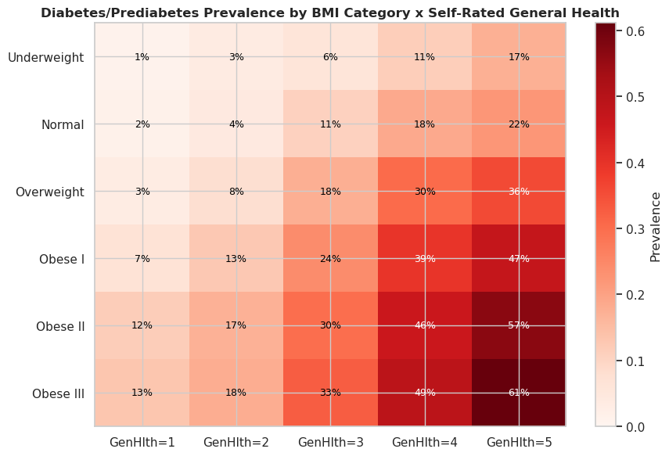

SECTION 2 - DATA PREPARATION
EDA & Feature Engineering: From Insight to Model-Ready Data
253,680
21
5.34 : 1
7
respondents
(BRFSS 2015)
raw indicators
class imbalance
engineered
features
FEATURE ENGINEERING - VALIDATED, NOT ASSUMED
Comorbidity_Score (r=0.347) and BMI x HighBP interaction (r=0.306) both beat the strongest raw feature (GenHlth, r=0.301) - direct evidence the engineered composites add genuine signal.
DATA BIAS & MITIGATION
Non-response bias
BRFSS silently excludes non-answers
Disclosed as a labelled limitation
1.1% -> 61.2% (56x)
Duplicate-profile bias
23,899 duplicates, ~99% healthy class
Duplicate-safe split, not deletion
BMI x GenHlth prevalence compounds - not additive. The strongest single finding in the EDA.
Subgroup outcome gaps
Prevalence differs by Sex/Age/Income
Sample size confirmed before fairness testing
GOVERNANCE FINDING - VERIFIED AGAINST THE MODELLING NOTEBOOK
Both trained models currently use only the 21 raw features - none of the 7 validated engineered features (incl. Comorbidity_Score and BMI x HighBP, which each outperform every raw feature) reach either model. This is the single highest-value next step identified for this project.

Slide 12

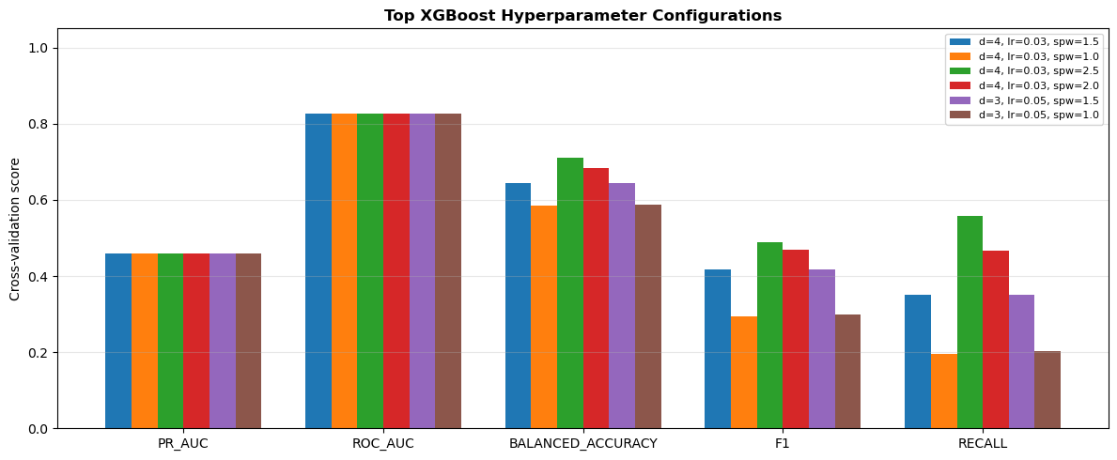
SECTION 3 - MODELLING & EXPERIMENTS
Baseline, Hypothesis & Tuning Strategy
BASELINE
CHALLENGER
Champion: XGBoost
Model A - Logistic Regression
Model B - XGBoost
Linear combination of risk factors is sufficient.
Non-linear interactions (BMI x HighBP) need a tree ensemble.
HARD GATES - ALL PASSED
12 tuning candidates (C x class_weight)
30 candidates: 5 structures x 6 class weights
- Checksum-verified exact-row comparison
Regularisation barely moves CV PR-AUC (0.0036 spread across 4 orders of magnitude)
Revised search - excludes the full imbalance ratio to avoid over-trading precision for recall
- Quality gate: test ROC-AUC >= 0.75 (0.825)
- SHAP explainability logged
PRIMARY METRIC
PR-AUC predeclared before results seen - XGBoost +0.032 vs. baseline.
DISCLOSED, NOT HIDDEN
Recall, F2, FNR and balanced accuracy all favour the baseline - reported openly as a real trade-off, not reframed as a win.
Cross-validated score by metric, top near-best XGBoost configurations

Slide 13
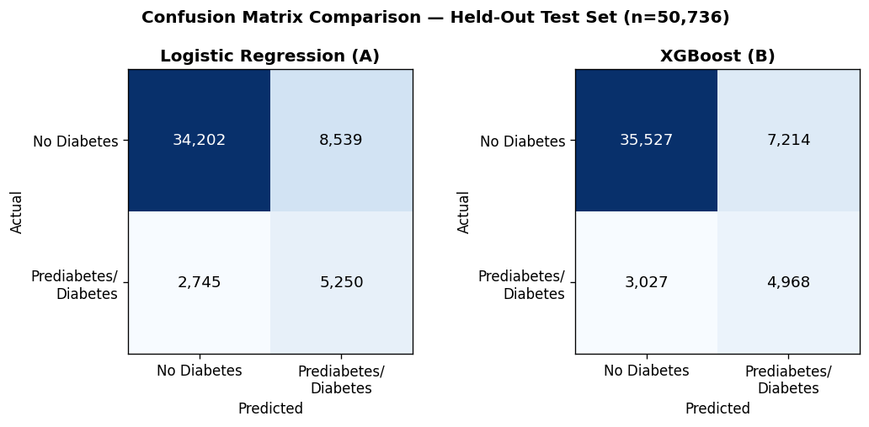


MODEL COMPARISON - SYSTEMATIC EVALUATION
Predictive Performance & Error Behaviour
Metric | LR | XGB
PR-AUC (primary) | 0.433 | 0.464
Recall | 0.657 | 0.621
Precision | 0.381 | 0.408
F1 | 0.482 | 0.492
Specificity | 0.800 | 0.831
FPR | 0.200 | 0.169
Why it matters: at ~5.34:1 imbalance, PR-AUC is the diagnostic metric - ROC-AUC (0.818 vs 0.825) looks deceptively similar; accuracy would be actively misleading.
Moving LR -> XGBoost trades 1,325 fewer false positives for 282 more false negatives.
Better at positive class
Fewer costly errors
PR trade-off
Logistic Regression - recall 0.657 vs. 0.621; catches 282 more of the 7,995 actual positives
Depends on cost assumption: LR has fewer FN (costlier, per Section 1); XGBoost has fewer FP - a real trade, not a win
XGBoost's PR-AUC curve sits at/above LR's across all thresholds - but LR still wins at each model's own chosen operating point
Notes:
Representative false negative
Young, low-BMI, no HighBP/HighChol, excellent self-rated health - an atypical, low-conventional-risk presentation the model cannot be expected to catch.
Representative false positive
HighBP + HighChol + high BMI + poor general health - confidently flagged for genuine, clinically sensible risk-factor co-occurrence, not an arbitrary error.

Slide 14
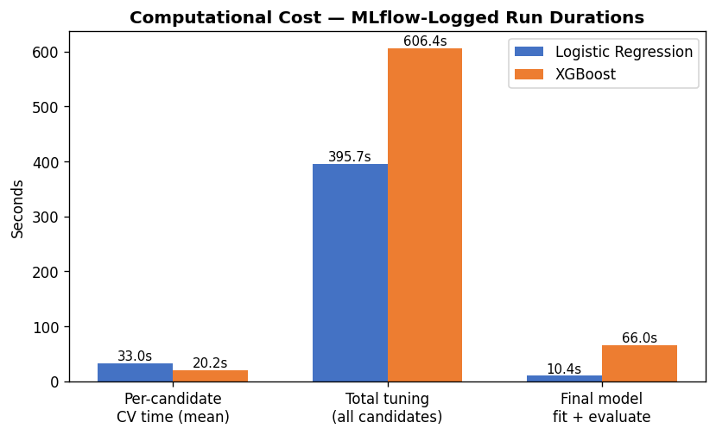
MODEL COMPARISON - SYSTEMATIC EVALUATION
Model Characteristics: Trade-offs Beyond the Numbers
Characteristic | Logistic Regression | XGBoost
Interpretability | High - signed coefficients read directly | Lower - needs SHAP post-hoc
Complexity | 2 hyperparameters, 12 candidates | 9 hyperparameters, 30 candidates
Computational cost | Final fit+eval: 10.4s | Final fit+eval: 66.0s (~6.3x)
Feature-relationship sensitivity | Assumes linear, additive effects | Learns interactions automatically
Non-linear modelling | None natively | Native (motivated by BMI x HighBP finding)
Deployment / maintenance | Lightweight artifact, trivial to audit | Heavier artifact + SHAP dependency
Surprise: XGBoost's mean per-candidate CV time (20.2s) is shorter than LR's (33.0s) - the opposite of the usual assumption.
NO UNIVERSAL WINNER
Each characteristic is a genuine trade-off a deployment decision must weigh - not a checklist where more complexity automatically wins.

Slide 15
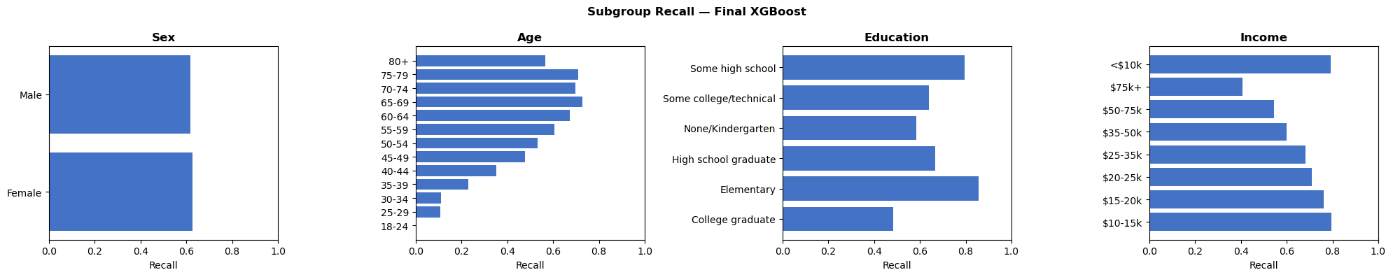
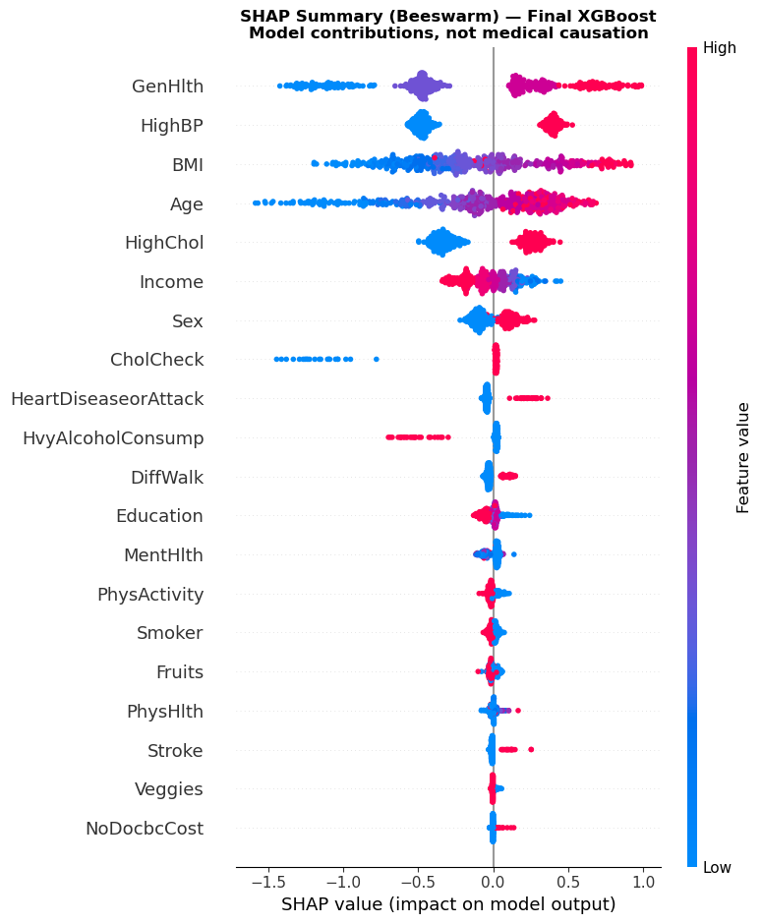
SECTION 5 - TEST REPORT
Fairness & Explainability Testing
FAIRNESS
3 of 4 attributes flagged
Age, Education, Income - recall gaps up to 0.73. Sex: clear (gap 0.01). Gaps not materially worse than the baseline model on 3 of 4 attributes - a required check for champion selection.
EXPLAINABILITY
Stable (r = 0.996)
Top drivers - GenHlth, HighBP, BMI, Age, HighChol - rank consistently across independent samples, not a sampling fluke.
Face-valid
Local explanations for specific wrong predictions match established clinical reasoning, not arbitrary patterns.
Non-causal by design
SHAP values describe model contribution - stated as a standing caveat alongside every explanation, not medical causation.

Slide 16
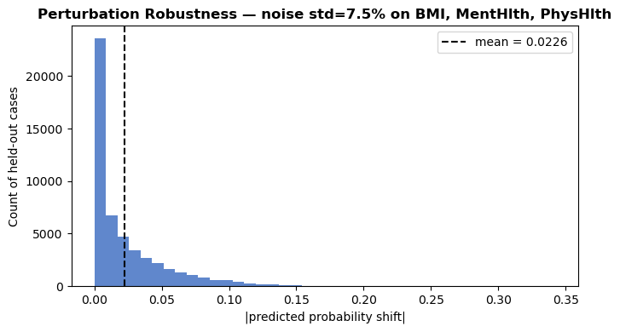
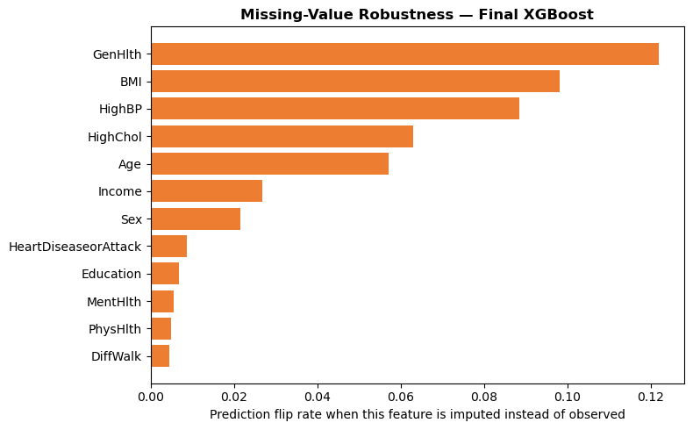

SECTION 5 - TEST REPORT
Robustness Testing & Cross-Pillar Governance Insight
ROBUSTNESS
3.52% / 100%
flip rate under noise / deterministic on repeat runs
GenHlth, BMI, HighBP
most sensitive to missing input -> now mandatory intake-form fields
8.6% borderline
cases flagged for review, not resolved silently
Probability shift under +/-7.5% input noise
Prediction flip rate when a field is simulated missing
CROSS-PILLAR INTERPRETATION - NOT THREE INDEPENDENT CHECKLISTS
GenHlth, HighBP and BMI are simultaneously the top SHAP drivers (Explainability), the fields most sensitive to missing input (Robustness), and directly implicated in the Income/Education fairness gaps (Fairness) - the single clearest governance signal in this Test Report.
GOVERNANCE RECOMMENDATION
These three fields deserve the most careful data-quality, UX and monitoring attention of any field in the deployed system - escalate the Income/Education fairness gaps for human review before deployment.

Slide 17
SECTION 04
04
MLOps, Deployment & Live Demo
Governed MLOps pipeline, tracking and versioning, serverless deployment, and the live end-to-end demo
Teh Tze Chee
MLOPs & Deployment

Slide 18
1
MLflow Foundation → Champion SageMaker Pipeline
Notebook 01A establishes Team02 tracking; Notebook 03 v5 selects and operationalises the frozen champion.
Notebook 01A — Set Up SageMaker MLflow App
1
Environment
2
S3 artifact store
3
SageMaker MLflow App
4
MLflow access
5
Handoff config
Role + SDK/API preflight
Verify Team02 prefix is writable
Create or reuse + verify TeamId tag
Presigned UI URL + connectivity run
Save mlflow_app_config_ team02.json
MLflow ARN + experiment + artifact-store configuration
Notebook 03 v5 — Champion-Selected Pipeline, Registry, Deployment & Monitoring
Final evidence
Champion rule
S3 + lineage
Preprocess
Train
Evaluate
MLflow
Registry
Human gate
Deploy + monitor
LR + XGB runs
Held-out PR-AUC
Data/hash verification
80/20 stratified
Frozen XGBoost configuration
Hold-out + fairness
Params · metrics artifacts · run ID
PendingManual Approval
Review + approve
Serverless endpoint CloudWatch · drift
Frozen champion: XGBoost | Held-out PR-AUC 0.464397 vs Logistic Regression 0.432749 | Passing the technical gate does not auto-deploy — human approval remains mandatory.
Key MLflow role: connect the exact model, data, preprocessing configuration, metrics and artifacts to the registered release.
Notes:
Here is our main MLOps flow.
Notebook 01A sets up the SageMaker MLflow environment, including the artifact store, MLflow app, experiment access and handoff configuration.
Notebook 03 then takes the final model evidence, applies the held-out PR-AUC champion rule, verifies data lineage, preprocesses the data, trains and evaluates XGBoost, and records the run in MLflow.
The model is then registered as PendingManualApproval. Only after human approval is it deployed to the SageMaker serverless endpoint and monitored.
The key point is that MLflow links the exact model, data, configuration, metrics and artifacts to the deployed release.”

Slide 19
2
S3 Dataset Copy → Polling Trigger → Pipeline Rebuild
A timestamped S3 copy simulates a new-data event; the polling notebook validates lineage before starting a new pipeline execution.
S3 Dataset Copy notebook
1
Cleaned dataset
2
copy_object()
3
Timestamp
4
Trigger folder
.../data/diabetes/cleaned/ diabetes_binary_cleaned_dataset.csv
Server-side copy; source remains unchanged
YYYYMMDD_HHMMSS unique trigger filename
.../trigger/input/ new CSV object
new S3 object detected
S3 Polling Trigger v2
1
Baseline
2
Poll every 60 s
3
Detect change
4
Pipeline contract
5
Lineage preflight
Ignore existing files PROCESS_EXISTING_OBJECTS=False
List trigger objects
key + ETag + size + last-modified
Verify final v5 name · params · steps
253,680 rows · schema profile + split hashes
NO → BLOCK TRIGGER Write reason + fingerprint to JSONL audit trail
Valid?
YES → start_pipeline_execution("team02-diabetes-risk") Pass 5 frozen parameters → new pipeline execution ARN → model package remains PendingManualApproval
Governance boundary: this demonstrates controlled pipeline retraining/reproducibility — arbitrary changed data is rejected, and the trigger never auto-approves or auto-deploys.
Notes:
This demonstrates how we trigger a new pipeline execution when new data arrives.
The Dataset Copy notebook creates a timestamped copy of the cleaned dataset inside the S3 trigger folder.
The polling notebook checks that folder every 60 seconds and detects new objects using the key, ETag, size and last-modified information.
Before retraining, it validates the pipeline contract and performs a lineage preflight, including row count, schema and dataset hashes.
If validation passes, it starts a new SageMaker pipeline execution using the frozen parameters.
If validation fails, the trigger is blocked and the reason is written to the audit log.
Most importantly, the trigger does not automatically approve or deploy the new model.

Slide 20
3
Streamlit → ngrok/FastAPI Relay → SageMaker Endpoint
The relay keeps AWS credentials inside SageMaker, exposes only temporary authenticated routes, and validates champion lineage.
Relay notebook preflight
1
AWS identity
2
Endpoint check
3
Direct invoke
4
Start FastAPI
5
Local test
6
ngrok tunnel
Run inside Team02 SageMaker Studio
team02-diabetes-risk status = InService
SageMaker Runtime + lineage PASS
/health + /predict x-api-key
FastAPI → SageMaker response validated
Expose port 8000 public HTTPS URL
Live inference path
User
Streamlit
ngrok HTTPS
FastAPI relay
boto3 runtime
Serverless endpoint
Response
Streamlit result
single form or CSV
validate 21 features + acknowledgement
temporary public /predict URL
auth + fixed endpoint lineage checks
SageMaker execution role
team02-diabetes-risk XGBoost champion
class · probability threshold + lineage
plain-language screening output
Serving-time controls
No AWS keys on Streamlit
x-api-key required
Fixed endpoint server-side
Fail closed on lineage mismatch
Target label never sent
User-facing governance: academic screening support only — not a diagnosis; output wording is “Follow-up suggested” or “No warning detected”.
Notes:
This shows our deployed inference architecture.
The FastAPI notebook first verifies the SageMaker endpoint and model lineage, then starts authenticated /health and /predict APIs and exposes them through an ngrok HTTPS tunnel.
The user interacts with the Streamlit application, which validates the 21 input features and requires acknowledgement that this is screening support only.
The request then flows:
Streamlit → ngrok → FastAPI → SageMaker serverless endpoint → XGBoost → Streamlit result.
AWS credentials stay inside SageMaker, and the application only displays plain-language outputs such as ‘Follow-up suggested’ or ‘No warning detected’.

Slide 21
4
Live Demo — MLflow + Streamlit App
Keep the demo fast: prove reproducibility in MLflow, then prove the deployed end-to-end inference path in Streamlit.
A. MLflow demo | ~60 seconds
B. Streamlit demo | ~60–90 seconds
Goal: show the audit trail behind the champion release.
Pre-demo: FastAPI/ngrok notebook is running; public /predict URL is configured; endpoint is InService.
1
Open Team02 experiment
1
Check system connection
ITI113/team02/diabetes-risk
Show relay reachable + SageMaker endpoint InService
2
Open final champion / pipeline evidence run
2
Check one person
Identify the exact MLflow run ID
Enter a simple example across the 21-feature form
3
Show Parameters
3
Tick acknowledgement
model type · threshold · data/preprocessing config · source run IDs
Screening support only — not a medical diagnosis
4
Show Metrics
4
Run prediction
PR-AUC first; then ROC-AUC · recall · F1 / F2
Streamlit → ngrok → FastAPI → SageMaker → XGBoost
5
Show Artifacts + Run ID
5
Show result + evidence
reproducibility / lineage / evaluation evidence → Registry handoff
plain-language result; technical score / threshold / latency; download evidence JSON
Say this: “MLflow is our reproducibility and audit record — not just a dashboard.”
Optional if time: upload/paste a CSV and show batch validation + results.
Recommended order: MLflow → Streamlit
Notes:
For the live demo, I will first show MLflow.
I will open the Team02 experiment, select the champion run, and show the parameters, metrics and artifacts.
The most important metric is PR-AUC, because that is our primary champion-selection metric.
I will also show the MLflow run ID, which provides the audit link back to the exact model release.
The key message is: MLflow is our reproducibility and audit record, not just a dashboard.
Next, I will demonstrate the Streamlit application.
I will check the system connection, enter one sample, acknowledge the screening disclaimer and run the prediction.
This demonstrates the complete live path from Streamlit through FastAPI to SageMaker and back to the user.

Slide 22


Thank You & Questions
Unified End-to-End Governed MLOps Pipeline for Diabetes Risk Screening AI
Data & Baselines
Champion & Governance
Production MLOps
253k BRFSS records, non-linear compounding risk, balanced Logistic Regression baseline.
XGBoost (PR-AUC 0.514), AI Verify subgroup fairness audit, SHAP stability r=0.996.
SHA-256 hashes, SageMaker pipelines, human-in-the-loop release, FastAPI relay.
Team 02: Fong Siang Yi | Djony Pamudji | Teh Tze Chee
Diabetes Risk Screening AI
Slide 18 of 18

