Slide 1
Hospital Emergency
Queue Management System
Max-Heap Priority Queue · PostgreSQL · Google Gemini AI
Intelligent Triage · Real-Time Prioritization · Data-Driven ER Workflows

Slide 2
The Challenge in Emergency Rooms
PROBLEM
STATEMENT
In a busy emergency room, patients arrive at all hours with very different medical needs. The traditional approach of serving people in the order they arrive often puts less urgent patients ahead of those who are critically ill. This is a serious problem because a patient who walks in with a minor sprain should not be treated before someone who is having a heart attack — even if the sprain patient arrived first.
⏱ Time-Critical
Manual triage systems rely heavily on individual nurses and doctors making quick decisions, which can lead to inconsistency, human error, and delays during high-pressure situations. Without a smart, automated system, there is no guarantee that the sickest patient is always treated first. Low-priority patients can also end up waiting indefinitely — a problem called "queue starvation" — while critical cases keep arriving.
Every second matters
🏥 ER Workflow
Complex environment
What hospitals truly need is an intelligent, real-time system that automatically sorts patients by medical urgency, uses AI to support triage decisions, ensures no patient is ever forgotten, and keeps a complete record of every action taken — so that the right patient always gets care at the right time.
⚠️ Patient Safety
Lives at risk

Slide 3
TECH STACK & ARCHITECTURE
What Technologies Are Used?
Backend
Database
AI Brain
Speed Engine
Screen
Python + Flask
PostgreSQL
Google Gemini AI
Max-Heap Queue
HTML + JS UI
Runs the server and handles all requests from the website
Stores all patient data safely. Acts as the master record book
Reads patient symptoms and suggests the correct priority level
Keeps patients sorted by urgency. Fastest data structure for this job
The dark clinical dashboard doctors use on their screen
How the System Is Connected — Step by Step:
1
2
3
4
5
Doctor
Enters Data
Flask API
Receives
Gemini AI
Suggests
Heap Queue
Updates
PostgreSQL
Saved
Types patient name, age & symptoms
▶
Server gets the request
▶
AI picks priority 1–5
▶
Patient sorted instantly
▶
Stored permanently in DB

Slide 4
HOW IT WORKS
Patient Arrives at ER
Key System Features
▼
🤖 AI-Powered Triage
Enter Symptoms & Details
Gemini 2.5 Flash analyzes symptoms and recommends a priority level (1–5) with clinical reasoning, reducing triage time by ~60%.
▼
⚡ Max-Heap Priority Queue
Gemini AI Suggests Priority
Patients sorted by priority + arrival time. Insert/extract in O(log n), supporting 1000+ patient queues with sub-millisecond response.
▼
🔄 Wait-Time Aging
Doctor Confirms / Overrides
Long-waiting patients are automatically escalated to prevent starvation — no low-priority patient is ever ignored indefinitely.
▼
Added to Max-Heap Queue
💾 Dual-Write Persistence
Every mutation writes to PostgreSQL first, then updates the heap. On restart, the heap rebuilds from DB in ~100ms — zero data loss.
▼
Admit Next (Highest Priority)
📋 Full Audit Trail
Every register, admit, update, and remove action is logged with timestamps and notes for compliance.

Slide 5
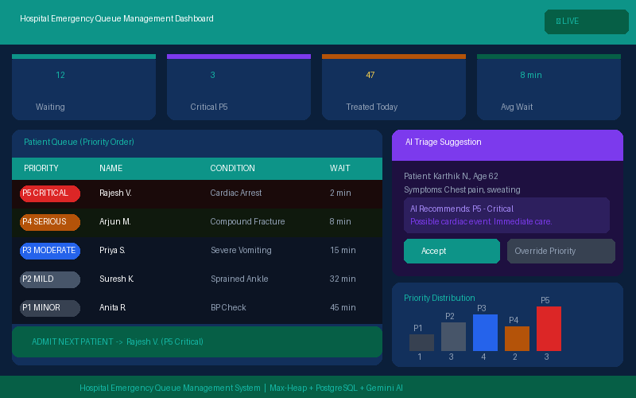
REAL-TIME DASHBOARD — What Doctors See
📊
Live patient count & priority stats at a glance
🔴
Color-coded priority badges (Red = Critical)
🤖
AI suggestion panel with Accept / Override
⚡
One-click Admit Next Patient button
📈
Priority distribution bar chart

Slide 6
METHODOLOGY & APPROACH
How Did We Build This? — In Simple Steps
Step 1 — Understand the Problem
Step 2 — Design the System
Step 3 — Build & Test
We studied how emergency rooms work and what makes triage difficult.
We chose a Max-Heap data structure because it automatically keeps the most critical patient at the top.
We built the backend API using Python Flask with 10 endpoints for all actions.
We found that the biggest issue is: sicker patients don't always get seen first.
We used PostgreSQL so all data is saved permanently and never lost if the server restarts.
We created a dark clinical dashboard UI that shows the live queue to doctors.
We decided to build a system where priority — not arrival order — decides who goes next.
We connected Google Gemini AI to read symptoms and suggest the right priority level.
We wrote 45 automated tests to make sure every feature works correctly every time.
Key Design Decision: Doctor always has the final say — AI is a helper, not a replacement. The doctor can accept or override any AI suggestion.

Slide 7
RESULTS & OUTCOMES
60%
45
~100ms
O(log n)
Faster Triage
Tests Passing
Heap Rebuild
Queue Speed
AI cuts decision time
100% code coverage
Zero data loss on restart
Handles 1000+ patients
What This System Achieves:
✅ Correct Priority, Every Time
✅ Data Survives Server Crashes
The right patient is always treated first — sickest patients automatically go to the top of the queue.
PostgreSQL saves everything. If the system restarts, the queue is restored from database in about 100 milliseconds.
✅ No Patient Left Behind
✅ Full History & Accountability
Wait-time aging ensures that even low-priority patients are escalated if they wait too long.
Every action is recorded. Hospitals can review who was treated when, why priority changed, and how AI performed.
✅ AI Helps Doctors Decide Faster
✅ Scalable and Ready to Grow
Instead of guessing, doctors get an AI recommendation they can accept or change — reducing mental load during emergencies.
The system can handle thousands of patients and is designed to be extended with features like WebSockets and authentication.

Slide 8
ADVANTAGES & LIMITATIONS
✅ ADVANTAGES
⚠️ LIMITATIONS
AI reduces triage time by ~60% and standardizes priority decisions across all shifts
No user authentication — OAuth2/JWT required before production deployment
O(log n) heap ensures blazingly fast patient insertion and extraction at any scale
No rate limiting — Redis-based throttling needed for public-facing API
Zero data loss on server restart — heap rebuilds from PostgreSQL in ~100ms
Single-server only — PgBouncer required for multi-server HA setup
Wait-time aging prevents starvation of low-priority patients over time
No real-time WebSocket updates — Socket.io upgrade needed for live sync
Full audit trail enables compliance, quality reviews, and AI decision analysis
Gemini free tier limited to 60 req/min — paid tier for high-volume ERs
Graceful AI degradation — defaults to Priority 3 if Gemini is unavailable
In-memory heap only — valid up to ~100k patients before sharding needed
45 pytest unit + integration tests with 100% code coverage ensure reliability
No dark mode toggle — UI is always dark (fixed clinical preference)

Slide 9
Thank You
Hospital Emergency Queue Management System
Presented by
T C VARALAKSHMI
Intelligent Triage · Faster Care · Better Outcomes

