Slide 1

An Experimental Study on Pretraining Transformers from Scratch for IR
Carlos Lassance
Hervé Dejean
Stéphane Clinchant
Notes:
TODO Add names

Slide 2
Two Conflicting Views
Middle training
MLM is not enough for IR
Ex:
CoCondenser
RetroMAE
LexMAE
Foundation Models
Pretraining on broad data at scale and are adaptable to a wide range of downstream tasks

Slide 3
A Research Question
What’s the role of pretraining collection for the final performance?
Do we actually need large scale pretraining for Neural IR?
How do we control the data used to train the models?
What do we gain from pretraining from a broad collection?
How to integrate architectural improvements?

Slide 4
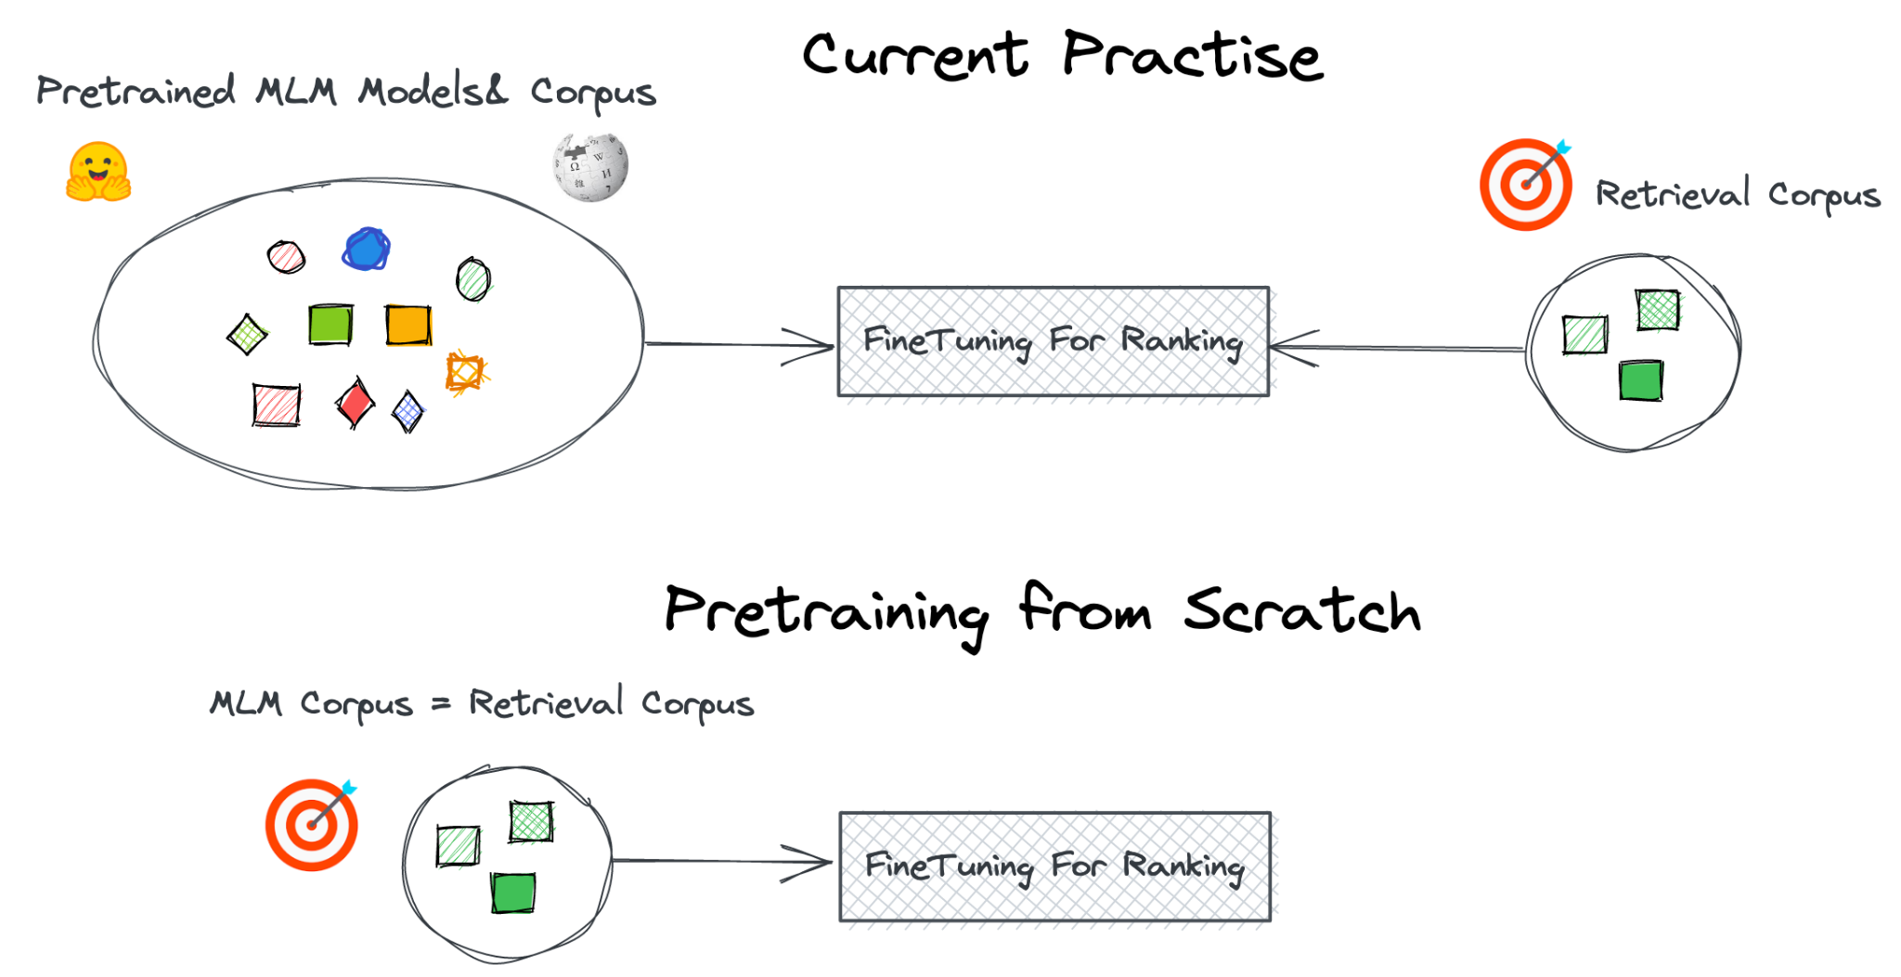
Pretraining from Scratch
Notes:
1.Training from Scratch:
1.Design Architecture, Vocab, Efficiency
2.Data Bias

Slide 5
Pretrained Models
Pretraining Corpora: MSMARCO, Tripclick, Mr-Tidy (Ar, Ru, Ja)
 | BERT | Distilbert | MLM 6L | MLM 12L
Collection | Wiki,BookC | Wiki+BookC | Retrieval | Retrieval
Size(words) | 3300M | 3300M | 100M-500M | 100M-500M
#params | 110M | 66M | 67M | 110M
#layers | 12 | 6 | 6 | 12

Slide 6
Pretrained Models
Tokenizers: 32K on each retrieval collection
Cost: 8 A100 for 6 to 24 hours
MLM+Flops unsupervised learning [1]
Was used as middle training, but we test it as pretraining
[1] Lassance and Clinchant. "An efficiency study for SPLADE models." @ SIGIR 2022

Slide 7
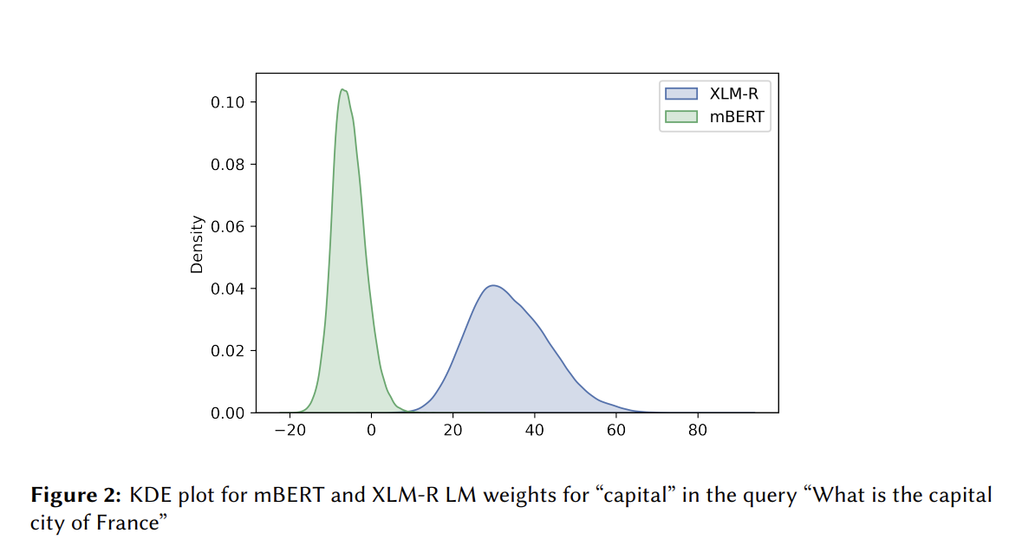
Why MLM+FLOPS?
Previous work (SPLADE-x) identified problems:
Vocabulary size, initialization
Image from: Nair et al 2022, SPLADE-x Learning a Sparse Representation Model for Neural CLIR @ DESIRES22

Slide 8
MLM + FLOPS
Default MLM
Avoid collapse
Document expansion
But sparse and with SPLADE act
Enforce sparsity
Balance vocabulary
Bounds values
Introduces sparsity
Notes:
I gu

Slide 9
Experimental Setup
General data: MSMARCO
First stage retrieval: Dense and SPLADE
Reranking: Cross-encoding
Zero-Shot: OOD on BEIR
Domain specific data: TripClick
Non English data: Mr. Tydi
Changing the architecture: DeBerta (negative result, did not work)
Trained:
without distillation
without passage titles
Hard negatives
Notes:
Mention the architecture experiment
add a slide for it

Slide 10

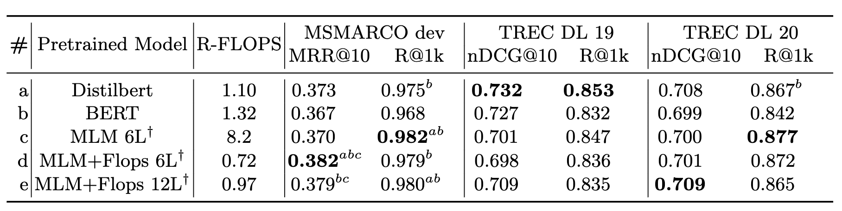
It works as well or better for SPLADE!

Slide 11
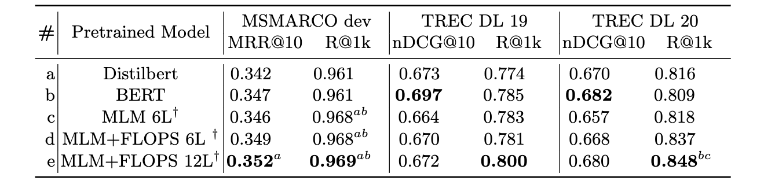
It works as well or better for Dense!

Slide 12
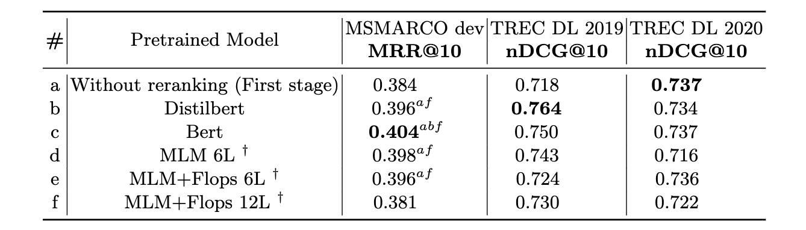
However, not so much for reranking

Slide 13
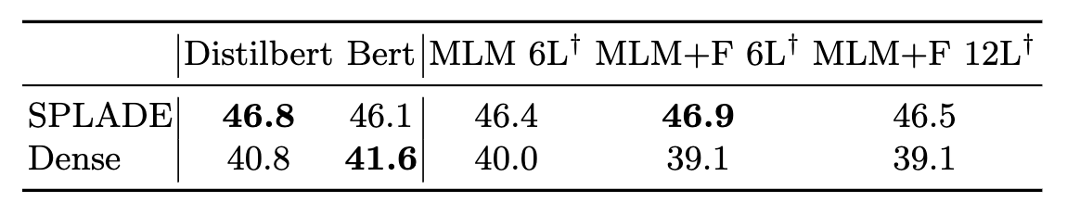
Does zero-shot still work?
BEIR is supposed to evaluate in zero-shot
Hard to guarantee: some collections from Wikipedia
Pretraining from scratch: control the data used
However, some of Wikipedia may be present in MSMARCO
Notes:
Testing the generalization

Slide 14
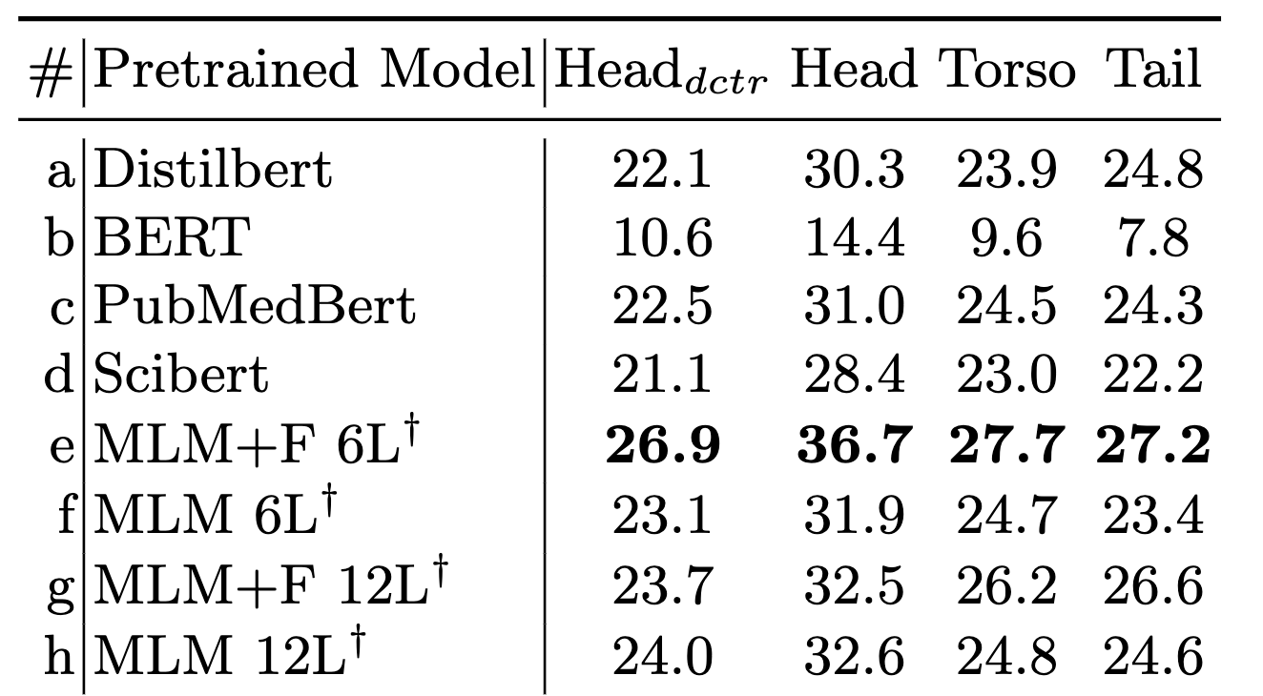
It also works on specific domain data (Tripclick)
Pretraining on the same collection improves results

Slide 15

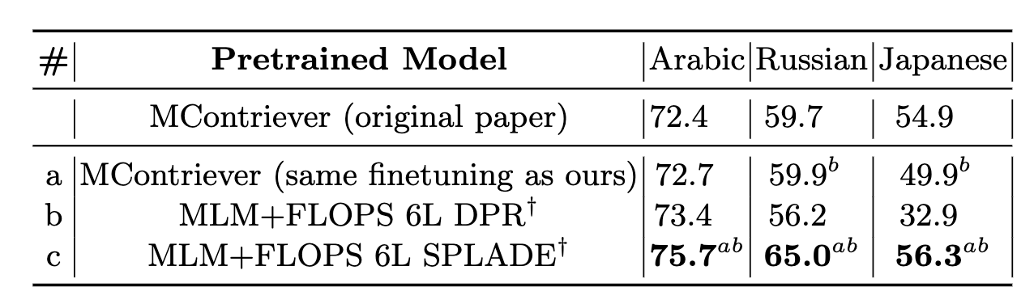
Also works for non English data!

Slide 16

Conclusion
Pretraining from scratch works well
Gains on MrTidy,Tripclick, similar on MSMARCO
Already validated on other contexts:
MIRACL 🌍🙌🌏
Corporate data
Notes:
Future work on control
Gains on internal data
Especially due to control of data bias
Applicable on TREC
Huggingface
SPLIT into two slides

Slide 17
Conclusion
Tydi and MSMARCO
Models available at:
https://huggingface.co/naver
Pretraining from scratch allows for more control:
Data bias (this work)
Architecture (negative result, future work)
Vocabulary (future work)
Goes against “foundational models”
What are these models missing?
Code will be available at:
https://github.com/naver/splade
Notes:
Future work on control
Gains on internal data
Especially due to control of data bias
Applicable on TREC
Huggingface
SPLIT into two slides

