Slide 1
Verification of Control Barrier Functions
Final Project
Chuyuan Tao

Slide 2
Motivation & Contribution
The problem of verifying whether the CBF constraints can always be satisfied has received less attention. The work propose a framework for verifying that a CBF guarantees safety for all time and synthesizing CBFs with verifiable safety in polynomial control systems.
The approach is based on the fact that the safety guarantees rely on two properties.
There should be no point on the boundary of the CBF for which the Lie derivative of the CBF is always negative
The safe region of the CBF should be contained within the overall safe region.

Slide 3
Motivation & Contribution
The paper develop a SOS program for verifying that a given CBF construction ensures safety. We extend this approach to high-order CBFs and systems with multiple CBF constraints.
The paper propose an alternating-descent heuristic for synthesizing CBFs using the proposed conditions.
Considering special cases of the approach, including compact safe regions and constraints where the unsafe region is a union of non-overlapping convex sets.

Slide 4
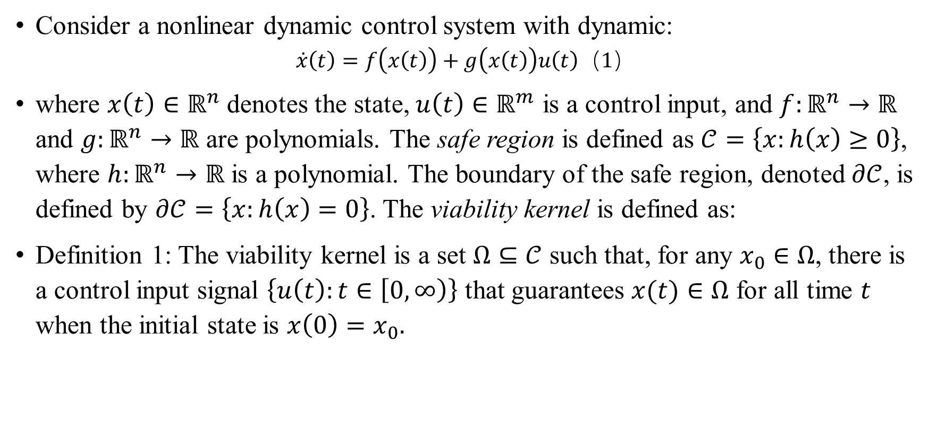
Problem Formulation
Consider a nonlinear dynamic control system with dynamic:
$$\begin{aligned}\begin{aligned}\dot{x}\left(t\right)=f\left(x\left(t\right)\right)+g\left(x\left(t\right)\right)u\left(t\right)\#\end{aligned}\#\#（1）\end{aligned}$$
where $x\left(t\right)∈ℝ^{n}$ denotes the state, $u\left(t\right)∈ℝ^{m}$ is a control input, and $f:ℝ^{n}→ℝ$ and $g:ℝ^{n}→ℝ$ are polynomials. The safe region is defined as $𝒞=\left\{x:h\left(x\right)≥0\right\}$, where $h:ℝ^{n}→ℝ$ is a polynomial. The boundary of the safe region, denoted $∂𝒞$, is defined by $∂𝒞=\left\{x:h\left(x\right)=0\right\}$. The viability kernel is defined as:
Definition 1: The viability kernel is a set $Ω⊆𝒞$ such that, for any $x_{0}∈Ω$, there is a control input signal $\left\{u\left(t\right):t∈\left[0,∞\right)\right\}$ that guarantees $x(t)∈Ω$ for all time $t$ when the initial state is $x\left(0\right)=x_{0}.$

Slide 5
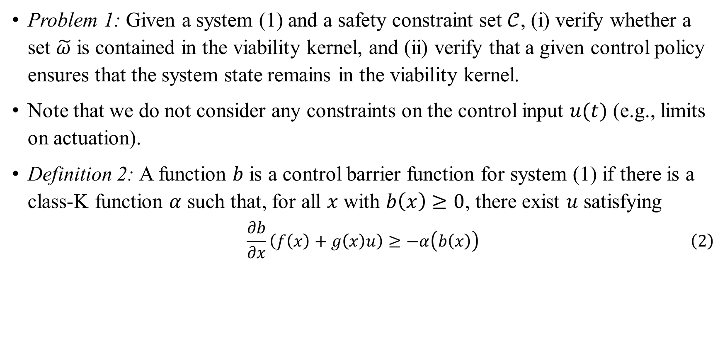
Problem Formulation
Problem 1: Given a system (1) and a safety constraint set $𝒞$, (i) verify whether a set $\tilde{ω}$ is contained in the viability kernel, and (ii) verify that a given control policy ensures that the system state remains in the viability kernel.
Note that we do not consider any constraints on the control input $u(t)$ (e.g., limits on actuation).
Definition 2: A function $b$ is a control barrier function for system (1) if there is a class-K function $α$ such that, for all $x$ with $b\left(x\right)≥0$, there exist $u$ satisfying
$$\begin{aligned}\frac{∂b}{∂x}\left(f\left(x\right)+g\left(x\right)u\right)≥−α\left(b\left(x\right)\right)\#\left(2\right)\end{aligned}$$

Slide 6
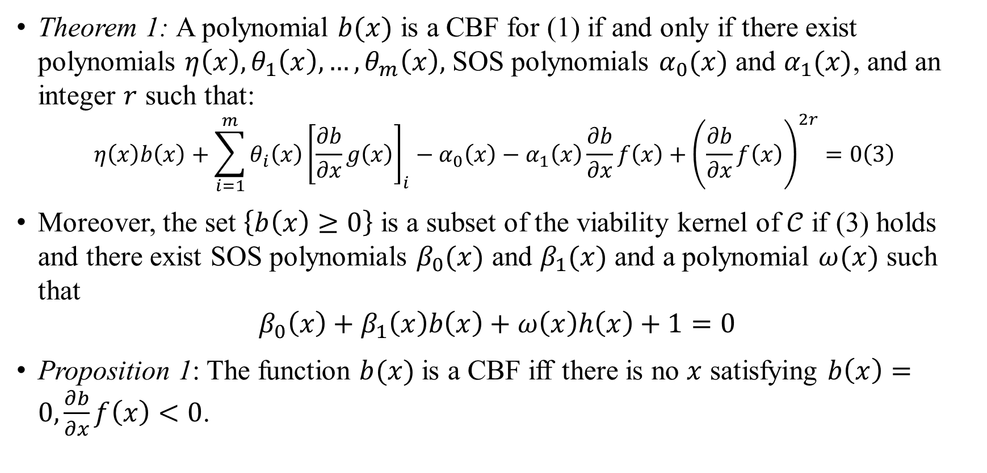
CBF Verification
Theorem 1: A polynomial $b(x)$ is a CBF for (1) if and only if there exist polynomials $η\left(x\right), θ_{1}\left(x\right), …, θ_{m}\left(x\right),$ SOS polynomials $α_{0}(x)$ and $α_{1}(x)$, and an integer $r$ such that:
$$\begin{aligned}η\left(x\right)b\left(x\right)+\sum_{i=1}^{m}{θ_{i}\left(x\right)}{\left[\frac{∂b}{∂x}g\left(x\right)\right]}_{i}−α_{0}\left(x\right)−α_{1}\left(x\right)\frac{∂b}{∂x}f\left(x\right)+{\left(\frac{∂b}{∂x}f\left(x\right)\right)}^{2r}=0\#\left(3\right) \end{aligned}$$
Moreover, the set $\left\{b\left(x\right)≥0\right\}$ is a subset of the viability kernel of $𝒞$ if (3) holds and there exist SOS polynomials $β_{0}(x)$ and $β_{1}(x)$ and a polynomial $ω(x)$ such that
$$β_{0}\left(x\right)+β_{1}\left(x\right)b\left(x\right)+ω\left(x\right)h\left(x\right)+1=0$$
Proposition 1: The function $b(x)$ is a CBF iff there is no $x$ satisfying $b\left(x\right)=0,\frac{∂b}{∂x}f\left(x\right)<0$.

Slide 7
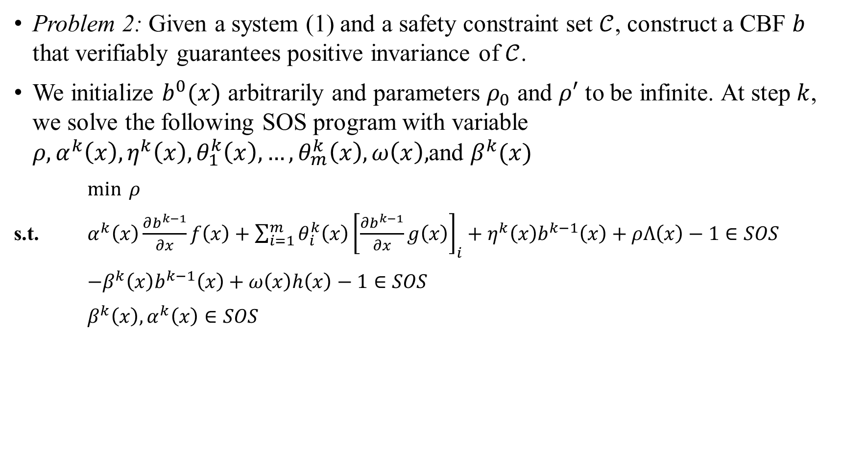
Control Barrier Function Construction
Problem 2: Given a system (1) and a safety constraint set $𝒞$, construct a CBF $b$ that verifiably guarantees positive invariance of $𝒞$.
We initialize $b^{0}(x)$ arbitrarily and parameters $ρ_{0}$ and $ρ′$ to be infinite. At step $k$, we solve the following SOS program with variable $ρ, α^{k}\left(x\right), η^{k}\left(x\right),θ_{1}^{k}\left(x\right),…, θ_{m}^{k}\left(x\right),ω\left(x\right),$and $β^{k}(x)$
$\min{ ρ}$
s.t. $α^{k}\left(x\right)\frac{∂b^{k−1}}{∂x}f\left(x\right)+\sum_{i=1}^{m}{θ_{i}^{k}\left(x\right){\left[\frac{∂b^{k−1}}{∂x}g\left(x\right)\right]}_{i}}+η^{k}\left(x\right)b^{k−1}\left(x\right)+ρΛ\left(x\right)−1∈SOS$
$−β^{k}\left(x\right)b^{k−1}\left(x\right)+ω\left(x\right)h\left(x\right)−1∈SOS$
$β^{k}\left(x\right),α^{k}\left(x\right)∈SOS$

Slide 8
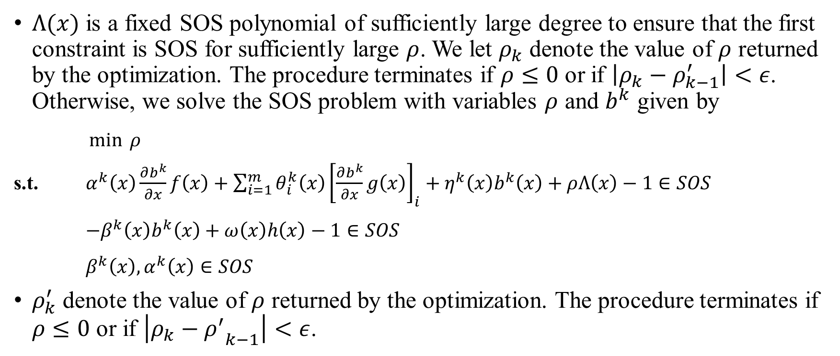
Control Barrier Function Construction
$Λ(x)$ is a fixed SOS polynomial of sufficiently large degree to ensure that the first constraint is SOS for sufficiently large $ρ$. We let $ρ_{k}$ denote the value of $ρ$ returned by the optimization. The procedure terminates if $ρ≤0$ or if $\left|ρ_{k}−ρ_{k−1}^{′}\right|<ε$. Otherwise, we solve the SOS problem with variables $ρ$ and $b^{k}$ given by
$\min{ ρ}$
s.t. $α^{k}\left(x\right)\frac{∂b^{k}}{∂x}f\left(x\right)+\sum_{i=1}^{m}{θ_{i}^{k}\left(x\right){\left[\frac{∂b^{k}}{∂x}g\left(x\right)\right]}_{i}}+η^{k}\left(x\right)b^{k}\left(x\right)+ρΛ\left(x\right)−1∈SOS$
$−β^{k}\left(x\right)b^{k}\left(x\right)+ω\left(x\right)h\left(x\right)−1∈SOS$
$β^{k}\left(x\right),α^{k}\left(x\right)∈SOS$
$ρ_{k}^{′}$ denote the value of $ρ$ returned by the optimization. The procedure terminates if $ρ≤0$ or if $\left|ρ_{k}−{ρ^{′}}_{k−1}\right|<ε$.

Slide 9
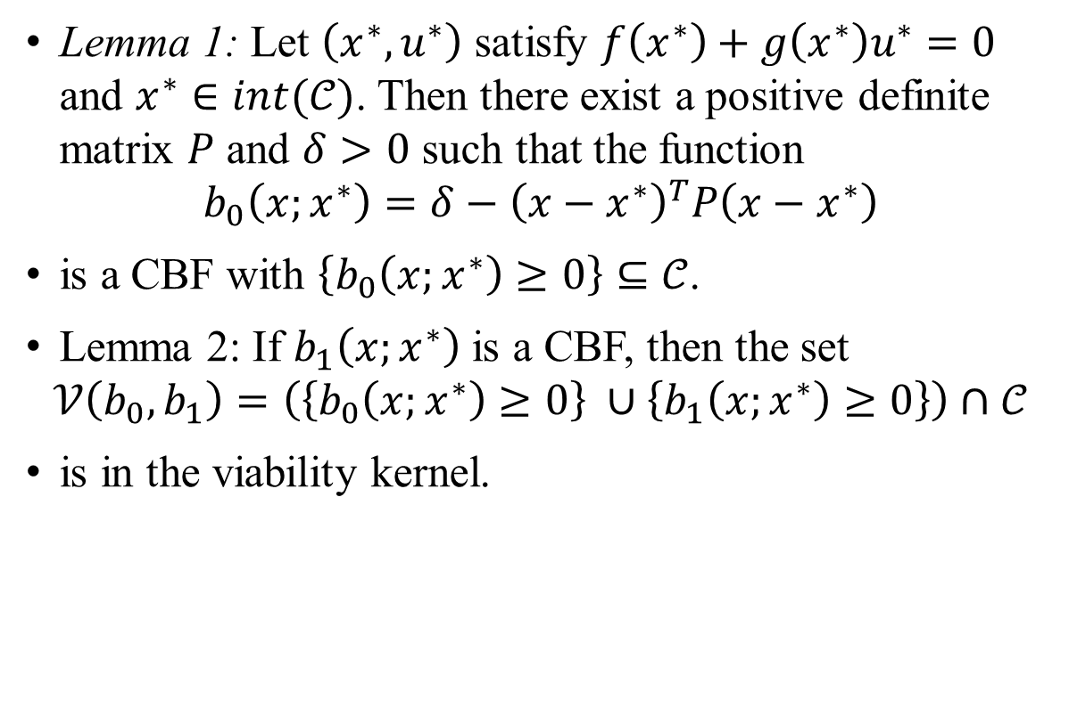
Compact Safe Region
Lemma 1: Let $\left(x^{∗},u^{∗}\right)$ satisfy $f\left(x^{∗}\right)+g\left(x^{∗}\right)u^{∗}=0$ and $x^{∗}∈int(𝒞)$. Then there exist a positive definite matrix $P$ and $δ>0$ such that the function
$$b_{0}\left(x;x^{∗}\right)=δ−{\left(x−x^{∗}\right)}^{T}P\left(x−x^{∗}\right)$$
is a CBF with $\left\{b_{0}\left(x;x^{∗}\right)≥0\right\}⊆𝒞$.
Lemma 2: If $b_{1}\left(x;x^{∗}\right)$ is a CBF, then the set
$$𝒱\left(b_{0},b_{1}\right)=\left(\left\{b_{0}\left(x;x^{∗}\right)≥0\right\} ∪\left\{b_{1}\left(x;x^{∗}\right)≥0\right\}\right)∩𝒞$$
is in the viability kernel.
Unsafe Region
Safe Region

Slide 10
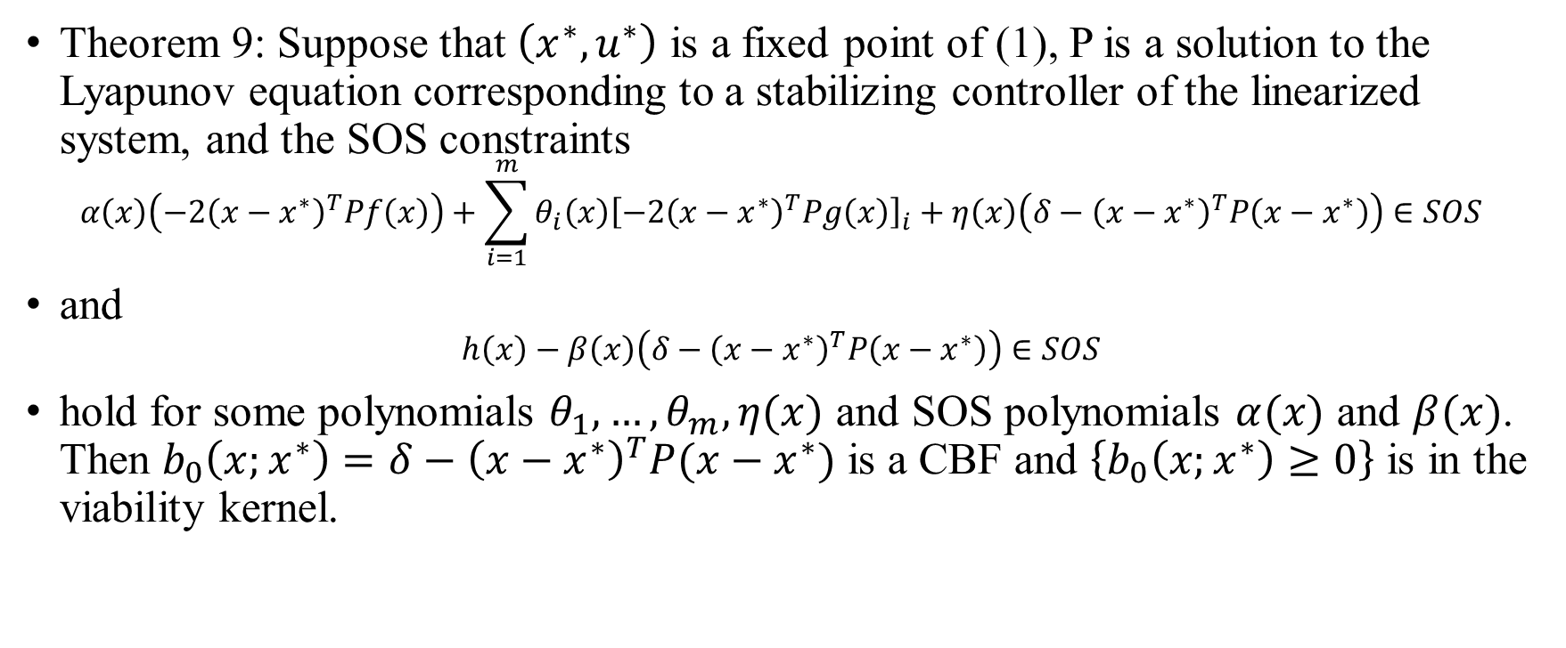
Compact Safe Region
Theorem 9: Suppose that $\left(x^{∗},u^{∗}\right)$ is a fixed point of (1), P is a solution to the Lyapunov equation corresponding to a stabilizing controller of the linearized system, and the SOS constraints
$$α\left(x\right)\left(−2{\left(x−x^{∗}\right)}^{T}Pf\left(x\right)\right)+\sum_{i=1}^{m}{θ_{i}\left(x\right){\left[−2{\left(x−x^{∗}\right)}^{T}Pg\left(x\right)\right]}_{i}}+η\left(x\right)\left(δ−{\left(x−x^{∗}\right)}^{T}P\left(x−x^{∗}\right)\right)∈SOS$$
and
$$h\left(x\right)−β\left(x\right)\left(δ−{\left(x−x^{∗}\right)}^{T}P\left(x−x^{∗}\right)\right)∈SOS$$
hold for some polynomials $θ_{1},…,θ_{m},η(x)$ and SOS polynomials $α(x)$ and $β(x)$. Then $b_{0}\left(x;x^{∗}\right)=δ−{\left(x−x^{∗}\right)}^{T}P(x−x^{∗})$ is a CBF and $\left\{b_{0}\left(x;x^{∗}\right)≥0\right\}$ is in the viability kernel.

Slide 11
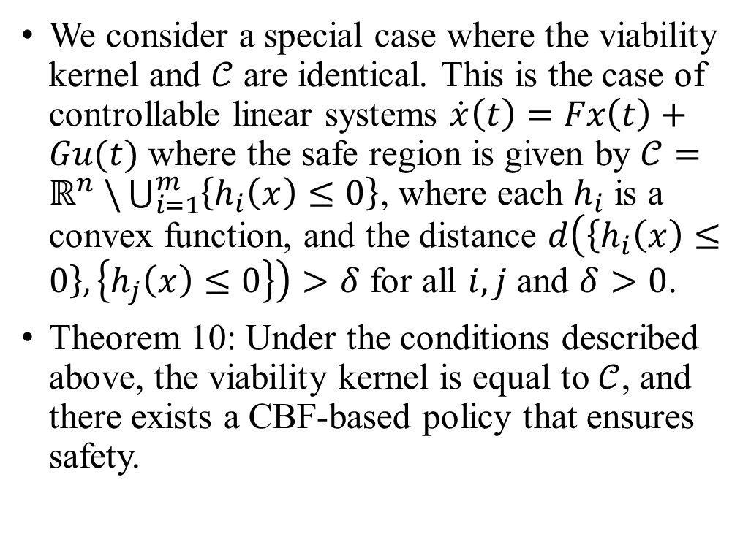
Compact Unsafe Region
We consider a special case where the viability kernel and $𝒞$ are identical. This is the case of controllable linear systems $\dot{x}\left(t\right)=Fx\left(t\right)+Gu(t)$ where the safe region is given by $𝒞=ℝ^{n} \backslash \bigcup_{i=1}^{m}{\left\{h_{i}\left(x\right)≤0\right\}}$, where each $h_{i}$ is a convex function, and the distance $d\left(\left\{h_{i}\left(x\right)≤0\right\},\left\{h_{j}\left(x\right)≤0\right\}\right)>δ$ for all $i,j$ and $δ>0$.
Theorem 10: Under the conditions described above, the viability kernel is equal to $𝒞$, and there exists a CBF-based policy that ensures safety.
Safe Region
UnSafe Region

Slide 12
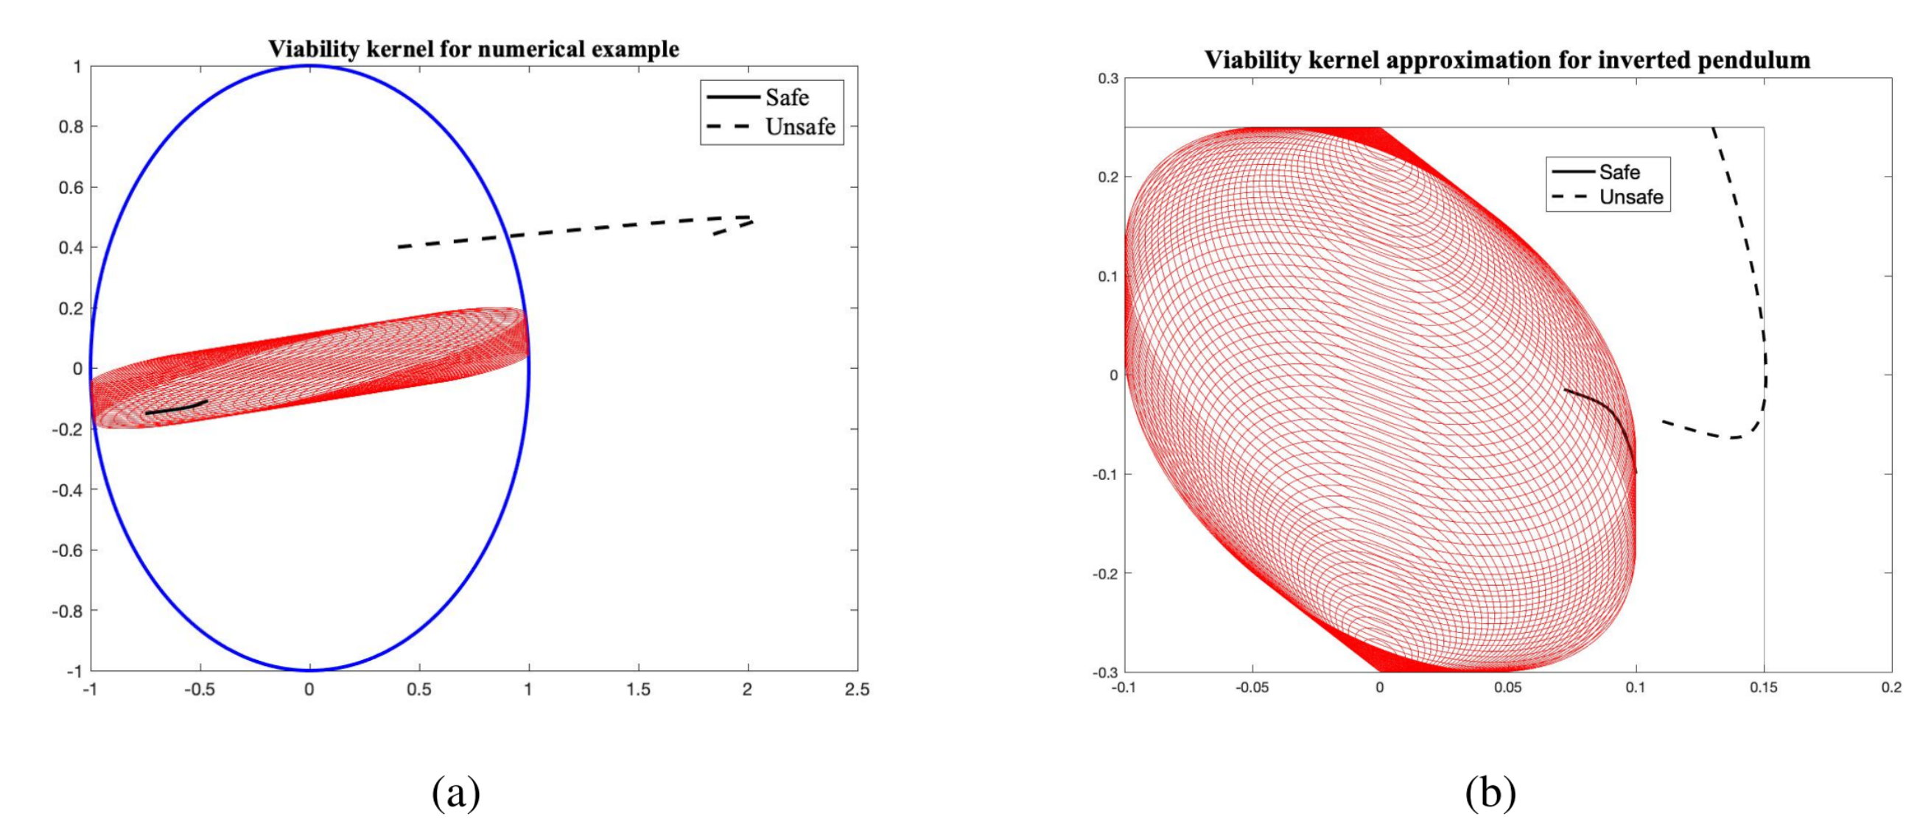
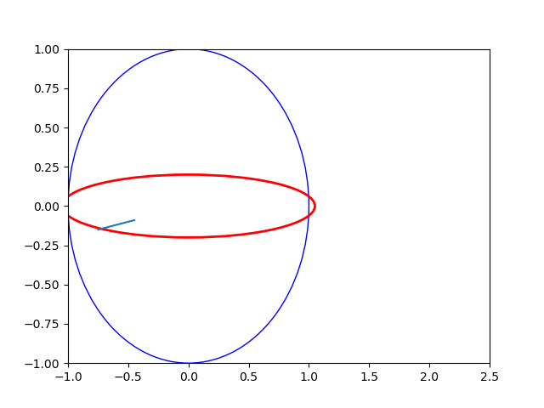
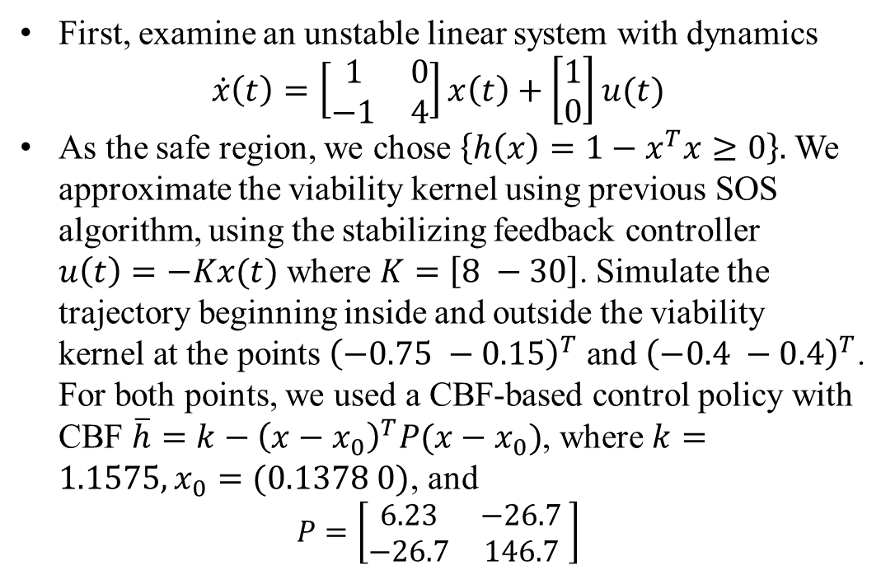
Simulation
First, examine an unstable linear system with dynamics
$$\dot{x}\left(t\right)=\left[\begin{matrix}1 & 0 \\ −1 & 4\end{matrix}\right]x\left(t\right)+\left[\begin{matrix}1 \\ 0\end{matrix}\right]u(t)$$
As the safe region, we chose $\left\{h\left(x\right)=1−x^{T}x≥0\right\}.$ We approximate the viability kernel using previous SOS algorithm, using the stabilizing feedback controller $u\left(t\right)=−Kx(t)$ where $K=\left[8 −30\right]$. Simulate the trajectory beginning inside and outside the viability kernel at the points ${\left(−0.75 −0.15\right)}^{T}$ and ${\left(−0.4 −0.4\right)}^{T}$. For both points, we used a CBF-based control policy with CBF $\overline{h}=k−{\left(x−x_{0}\right)}^{T}P(x−x_{0})$, where $k=1.1575, x_{0}=(0.1378 0)$, and
$$P=\left[\begin{matrix}6.23 & −26.7 \\ −26.7 & 146.7\end{matrix} \right]$$

Slide 13
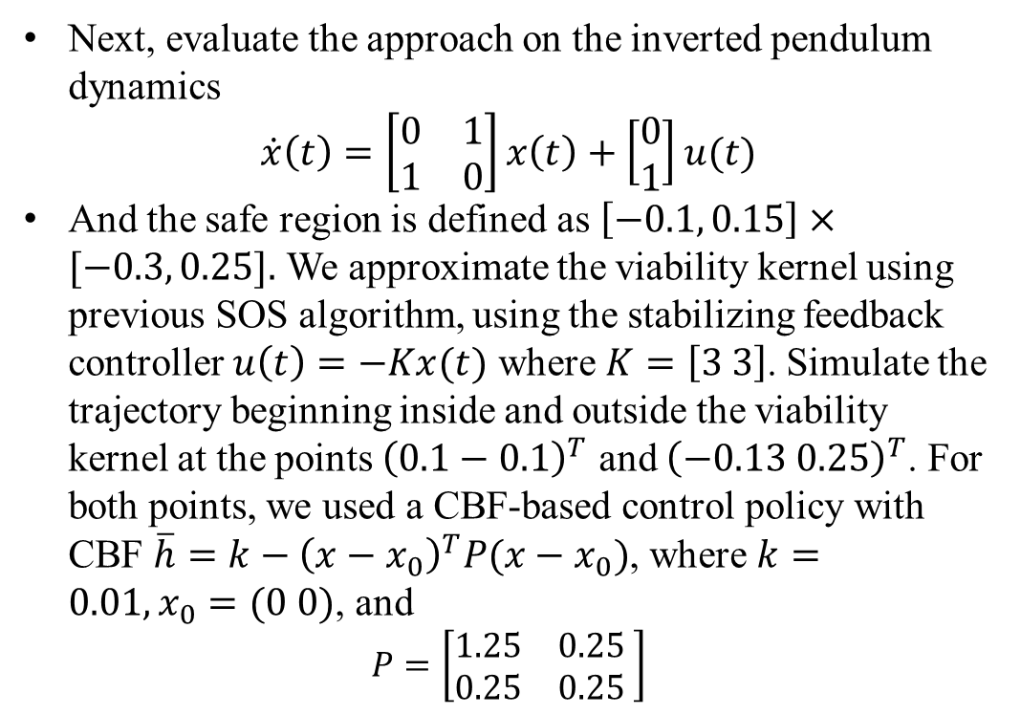
Simulation
Next, evaluate the approach on the inverted pendulum dynamics
$$\dot{x}\left(t\right)=\left[\begin{matrix}0 & 1 \\ 1 & 0\end{matrix}\right]x\left(t\right)+\left[\begin{matrix}0 \\ 1\end{matrix}\right]u(t)$$
And the safe region is defined as $\left[−0.1, 0.15\right]×[−0.3, 0.25].$ We approximate the viability kernel using previous SOS algorithm, using the stabilizing feedback controller $u\left(t\right)=−Kx(t)$ where $K=\left[3 3\right]$. Simulate the trajectory beginning inside and outside the viability kernel at the points ${\left(0.1−0.1\right)}^{T}$ and ${\left(−0.13 0.25\right)}^{T}$. For both points, we used a CBF-based control policy with CBF $\overline{h}=k−{\left(x−x_{0}\right)}^{T}P(x−x_{0})$, where $k=0.01, x_{0}=(0 0)$, and
$$P=\left[\begin{matrix}1.25 & 0.25 \\ 0.25 & 0.25\end{matrix} \right]$$

Slide 14
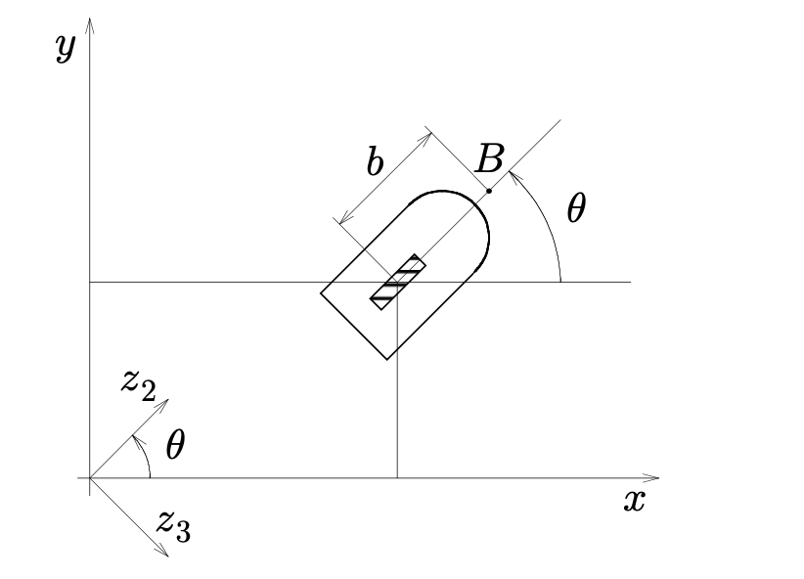
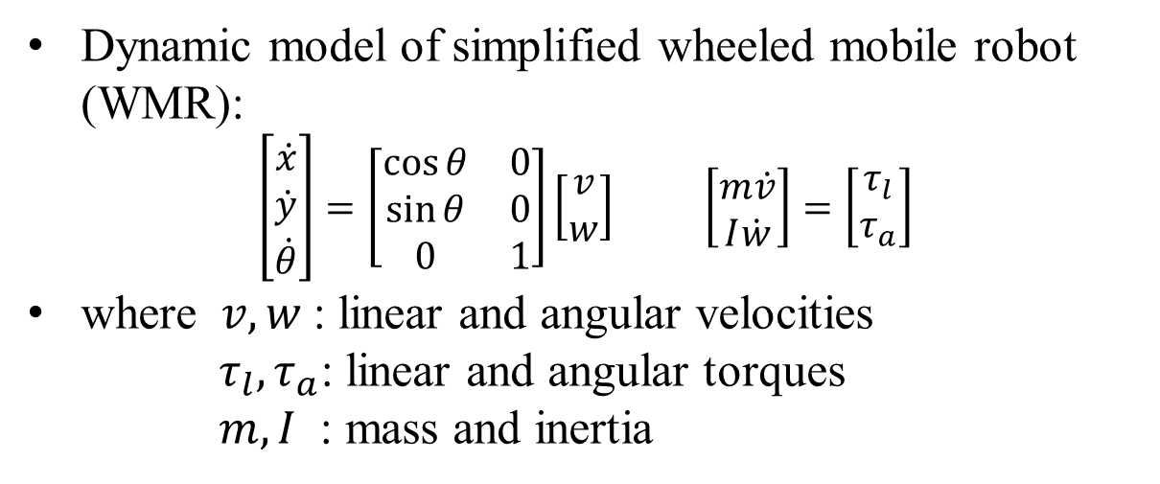
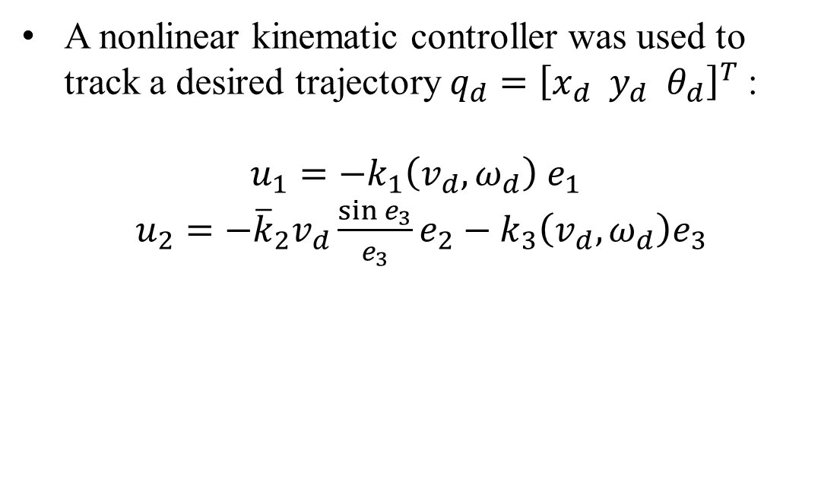
Multi-agent Simulation
Dynamic model of simplified wheeled mobile robot (WMR):
$\left[\begin{matrix}\dot{x} \\ \dot{y} \\ \dot{θ}\end{matrix}\right]=\left[\begin{matrix}\cos{θ} & 0 \\ \sin{θ} & 0 \\ 0 & 1\end{matrix}\right]\left[\begin{matrix}v \\ w\end{matrix}\right]$ $\left[\begin{matrix}m\dot{v} \\ I\dot{w}\end{matrix}\right]=\left[\begin{matrix}τ_{l} \\ τ_{a}\end{matrix}\right]$
where $v,w$: linear and angular velocities
$τ_{l},τ_{a}$: linear and angular torques
$m, I$ : mass and inertia
A nonlinear kinematic controller was used to track a desired trajectory $q_{d}={\left[x_{d} y_{d} θ_{d}\right]}^{T}$:
$$u_{1}=−k_{1}\left(v_{d},ω_{d}\right){ e}_{1}$$
$u_{2}=−{\overline{k}}_{2}v_{d}\frac{\sin{e_{3}}}{e_{3}}e_{2}−k_{3}\left(v_{d},ω_{d}\right)e_{3}$

Slide 15
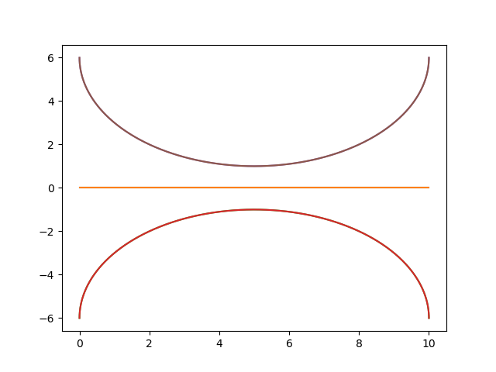
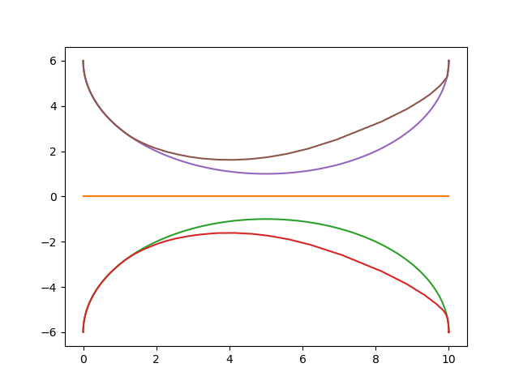
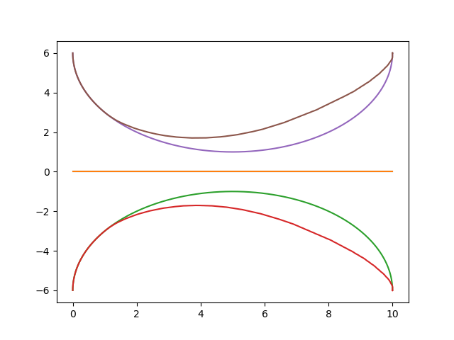
Multi-agent Simulation
The result of multi-agent trajectory following result, we predefined the trajectories for each agent. And we design a control barrier function to guarantee the safe distance between each agents. The first figure is when no CBF is working and the second figure is a conservative CBF which using Euclidean distance as the CBF. And the last figure is the least conservative CBF constructed by the SOS programming.

Slide 16
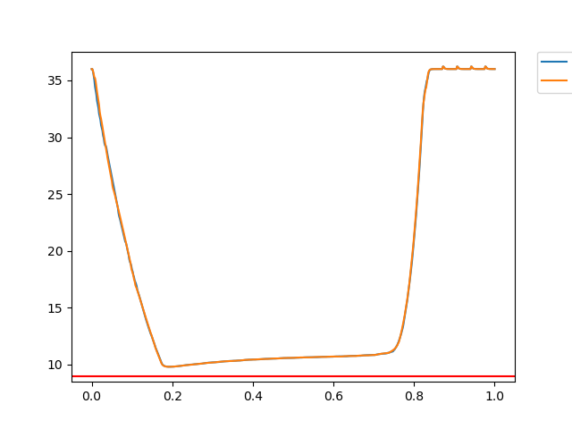
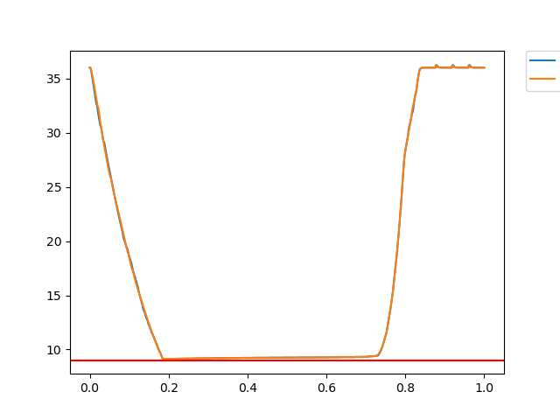
Multi-agent Simulation
more conservative
less conservative
The result of multi-agent trajectory following result, we predefined the trajectories for each agent. And we design a control barrier function to guarantee the safe distance between each agents. The first figure is when no CBF is working and the second figure is a conservative CBF which using Euclidean distance as the CBF. And the last figure is the least conservative CBF constructed by the SOS programming.

Slide 17
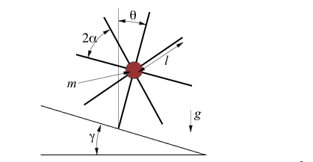
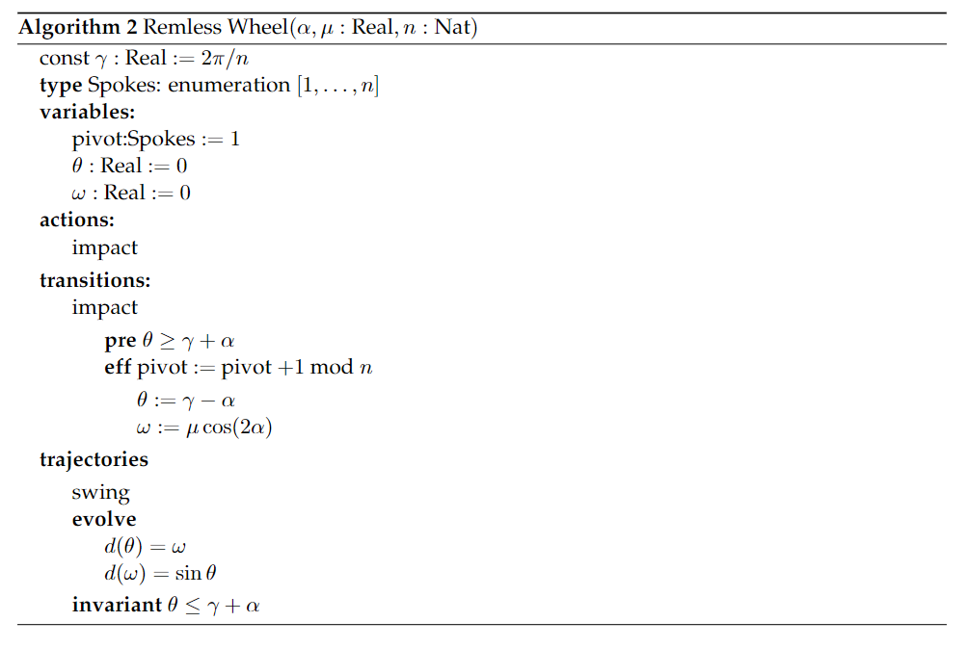
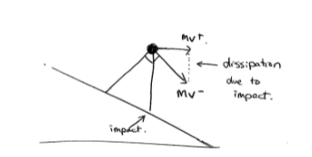
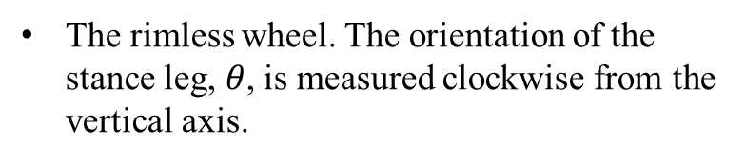
Hybrid System Simulation
The rimless wheel. The orientation of the stance leg, $θ$, is measured clockwise from the vertical axis.
Angular momentum is conserved around the point of impact

Slide 18
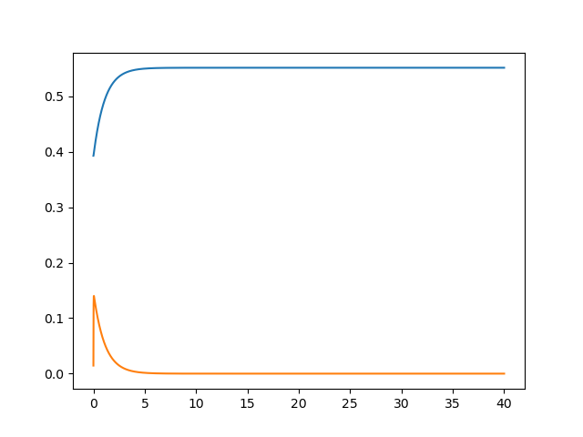
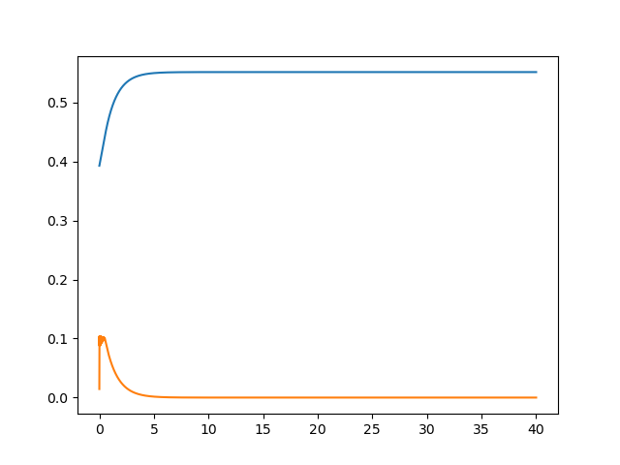

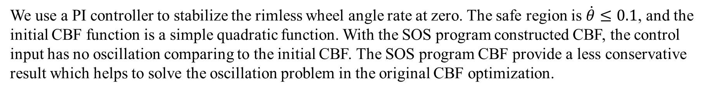
Hybrid System Simulation
oscillation
no oscillation
We use a PI controller to stabilize the rimless wheel angle rate at zero. The safe region is $\dot{θ}≤0.1$, and the initial CBF function is a simple quadratic function. With the SOS program constructed CBF, the control input has no oscillation comparing to the initial CBF. The SOS program CBF provide a less conservative result which helps to solve the oscillation problem in the original CBF optimization.

Slide 19
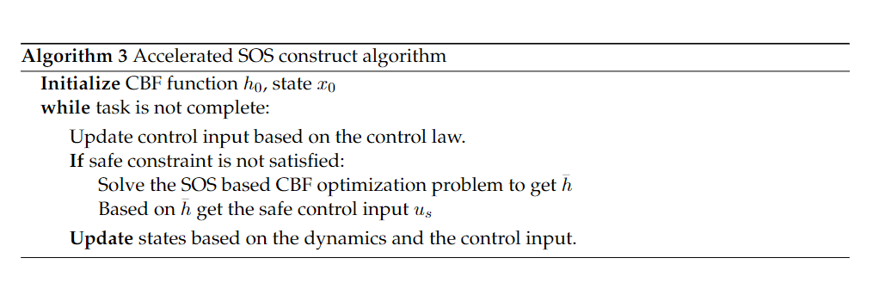
Acceleration with Z3 solver
Dynamics | SOS-CBF | SOS-CBF with Z3 solver
Multi-agent system | 36.972554445266724 seconds | 2.069892644882202
Rimless-wheel system | 20.53864312171936 secs | 0.4408400058746338 secs

