Slide 2
The paper develop a SOS program for verifying that a given CBF construction ensures safety. We extend this approach to high-order CBFs and systems with multiple CBF constraints.
The paper propose an alternating-descent heuristic for synthesizing CBFs using the proposed conditions.
Considering special cases of the approach, including compact safe regions and constraints where the unsafe region is a union of non-overlapping convex sets.

Slide 3
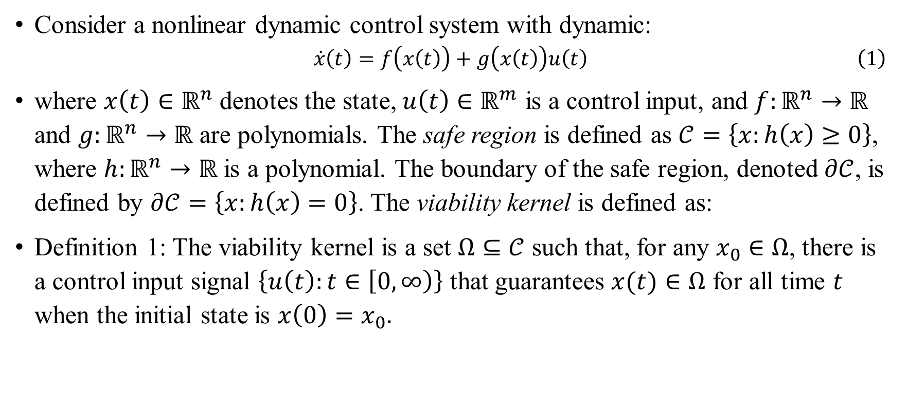
Consider a nonlinear dynamic control system with dynamic:
$$\begin{aligned}\dot{x}\left(t\right)=f\left(x\left(t\right)\right)+g\left(x\left(t\right)\right)u\left(t\right)\#\left(1\right)\end{aligned}$$
where $x\left(t\right)∈ℝ^{n}$ denotes the state, $u\left(t\right)∈ℝ^{m}$ is a control input, and $f:ℝ^{n}→ℝ$ and $g:ℝ^{n}→ℝ$ are polynomials. The safe region is defined as $𝒞=\left\{x:h\left(x\right)≥0\right\}$, where $h:ℝ^{n}→ℝ$ is a polynomial. The boundary of the safe region, denoted $∂𝒞$, is defined by $∂𝒞=\left\{x:h\left(x\right)=0\right\}$. The viability kernel is defined as:
Definition 1: The viability kernel is a set $Ω⊆𝒞$ such that, for any $x_{0}∈Ω$, there is a control input signal $\left\{u\left(t\right):t∈\left[0,∞\right)\right\}$ that guarantees $x(t)∈Ω$ for all time $t$ when the initial state is $x\left(0\right)=x_{0}.$

Slide 4
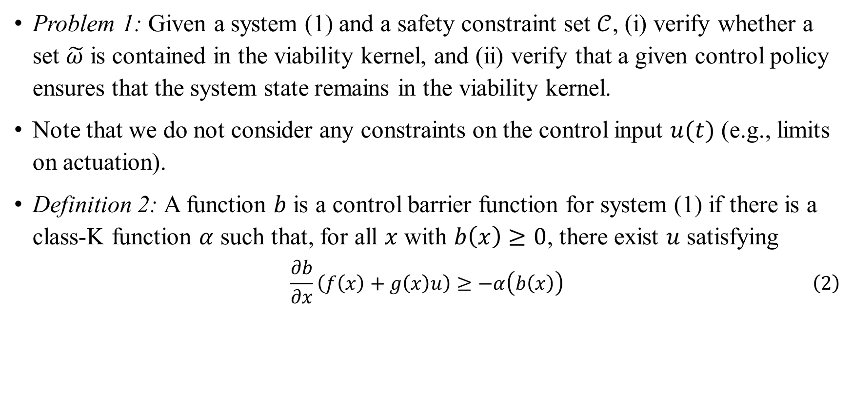
Problem 1: Given a system (1) and a safety constraint set $𝒞$, (i) verify whether a set $\tilde{ω}$ is contained in the viability kernel, and (ii) verify that a given control policy ensures that the system state remains in the viability kernel.
Note that we do not consider any constraints on the control input $u(t)$ (e.g., limits on actuation).
Definition 2: A function $b$ is a control barrier function for system (1) if there is a class-K function $α$ such that, for all $x$ with $b\left(x\right)≥0$, there exist $u$ satisfying
$$\begin{aligned}\frac{∂b}{∂x}\left(f\left(x\right)+g\left(x\right)u\right)≥−α\left(b\left(x\right)\right)\#\left(2\right)\end{aligned}$$

Slide 5
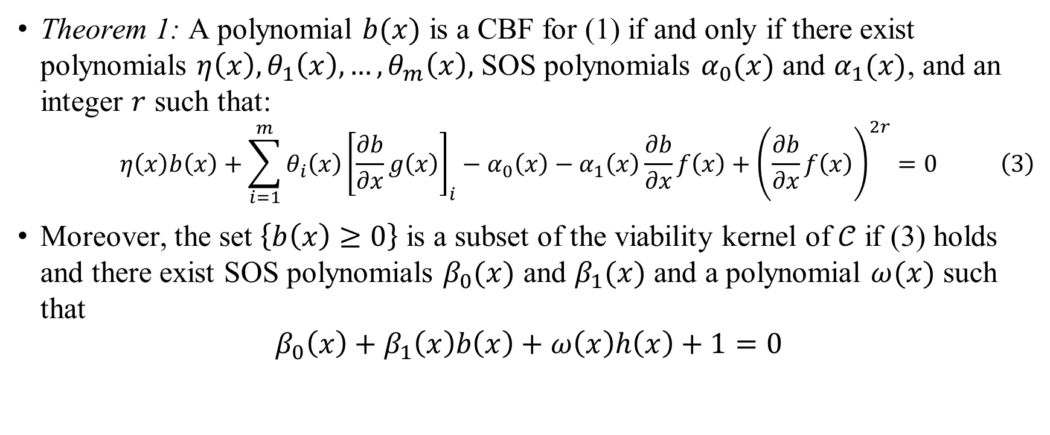
Theorem 1: A polynomial $b(x)$ is a CBF for (1) if and only if there exist polynomials $η\left(x\right), θ_{1}\left(x\right), …, θ_{m}\left(x\right),$ SOS polynomials $α_{0}(x)$ and $α_{1}(x)$, and an integer $r$ such that:
$$\begin{aligned}η\left(x\right)b\left(x\right)+\sum_{i=1}^{m}{θ_{i}\left(x\right)}{\left[\frac{∂b}{∂x}g\left(x\right)\right]}_{i}−α_{0}\left(x\right)−α_{1}\left(x\right)\frac{∂b}{∂x}f\left(x\right)+{\left(\frac{∂b}{∂x}f\left(x\right)\right)}^{2r}=0\#\left(3\right) \end{aligned}$$
Moreover, the set $\left\{b\left(x\right)≥0\right\}$ is a subset of the viability kernel of $𝒞$ if (3) holds and there exist SOS polynomials $β_{0}(x)$ and $β_{1}(x)$ and a polynomial $ω(x)$ such that
$$β_{0}\left(x\right)+β_{1}\left(x\right)b\left(x\right)+ω\left(x\right)h\left(x\right)+1=0$$

Slide 6
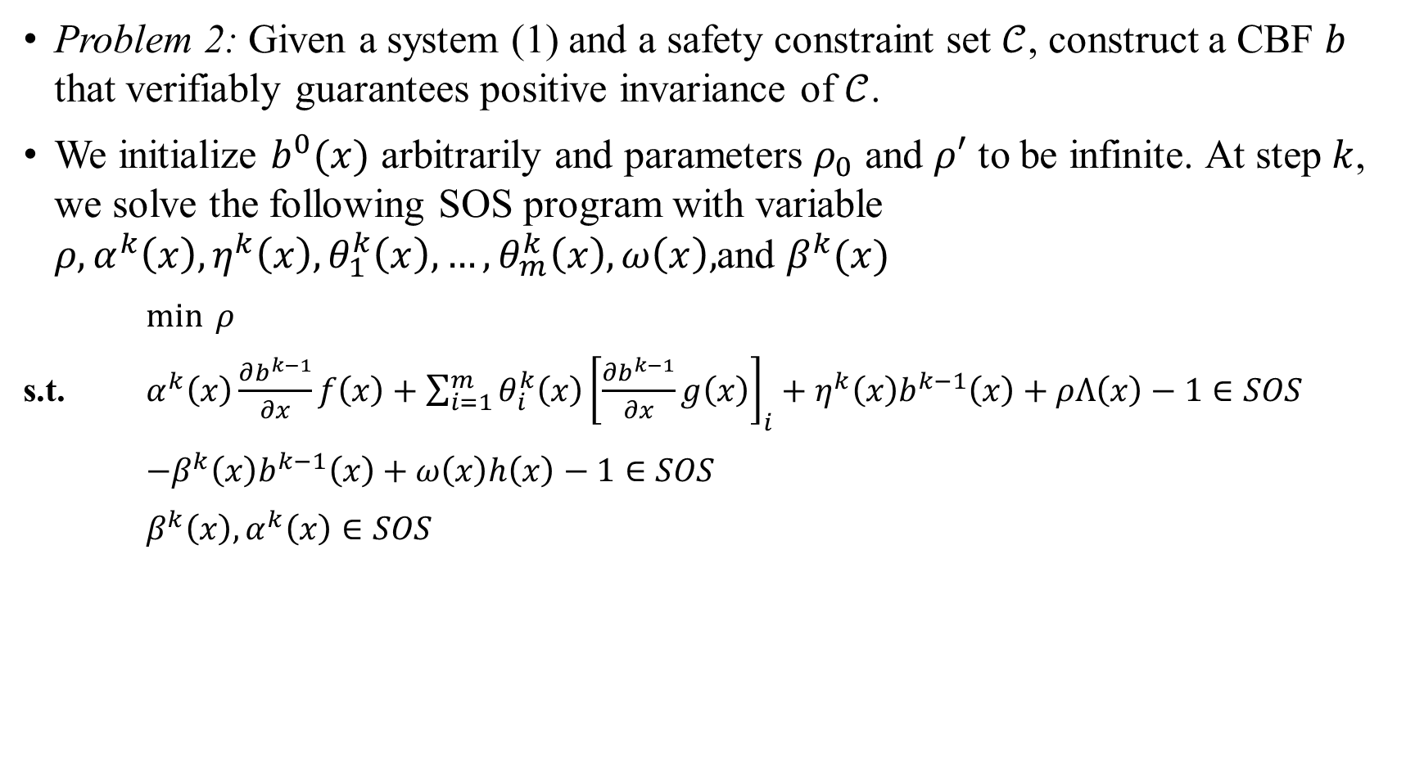
Control Barrier Function Construction
Problem 2: Given a system (1) and a safety constraint set $𝒞$, construct a CBF $b$ that verifiably guarantees positive invariance of $𝒞$.
We initialize $b^{0}(x)$ arbitrarily and parameters $ρ_{0}$ and $ρ′$ to be infinite. At step $k$, we solve the following SOS program with variable $ρ, α^{k}\left(x\right), η^{k}\left(x\right),θ_{1}^{k}\left(x\right),…, θ_{m}^{k}\left(x\right),ω\left(x\right),$and $β^{k}(x)$
$\min{ ρ}$
s.t. $α^{k}\left(x\right)\frac{∂b^{k−1}}{∂x}f\left(x\right)+\sum_{i=1}^{m}{θ_{i}^{k}\left(x\right){\left[\frac{∂b^{k−1}}{∂x}g\left(x\right)\right]}_{i}}+η^{k}\left(x\right)b^{k−1}\left(x\right)+ρΛ\left(x\right)−1∈SOS$
$−β^{k}\left(x\right)b^{k−1}\left(x\right)+ω\left(x\right)h\left(x\right)−1∈SOS$
$β^{k}\left(x\right),α^{k}\left(x\right)∈SOS$

Slide 7
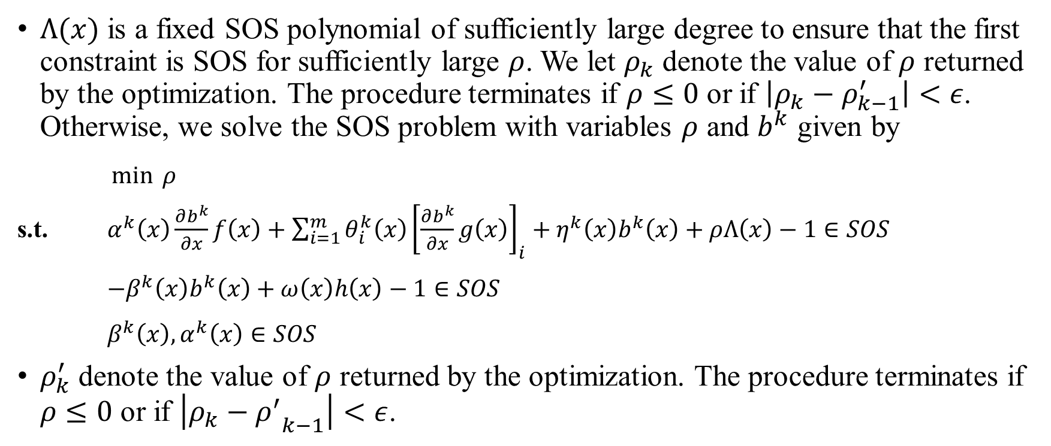
Control Barrier Function Construction
$Λ(x)$ is a fixed SOS polynomial of sufficiently large degree to ensure that the first constraint is SOS for sufficiently large $ρ$. We let $ρ_{k}$ denote the value of $ρ$ returned by the optimization. The procedure terminates if $ρ≤0$ or if $\left|ρ_{k}−ρ_{k−1}^{′}\right|<ε$. Otherwise, we solve the SOS problem with variables $ρ$ and $b^{k}$ given by
$\min{ ρ}$
s.t. $α^{k}\left(x\right)\frac{∂b^{k}}{∂x}f\left(x\right)+\sum_{i=1}^{m}{θ_{i}^{k}\left(x\right){\left[\frac{∂b^{k}}{∂x}g\left(x\right)\right]}_{i}}+η^{k}\left(x\right)b^{k}\left(x\right)+ρΛ\left(x\right)−1∈SOS$
$−β^{k}\left(x\right)b^{k}\left(x\right)+ω\left(x\right)h\left(x\right)−1∈SOS$
$β^{k}\left(x\right),α^{k}\left(x\right)∈SOS$
$ρ_{k}^{′}$ denote the value of $ρ$ returned by the optimization. The procedure terminates if $ρ≤0$ or if $\left|ρ_{k}−{ρ^{′}}_{k−1}\right|<ε$.

Slide 8

Compact Safe Region
Let $\left(x^{∗},u^{∗}\right)$ satisfy $f\left(x^{∗}\right)+g\left(x^{∗}\right)u^{∗}=0$ and $x^{∗}∈int(𝒞)$. Then there exist a positive definite matrix $P$ and $δ>0$ such that the function
$$b_{0}\left(x;x^{∗}\right)=δ−{\left(x−x^{∗}\right)}^{T}P\left(x−x^{∗}\right)$$
is a CBF with $\left\{b_{0}\left(x;x^{∗}\right)≥0\right\}⊆𝒞$

Slide 9
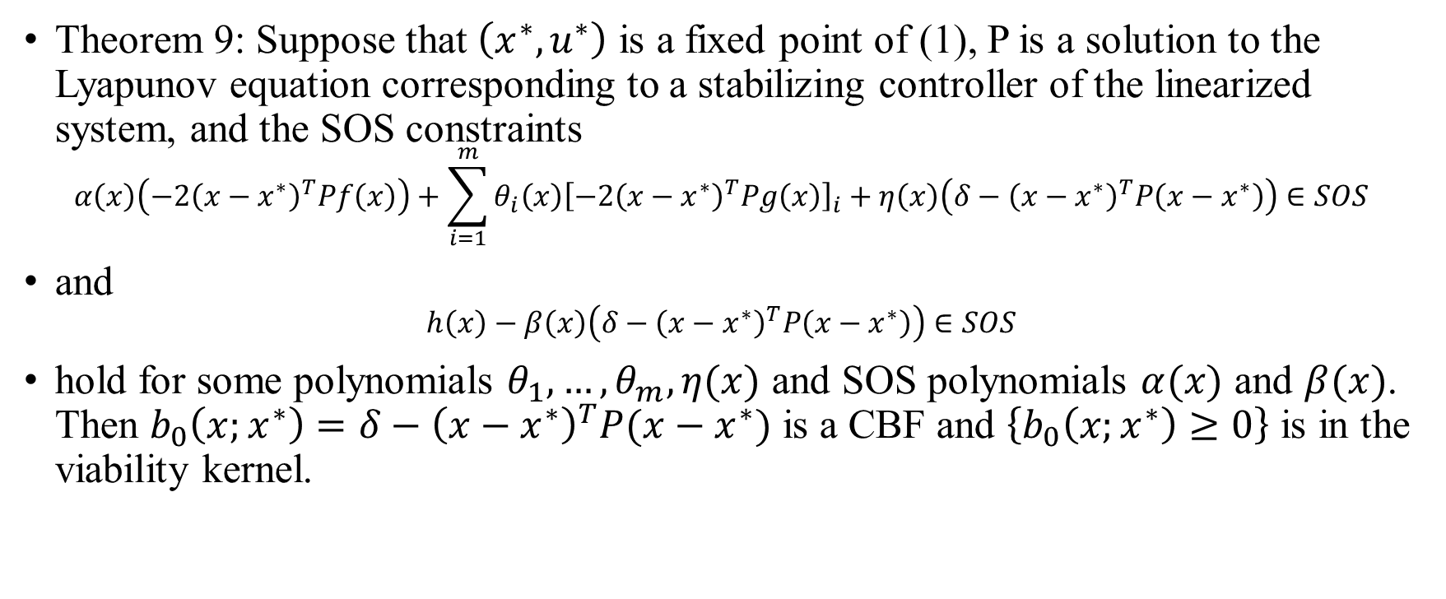
Compact Safe Region
Theorem 9: Suppose that $\left(x^{∗},u^{∗}\right)$ is a fixed point of (1), P is a solution to the Lyapunov equation corresponding to a stabilizing controller of the linearized system, and the SOS constraints
$$α\left(x\right)\left(−2{\left(x−x^{∗}\right)}^{T}Pf\left(x\right)\right)+\sum_{i=1}^{m}{θ_{i}\left(x\right){\left[−2{\left(x−x^{∗}\right)}^{T}Pg\left(x\right)\right]}_{i}}+η\left(x\right)\left(δ−{\left(x−x^{∗}\right)}^{T}P\left(x−x^{∗}\right)\right)∈SOS$$
and
$$h\left(x\right)−β\left(x\right)\left(δ−{\left(x−x^{∗}\right)}^{T}P\left(x−x^{∗}\right)\right)∈SOS$$
hold for some polynomials $θ_{1},…,θ_{m},η(x)$ and SOS polynomials $α(x)$ and $β(x)$. Then $b_{0}\left(x;x^{∗}\right)=δ−{\left(x−x^{∗}\right)}^{T}P(x−x^{∗})$ is a CBF and $\left\{b_{0}\left(x;x^{∗}\right)≥0\right\}$ is in the viability kernel.

Slide 10
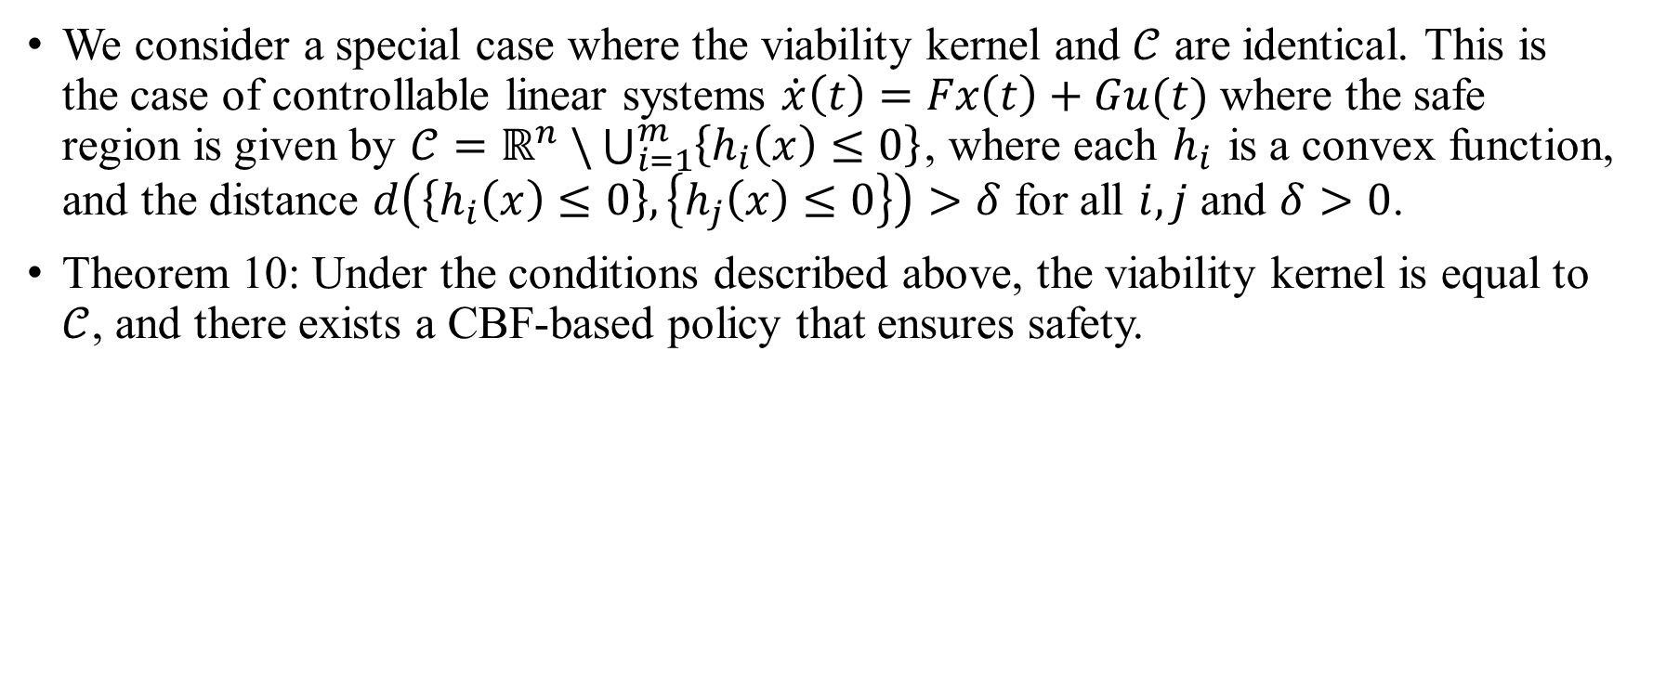
Compact Unsafe Region
We consider a special case where the viability kernel and $𝒞$ are identical. This is the case of controllable linear systems $\dot{x}\left(t\right)=Fx\left(t\right)+Gu(t)$ where the safe region is given by $𝒞=ℝ^{n} \backslash \bigcup_{i=1}^{m}{\left\{h_{i}\left(x\right)≤0\right\}}$, where each $h_{i}$ is a convex function, and the distance $d\left(\left\{h_{i}\left(x\right)≤0\right\},\left\{h_{j}\left(x\right)≤0\right\}\right)>δ$ for all $i,j$ and $δ>0$.
Theorem 10: Under the conditions described above, the viability kernel is equal to $𝒞$, and there exists a CBF-based policy that ensures safety.

