Slide 1


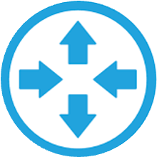

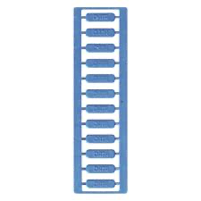
MaiaEdge Architecture for Centra
External Fabrics
Customer
SaaS / Partners
Minneapolis
AWS
Azure
GCP
Customer
Equinix
Fabric
EXTERNAL
FABRIC
HUB
Portland
DC Router
Carrier Cage
Carrier Cage
Reno-1
strand-1
strand-1
strand-2
Wave-1
strand-2
DIA-1
DC Router
DIA-2
DC Router
Wave-2
Reno-2
Charlotte
DC Router
DC Router
Legend
Primary DIA mesh path
Secondary DIA mesh path
Wave from Portland to Equinix Fabric
Carrier Fiber Strands
Customer Fiber Strands
External Fabric (Equinix)
Hub site (Portland)
Wave between Portland and Charlotte

Slide 2
MaiaEdge Architecture for Centra:
Redundant MaiaEdge PBCs and Port Extenders
Redundant DIAs for diverse L2 meshed paths
Termination of carrier fibers into MaiaEdge PBCs serving as a MMR with automated and dynamic cross connect functionality
Encrypted and authenticated L2 paths
Portland, ME datacenter is the Equinix fabric hub providing cloud onramp services
Advertise and sell cloud onramp services to customers and partner providers in the MaiaEdge Marketplace

