Slide 1
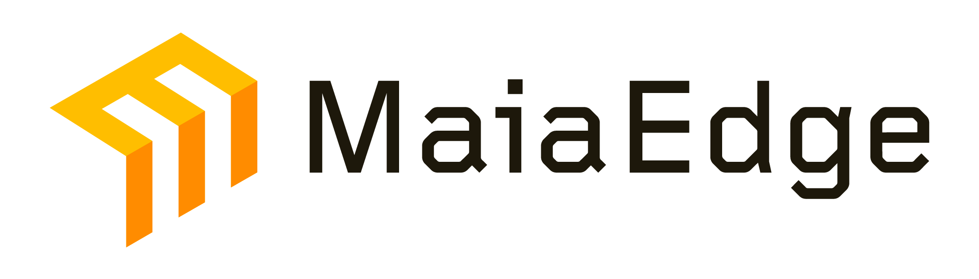




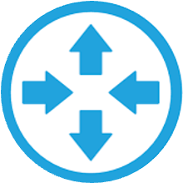
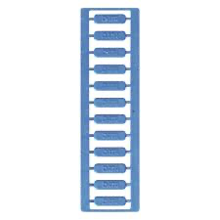
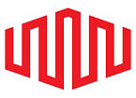
Architecture for CENTRA Digital
Legend
Customer
Wave between Datacenters
Primary DIA mesh path
Minneapolis
Secondary DIA mesh path
Customer
Wave to Equinix Fabric
External Fabric (Equinix)
Portland
Fabric Hub site (Charlotte)
DC Router
Carrier Cage
Carrier Cage
Reno-1
strand-1
strand-1
strand-2
External Fabric
strand-2
DIA-1
SaaS / Partners
DC Router
AWS
Azure
GCP
DIA-2
Equinix
Fabric
DC Router
EXTERNAL
FABRIC
HUB
Reno-2
Charlotte
DC Router
DC Router
MaiaEdge · Reference Architecture for CENTRA Digital · Confidential · 1 / 2

Slide 2

MaiaEdge Architecture for CENTRA — Key Properties
■ Redundant MaiaEdge PBCs and Port Extenders at every CENTRA site
■ Redundant DIAs (DIA-1 / DIA-2) provide diverse, encrypted L2 mesh paths between all sites
■ Termination of carrier fibers into MaiaEdge PBCs serving as a software-defined MMR with automated, dynamic cross-connect functionality
■ Encrypted and authenticated L2 paths at line rate over both wave and DIA underlays
■ Charlotte datacenter is the Equinix Fabric hub providing cloud onramp services to AWS, Azure, GCP, and SaaS / partner providers
■ Dedicated waves connect Portland, Reno-1, and Reno-2 to the Charlotte hub for premium, deterministic transport
■ Minneapolis joins the same fabric without dedicated fiber — DIA mesh extends every service, including cloud onramp, to sites where waves are not yet available
■ End-to-end service visibility for CENTRA and its tenants — every customer service is observable path-by-path and hop-by-hop, eliminating colo / carrier / customer finger-pointing
■ Advertise and sell cross-site connectivity and cloud onramp services to customers and partner providers in the MaiaEdge Marketplace
MaiaEdge · Reference Architecture for CENTRA Digital · Confidential · 2 / 2

