Slide 1


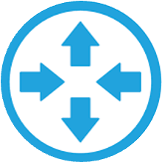

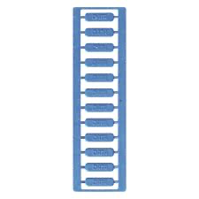
MaiaEdge Federated Interconnection Reference Architecture
External Fabrics
Customer
SaaS / Partners
Central Site
AWS
Azure
GCP
Customer
External
Fabric
EXTERNAL
FABRIC
HUB
Hub Site
DC Router
Carrier Cage
Carrier Cage
West Site 1
strand-1
strand-1
strand-2
Wave-1
strand-2
DIA-1
DC Router
DIA-2
DC Router
Wave-2
West Site 2
Northeast Site
DC Router
DC Router
Legend
Primary DIA mesh path
Secondary DIA mesh path
Wave from Hub to External Fabric
Carrier Fiber Strands
Customer Fiber Strands
External Fabric
Hub Site (Region A)
Wave between Hub and Northeast Site

Slide 2
MaiaEdge Federated Interconnection Reference Architecture:
Redundant MaiaEdge PBCs and Port Extenders
Redundant DIAs for diverse L2 meshed paths
Termination of carrier fibers into MaiaEdge PBCs serving as a MMR with automated and dynamic cross connect functionality
Encrypted and authenticated L2 paths
The Hub Site lands the External Fabric (e.g., Equinix Fabric, Digital Realty Service Fabric) providing cloud onramp services
Advertise and sell cloud onramp services to customers and partner providers in the MaiaEdge Marketplace

